Slide 1

COMPUTER NETWORK
Lê Quốc Định
Lê Quang Thắng
Phạm Đan Tâm
Lê Duy Quốc Thắng

Slide 2
CODE ANALYSIS
To successfully code this app, it is required to:
+ have knowledge of object-oriented programming, specifically classes, to create objects.
+ code sockets, which are communication channels between the server and clients.
+ code multi-threading to handle concurrent execution of tasks.
+ code interface using tkinter.
+ use SQL as a database management system to store and retrieve data.

Slide 3
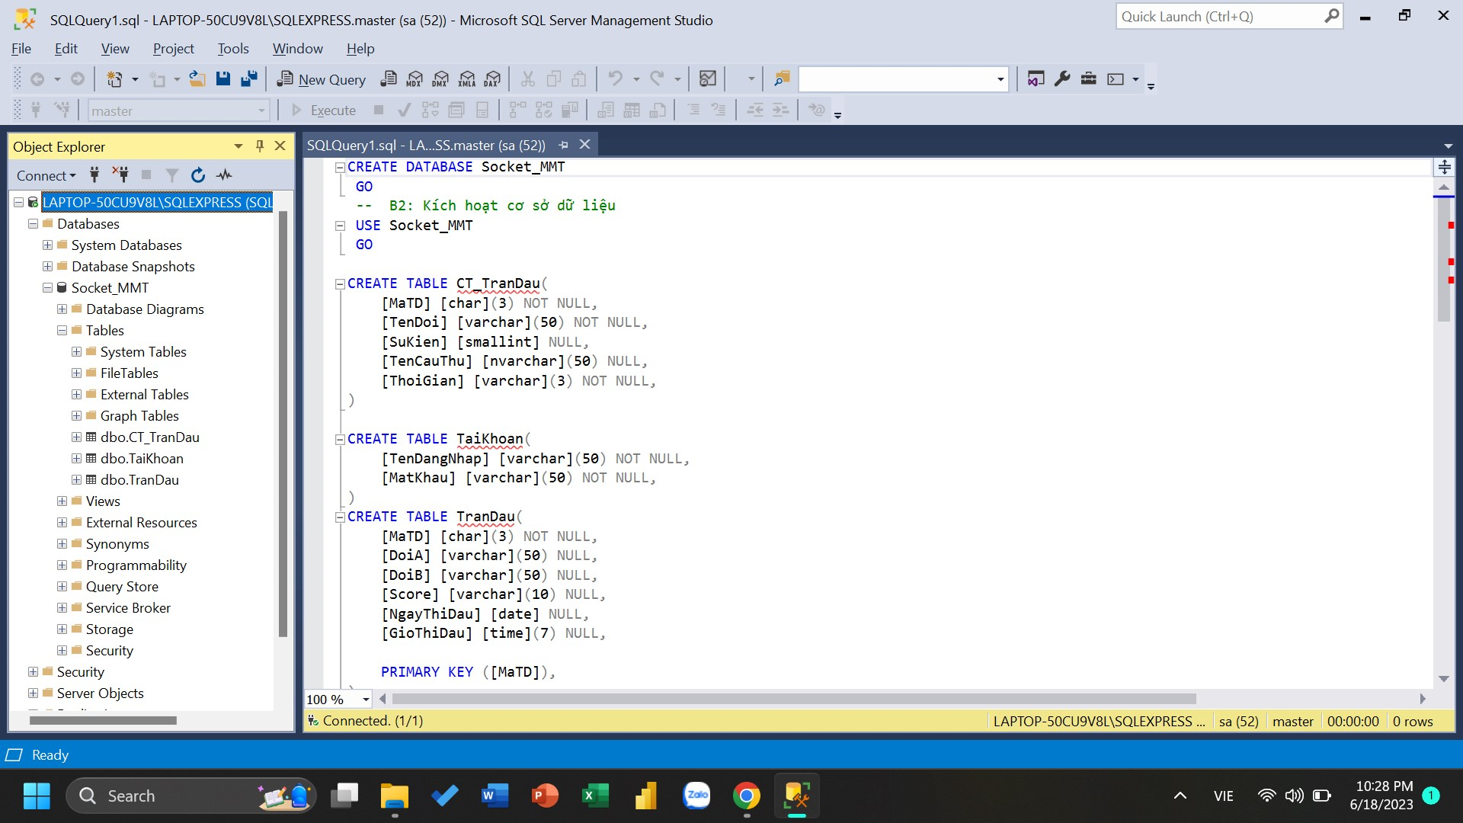
CODE FOR SQL
In SQL, we will code to create tables for storage, define relationships, and create keys to connect the information between the tables in DB.

Slide 4
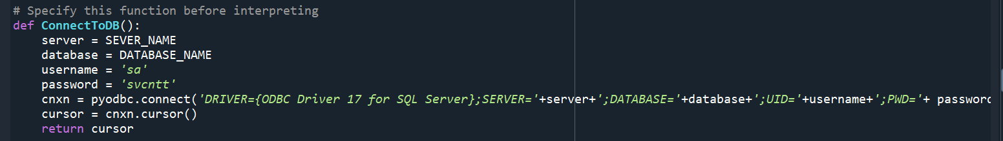
CODE FOR SQL
The server will directly connect to SQL to store and retrieve information.
import pyodbc
During this process, the client will send requests to the server in the form of data packets through the socket communication channel, and the server will fetch data from SQL, package it, and send it back to the client.

Slide 5
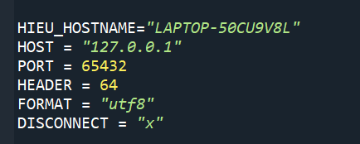
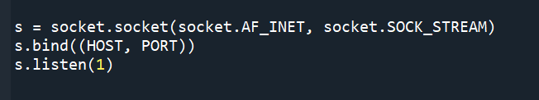
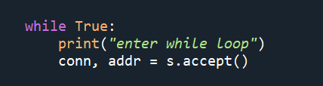
CODE FOR (SOCKET)
Server
import socket

Slide 6
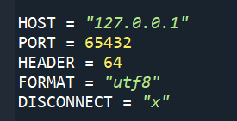
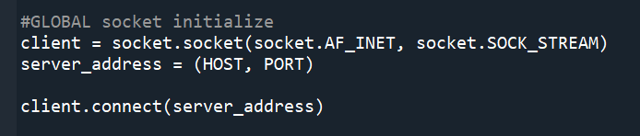
CODE FOR (SOCKET)
Client
import socket

Slide 7
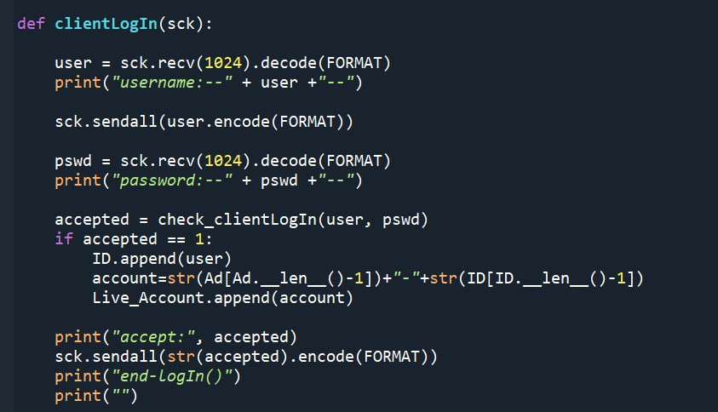
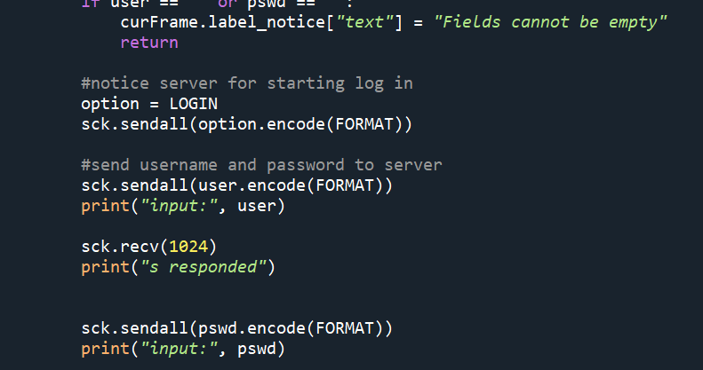
CODE FOR PYTHON (SOCKET)
A sample communication between the server and client

Slide 8
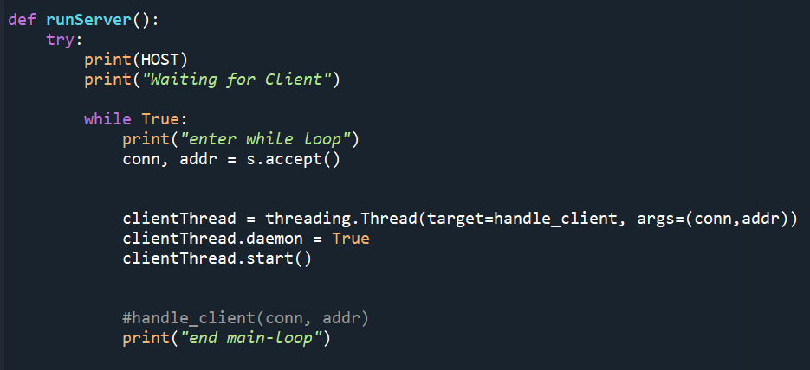
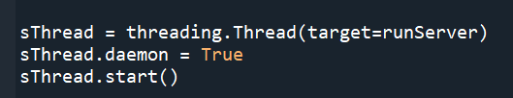
CODE FOR (THREAD)
Used for the server to work simultaneously with multiple clients.
import threading

Slide 9
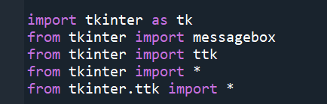
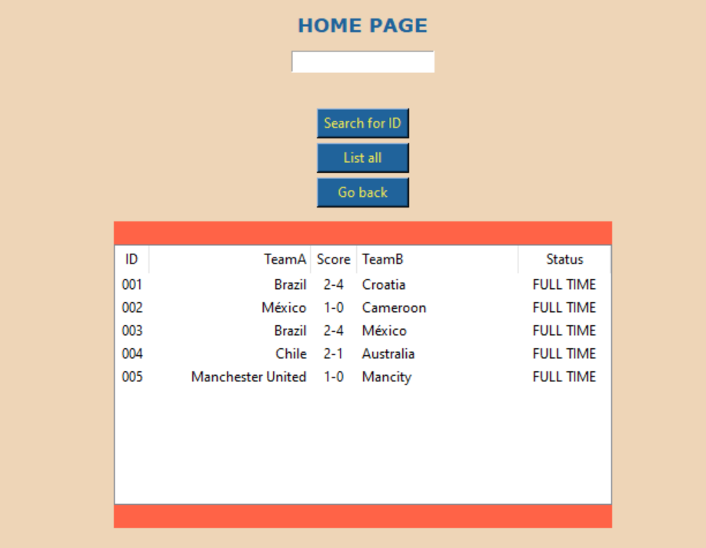
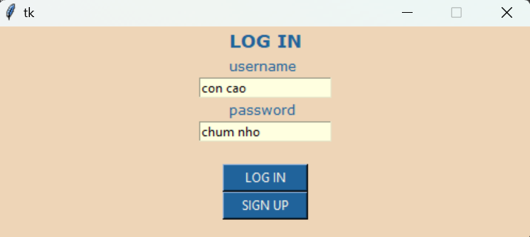
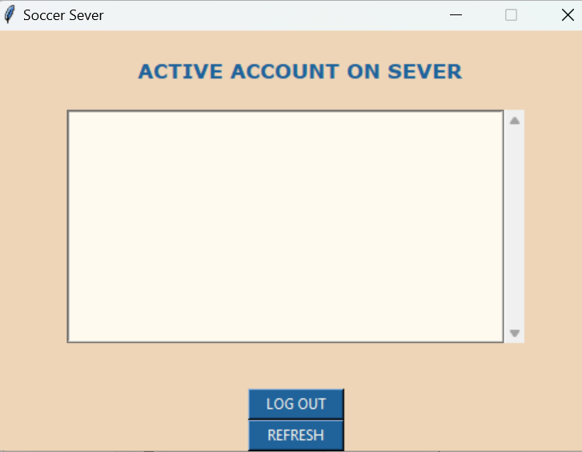
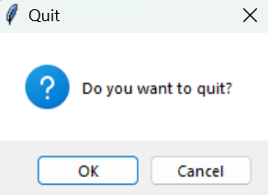
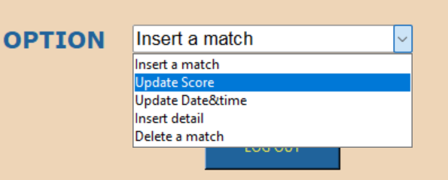
CODE INTERFACE (TKINTER)
Simple interface:
+ button
+ entry
+ lable
+ masagebox
+ ttk.Treeview (small table)
+ tk.Listbox (tk.scrollbar)
+ ttk.Combobox (option bar)

Slide 10
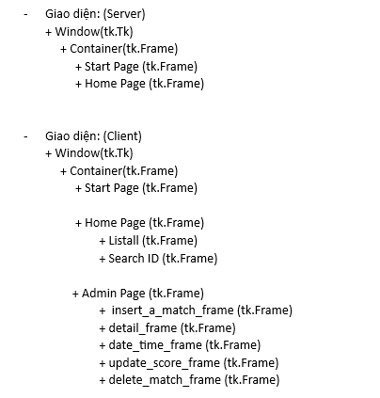
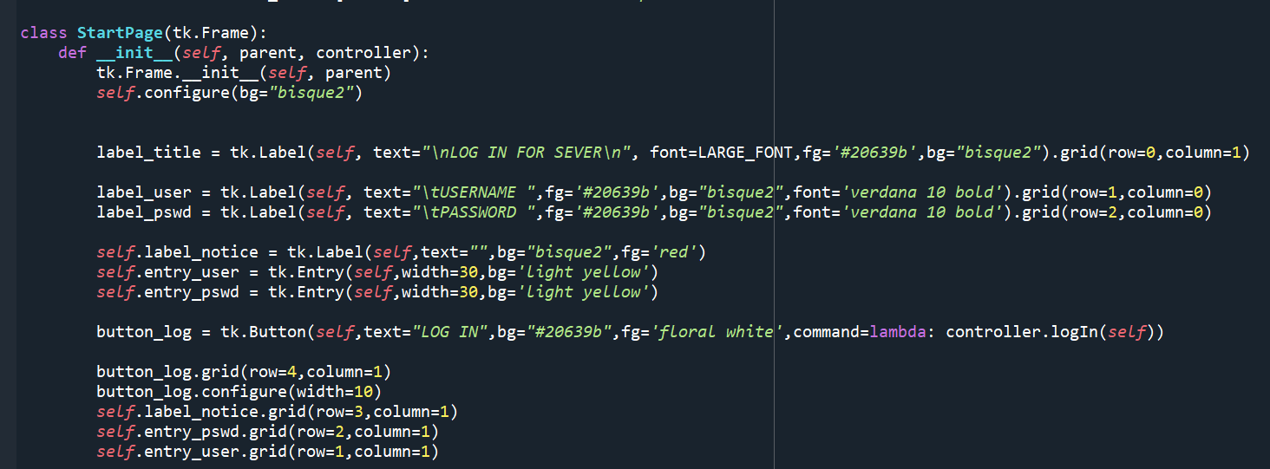

Slide 11
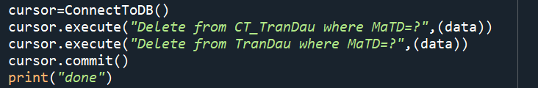

CODE FOR PYTHON (THE FUNCTIONS OF THE CODE)
Server connect to DB

Slide 12
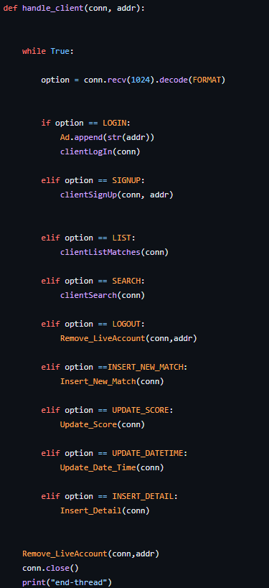
CODE FOR PYTHON (THE FUNCTIONS OF THE CODE)
Server

Slide 13
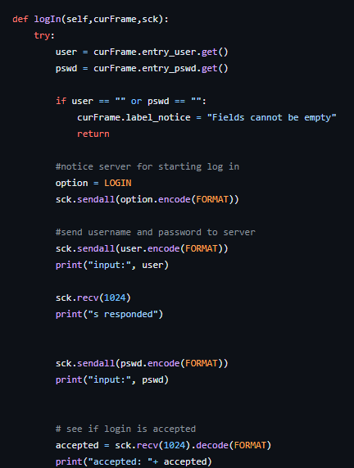
CODE FOR PYTHON (THE FUNCTIONS OF THE CODE)
Client:
+ Login

Slide 14
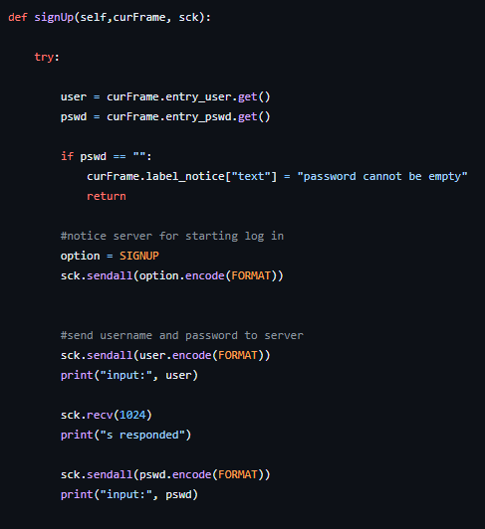
CODE FOR PYTHON (THE FUNCTIONS OF THE CODE)
Client:
+ Sign up

Slide 15
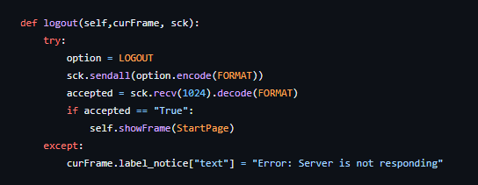
CODE FOR PYTHON (THE FUNCTIONS OF THE CODE)
Client:
+ Log out

Slide 16
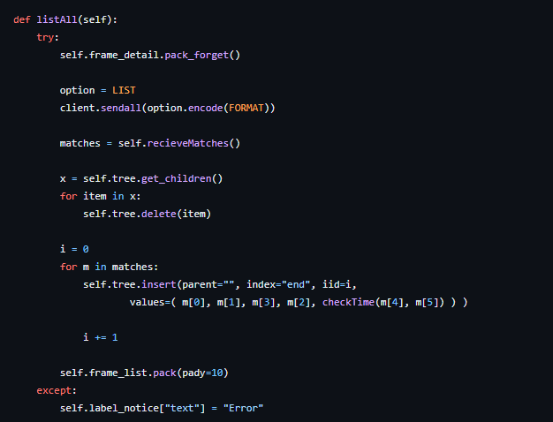
CODE FOR PYTHON (THE FUNCTIONS OF THE CODE)
Client:
+ List all

Slide 17
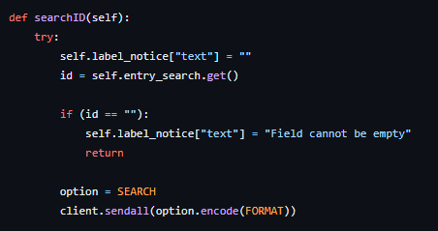
CODE FOR PYTHON (THE FUNCTIONS OF THE CODE)
Client:
+ Search ID

Slide 18
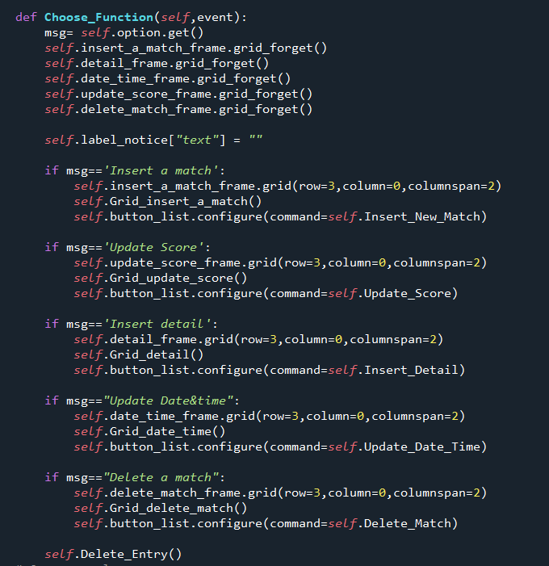
CODE FOR PYTHON (THE FUNCTIONS OF THE CODE)
Client:
+ Admin setup data

Slide 19
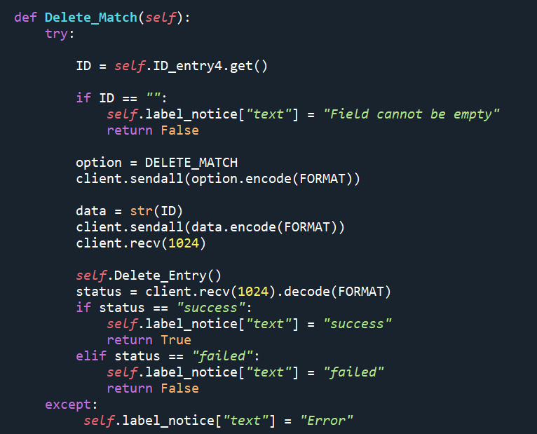
CODE FOR PYTHON (THE FUNCTIONS OF THE CODE)
Client:
+ Delete data

