Slide 1
Game Development - Driving Vietnam's and Your Own Future
Prepared for VNG GDC 2012
July 21st, 2012
Tetsuya Mori
DeNA Asia Pacific

Slide 2
Vietnam as a hidden gem
Global game market
A Little Bit about DeNA
A Big Picture you want to care about

Slide 3
Vietnam as a Hidden Gem
Did you know?
VNG is the largest Internet company across SEA and India?
Vietnam game market is by far the largest across SEA and India?
Vietnam has the best mobile broadband access across SEA and India?
Vietnamese engineers are by far the best in SEA, as good as Japanese engineers?
Vietnam has the most active local Internet developer community across SEA and India?

Slide 4
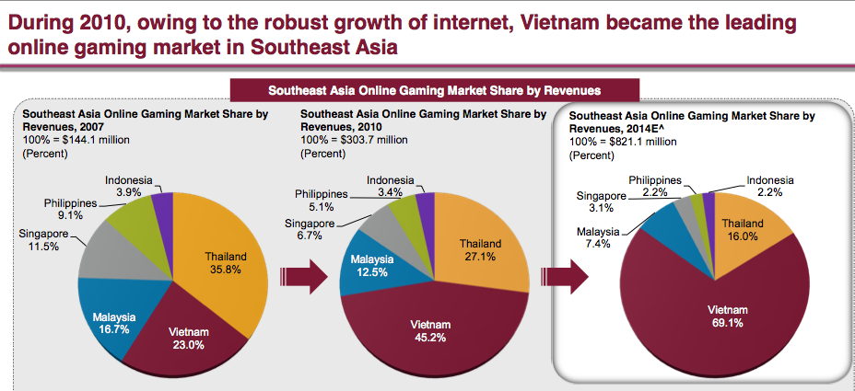
Vietnam – Unquestionable Leaders in SEA Gaming Industry

Slide 5
Internet Foundation SEA + India Country Score Board
Country | Population | Network |  | Consumer acceptance
 |  | 3G/4G | WIFI | Net literacy | Online games | Smart phone
India | 1200M
Indonesia | 240M
Philippine | 93M
Vietnam | 87M
Thailand | 69M
Malaysia | 28M
Singapore | 5M

Slide 6
Vietnam IT Resources Observations from VNG, Punch, Fsoft, VNG, and others
Leaders – some highly talented visionary leaders
Software engineering – on par with Japanese counterparts
English skills – better than Japanese counterparts
Organizations - easily scaling up to several hundreds and more, better than Japanese counterparts
Internal management process – on par with Japanese counterparts
Finance – good ops generate good margin relatively easily
OPEX – 1/10 of Japan, 1/15 of US, very low cost of failure

Slide 7
Vietnam as a hidden gem
Global game market
A Little Bit about DeNA
A Big Picture you want to care

Slide 8
A Brief History of Computer Games Markets
1980
1990
2000
2010
Game
Market*
Major
Publishers
Console Games
Nintendo NES
Activision
Electronic Arts
Bandai Namco
$30B
PC Games
3D accelerator
Online Games (MMO)
Tencent
Nixon
Shanda
Broadband
Internet
$16B
Social Games
DeNA
GREE
Zynga
Facebook
$8B
Mobile Games
J2ME+3G
$6B
EA
Gameloft
*Title revenue only. Hardware sales not included.

Slide 9
Comparing Game Types
 | Console Games | Online Games MMOs | Social Games
Product | Package product | Online services
Distribution | Retail stores | Internet (ADSL, mobile 3G)
Platform | PC |  | PC & mobile
Look & Feel | Super intense 3D | Intense 3D | High quality 2D and simple 3D
Game play | Intense 1-3 hr/play |  | Casual, frequent 5-30 min/play
Development | >$50M >2 yrs | >1000 m.month 1-2 yrs | 100-200 m.month 3-6 months
Operations | N/A | Data center, Data mining
Performance KPIs | Unit sold Gross margins | DAU MAU CU PCU ARPU ARPPU | DAU MAU ARPU ARPPU LTV eCPNU

Slide 10
Social Games = Online Games Meshed into Social Networks
Online Games
Card Battle
Simulations
Strategy
Dating
Town building
Management
RPG
FPS
Sports
Board Games
Social Networks
Community
Messaging
User posting
Invites
Daily access
Cross promotion
Viral effects
+
PC
Mobile

Slide 11
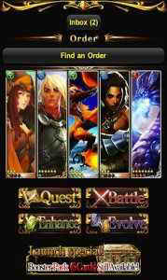

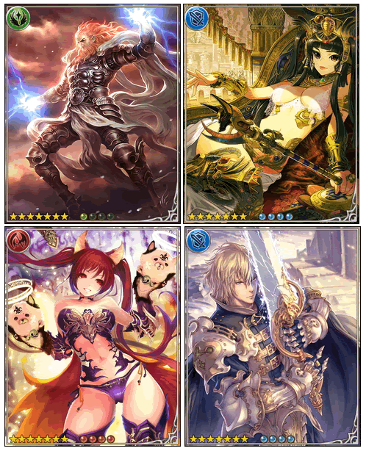
Card Battle Type Social Game - Examples

Slide 12
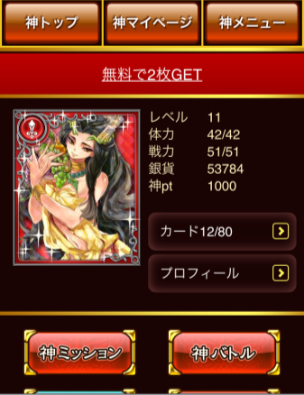
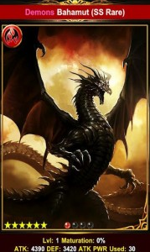
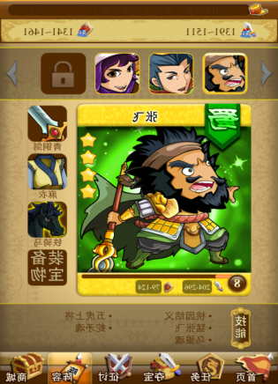
Card Battle Type Social Games Sets a New Trend
Japan
US
China
Korea
Soon to come
JP market turned
completely to CBG
Android No.1
iPhone No.1

Slide 13
Vietnam as a hidden gem
Global game market
A Little Bit about DeNA
A Big Picture you want to care

Slide 14
Global Leaders of Game Publishing
Company Name | Revenue | Country | Game Type | Growth
Bandai Namco | $5.5B | Japan | Console games | +
Activision Blizzard | $4.8B | US | Console games
Electronic Arts | $4.1B | US | Console games
Tencent Games | $3.0B | China | Online games | ++
DeNA | $1.9B | Japan | Social games | ++
GREE | $1.5B | Japan | Social games | ++
Square Enix | $1.5B | Japan | Console games
Zynga | $1.1B | US | Social games | ++
Nexon | $1.1B | Korea | Online games | ++
Take-Two | $1.1B | US | Console games
Ubi Soft | $1.1B | France | Console games

Slide 15
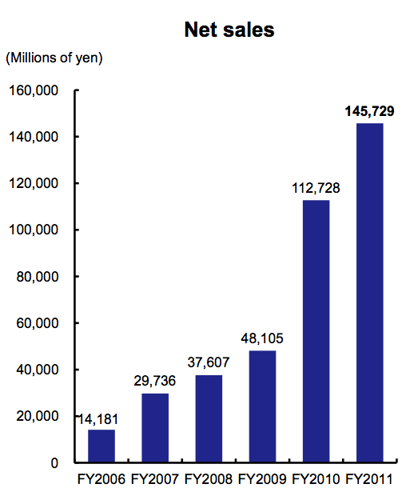
JP Social Mobile Games – Explosive Growth
DeNA Net Revenue
US$2B
Mobile Social Games launch
Japan’s mobile social game market
0→$5B in 3 years
Highest ARPU x20 US
US$1B

Slide 16
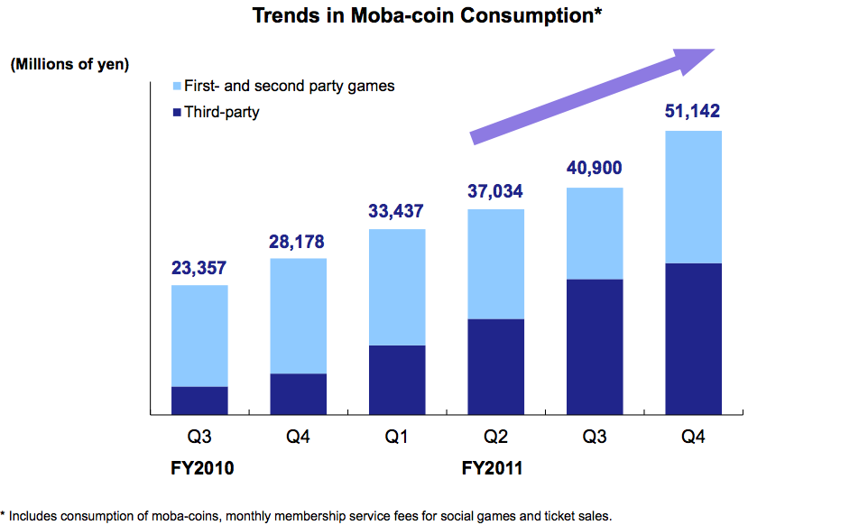
Over 50% of Mobage Game Revenue Comes from 3rd Party Developers
3rd Party
Games

Slide 17
Big Title Revenue Scale
Mobage top 20 title aiming at $1M/month
Mobage top 5 title double digits millions / month
Market Enabling Rev Share Model
Gross Rev → Carriers 13%, DeNA 87%
Out of 87% → DeNA 30%, Developers 70%

Slide 18
Big Traffic and Big Data Mining
Big traffic – 20 billions PV / Day
20% of Japan’s mobile data traffic
1.2TB event log data / Day
480 CPU cores and Hadoop for real time processing
Internal analytic tools
Data miners (business analysts+ engineers)

Slide 19
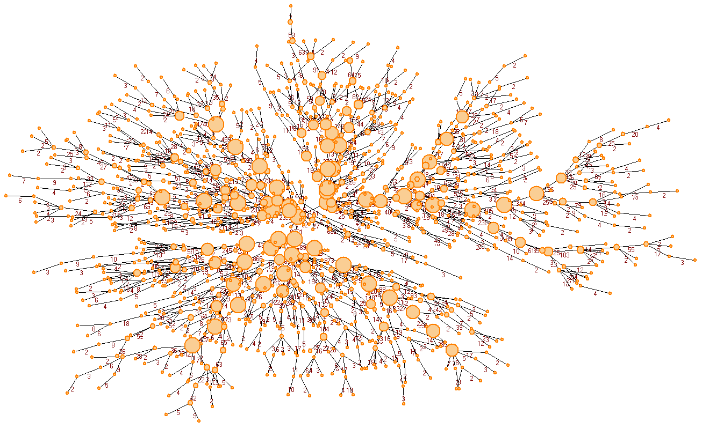
Mobage Net Effect
Start from a single user
An invite to 1 core user led to 15,000 user sign ups

Slide 20

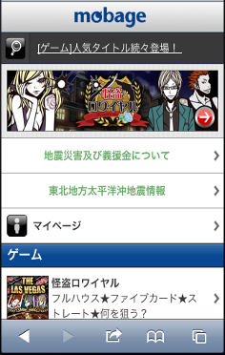

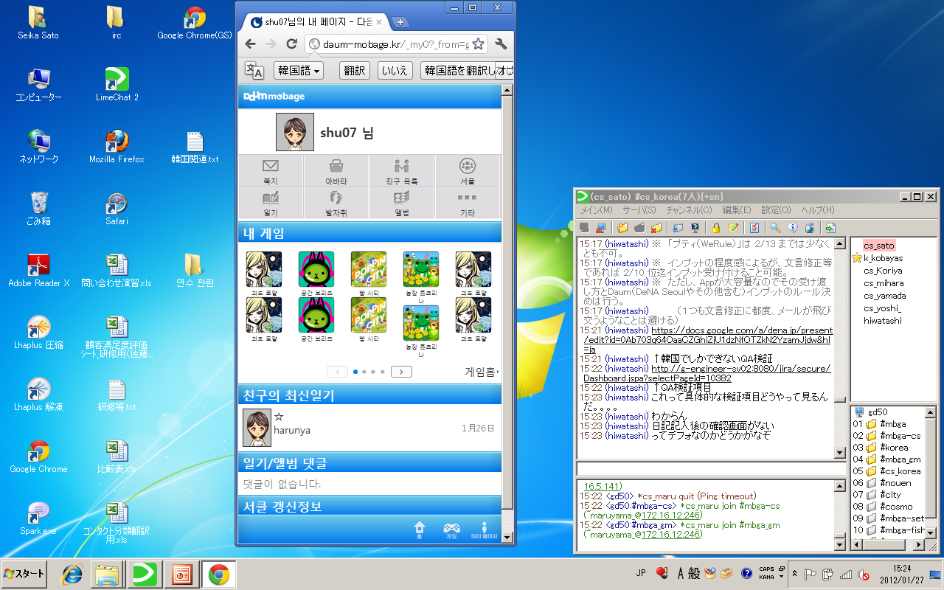

DeNA Distribute Social Games Globally
Japan
China
Korea
Global

Slide 21
Mobage Titles Winning The U.S.
US GooglePlay market Top Grossing
Rage of Bahamut
No.1
1st
Tapfish
No.10
20th
Ninja Royale
No.14
40th
60th
80th
100th
4/10
4/15
4/23

Slide 22
DeNA in Vietnam
Punch Entertainment
Acquisition Q4 2011
Integrated into DeNA in-house studio in Japan
VNG
Entered into global social game partnership
Co-producing social games targeting Japanese market
New initiative to help improve artwork quality standard

Slide 23
Vietnam as a hidden gem
Global game market
A Little Bit about DeNA
A Big Picture you want to care about

Slide 24
4 years ago, I saw in Vietnam
Like Japan in 1960s
Organized chaos
Young, humble and hard working people
Strong education foundation, excellent students
Entrepreneurship everywhere
Construction everywhere
Shared code of building community and nation
‘Tomorrow is better than today’

Slide 25
Now I see…
New cityscape, upgraded quality of life
All I saw 4 years ago still remains good
However…
Slow industrialization
Macro economy remains fragile
Country run by money borrowed continuously
My friend’s comment ‘Vietnamese people learned to enjoy their lives before they gained a competitive edge’

Slide 26
Vietnam Very Scary Picture
Vietnam Exports
Top 7 Export Products Remain Unchanged
$96B
 | 1998 | 2011
1 | Crude oil | Garment & textiles
2 | Garment & textiles | Footwear
3 | Rice | Fishery
4 | Footwear | Crude oil
5 | Fishery | Electronic parts/products
6 | Coffee | Wooden products
7 | Mechanical parts/products | Rice
Competition
from
Myanmar
emerging
10X
$9.4B
1998
2011

Slide 27
Build country’s sustainable growth…
Earn ‘Hard Currencies’ by driving exports
Leverage Vietnam based foreign companies to accelerate near term exports
- Honda VN : manufactures 25% of SEA motorcycle production
WW 43M => SEA 9.5M => Honda VN 2.5M
- Samsung BacNinh plant : Exported $6B mobile phones in 2011
- Canon Tanh Long plant : Exported $2B inkjet printers in 2011
Intel : Exported $0.5B in 2011 which is a half of Saigon High Tech Park’s total export
Build globally competitive VN enterprises
→ This is about all of you!

Slide 28
Japan : 150 Years of Industrialization Building Globally Competitive Companies
Today’s Japan
Top 100 Companies
1868
Meiji Revolution
1878
Tokyo Stock Exchange founded
Industry
Foundation
Building
Founded before 1905
28 companies
Mitsubishi, Mitsui, Sumitomo,
Japan Rail, NTT, Nippon Steel,
Kirin Brewery, Asahi Beer, Shiseido,
Nintendo, Tokyo Marine Insurance…
1882
Central Bank established
1895
The Shino-Japanese War 1895
1905
The Russo-Japanese War
Phongtrào
Đông Du
‘Taisho Democracy’
Emergence of Consumer Economy
Industry
Expansion
Founded 1905 - 1945
42 companies
Toyota, Suzuki, Canon, Nikon, Kao, Takeda Pharmaceutical, Astellas Pharma, JFE Steel, Komatsu,
Ito-Yokado, EON, Termo, HOYA, Asahi Glass, Yamato …
1937
The Shino-Japanese War 1937 began
State Mobilization Law
War
Economy
1942
The Pacific War began
Priority Industry Association Act
1945
The Pacific War ended
US occupation began
1964
Tokyo Olympic Game
Bullet Trains in operation
Hyper
Economic
Growth
Founded after 1945
30 companies
Honda, Nidec, Sony, Kyocera, Fanuc, Secom, Orix, NTT DoCoMo, NTT Data, KDDI, Softbank, Yahoo Japan, UNIQLO, Unicharm, Lawson, Oriental Land…
1968
Japan as world second
largest economy
1989
Bubble at height
1990~
‘Lost decades’ began
Internet economy began
Matured
Economy
2008
World economic crises

Slide 29
Games for You and for Your Country
For You… Guess I don’t need to explain
For Vietnam
Badly needed exports
Technology advancement
Globally competitive companies and talents
Tax revenue

Slide 30
Initial Steps
Play and study top ranking games outside Vietnam
Build your game ‘vocabulary’
Develop games you and your customers want
This is a business, not a hobby
Don’t be happy until you made names outside Vietnam
Your opportunity and responsibility

Slide 31

Cố gắng!

