Slide 1
Value-guided molecular generation
Soft value-based decoding (SVDD) on a frozen DiGress model, QM9, SA reward
Abel Le | CIS 6930 Generative AI, USF | Nov 13, 2026
Notes:
One sentence: can we steer a pretrained graph diffusion model toward molecules that are easier to synthesize, without retraining it, and does it beat just sampling more and keeping the best?

Slide 2
Steering a diffusion model without retraining it
DiGress generates QM9 molecules as graphs, but samples ignore what we want (e.g. synthesizability, SA score)
Fine-tuning changes the model; best-of-N wastes N full generations
SVDD steers only at inference: at each denoising step, pick among M children using a value estimate
Gap: SVDD was shown on continuous diffusion (GDSS, ZINC). Does it work on discrete graph diffusion, against a fair best-of-N?
500
denoising passes for one unguided molecule
10
children per step (M); one DiGress pass serves all M
Notes:
Frozen model: our own training, validity 99.1 %, uniqueness 96.1 %, checkpoint pinned by SHA-256. Official checkpoint link is dead, so we trained it. Best-of-N with N=M matches candidates, not passes.

Slide 3
SVDD: propose M children, score, resample
1
Propose
2
Score
3
Select
From state x_t draw M children from the frozen DiGress reverse step
Value function v(x_{t-1}) estimates the final reward (MLP on the posterior mean, or the posterior-mean reward itself, PM)
Pick one child with weights proportional to exp(v / alpha): argmax is the alpha-to-0 limit
Cost: unguided T passes; best-of-10 M*T; SVDD-MLP T (children share the pass, values are cheap); SVDD-PM (M+1)*T
Notes:
Explain why children share a pass: DiGress gives a distribution over x_{t-1} from one forward pass, so M samples from it cost one pass. PM needs one extra forward pass per child to get its posterior mean, hence (M+1)T. Derive the soft value: v_t(x) = alpha log E[exp(r/alpha) | x_t = x].

Slide 4
Setup: one rule, fixed before running
Model: DiGress QM9, trained by us (seed 0, 1000 epochs), frozen, SHA-256 pinned
Reward: SA score (higher = easier to make), 2000 molecules per run, 3 seeds, mean and std over seeds
Baselines: unguided (500 passes), random select, best-of-10 (5000 passes)
Pre-registered rule: SVDD-MLP argmax must beat best-of-10 at equal passes
Metrics: SA reward, strict validity, uniqueness, novelty, diversity, passes per molecule
Notes:
Stress honesty: the rule was written before results. Softmax over alpha is an exploratory arm added after the pilot showed argmax collapsing. Validity has two definitions: strict (connected, valid) vs RDKit parse; say which.

Slide 5
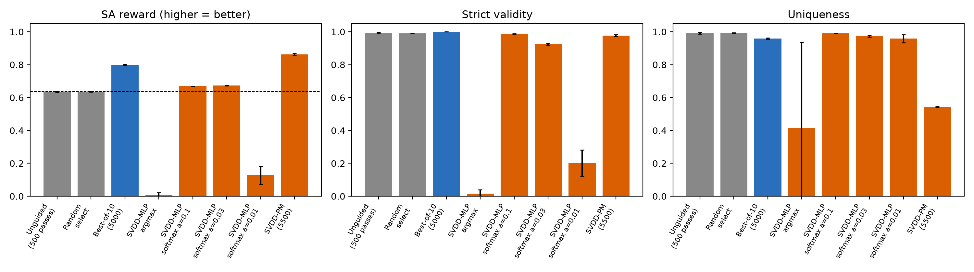
Result: the pre-registered SVDD-MLP rule fails
Argmax SVDD-MLP: SA 0.008, validity 0.015 (best-of-10: SA 0.799, validity 1.0)
Softmax a=0.1 / 0.03: SA 0.669 / 0.674 vs 0.635 unguided, validity 0.99 / 0.93 at 500 passes; a=0.01 collapses
SVDD-PM: SA 0.862 but uniqueness 0.54 (reward hacking onto a few molecules)
Notes:
Numbers from tag talk-snapshot, results/tables/summary.csv. Best-of-10 wins the pre-registered comparison. Softmax is cheap (500 passes, 10x fewer than best-of-10) and gives a small, real gain. PM beats best-of-10 on mean SA but at 0.54 uniqueness it collapses diversity.

Slide 6
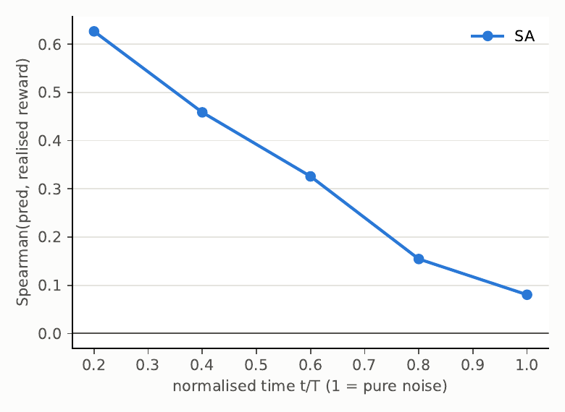
Why: the value function is weak and gets exploited
Value tracks the final reward late (Spearman 0.6 near t/T=0.2) but fades to 0.08 near pure noise
Ranking siblings of one parent (H1) is weak: Spearman 0.04 to 0.13
Argmax chases value-function errors off the training distribution, so molecules stop being valid
Softmax tempers this: alpha trades reward against staying on the data manifold
Notes:
H1 (value function ranks siblings) is only weakly supported; H3 is supported. Explain exploitation: the MLP is trained on on-distribution states, argmax pushes into regions it never saw.

Slide 7
Limitations
One DiGress training seed; 3 sampling seeds
QED only for unguided and best-of-10; SVDD arms are SA only
Several arms ran on one machine; a 5090 replicate of PM and random agrees to about 1e-3
H4 not run; no independent SVDD reimplementation; no real-model M=1 equals unguided test
Softmax arm is exploratory, chosen after seeing the pilot
Notes:
Say these before they are asked.

Slide 8
Next: ablations, planned not shown
M sweep and compute-matched curves | GNN value function | QED for every arm | more seeds | H4
Takeaway: on discrete graph diffusion, naive SVDD does not beat best-of-N; tempered SVDD is a cheap partial win.
Notes:
Demo, if time: scripts/demo.py replay (denoising movie, one SVDD step, head-to-head).

