Slide 1
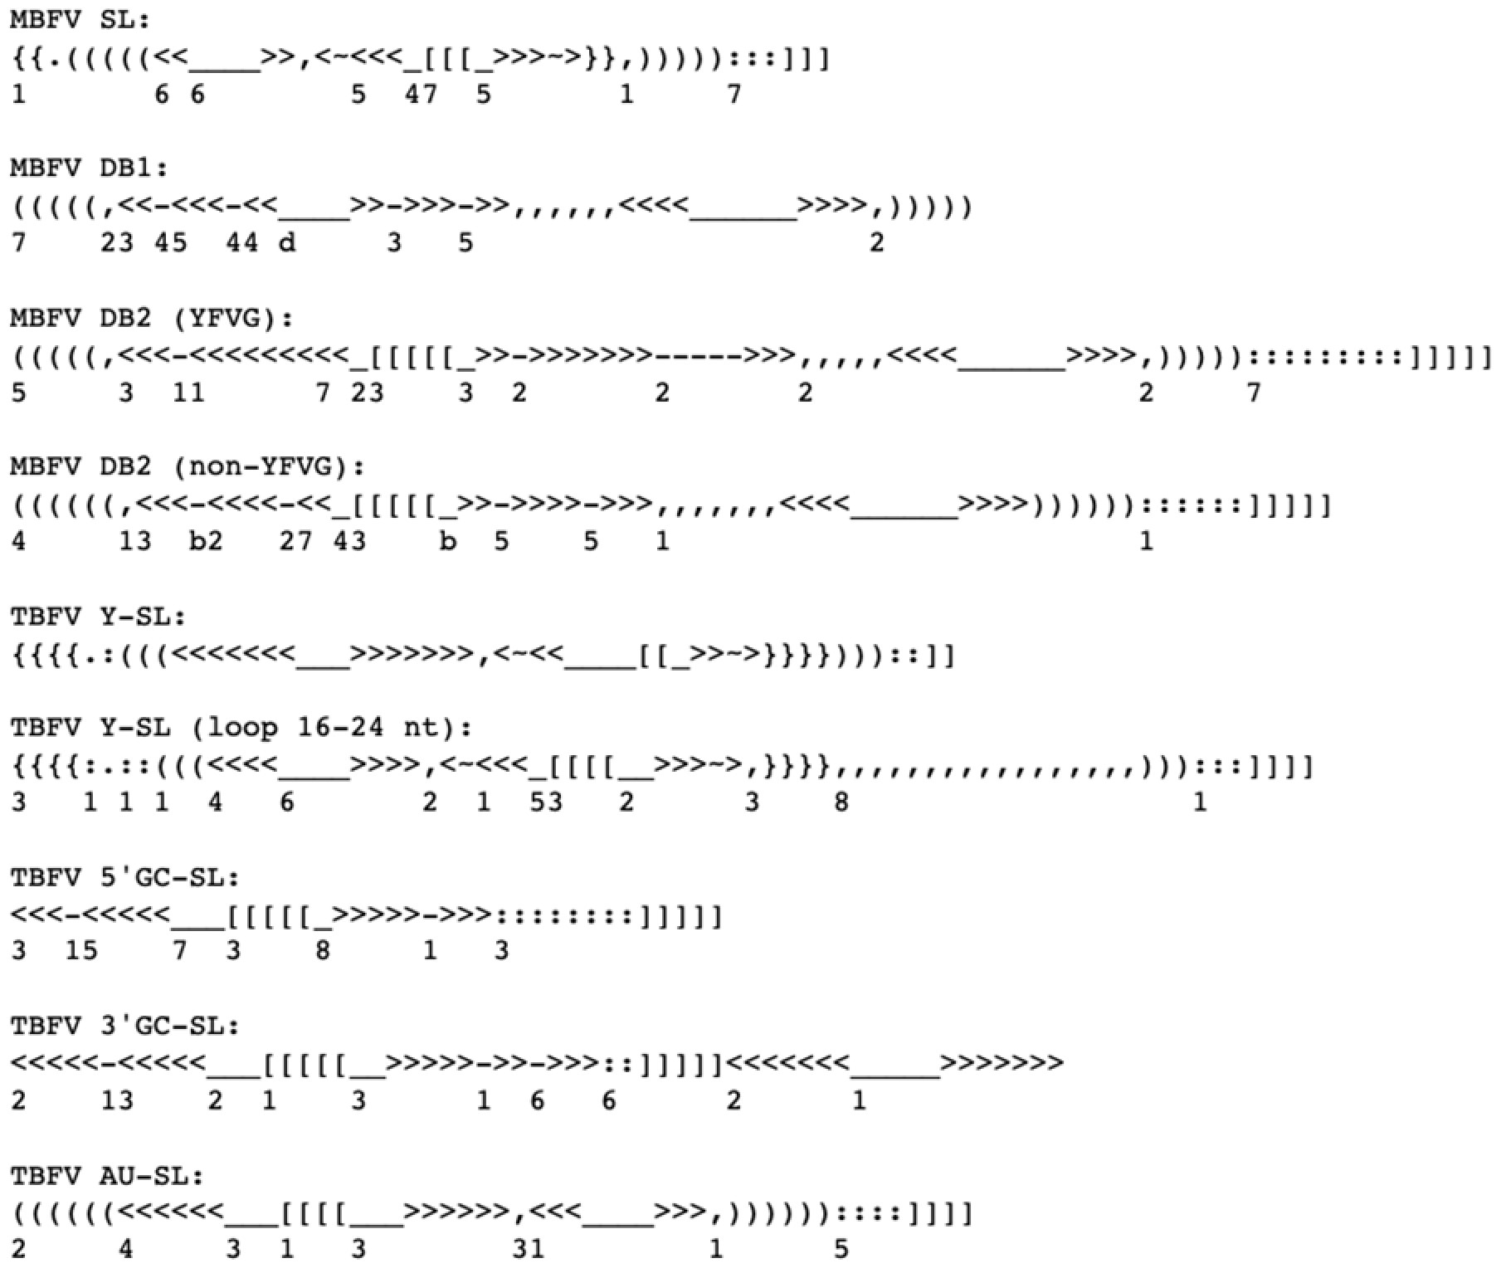
Zammit descriptors

Slide 2

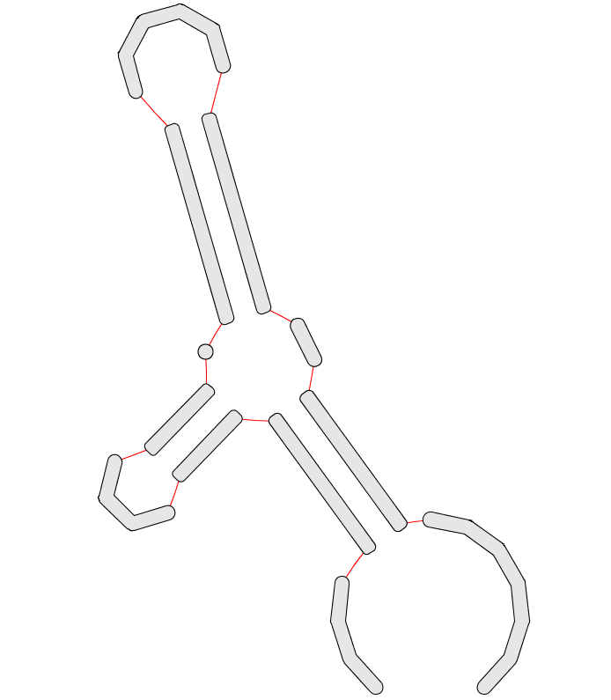
Min: 2
Max: 18
Min: 4
Max: 16
Min: 4
Max: 9
Allow 2 bulges and loops
Min: 2
Max: 3
Min: 1
Max: 1
Min: 5
Max: 5 Max: 6 (compensation adj.)
Min: 1
Max: 7
Min: 3
Max: 10
Min: 5
Max: 13
Min: 2
Max: 8

Slide 3
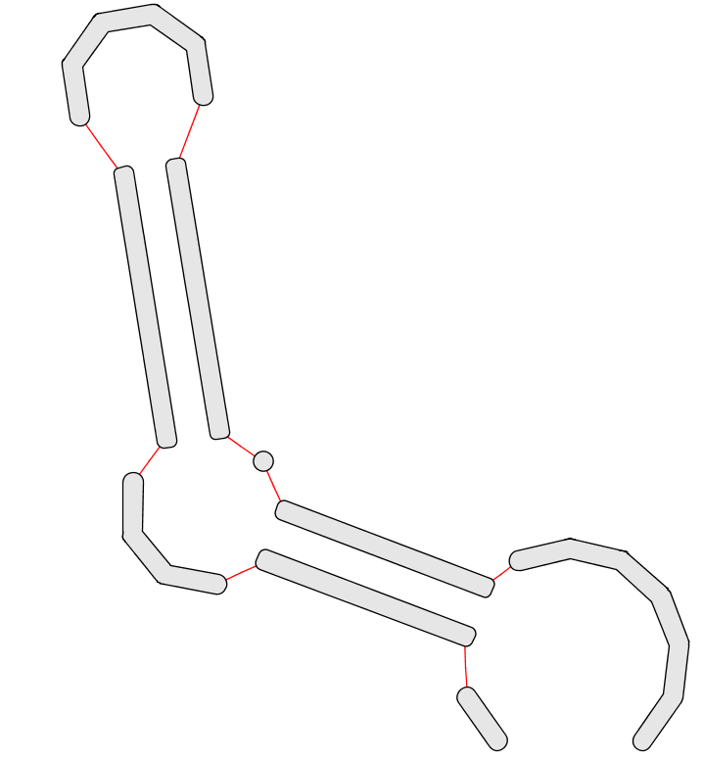
Min: 5 DENV SL II Liu/Villordo
Max: 9 DENV SL I Liu/Villordo
Min: 6 DENV SL I Liu
Max: 9 DENV SL II Villordo
Allow 2 left bulges (SLII Villordo)
Min: 0 Villordo
Max: 2 Liu
Min: 6 Liu Max: 10 Villrodo DENV SL I (minimum/maximum distance covering pseudoknot)
Min: 5 Liu/Villordo
Max: 5 Liu/Villordo Max: 6 patch
Min: 7 (DENV SLI - Villordo)
Max: 9 (DENV SLII - Villordo)
Min: 2
Max: 1

Slide 4
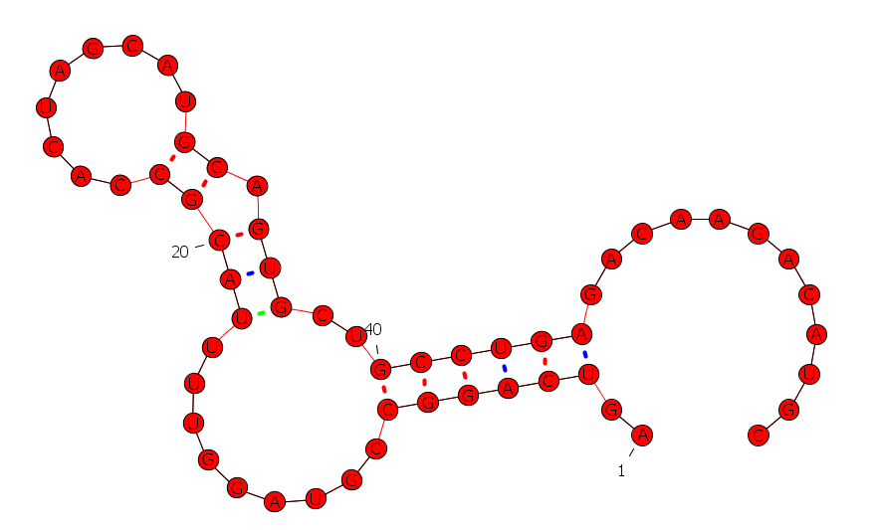
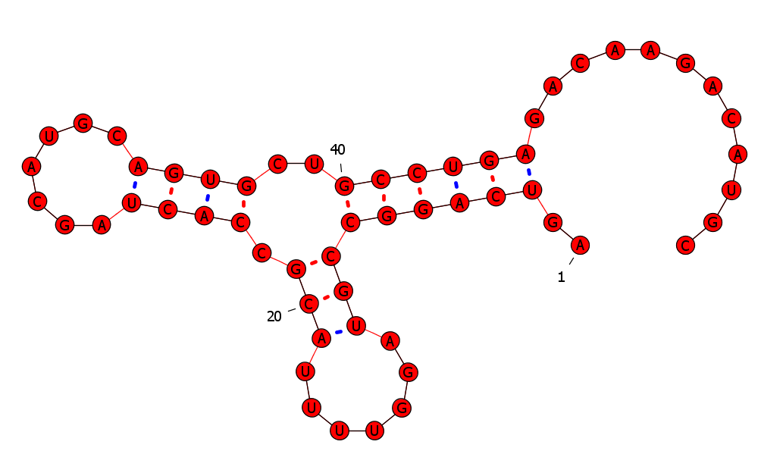
Ntaya virus SLII and SLI (misfolded base stem 6nt instead of 5nt and disrupted tertiary AU interaction) Reason to increase the base stem range of the NA2D query to 6

Slide 5
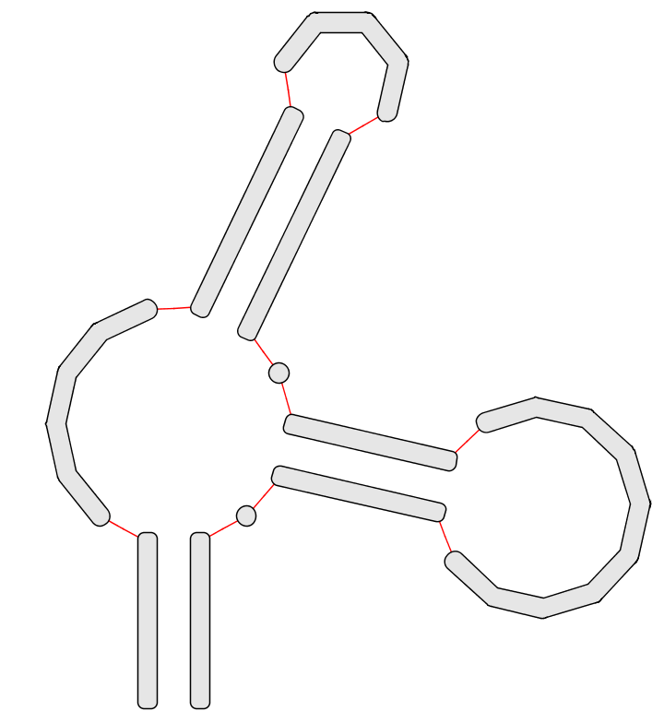
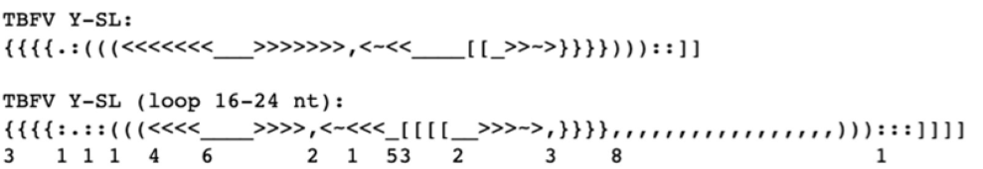
TBFV Y-SL
Min: 3 Max: 9
Min: 3
Max: 7
Min: 3
Max: 5
Allow inner loop
Structure and function of cis‐acting RNA elements of flavivirus - Liu
(inner loop - slide 12)
Min: 0 Max: 2
Min: 4 Max: 7
Min: 4 Max: 14
Min: 0
Max: 3
Min: 3 Max: 6
Allow inner loop

Slide 6
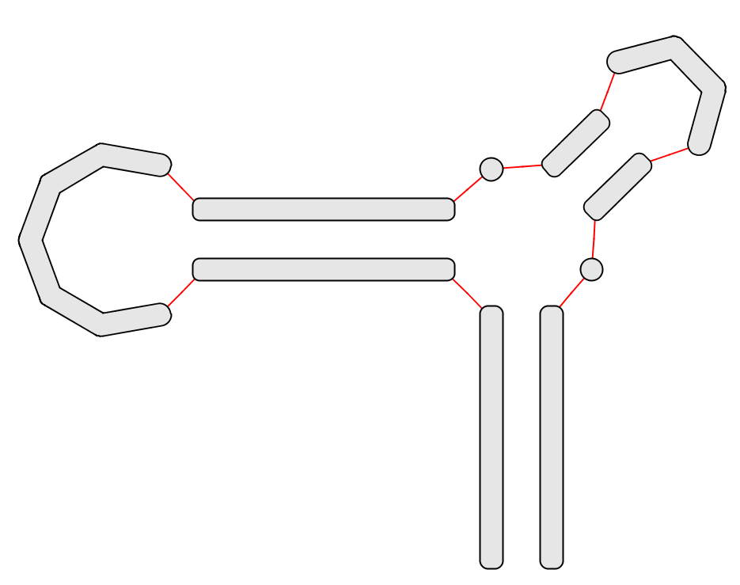
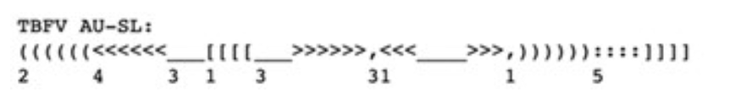
Min: 4
Max: 4
Min: 0
Max: 3
Min: 2
Max: 3
Min: 7
Max: 14
Min: 0
Max: 1
Min: 5
Max: 9
Min: 5
Max: 7

Slide 7
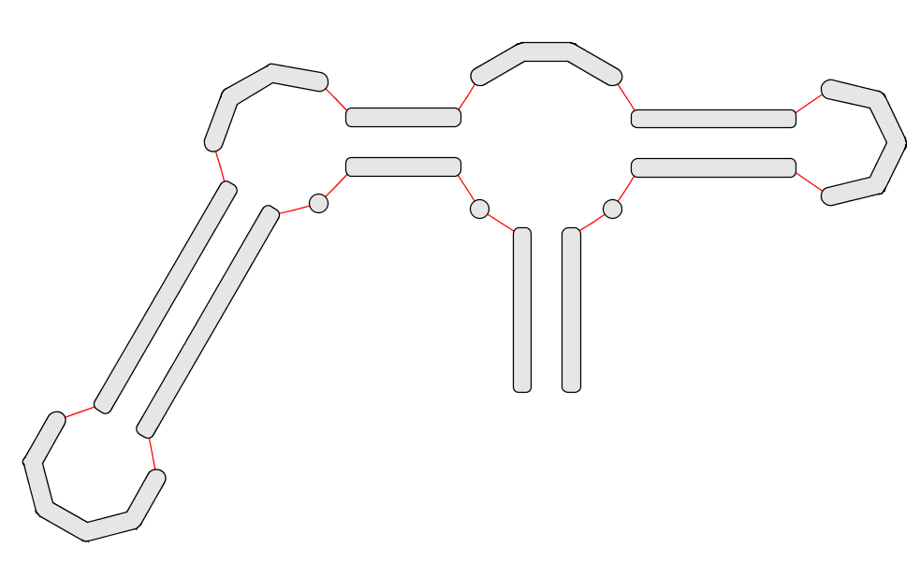
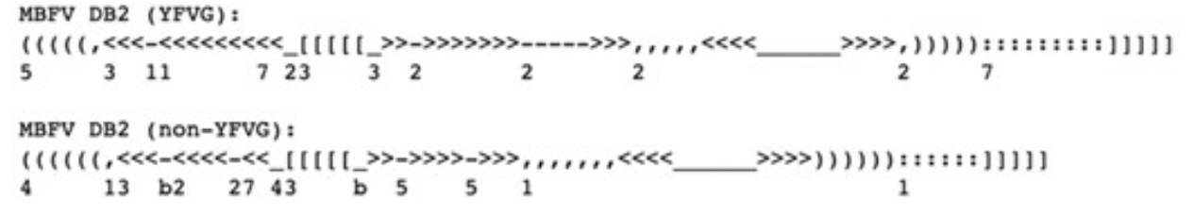
DB2
Min: 4
Max: 6
Min: 4
Max: 6
Min: 4
Max: 4
Min: 6
Max: 6
Min: 2
Max: 5
Min: 0
Max: 2
Min: 7
Max: 14 (Yokose) Allow right bulge
Min: 4
Max: 9
Min: 4
Max: 12

Slide 8
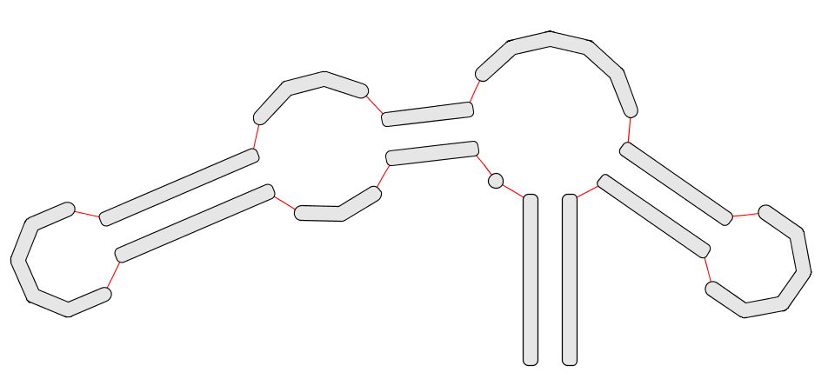
Min: 6
Max: 7
Min: 2
Max: 9
Allow right bulge
Min: 0
Max: 5
Min: 4
Max: 4
Min: 0
Max: 1
Min: 0
Max: 11 (Bagaza)
Min: 4
Max: 14? Allow all modifications
Min: 5
Max: 9
Min: 6
Max: 6
Min: 4
Max: 20

Slide 9
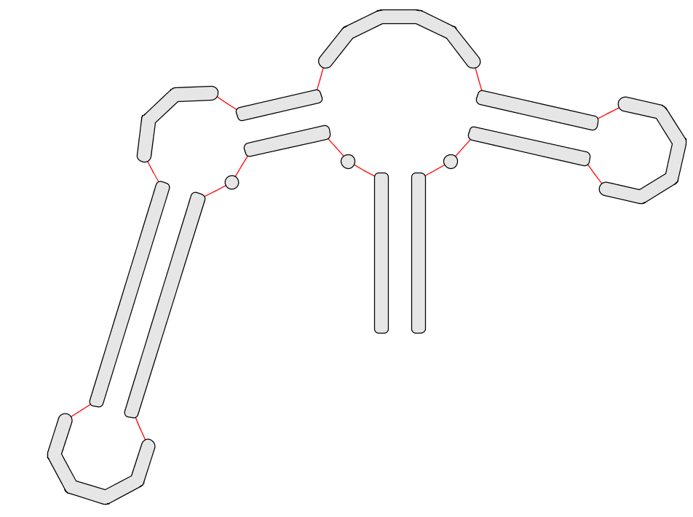
DB1 (no PK)
Min: 6
Max: 6
Min: 1
Max: 4
Min: 4
Max: 4
Min: 0
Max: 5
Min: 6
Max: 6
Min: 0
Max: 2
Min: 0
Max: 4
Min: 4
Max: 11
Min: 3
Max: 11 Allow all structural modifications
Min: 3
Max: 16

Slide 10
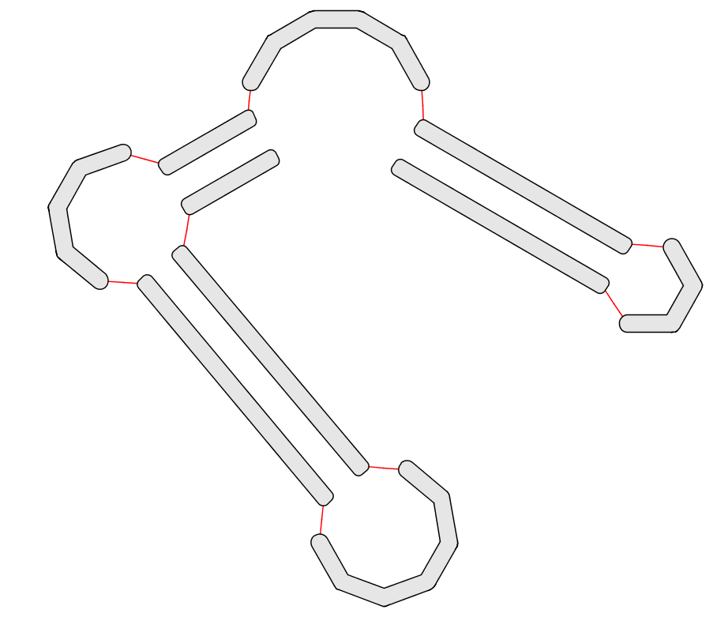
Min: 5
Max: 12
Min: 0
Max: 6
Min: 2
Max: 4
Min: 6
Max: 8
Min: 4
Max: 5
Min: 6
Max: 9
Allow inner loop
Min: 7
Max: 13

