Slide 1
KanBan
-by Apoorva Bhatnagar

Slide 2
What is KanBan
Kanban is an Agile Methodology for managing a software development process. Kanban methodology is less structured methodology than Scrum. There is no process framework in this methodology. It only has an introduced model who improves the process through incremental improvements. This methodology can apply on any other methodology which you are already running.

Slide 3
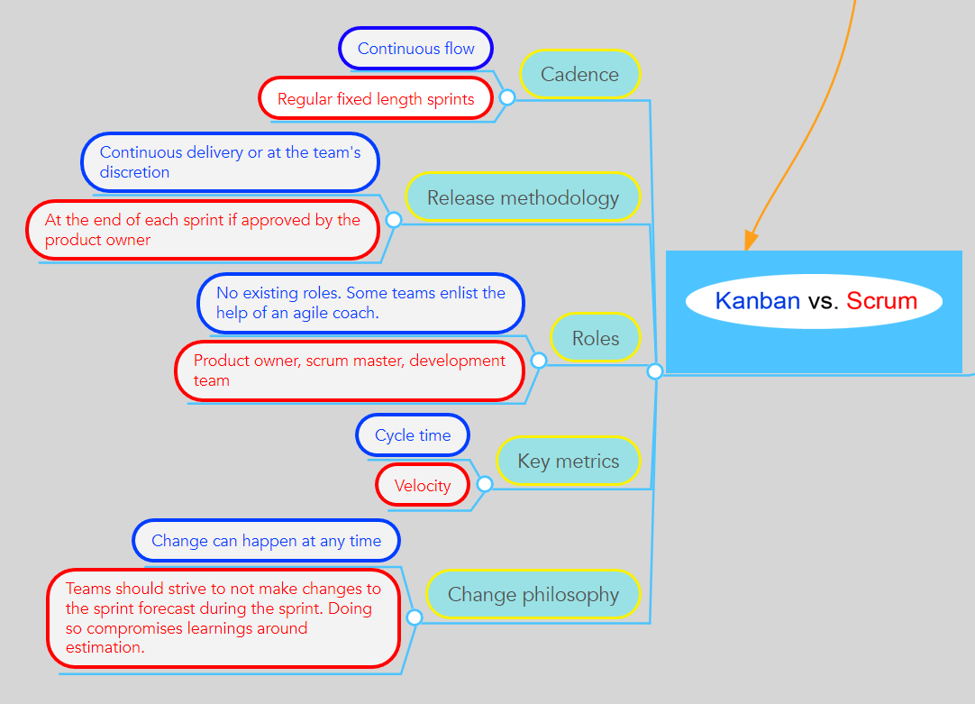
KanBan vs Scrum

Slide 4
Disadvantages of Kanban
Does not give the ability to forecast like scrum does. So, its harder to plan out and project large releases.
May cause poor productivity. Because there is no timeboxing in Kanban, productivity can slow down.
Easier to misuse process. Example: if there are no deadlines for assignments for CSS-566 ;) we will never do them.
Can be difficult to manage different priorities /influx of work. Unlike Scrum which requires prioritization of the backlog. Kanban has a backlog, but no prioritization of work items is required so it can be difficult to choose which task needs more attention.

Slide 5
Which is better? Depends upon…
The project types
While both Scrum and Kanban are Agile methods, their suitability to activity types is different.
Scrum is better for running projects. While encouraging the team to think more dynamically, Scrum still keeps a very clear structure in which the work is done. It gives a clear outline of work, team structure and thus is easier to coordinate and forecast for clients.
Kanban is better for creating products. It allows the flexibility and refining required when developing a product from scratch. By not limiting the team to a very strict schedule and only planning a short time ahead, Kanban allows for changes and updates along the way as well as customer input. Which is ideal for teams creating products.
The way you like to work
Another important thing to consider when choosing between Scrum and Kanban is the way your team is used to working. As the two methods offer quite different approaches to management and task assignments.
Scrum is better for teams that are used to structure. Out of the two Scrum is compiled out of a lot more rules and restrictions. The iterations are defined, tasks are assigned and the team has to adhere to clear roles. If your team is used to this type of environment and structure, this option is better for you as it allows to avoid chaos.
Kanban is better for teams that manage themselves. Contrary to Scrum, Kanban has very little rules you have to adhere to. It provides your team with guidelines and a few tools to maintain, but that is about it. It is up to you to set up the process, plan and complete tasks according to priority. So if you have a team that already manages itself, this would be a better choice.

Slide 6
Bottom Line….
Scrum and Kanban should not be compared. Both methodologies have their own benefits and it depends on the organization and their workflow, to choose the right agile framework for themselves.

