Slide 1
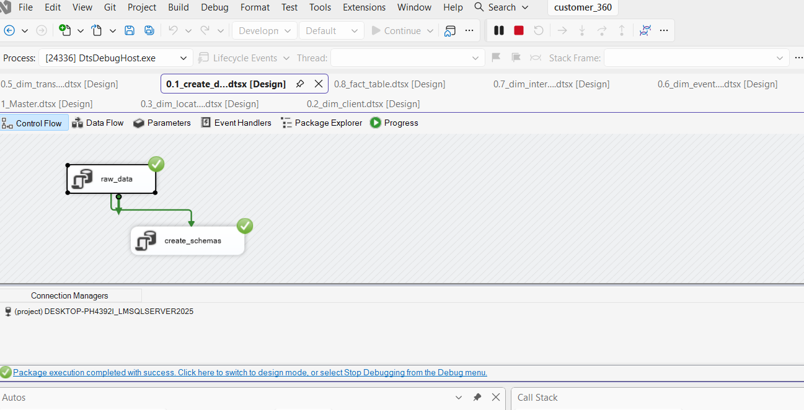
Customer 360 Data Warehouse
SQL Server + SSIS ETL Pipeline | Data Engineering Portfolio Project
A modern analytics solution built to
turn raw customer activity into
trusted business insight.
Source: raw CSV activity data
Stage: cleansing, profiling, validation
Model: star schema with dimensions and facts
Delivery: SSIS orchestration and SQL reporting

Slide 2
Project Overview
From messy operational data to customer intelligence
This project builds a Customer 360 analytical warehouse for understanding customer behaviour, transactions,
and engagement.
The solution consolidates customer, location, account, and interaction data into a reporting-ready structure.
Business questions include: customer distribution by province, transactional summaries, product segmentation,
and engagement analysis.
Why it matters
Customer 360 helps teams answer:
? Who are our customers?
? Where do they operate?
? How are they engaging?
? What drives revenue and activity?

Slide 3
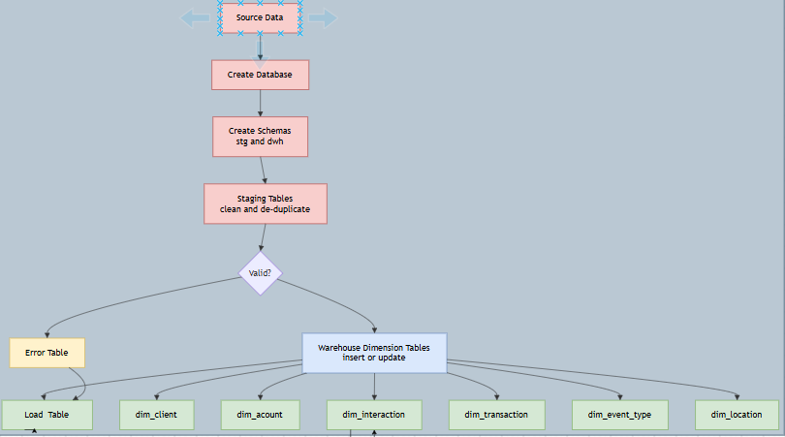
Architecture and Data Flow
Raw data ? staging ? dimensional warehouse ? business reporting
1. Load raw CSV files 2. Stage and cleanse 3. Model dimensions 4. Populate fact table 5. Query for insight

Slide 4
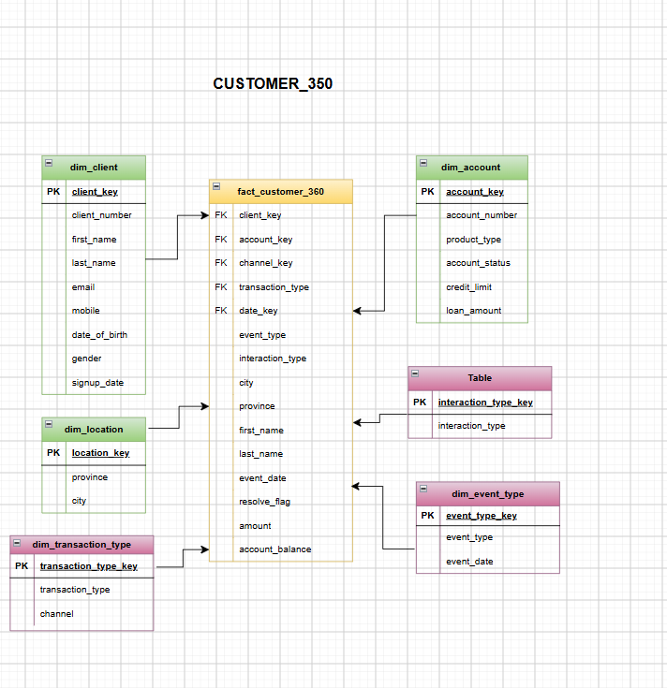
Star Schema Data Model
Dimension tables around a central fact table
Client
Location
Account
Transaction Type
Event Type
Interaction Type

Slide 5
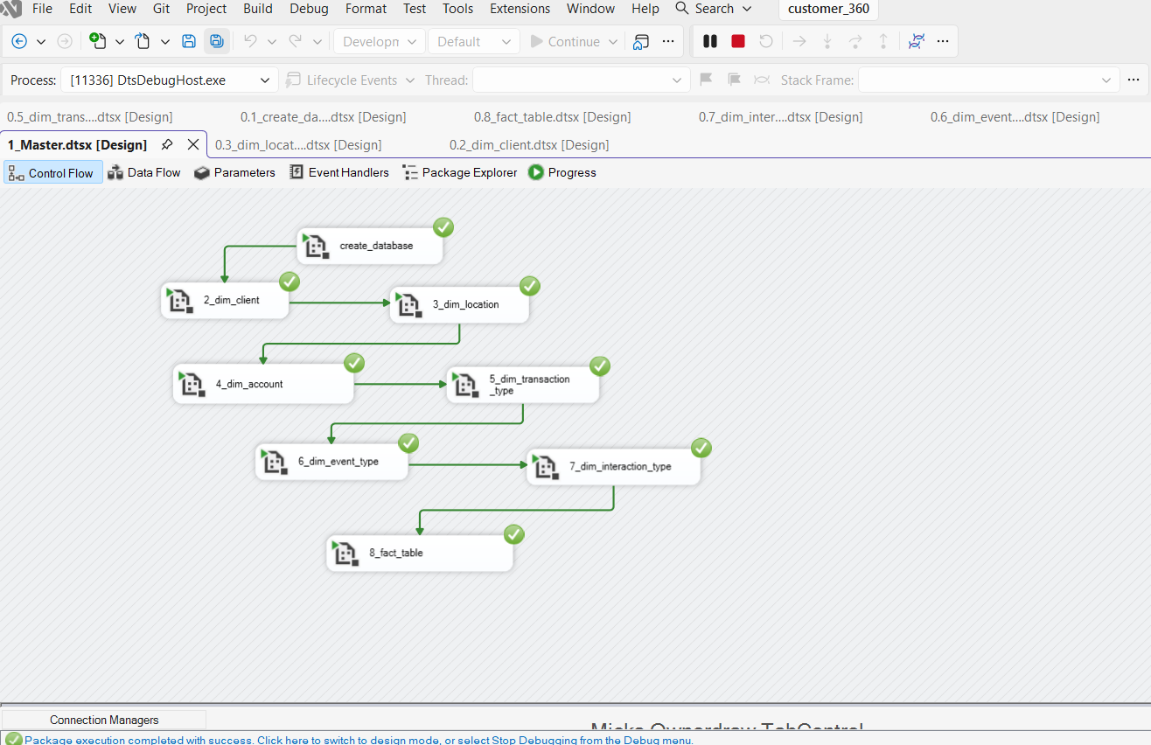
SSIS ETL Pipeline
Automated movement from source to warehouse
Extract
Read raw CSV activity files
Stage
Cleanse, validate, and standardize records
Transform
Normalize to dimension and fact structures
Load
Populate warehouse tables and reporting layer

Slide 6
Data Quality and Profiling
Ensuring source data is credible before warehouse load
Validated raw CSV structure and critical business fields
Removed whitespace and standardized values for consistency
Handled nulls and missing values to reduce reporting risk
Detected duplicates and cleaned repeated customer records
Prepared a trusted staging layer before final modeling
Supported stronger analytical accuracy and repeatable ETL execution

Slide 7
Business Use Cases
The warehouse supports customer and transaction analytics
Customer distribution by province and geography
Transactional summaries by account type or customer segment
Product and customer segmentation trends
Engagement and interaction pattern analysis
Operational reporting for customer activity and behavior
Decision support for portfolio and revenue analysis

Slide 8
Tech Stack and Repository Structure
End-to-end data engineering with SQL-first analytics
SQL Server / T-SQL
SSIS for ETL orchestration
CSV source data ingestion
Star schema dimensional modeling
SQL-based business reporting
Data quality checks and staging workflows
1.raw_csv_data
2.project_scope
3.data_modeling
4.ssis_pipeline_customer360
5.sql_scrips
6.data_quality_note_description
7.business_questions
8.screenshots

Slide 9
Conclusion
A practical data engineering solution for customer analytics
This project demonstrates how raw operational data can be
transformed into a usable, analytical warehouse.
By combining data profiling, dimensional modeling, ETL automation,
and SQL reporting, it provides a realistic and scalable data
engineering workflow.
The result is a trusted foundation for customer intelligence
and business decision-making.

