Slide 1
Min_child_weight

Slide 2
Recommended values
Tianqi
Owen Zhang
Abhishek Thakur
Us
 | Rule_of_thumb | Actual value for AXATP
Tianqi | 3 / event_rate | 666.67
Owen | 1 / sqrt(event_rate) | 14.9
Abhishek | { 1, 3, 5, 7 } | { 1, 3, 5, 7 }
Us | 1 ~ 6 | 4 (Tuned)

Slide 3
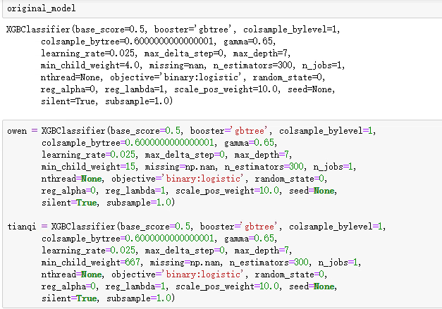
Recommended values

Slide 4
Acid test, no.1
 | AUC
Tianqi | 0.969
Owen | 0.973
Us | 0.967

Slide 5
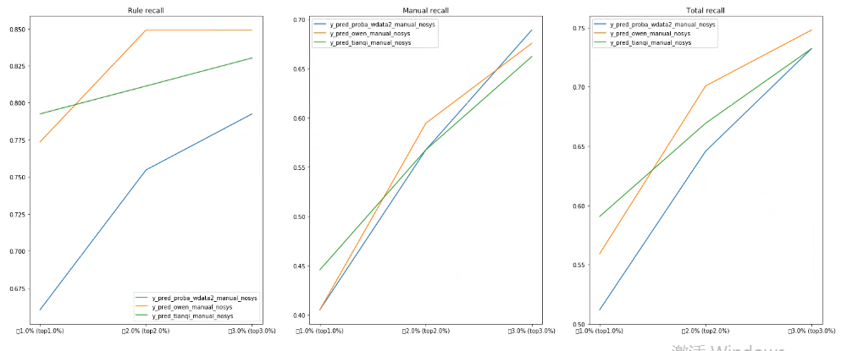
Acid test, no.2
In terms of what the business wants…
Notes:
By restricting mass, model ends up looking for more rule cases than manual cases (tianqi_manual_recall < owen_manual_recall < us_manual_recall). Suggests manual cases patterns are ‘more unique’.

Slide 6
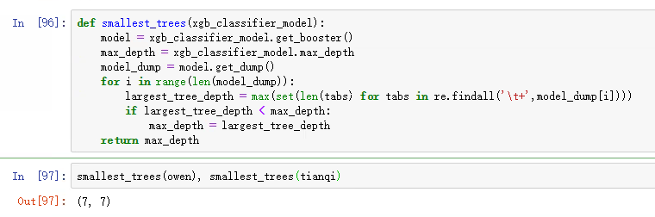
Did depth of trees change?
No

Slide 7
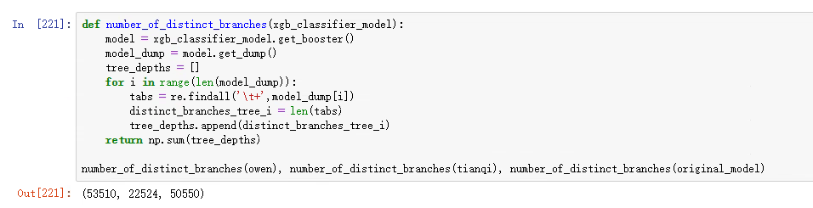
Did number of branches change?
Yes
Notes:
Somehow, Owen has higher min_child_weight but still resulted in more branches -> These should hopefully be good branches, means greedy tree growing was ‘pruned well’ by min_child_weight restriction.

Slide 8
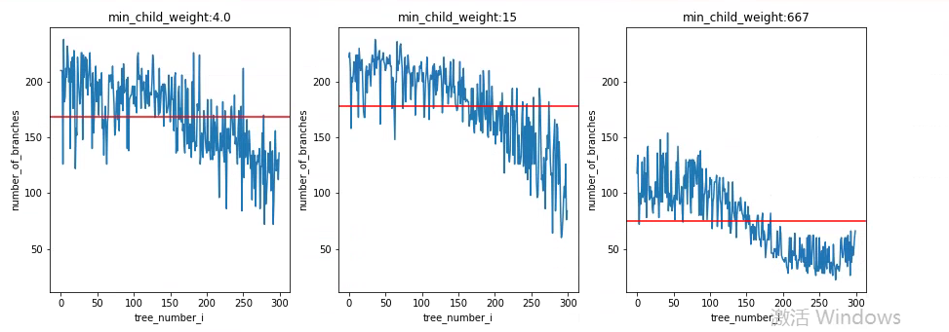
Did number of branches change, no.2
Notes:
Smaller trees in Tianqi
Owen has about the same trees with better performance (AUC)

Slide 9
Conclusions so far:
AUC – very similar. Us < Tianqi < Owen.
Manual Recall – very similar. Tianqi < Owen < Original.
Depth of trees – no change, all trees grown to max depth.

Slide 10
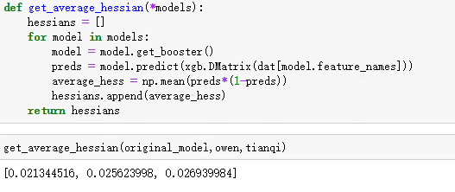
Sense of scale (Crude)
What hessians are we already at?
This is what the next tree, number 301, will be starting with.
We expect this because prediction quality is very similar amongst all three models.

Slide 11
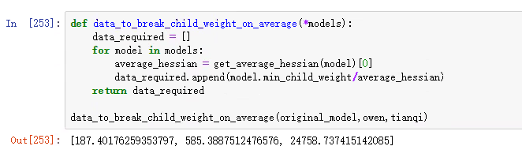
Sense of scale (Crude)
On average, how many data points are required to break the min_child_weight limit?
Notes:
February claims – 30k. Tianqi’s limit corresponds to an average of 2% of the data

Slide 12

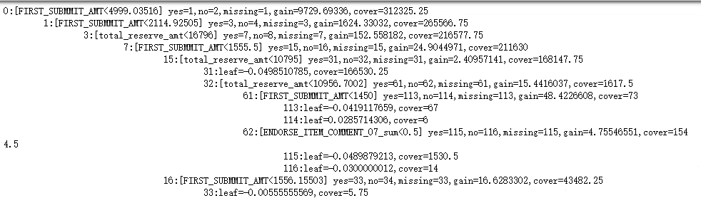
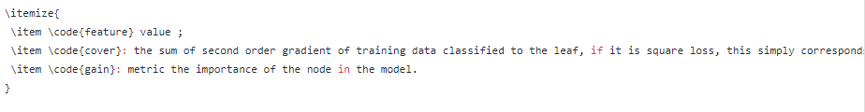
Hessians in leaves
‘Cover’ here means sum of hessians! (That’s why decimals are allowed)

Slide 13
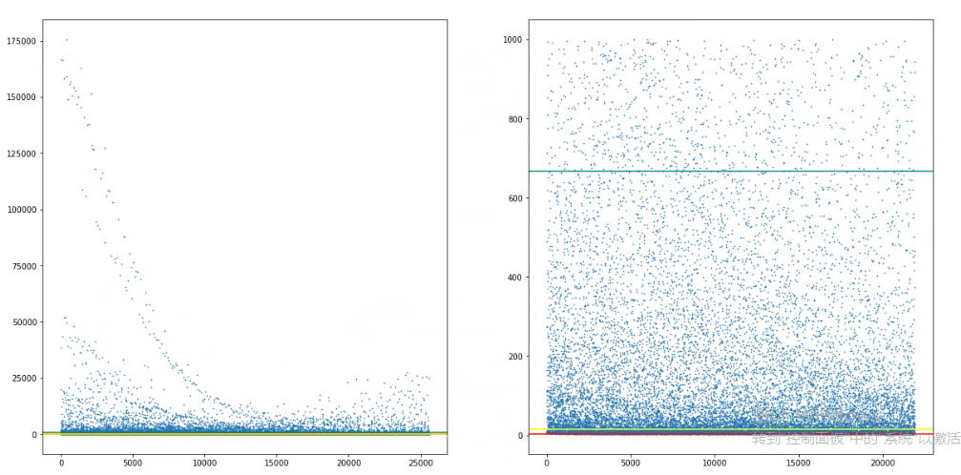
Hessians in leaves

Slide 14
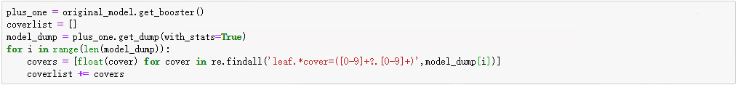
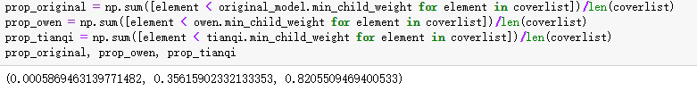
Hessians in leaves
Directly calculate the proportion of leaves that would be affected by the min_child_weight regime of Tianqi and Owen.
Why is there 0.05% in prop_original? It should be zero! (Since it’s so low, pretend we didn’t see it)
Effect of cutting leaves not trivial in growing trees.
Notes:
We should expect Owen and TQ to look much different from original model, but remember the number of branches – something else would have been grown.

Slide 15
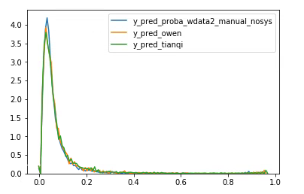
Actual predictions of the model
Predictions here means sigmoided leaf scores.

Slide 16
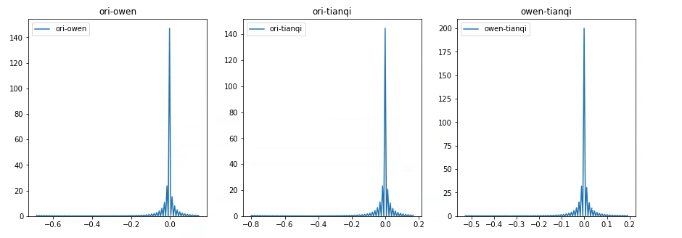
Actual predictions of the model
When so similar, you can also look at differences:

Slide 17
Recap
Crude sense of scale – measure too crude to inform what values to use, better look directly at performance metrics like AUC / Recall
Hessians on leaves – trees would look much different (closer to the leaves) , but due to greedy tree growing, something else will grow.
Actual predictions – very similar as we expect from the AUC scores.

Slide 18
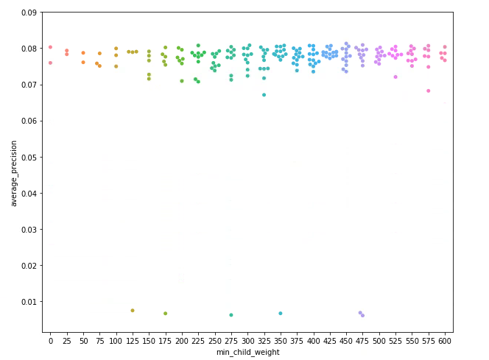
Directly compare model performance
Open up the grid of min_child_weight
Range from Abhishek to Tianqi
Looks flat.. But notice there are more points at larger values of min_child_weight.
With the extended grid, best min_child_weight changed 4-> 450

Slide 19
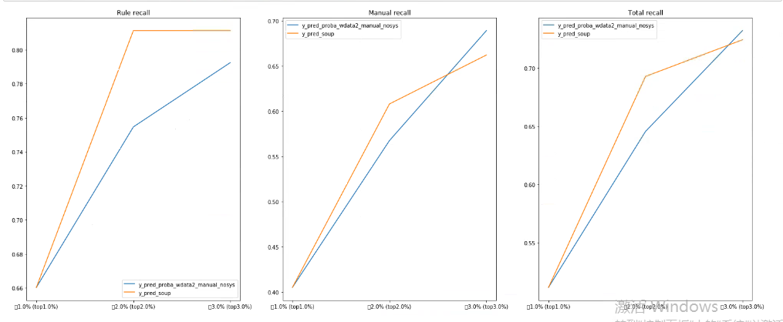
Directly compare model performance
But when validating, loses anyway.

Slide 20
Conclusions
Min_child_weight does not really affect performance of the model, even when considering values from 1 to 600. By Occam, can aim for smallest model (Tianqi), but no big benefit. Still unexplainable, prediction performance about the same.
What values to use for min_child_weight – depends on
Model quality (Log-loss)
Good quality predictions -> residuals are low, need more mass
Low quality predictions -> residuals are high, need less mass
Event rate also matters! If it’s a rare event we should allow more mass in a leaf.
The choice of loss. If it’s quadratic loss, don’t even care about model quality.

