Slide 1
AI
AI CV assistant
A free-tier plan for the portfolio's “Ask about me” widget
Cloudflare Workers AI · GitHub Pages · Angular 21
Answers only from the CV. Falls back to the current keyword matcher. No card, no bill.
Notes:
The ask: can the portfolio have a real AI assistant for free? Yes, with one small free backend.

Slide 2
Why it needs a backend at all
The site is static, so anything the browser can read, a visitor can read
01
Today The widget matches keywords against canned answers. It never invents anything, but only fires on an exact hit.
IN THE WIDGET TODAY
What Angular versions has she upgraded?
02
The gap “Can she start in March?” gets nothing. “availability” works. Recruiters phrase things their own way.
She maintains production Angular apps at IBM and has carried them from v14 through v18…
Can she start in March?
03
The catch GitHub Pages only serves files. An API key in the Angular bundle is public, and someone will spend the quota.
That isn't in her CV or posts, so I won't guess.
↑ The right phrasing works. The wrong phrasing gets nothing.
Notes:
The keyword matcher is honest but brittle. A model fixes phrasing, but the key cannot live in the browser.

Slide 3
Five ways to do it, one worth doing
All free. Only one is free, good and realistic at the same time
Option
Answer quality
Effort
Verdict
Keyword matcher (today)
Exact hits only
none
Keep as fallback
Cloudflare Worker + Workers AI
Good · Llama 3.1 8B
~1 day
Recommended
Worker + Gemini free tier
Better
~1 day
Upgrade later
In-browser model (WebLLM)
Fair
~1 day
~1 GB per visitor
Chrome built-in AI
Fair
low
Chrome only
Workers AI calls the model through a binding inside the Worker, so there is no third-party API key to store, rotate or leak.
Notes:
Recommended row is the only one that is free, decent quality and needs no key management.

Slide 4
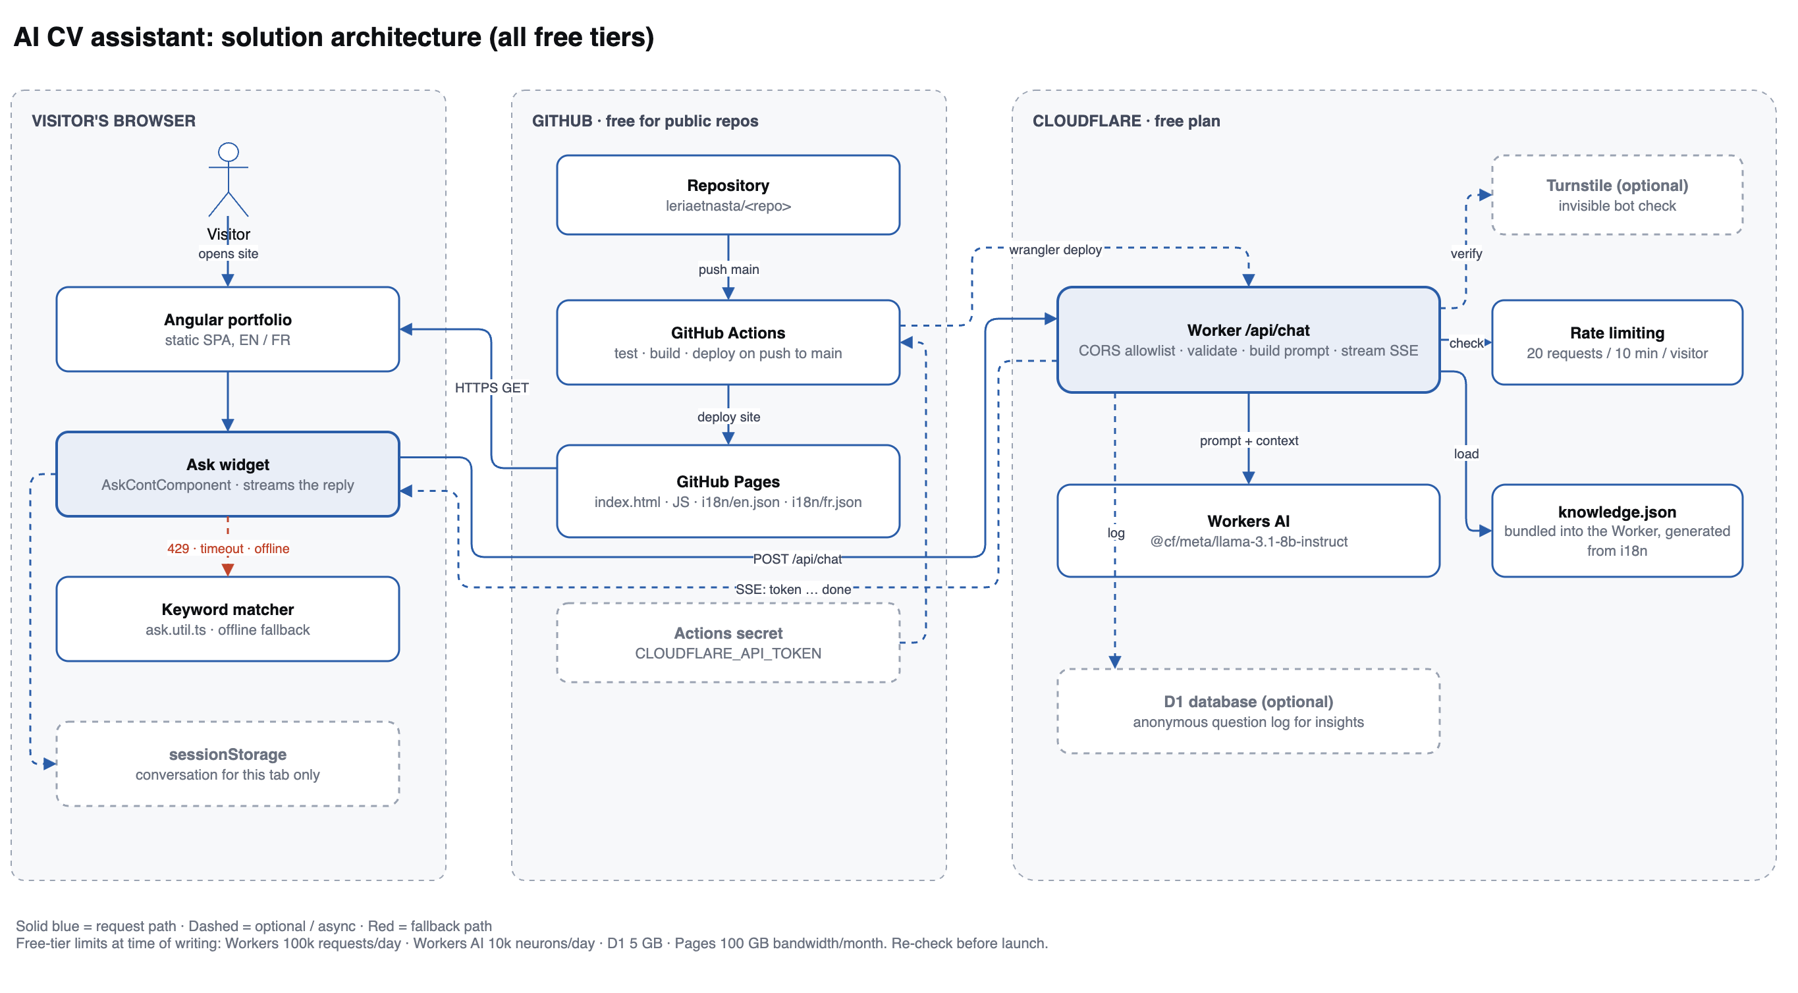
Solution architecture
Three zones, every one of them on a free tier
Browser
Widget streams the answer; keyword matcher stays as fallback
GitHub
Same push deploys the site and, later, the Worker
Cloudflare
The only new server: checks, prompt, model, stream

Slide 5
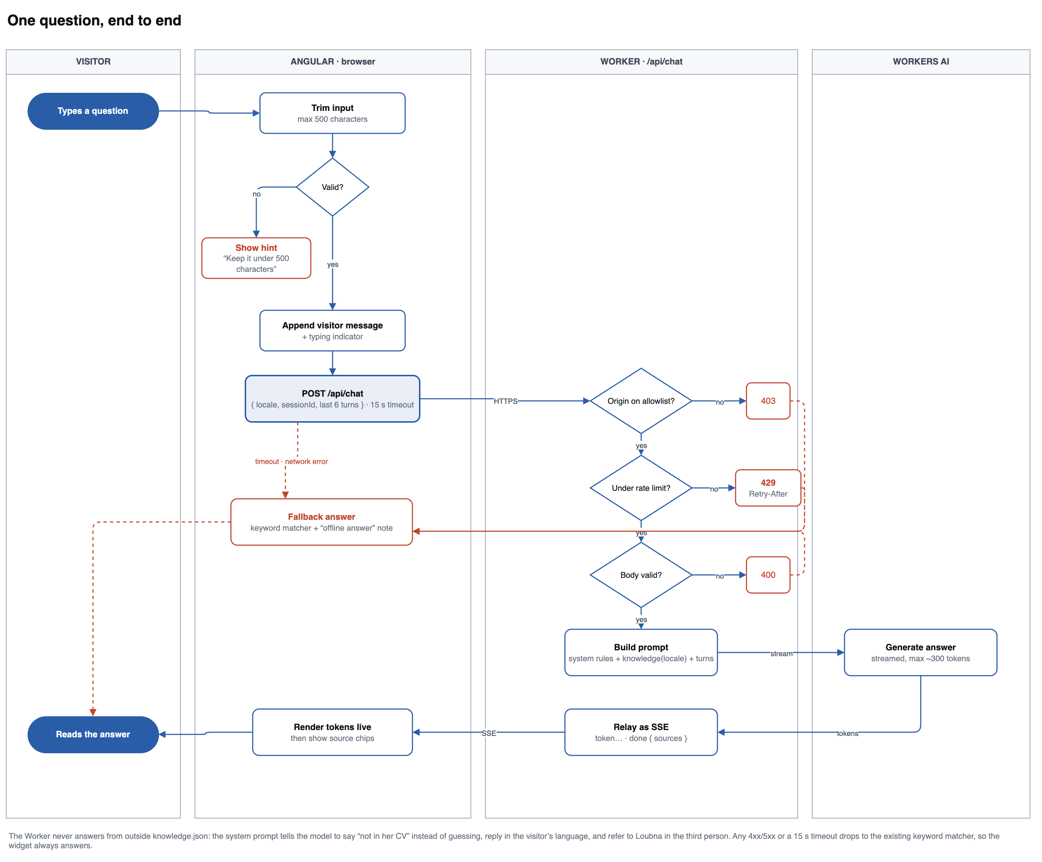
One question, end to end
Four gates in the Worker, and one path that catches every failure
403
403
Origin not on the allowlist
429
429
Over 20 requests / 10 min
400
400
Body, locale or length invalid
502
502
Daily free allowance used up
Every failure lands in the same place
Any 4xx/5xx, a 15-second timeout or a dead network drops to the keyword matcher, marked as an offline answer. The widget never shows an error and never hangs on a spinner.
Notes:
The failure paths are what make it feel solid: a recruiter never sees an error.

Slide 6
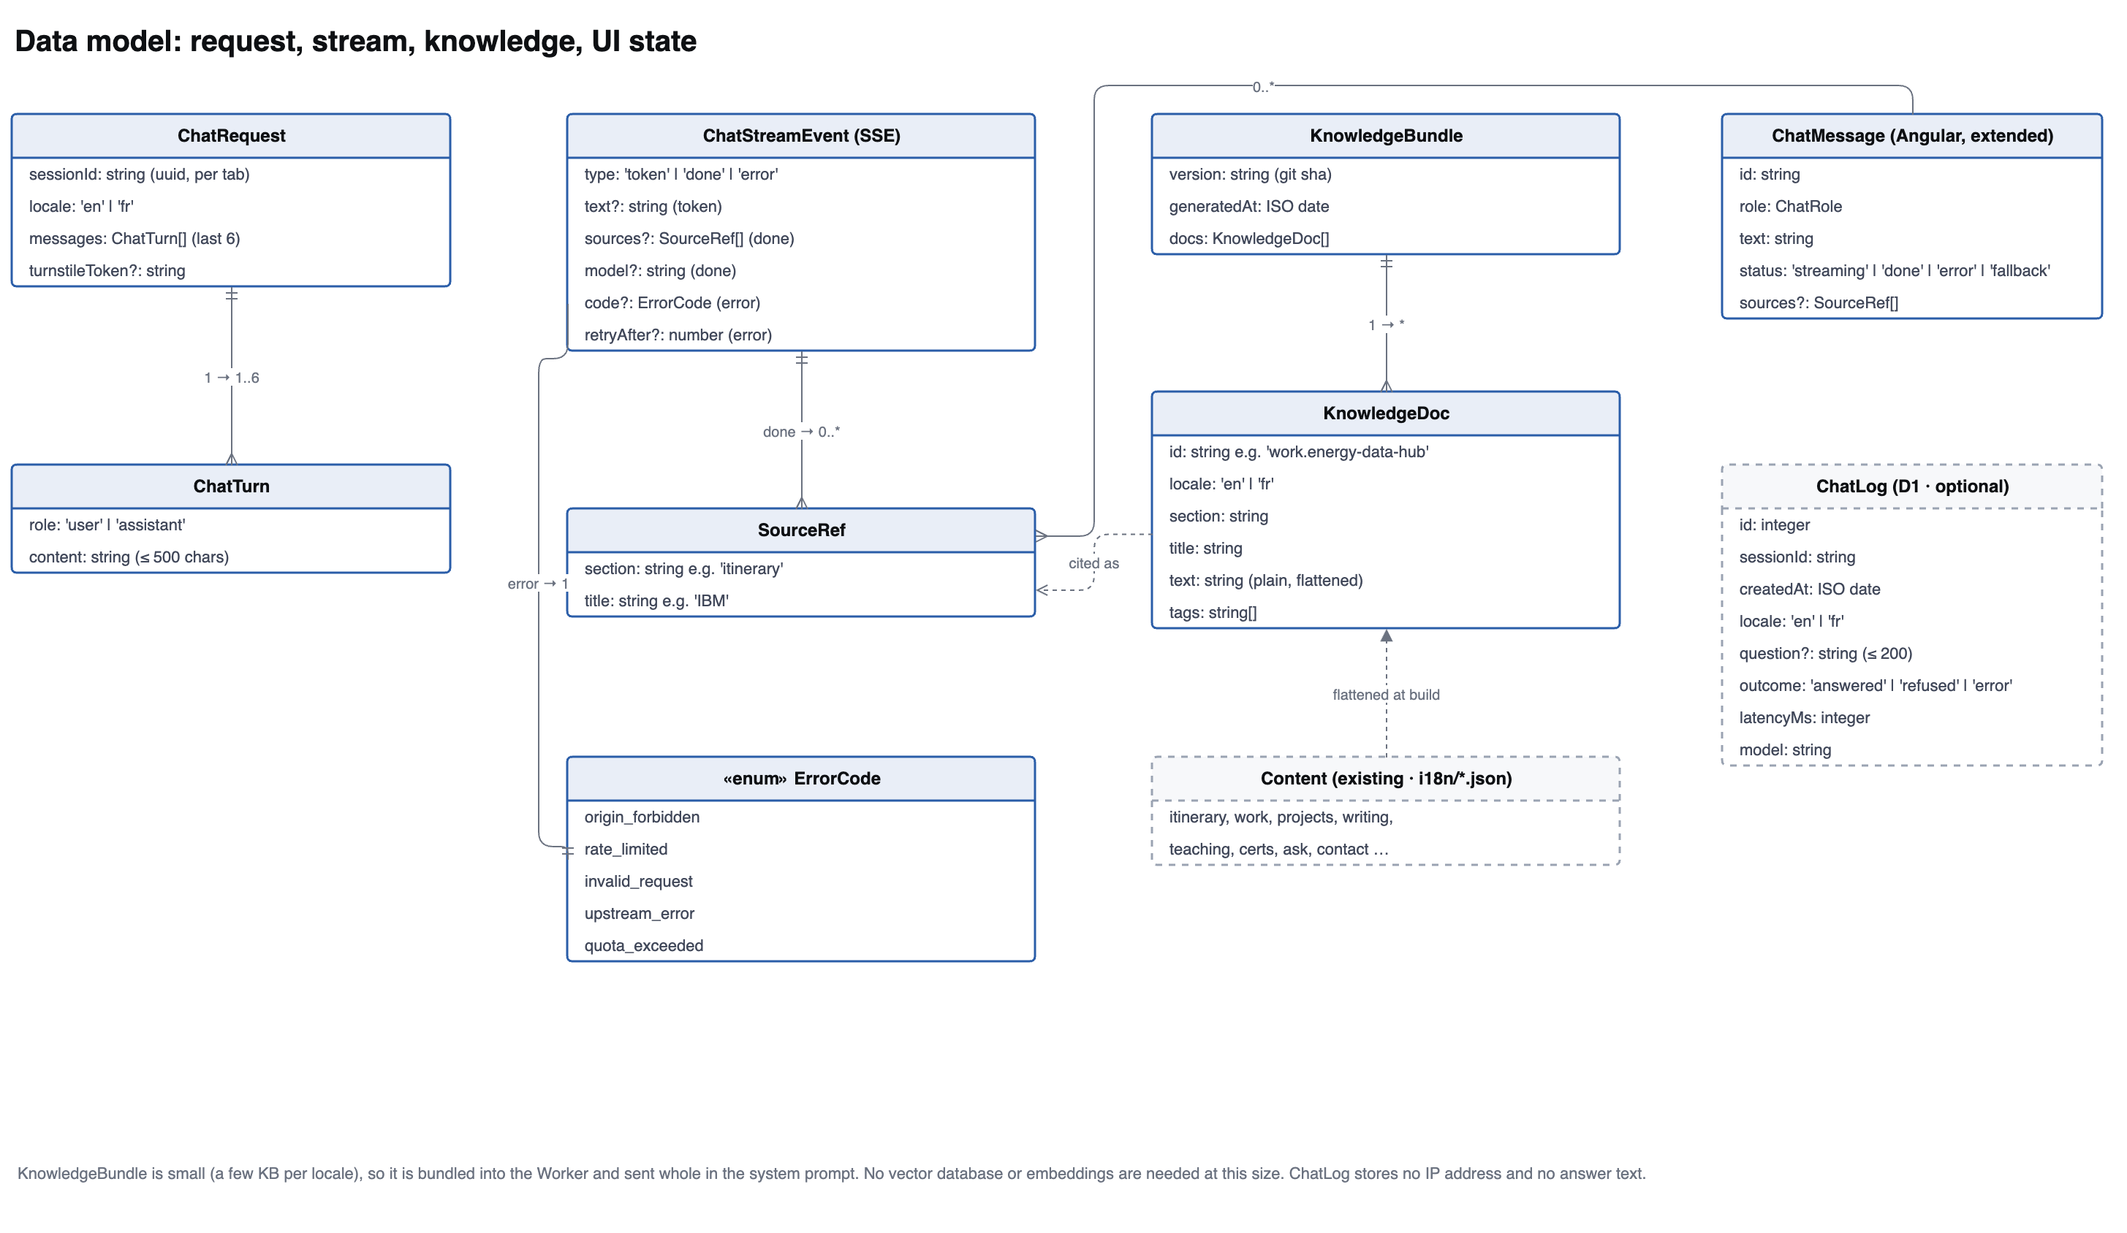
Data model
Small enough to skip embeddings entirely
Request
Last 6 turns, 500 chars each, so the prompt can't grow without limit
Knowledge
i18n JSON flattened into KnowledgeDoc records at build time
No vector DB
A few KB per locale goes into the prompt whole

Slide 7
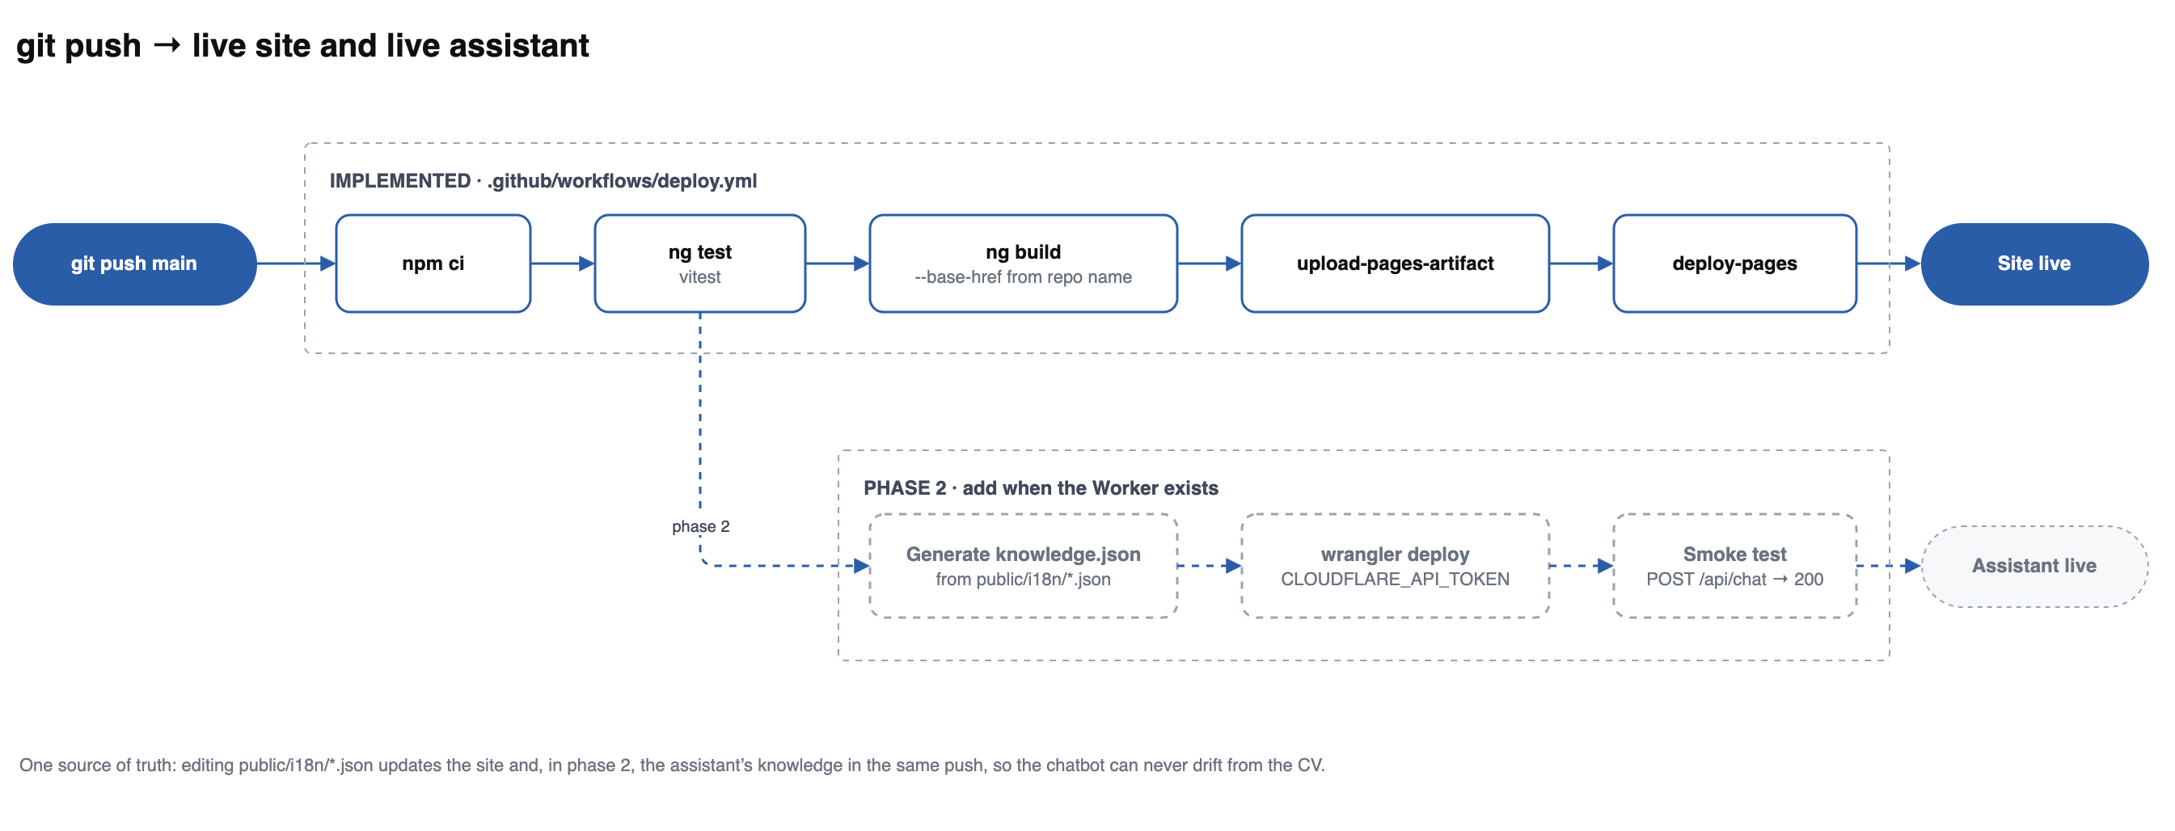
One push updates both
The CV and the assistant can never drift apart
public/i18n/*.json stays the single source of truth. Fix a date in the CV and the same push rebuilds the site and regenerates the assistant's knowledge. The chatbot cannot quote a version of the CV that no longer exists.
Notes:
Solid row exists today in deploy.yml. Dashed row is phase 2.

Slide 8
What stops it embarrassing you
Four guardrails, each one cheap to add
01
Knowledge only
02
Shown sources
The prompt says: answer from the CV, or say it isn't there. Never guess, never fill a gap with something plausible.
Each answer returns the sections it used, displayed as chips, so a reader can check it.
03
Locked down
04
Always answers
Origin allowlist, 20 requests per 10 minutes, 500-character inputs, ~300-token replies.
Quota gone or API down, the keyword matcher replies instead. Free tiers stop rather than charge.
Visitor text always stays in user turns, never merged into the system prompt, so “ignore your instructions” is just text the model was told to distrust.

Slide 9
Three phases, about a day
Only the first needs anything from you: a free Cloudflare account
PHASE 1
PHASE 2
PHASE 3
The Worker
Angular
Pipeline
Create the Worker project
Add the AI + rate-limit bindings
Implement POST /api/chat
Script i18n → knowledge.json
wrangler login, wrangler deploy
ChatService reads the SSE stream
ChatMessage gains status + sources
Render tokens as they arrive
Fall back on error or timeout
Worker URL in environment.ts
Cloudflare API token
Add CLOUDFLARE_API_TOKEN secret
Add the deploy job to the workflow
Smoke test /api/chat
Optional: Turnstile, D1 log
Everything except the Cloudflare login can be written for you.

Slide 10
What it costs
Nothing, and it stops rather than charges
100k
10k
$0
Worker requests
per day
Workers AI neurons
per day
with no payment
method on file
Someone drains the quota
Origin allowlist, rate limit, short replies, then a silent fallback
The model invents experience
Knowledge-only prompt, refusal instruction, sources shown
The assistant quotes an old CV
Knowledge is regenerated from i18n in the same deploy
Notes:
Free-tier limits as published at the time of writing; re-check before launch.

Slide 11
Next step
01
Create a free Cloudflare account
No card. The free plan is enough.
02
Run wrangler login once
The only step that needs your credentials.
03
The rest can be written for you
Worker, knowledge script, Angular widget, deploy job.
docs/ai-assistant/README.md · assistant-architecture.drawio

