Slide 1
My pecha
Generated using ComfyUI-PechaKucha

Slide 2
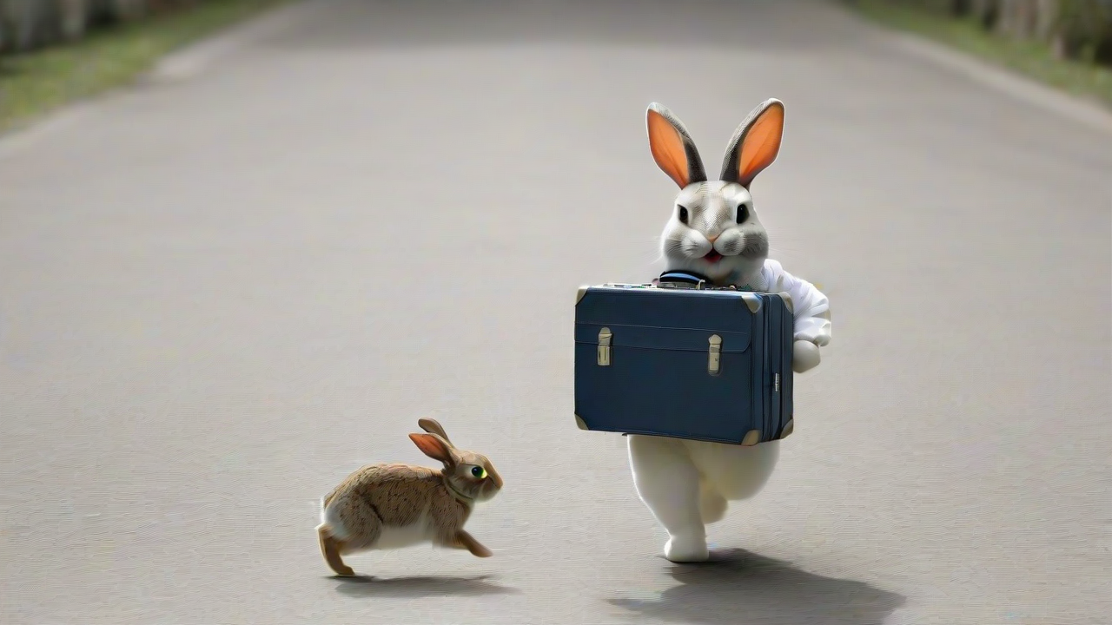
A rabbit walking with a suitcase

Slide 3
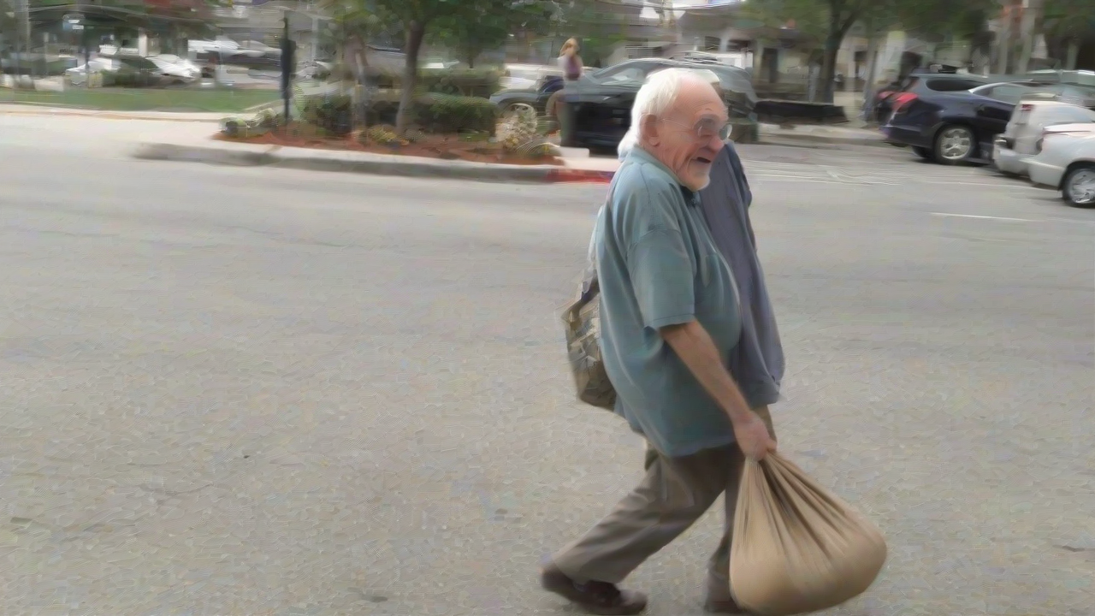
An old guy trying to carry a bag of money

Slide 4
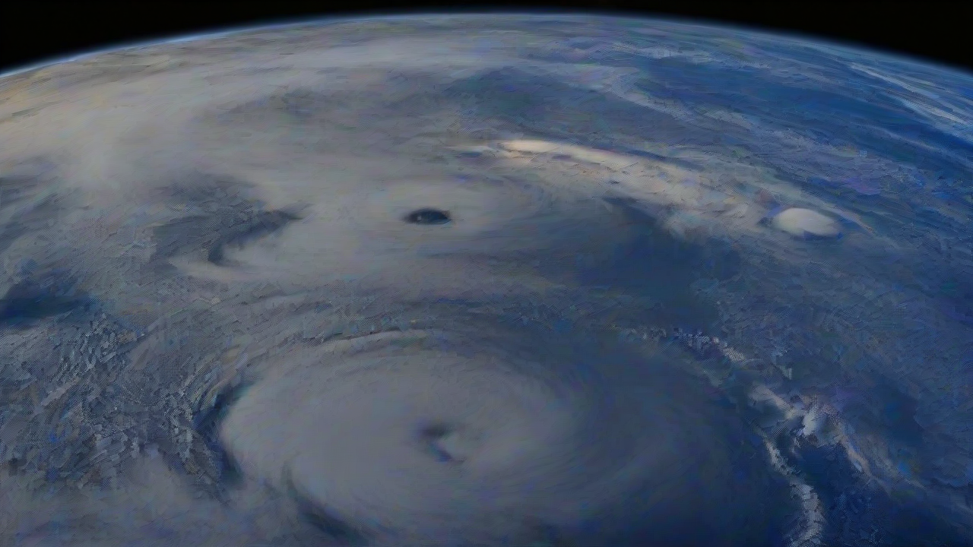
A space view from earth

