Slide 1


Hackathon 2017
French language and culture in the digital age

Slide 2
Team “Les CAFIG”
Aline Delperrie de Bayac
Laurent Erignoux
Zhenwei XIA
Roberta Zanibelli
Notes:
Our documentation: https://docs.google.com/document/d/19DL6b_7vhnK3xLqPvdqcWx0uvbjG84cJ4sF_tGBzD6g/edit#

Slide 3
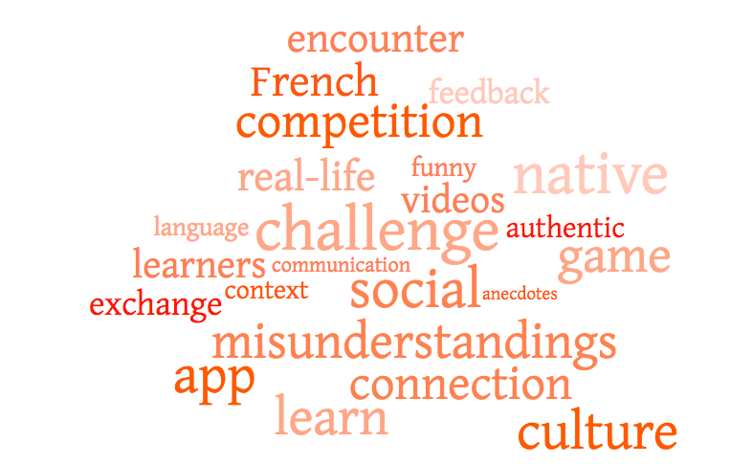

Slide 4
Problem we want to solve
Learners of French can make linguistic mistakes causing cultural misunderstandings when interacting with native speakers.

Slide 5
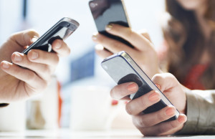

Customer Target
Age: 18-29
Gender: male and female users
Status: students, young professionals
All the countries where AF acts

Slide 6
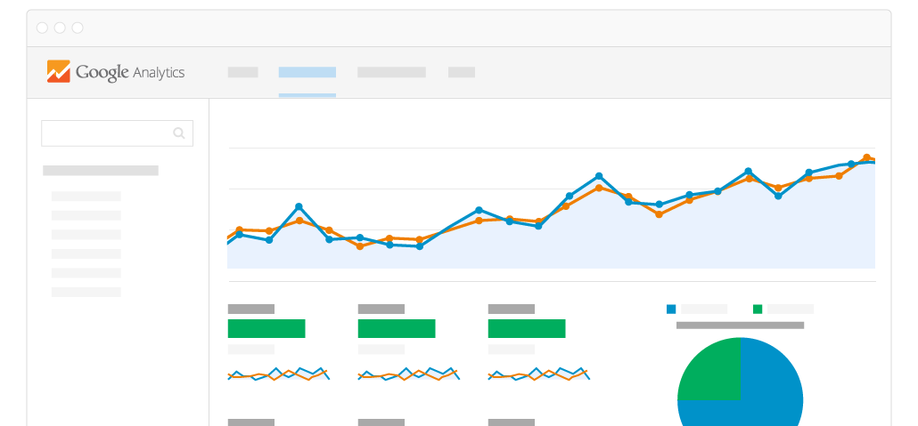
Market Research
The OIF estimates that the number of French speakers will rise to over 700 million by 2050¹
AF welcomes 460k learners of French/year in the world²
We would target learners of French with digital technology
1. Source: The status of French in the world
2. Source: AF in the world

Slide 7



Solution
Provide learners of French with an app offering videos featuring real-life situations.
Goal: help them learn and retain the French language and culture.
CULTURE
GAMIFICATION
EMOTION

Slide 8
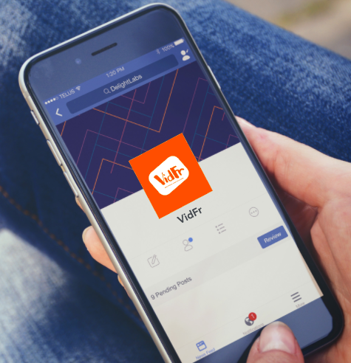
Our Viable Product
VidFr
(vidéos + françaises)
Real French,
funny situations

Slide 9



Business Model
REVENUE PROFIT:
$1.5 * 15k packages in the 1st year = $22,5k
$0.15 profit / package purchased (10%)
Revenue: $2,250
SOLUTION:
1 month free trial
$1.5 to access unlimited packages
Notes:
No investment.
At the end of the first year, we calculate to have a revenue of $2,250.

Slide 10
Merci de votre attention!

Slide 11
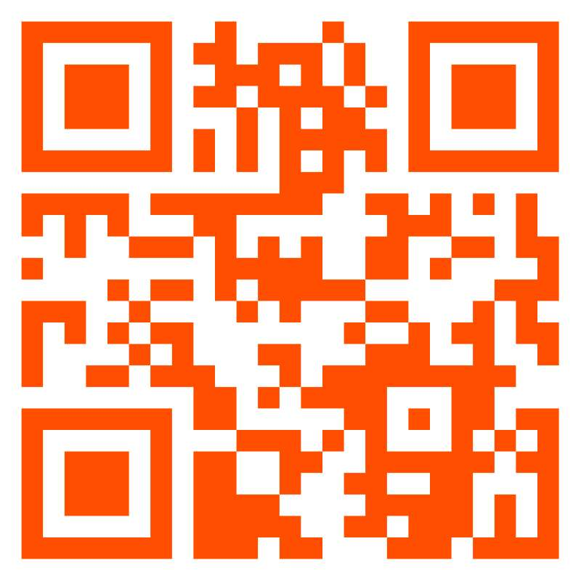
Q&A
Try out our app!

