Slide 1
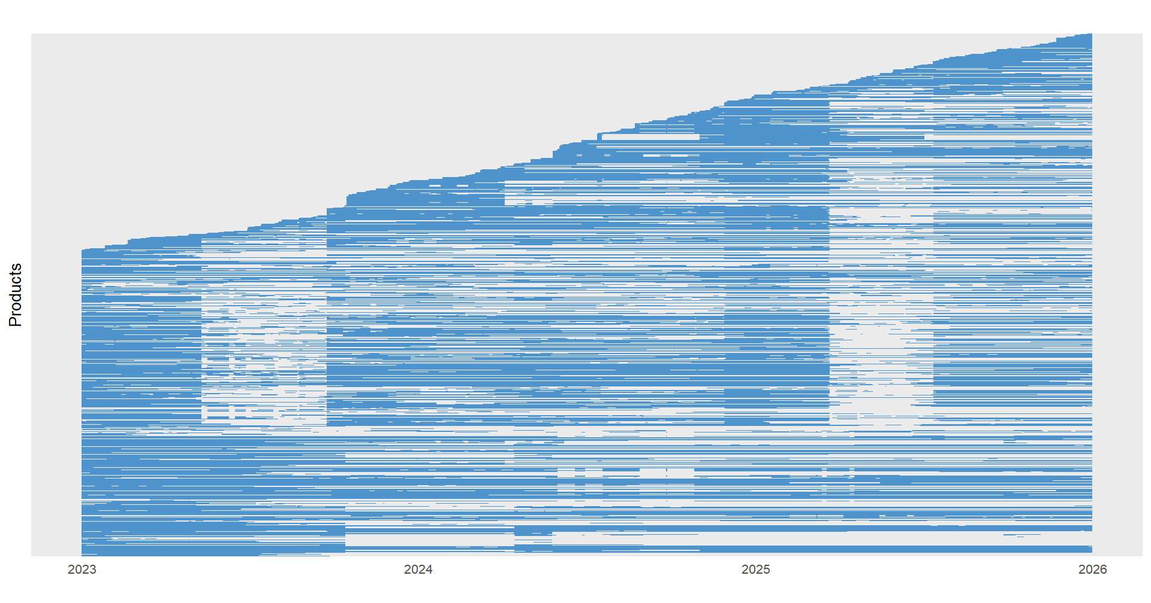
Temporary gaps in product availability
Products that disappear from the sample
> 150 new products entered the sample each year
Observations over time

Slide 2
Temporary gaps in product availability
Products that disappear from the sample
> 150 new products entered the sample each year

