Slide 1


Event Venue Finder for Münster
A Web-Based GIS Application
Khanh Giang Le 556087
Lerissa Merril Menezes 564864

Slide 2
Project Overview
🎯 Goal
📦 Datasets
An interactive map for discovering event venues in Münster with public transport accessibility.
Self-compiled event venues + external Münster bus stop locations, both in GeoJSON.
⚙️ Stack
🗺️ Key Output
GeoServer (WFS) · Leaflet.js · OSRM Routing · HTML / CSS / JavaScript
Venue popups with full attributes, nearest bus stop, and walking route on click.

Slide 3
System Architecture
Data Tier
Service Tier
Presentation Tier
Shapefile (.shp)
GeoServer WFS
Leaflet.js Frontend
▸ event_venues.shp
▸ OGC WFS endpoints
▸ Promise.all() fetch
→
→
▸ busstops.shp
▸ CORS enabled
▸ Haversine proximity
▸ UTF-8 encoding
▸ outputFormat=application/json
▸ Leaflet popups
▸ Stored in GeoServer data_dir
▸ Separate stores in a workspace
▸ OSRM routing
⚠️ CORS required: CrossOriginFilter enabled in web.xml with chainPreflight=false for Jetty 10 compatibility

Slide 4
Data Preparation
01
Author GeoJSON
⚠️ Shapefile Limitations
Self-compiled venue dataset with attributes. External bus stop GeoJSON for Münster.
Field names
Truncated to 10 chars
e.g. available_evenings → available_
02
Convert in QGIS
Arrays
Flattened to comma-
separated strings
Export to Shapefile with UTF-8 encoding. Add .cpg file to fix umlaut rendering.
Encoding
Requires explicit UTF-8
+ .cpg companion file
03
Publish in GeoServer
Create workspace → store → publish layer. Compute bounding box from data.
Booleans
Stored as 0/1 integers,
not true/false
04
Verify WFS
Test endpoint in browser. Confirm GeoJSON response with correct features.

Slide 5
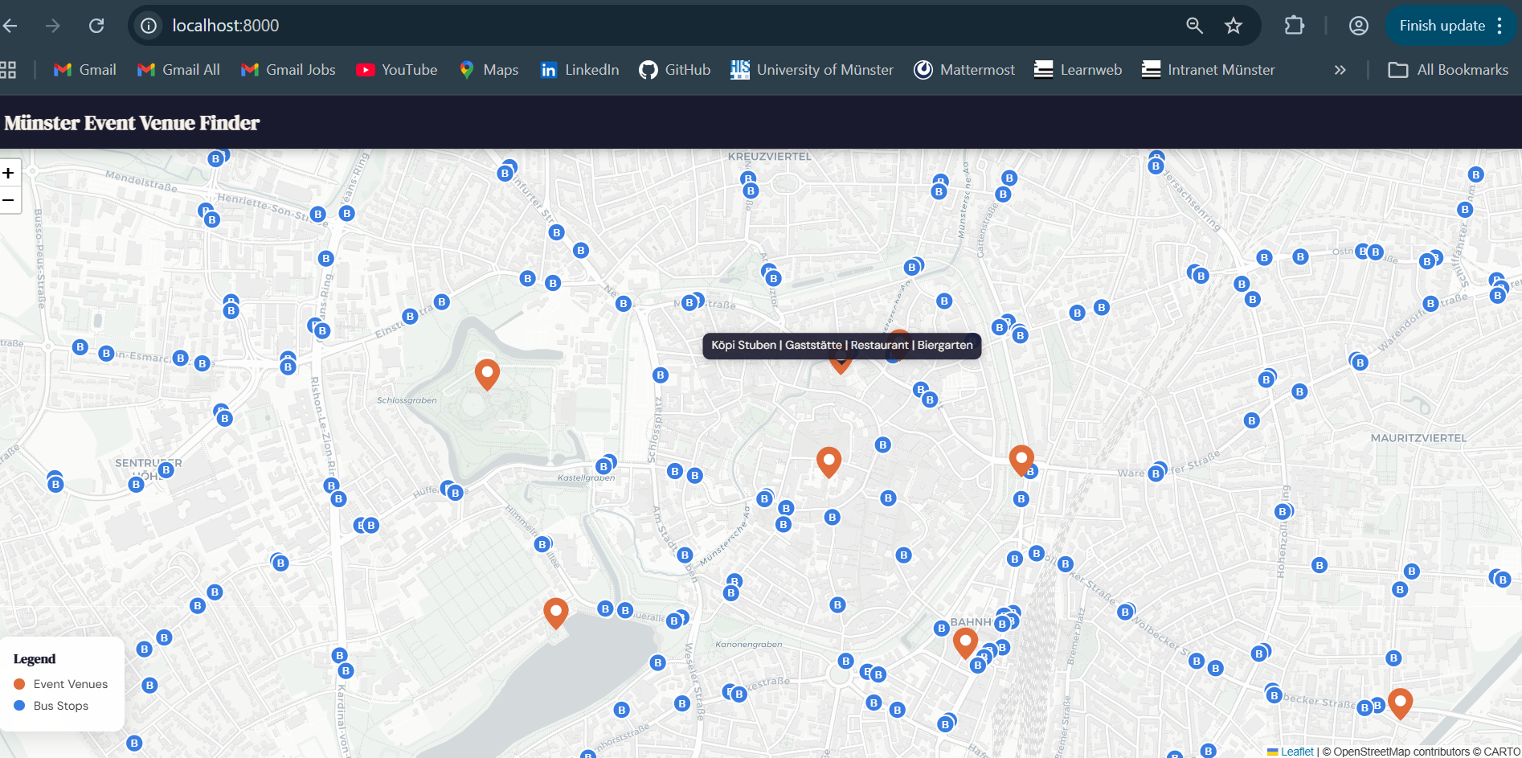
Map Interface
📸 Replace with your map screenshot
🟠
Orange markers
Event venues
🔵
Blue markers
Bus stops
📍
Hover tooltip
Shows venue/stop name
🖱️
Click venue
Opens full popup
🗺️
Click venue
Draws walking route

Slide 6
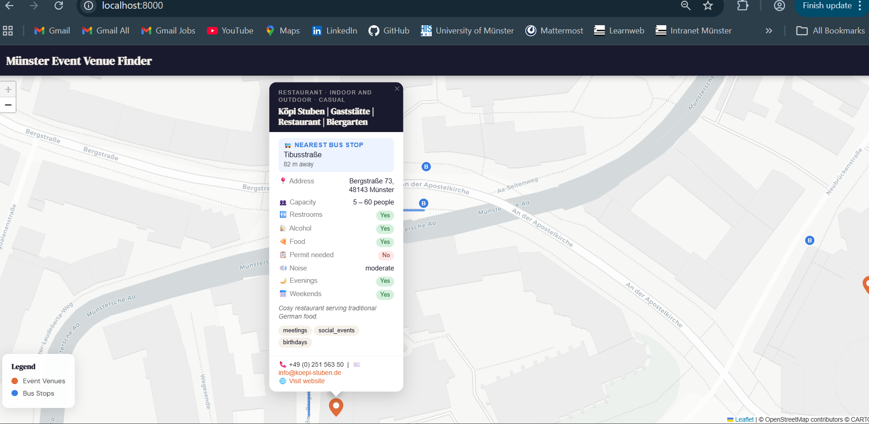
Venue Popup & Nearest Bus Stop
📸 Replace with venue popup screenshot
Popup Attributes
🚌 Nearest Bus Stop → Calculated via Haversine formula
📍 Address
👥 Min / Max Capacity
🚻 Restrooms
🍺 Alcohol allowed
🍕 Food allowed
📋 Permit required
🔊 Noise restrictions
🌙 Available evenings
📅 Available weekends

Slide 7
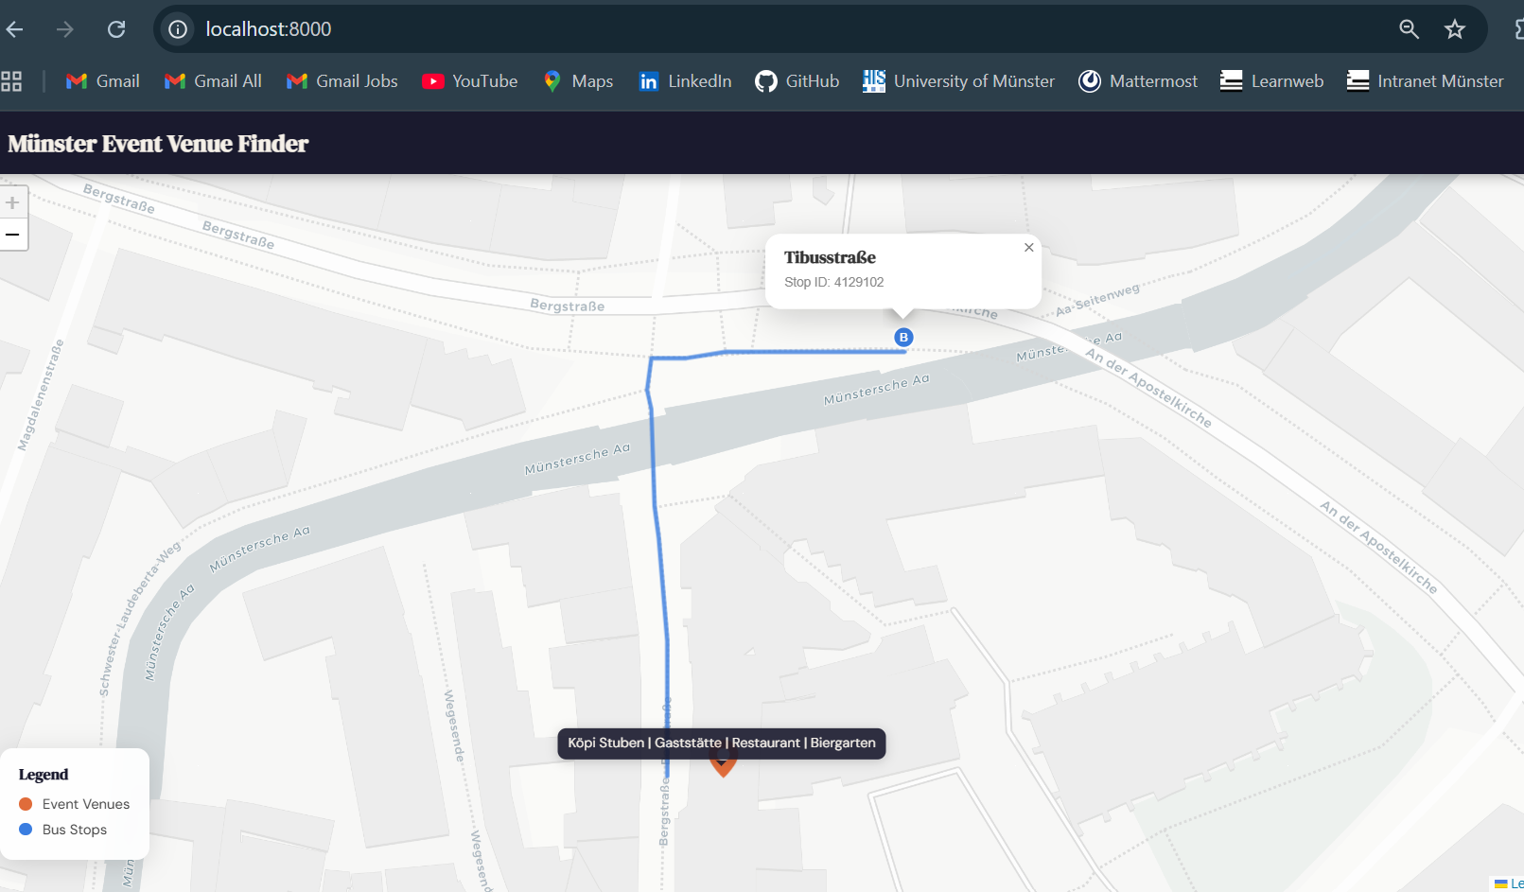
Walking Route to Nearest Bus Stop
📸 Replace with routing screenshot
1
User clicks venue
layer.on('click') event fires
2
Find nearest stop
Haversine loop over all bus stops
3
Call OSRM
Pedestrian routing via routing.openstreetmap.de
4
Draw route
Blue polyline, previous route removed

Slide 8
Challenges & Lessons Learned
🔒 CORS Configuration
✂️ Shapefile Field Truncation
web.xml CrossOriginFilter with chainPreflight=false required for Jetty 10. Both filter and filter-mapping blocks needed.
All attribute references in map.js had to match 10-char truncated names from GeoServer (e.g. available_ vs available_evenings).
🔤 UTF-8 Encoding
📐 Client-Side Spatial Logic
German umlauts corrupted without explicit UTF-8 export in QGIS and a .cpg companion file in the shapefile folder.
Haversine formula computed entirely in the browser — no server-side spatial query needed for nearest stop calculation.

Slide 9
Summary
GeoJSON datasets published through GeoServer as OGC WFS services
Leaflet.js frontend fetches both layers in parallel via Promise.all()
Nearest bus stop computed client-side using the Haversine formula
Walking route drawn on click using Leaflet Routing Machine + OSRM
Shapefile limitations required workarounds for field names, arrays, and encoding

