Slide 1
SGD vs Adam The Shape of Minima
By: Justin Smith and Rachel Miranda

Slide 2
Motivation
In non-convex optimization, there are often multiple local minima.
These local minima have different properties:
Sharpness
Generalization performance
Ease of convergence
In real-world applications:
Training data may be biased.
There may be irrelevant features in the data

Slide 3
What describes the shape of a minima?
There are multiple ways to describe the shape of a minima.
We will focus on sharpness
All definitions of sharpness describe the norm of the gradient in an area around the minima itself.
Why do we care?
Can change properties of convergence
Can change the generalization performance
Different optimization algorithms converge to sharper/flatter minima.
Generalization is (in general) affected by minima sharpness.

Slide 4

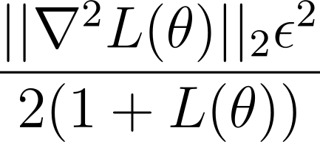
Sharpness

Slide 5
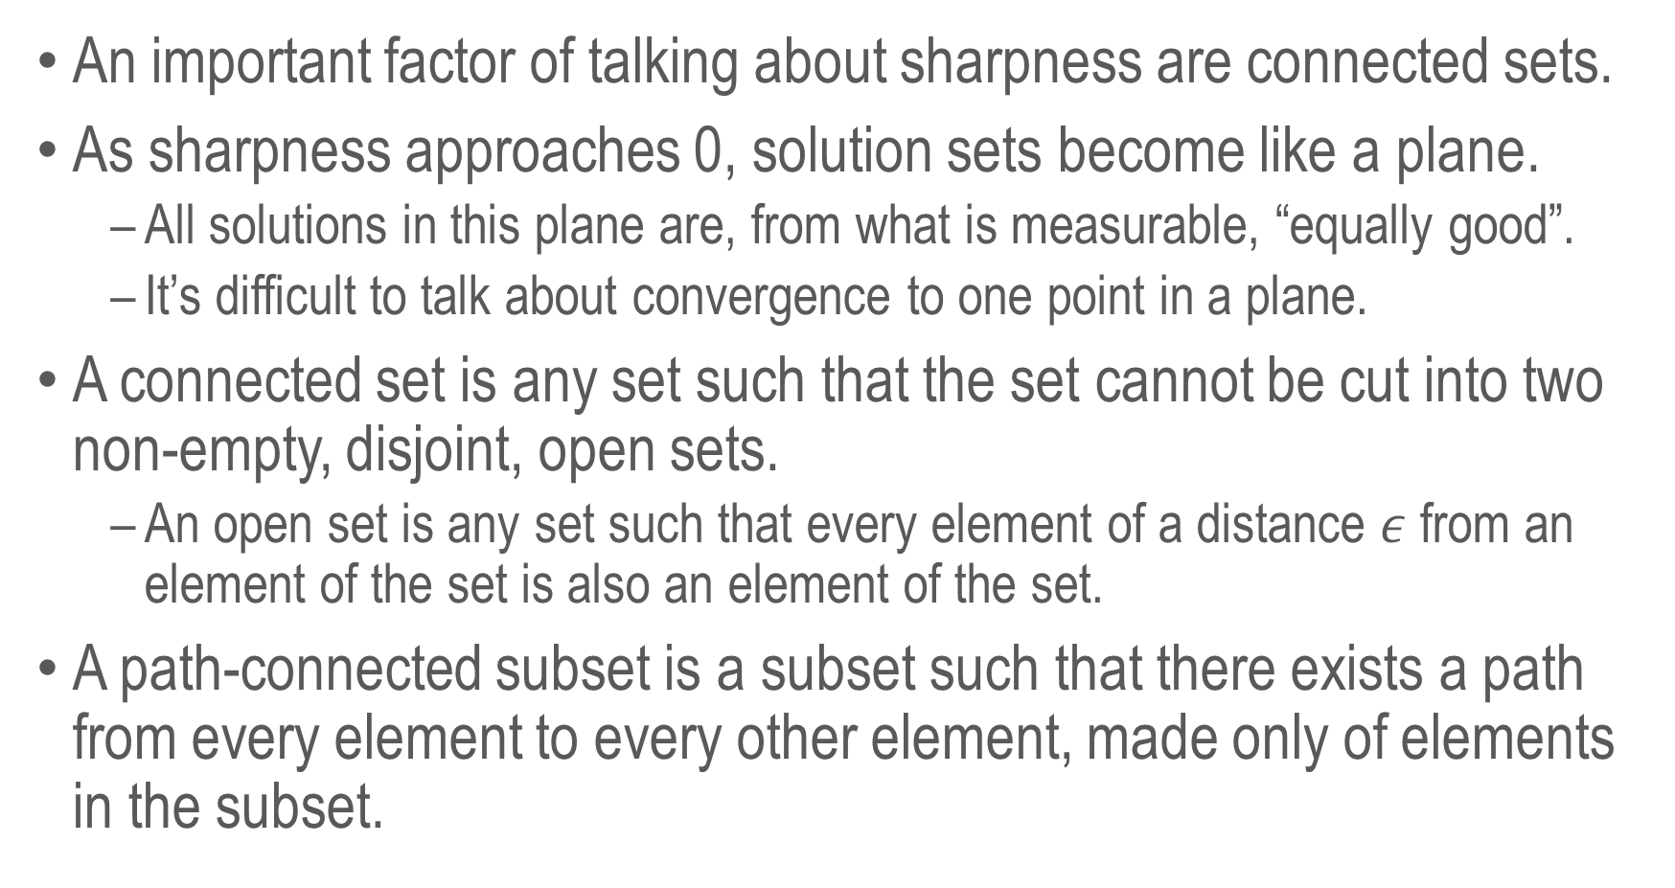
Connected Sets
An important factor of talking about sharpness are connected sets.
As sharpness approaches 0, solution sets become like a plane.
All solutions in this plane are, from what is measurable, “equally good”.
It’s difficult to talk about convergence to one point in a plane.
A connected set is any set such that the set cannot be cut into two non-empty, disjoint, open sets.
An open set is any set such that every element of a distance $ε$ from an element of the set is also an element of the set.
A path-connected subset is a subset such that there exists a path from every element to every other element, made only of elements in the subset.

Slide 6
Intuition
We want to define:
A path-connected subset representing all critical points in a plateau.
A region such that the gradient points to an element of the plateau.
A property associated with “leaving” a minima.
A path-connected subset allows us to define all elements that are “equally good”.
We can expect an algorithm that stays in a region where all gradients point to an element of this subset to converge to some element of that subset.
If a model is “leaving”, it will not converge to a minima in the subset.

Slide 7
Intuitive Answer
Adam slows down as minima get sharper.
This means that Adam is less likely to leave sharp minima.
SGD speeds up as minima get sharper.
This means that SGD is more likely to leave sharp minima.
Conversely, Adam speeds up as minima get flatter, while SGD slows down.
This means that overall, SGD will prefer flatter minima.
This explains why SGD tends to perform better at generalization than Adam.

Slide 8
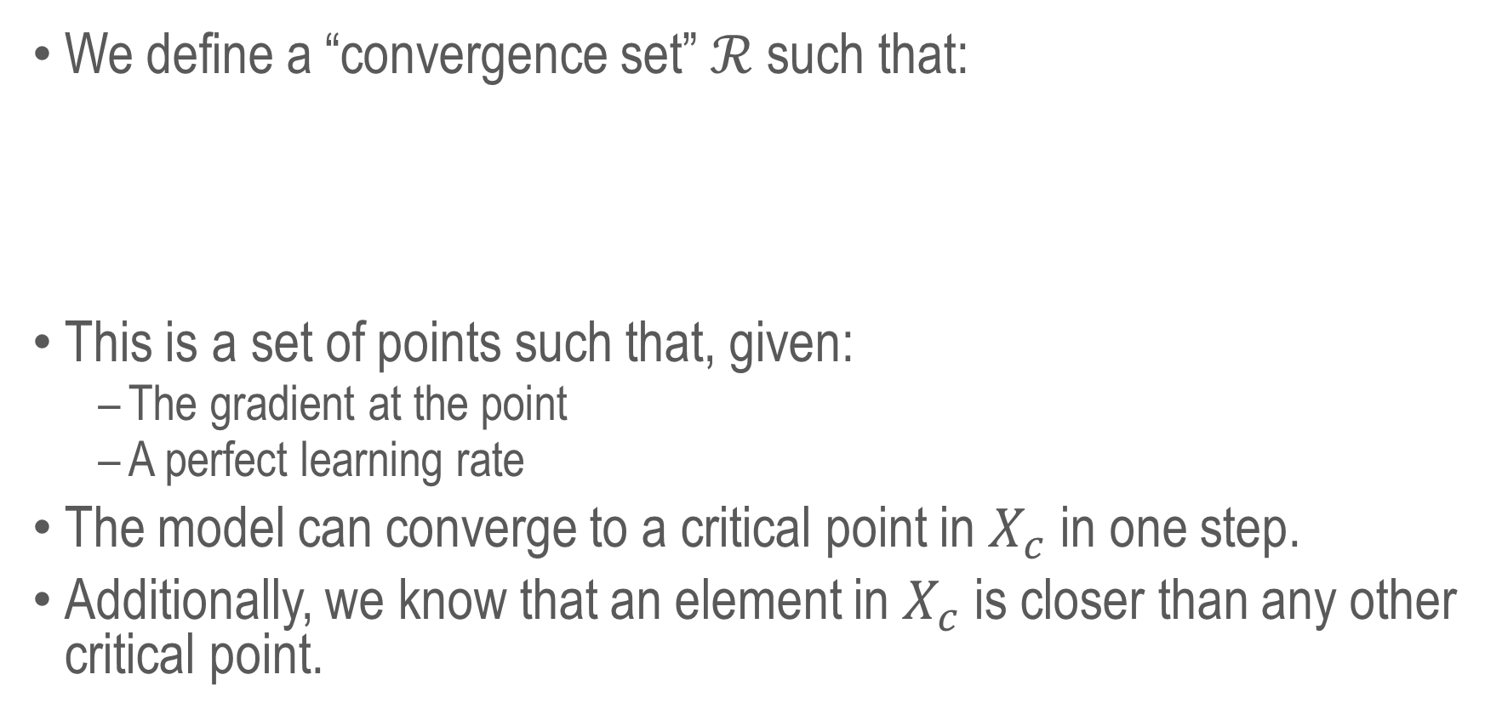
Convergence Sets
We define a “convergence set” $ℛ$ such that:
This is a set of points such that, given:
The gradient at the point
A perfect learning rate
The model can converge to a critical point in $X_{c}$ in one step.
Additionally, we know that an element in $X_{c}$ is closer than any other critical point.

Slide 9
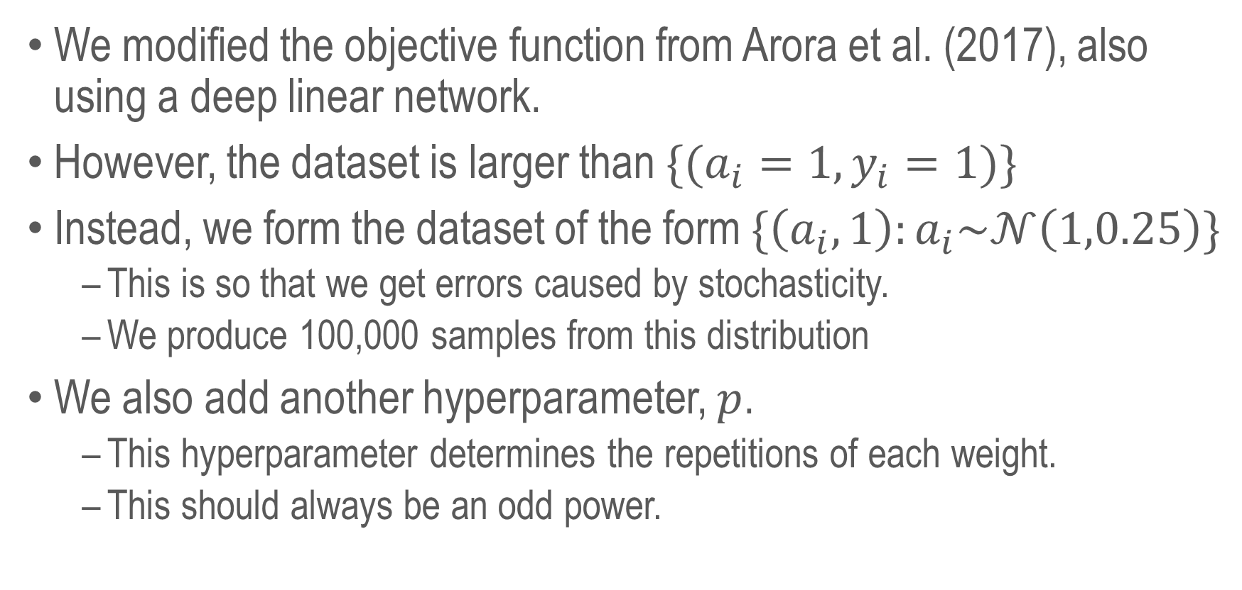
Optimization
We modified the objective function from Arora et al. (2017), also using a deep linear network.
However, the dataset is larger than $\{(a_{i}=1,y_{i}=1)\}$
Instead, we form the dataset of the form $\{\left(a_{i}, 1\right):a_{i}\sim 𝒩\left(1,0.25\right)\}$
This is so that we get errors caused by stochasticity.
We produce 100,000 samples from this distribution
We also add another hyperparameter, $p$.
This hyperparameter determines the repetitions of each weight.
This should always be an odd power.

Slide 10
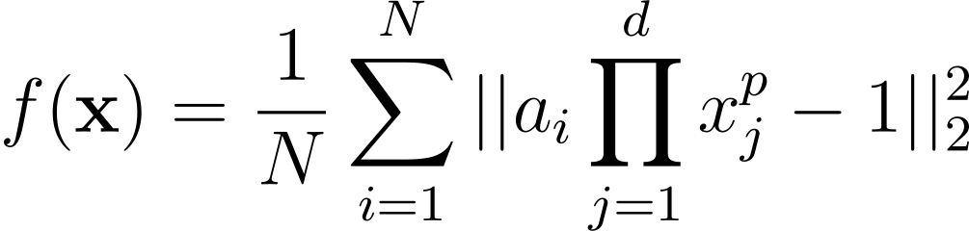
Objective Function

Slide 11
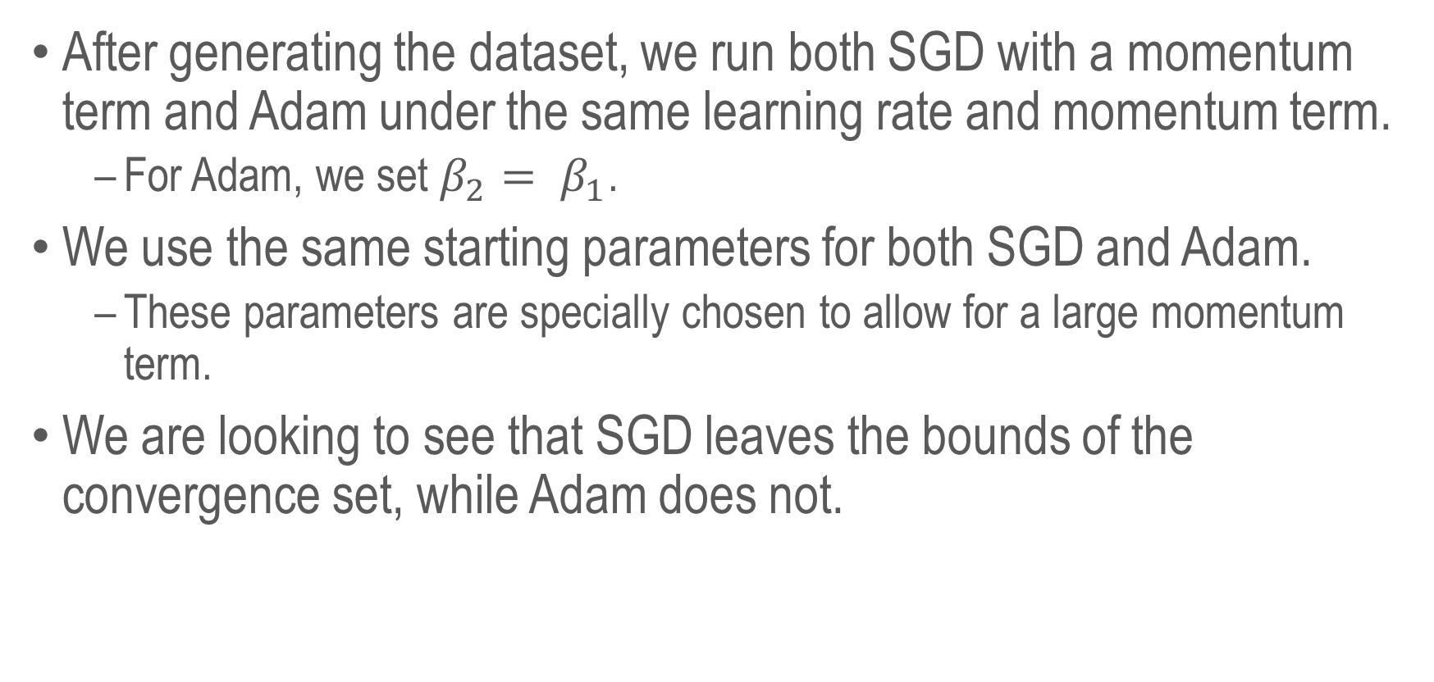
Training
After generating the dataset, we run both SGD with a momentum term and Adam under the same learning rate and momentum term.
For Adam, we set $β_{2}= β_{1}$.
We use the same starting parameters for both SGD and Adam.
These parameters are specially chosen to allow for a large momentum term.
We are looking to see that SGD leaves the bounds of the convergence set, while Adam does not.

Slide 12
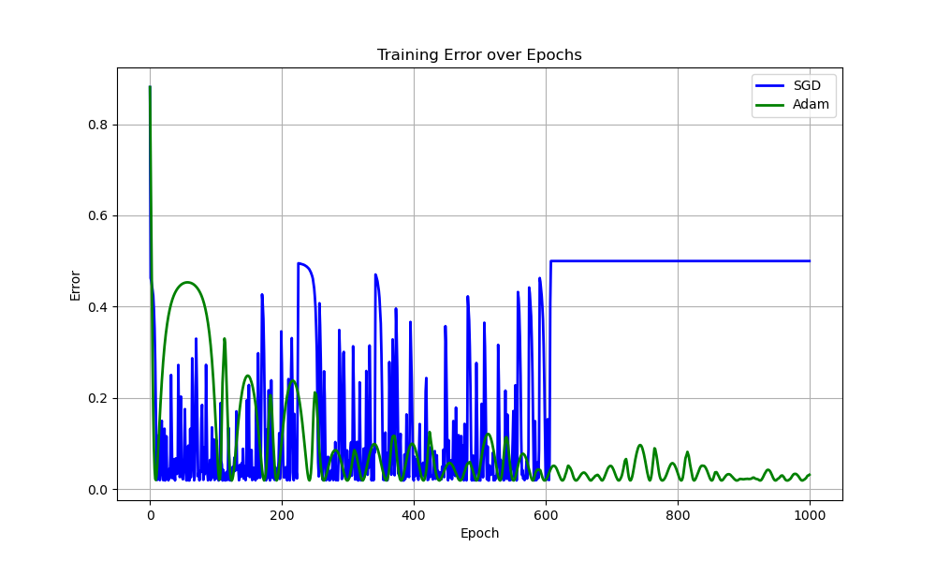
Error

Slide 13
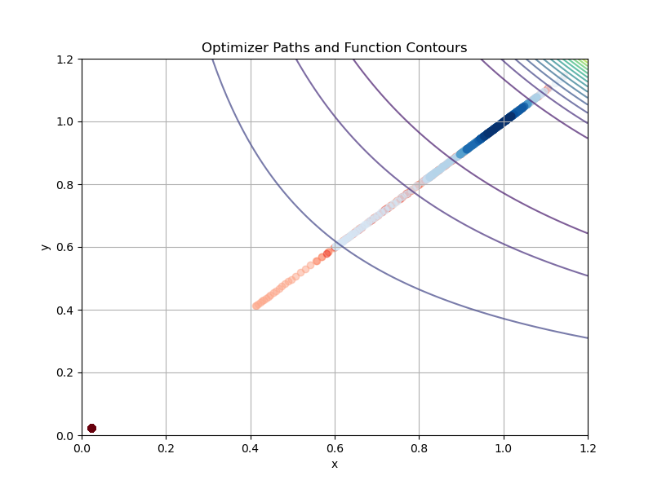
Trajectories

Slide 14
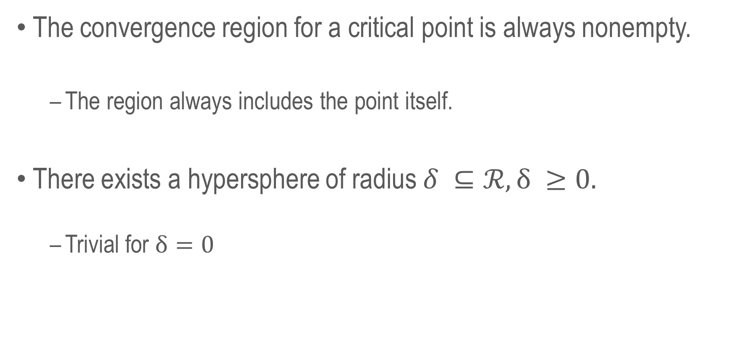
Lemmas (I & II)
The convergence region for a critical point is always nonempty.
The region always includes the point itself.
There exists a hypersphere of radius $δ ⊆ℛ, δ ≥0.$
Trivial for $δ=0$

Slide 15
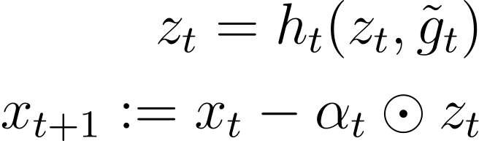

Lemma (III)
Any algorithm of the form
If there exists a step $t′$ such that
Then the algorithm diverges from all points in $X_{c}$.

Slide 16
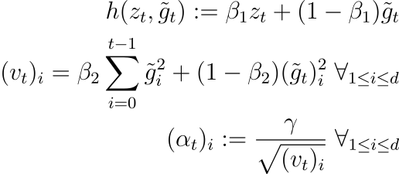

Theorem
Adam can avoid divergence from sharper minima than SGD.

Slide 17
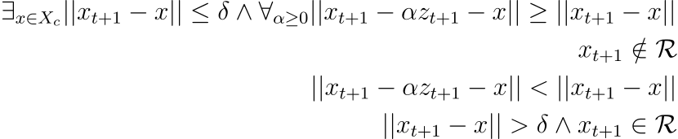
Theorem
Adam can avoid divergence from sharper minima than SGD

Slide 18
Discussions
How do we line up with prior work?
Most work in this area focuses on modifying the training algorithm:
Directly prefer flatter minima.
Modify the geometry of the objective function.
Some work that focuses on SGD vs Adam focuses on divergence.
This work also makes some very strong assumptions.
In contrast, we focus on proving a lack of divergence, rather than convergence directly.
Additionally, we focus on the effects of momentum.

Slide 19
Conclusions
Our work has examined the relationship between the sharpness of minima and the optimization algorithm being used.
SGD with momentum will diverge from overly sharp minima, while Adam will prefer to stay in that minima.
We have found this is true experimentally through a toy function.

Slide 20
Future Work
It would be interesting to do a more thorough test with a real-world dataset that includes sharp minima due to spurious features.
Spurious features are part of the input that line up very closely with a classification problem by happenstance, rather than being relevant to the problem.
Some datasets where this may be true:
Waterbirds
CIFAR-10

Slide 21
References
[1] Sanjeev Arora, Zhiyuan Li, and Abhishek Panigrahi. Understanding gradient descent on edge of stability
in deep learning. ArXiv, abs/2205.09745, 2022.
[2] Laurent Dinh, Razvan Pascanu, Samy Bengio, and Yoshua Bengio. Sharp minima can generalize
for deep nets. In Doina Precup and Yee Whye Teh, editors, Proceedings of the 34th International Conference
on Machine Learning, volume 70 of Proceedings of Machine Learning Research, pages 1019–1028. PMLR,
06–11 Aug 2017.
[3] Haowei He, Gao Huang, and Yang Yuan. Asymmetric valleys: Beyond sharp and flat local minima.
In H. Wallach, H. Larochelle, A. Beygelzimer, F. d'Alché-Buc, E. Fox, and R. Garnett, editors, Advances
in Neural Information Processing Systems, volume 32. Curran Associates, Inc., 2019.
[4] Sepp Hochreiter and Jürgen Schmidhuber. Flat minima. Neural Computation, 9:1–42, 01 1997.
[5] Nitish Shirish Keskar, Dheevatsa Mudigere, Jorge Nocedal, Mikhail Smelyanskiy, and Ping Tak Peter
Tang. On large-batch training for deep learning: Generalization gap and sharp minima, 2017.
[6] Boris Kryzhanovsky, Vladimir Kryzhanovsky, and Andrey Mikaelian. The Shape of a Local Minimum
and the Probability of its Detection in Random Search, pages 51–61. Springer Berlin Heidelberg, Berlin,
Heidelberg, 2009.
[7] Shuo Xie and Zhiyuan Li. Implicit bias of adamw: ℓ∞-norm constrained optimization. In Ruslan
Salakhutdinov, Zico Kolter, Katherine Heller, Adrian Weller, Nuria Oliver, Jonathan Scarlett, and Felix
Berkenkamp, editors, Proceedings of the 41st International Conference on Machine Learning, volume 235
of Proceedings of Machine Learning Research, pages 54488–54510. PMLR, 21–27 Jul 2024.

