Slide 1
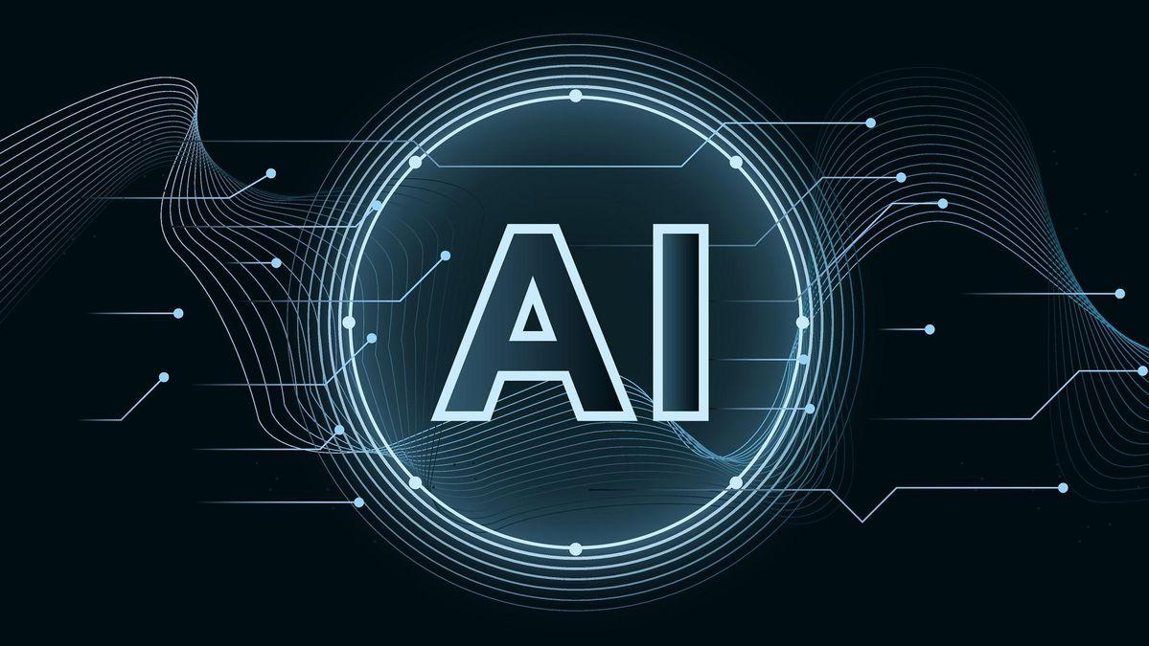
artificial intelligence
artificial intelligence
machine learning

Slide 2
this is the slide to show the graph

