Slide 1
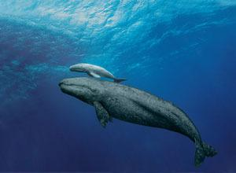
aquatic animals
1
7/7/2021

Slide 2
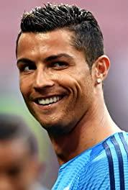
a set of pictures
2
7/7/2021
aquatic animals

