Slide 1
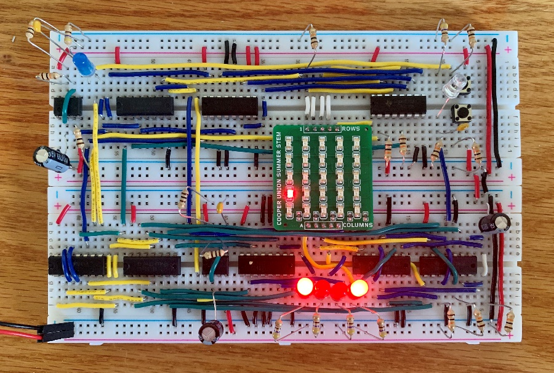
LED Invaders Laurence Lai
LED Invaders is a minigame in which the user must not let a falling LED Matrix reach any lit LED in the Target Row. Using a button that pushes the LED Matrix to the right, the player can push an LED away from the Target Row. If done successfully, the game restarts and the Target Row is randomized again. However, if a collision between the matrix and target row is detected, the game is over, and a blue LED is lit. There is a reset button to start over.
Picture goes here
Column Control Button: Pushes the LED on the matrix to the right by shifting a ring counter on the column control.
Reset Button: Resets the game at its start position. Row control is set to the first row and the target row is randomized again. The game over LED is off.
Target Row: When the LED Matrix is at the first row, a fast clock is used to randomize the Target Row.
Collision Detection: When an LED on the matrix falls onto a lit LED on the target row, collision detection kicks in and signifies a game over with the blue LED.
The only issue that persists is a finicky button for column control. Debouncing has aided the issue a bit, but the columns do still occasionally skip at times.
The LED Matrix, clocked row control, target LEDs, game over LED, and reset button all work properly.
Collision detection is seamless and does not have any apparent bugs.
Game correctly restarts when no collision is detected
https://www.youtube.com/watch?v=hOBHJfO1Xb0

Slide 2
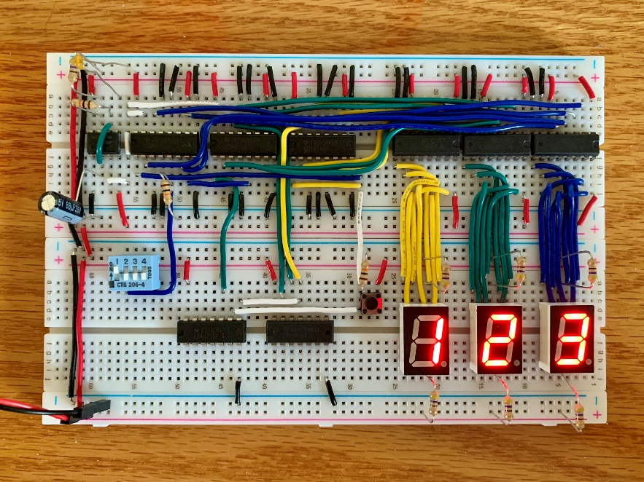
Simple Stopwatch Laurence LAi
This stopwatch circuit allows the user to measure an amount of time from 0:00 to 9:59 at a frequency of 1Hz. This time is displayed in minutes and seconds using the three 7-segment displays. When the on/off switch is low, the timer is able to count. When the on/off switch is high, the timer pauses all counting. A reset button is also used to set the timer to 0:00 at any given moment.
Picture goes here
START/STOP Switch: Switch 1 of the DIP Switch is utilized to start and stop the timer. It is connected to the CARRY-IN on the ones place counter (most left counter).
Reset Button: The reset button sets the timer back to 0:00 when pressed. It is connected to the PRESET ENABLE of all three counters, activating their jam inputs when pressed. The jam inputs are each set to 0000 to represent 0:00 on the timer.
Counting: This timer knows how to properly display time transitions such at 0:59 -> 1:00.
This stopwatch runs a little bit faster than a normal stopwatch because of our 555 timer. Given the resistors in the kit, the closest to a 1 second count on the 555 timer is a combination of 470ohms and 10kohms.
The 7 segment displays, counters, display drivers, reset button, and on/off switch all work perfectly.
The timer sometimes displays a random number when it is first powered but clicking the reset button quickly resolves the issue.
https://www.youtube.com/watch?v=-yrECE6wnYI

