Slide 1
PhytoFusion AI
Exploring, on paper, what moving a gene between two medicinal plants could mean
S. barbata · 13 chromosomes
S. baicalensis · 9 chromosomes
From pharmacy to plant genetics · EthnoHack, Track 2
Notes:
Good morning everyone! Before introducing our project, let me briefly introduce myself. My name is Edina Suma. I am a licensed Pharmacy Technician, and I am currently pursuing my education as a Bachelor of Pharmacy student at the Faculty of Medicine, University of Prishtina. My teammate comes from a different but equally important field: DevOps Engineering. Although pharmacy and technology may seem like two different worlds, combining them lets us approach scientific challenges from different perspectives.

Slide 2
What if we could use the genetic information of medicinal plants to explore new possibilities in natural compound production?
Different plants make different bioactive compounds, through highly specialized genetic and metabolic processes. Could we compare those processes and ask whether selected genetic characteristics could, in theory, be combined?
Notes:
Now, let me start with one question: what if we could use the genetic information of medicinal plants to explore new possibilities in natural compound production? Nature has already developed an incredible diversity of bioactive compounds. But what if we could compare these processes and investigate whether selected genetic characteristics could theoretically be combined? That is the idea behind our project: PhytoFusion AI. Understanding these differences requires genetics, molecular biology, biochemistry and pharmacology, so our objective is to bring these perspectives together through an AI-powered computational platform.

Slide 3



The problem
Medicinal plants make valuable compounds through genes spread across large, differently organised genomes.
Scattered data
Genomes, annotations and papers live in different places, under different names.
Genomes that differ
A researcher who asks "could a gene from one plant add a missing step in another?" has to piece together genomes, papers and pathways by hand, with no simple way to see how well the evidence supports the idea or what is still missing.
18 against 26 chromosomes, 30,313 against 34,909 genes: positions and names do not line up.
A match is not a result
A similar sequence is easily mistaken for a working, proven function.
Notes:
Here is the problem we set out to solve. Medicinal plants make valuable compounds through genes spread across large, differently organised genomes. A researcher asking whether a gene from one plant could add a missing step in another has to piece together genomes, papers and pathways by hand, and has no simple way to see how well the evidence supports the idea or what is still missing. The data is scattered, the genomes differ, and a similar sequence is easily mistaken for a proven function.

Slide 4


Two skullcaps, two chemistries
HOST · would receive the gene
DONOR · where the gene comes from
Scutellaria baicalensis
Scutellaria barbata
Known for flavonoids: baicalin, baicalein and wogonin
Studied for anti-inflammatory and antioxidant effects, including influence on IL-6 and TNF-alpha
A traditional Chinese medicine: the root is used to clear heat and dampness (Zhao et al. 2019, PMID 31236960)
Known for clerodane diterpenoids
Studied in preclinical work for effects on cancer cell proliferation and apoptosis
Used in traditional Chinese and Korean medicine, mainly to clear heat and detoxify (Wang et al. 2020, PMID 31577937)
Traditional use and these activities are reasons to study the plants, not proof that either is an established treatment.
Notes:
For our case study we selected two medicinal plants from the same genus: Scutellaria baicalensis and Scutellaria barbata. They have different natural-product profiles. Baicalensis is our proposed host plant, known for flavonoids such as baicalin, baicalein and wogonin, investigated for anti-inflammatory and antioxidant properties through mediators such as IL-6 and TNF-alpha. Barbata is interesting because of its clerodane diterpenoids, investigated for potential antitumor activity in preclinical studies. Both plants are used in traditional Chinese medicine, according to two published reviews. Importantly, traditional use and these activities are research findings and reasons to study the plants, not proof that either plant is an established treatment.

Slide 5


Same genus, different genome structure
DNA
Diploid chromosome number
carries the genetic information of an organism
18
26
Genes
functional segments of DNA with instructions for RNA or proteins
S. baicalensis
9 pairs
S. barbata
13 pairs
Chromosomes
the structures in which DNA is organized
Both have published genome assemblies.
We are not combining entire chromosomes. We study selected genetic characteristics in the context of the host genome, which is why we compare instead of assuming genes will work the same way.
Notes:
To understand our approach we need three concepts. DNA contains the genetic information of an organism. Genes are functional segments of DNA that provide instructions for producing functional RNA or proteins. Chromosomes are structures in which DNA is organized. Scutellaria baicalensis has 18 chromosomes in its diploid cells, while Scutellaria barbata has 26. Both species have published genome assemblies. Although they belong to the same genus, their genome structures are not identical. This is why we need comparative genomic analysis instead of assuming their genes will function in the same way. We are not combining entire chromosomes; we are investigating selected genetic characteristics within the context of the host plant's genome.

Slide 6
Our question: the KPS gene family
What the 2023 study found
THE QUESTION
Qiu and colleagues identified and functionally characterized KPS enzymes in both species
SbarKPS1, from S. barbata, produces an intermediate of clerodane diterpene biosynthesis
SbaiKPS1, its counterpart in S. baicalensis, showed very low expression in the tissues examined
Could introducing or changing the expression of a donor KPS gene theoretically alter the early steps of diterpenoid biosynthesis in S. baicalensis?
One gene is not a finished compound. The host would also need downstream enzymes, precursors and metabolic machinery.
Qiu T et al., The Plant Journal 2023 · PMID 37395679 · doi:10.1111/tpj.16377
Notes:
Our research focuses on genes for the biosynthesis of natural compounds. PAL, CHS, 4CL and CHI belong to flavonoid biosynthesis, but our main interest is the KPS gene family, involved in clerodane diterpene biosynthesis. A 2023 study by Qiu and colleagues characterized different KPS enzymes in these two Scutellaria species. SbarKPS1 in S. barbata produces an intermediate of clerodane diterpene biosynthesis, while the corresponding SbaiKPS1 in S. baicalensis showed very low gene expression in the examined tissues. This gives us a specific question: could introducing or modifying the expression of a donor genetic characteristic theoretically alter the early stages of diterpenoid biosynthesis in the host? Introducing one gene does not automatically produce a complete bioactive compound, and we want to investigate these requirements rather than assume a therapeutic effect. Hand over to my teammate.

Slide 7





Pharmacy meets DevOps
Pharmacy gives the meaning
DevOps gives the reliability
Genes, active compounds and enzymes
Their potential pharmacological relevance
The scientific foundation
×
Collect, process, validate and organize data
Automation, pipelines, testing and deployment
Reproducible, accessible workflows
Automated tests and CI on every change
Live on Netlify, Render and Supabase
Every finding traced to a PMID or DOI
Notes:
Thank you, Edina! I come from DevOps Engineering, where I work with software infrastructure, automation and system development. In this project my role is to transform scientific information into a structured, reliable and accessible solution. Pharmacy helps us understand the biological meaning of the data: genes, active compounds, enzymes and their pharmacological relevance. DevOps lets us build the infrastructure that collects, processes, validates and organizes it. Through automation, data pipelines, testing and deployment, complex scientific workflows become more reproducible and accessible.

Slide 8
Five connected engines
1
2
3
4
5
Scientific data ingestion
Comparative genomics
Pathway intelligence
GeneBridge AI
CRISPR simulator
Collects genomes, gene annotations and publications from established databases.
Compares gene and protein sequences, finds gene relationships and chromosome locations.
Links genes to proteins, enzymes, reactions and natural compounds.
Combines sequence analysis with literature to assess compatibility, with references.
Explores hypothetical gene modifications and states their limits.
GeneBridge assesses the evidence; the simulator uses it to explore a hypothetical scenario. The two work together.
Notes:
PhytoFusion AI is built around five connected computational engines. First, Scientific Data Ingestion collects genomic information, gene annotations and publications from established databases. Second, the Comparative Genomics Engine compares genetic and protein sequences of our two plants, investigates gene relationships and identifies their chromosomal locations. Third, Pathway Intelligence connects genes to proteins, enzymes, biochemical reactions and natural compounds. Our fourth and fifth engines, GeneBridge AI and the CRISPR Scenario Simulator, work together.

Slide 9


GeneBridge AI explains why, with evidence
Sequence
Are the selected genes genetically related?
The answer
An explainable assessment with an evidence class:
Function
Are their functions experimentally documented?
strong
moderate
limited
Pathway
Does the host have the needed pathway components?
Every finding traced to a PMID or DOI
Says "unknown" when evidence is missing
A class, never a score or probability
Expression
Is there supporting expression evidence?
Gaps
What important information is still missing?
Notes:
Our central innovation is GeneBridge AI. Comparing DNA sequences alone is not enough to decide whether two genetic characteristics are functionally compatible; two genes may have similar sequences but different functions. So GeneBridge combines computational genomic analysis with scientific literature retrieval. It asks: are the genes genetically related? Are their functions experimentally documented? Does the host have the needed pathway components? Is there supporting expression evidence? And what important information is still missing? The system then generates an explainable assessment supported by references. We do not want an AI that simply gives an answer; we want one that explains why and shows the evidence behind it.

Slide 10


CRISPR scenarios, explored on paper
Host gene modification
Donor genetic integration
How could a chosen change to an existing host gene influence its metabolic pathway?
What would it mean, in theory, to introduce a donor gene, for example a KPS gene from S. barbata, into S. baicalensis with a CRISPR-assisted approach?
CRISPR editing does not guarantee a whole donor gene is integrated. Nothing is built here.
Even a technical success would still need laboratory studies of expression, resulting compounds and pharmacological activity.
Notes:
The simulator explores two hypothetical approaches. The first is host gene modification: how a selected modification to an existing host gene could potentially influence its metabolic pathway. The second is donor genetic integration: evaluating the theoretical introduction of a selected genetic characteristic from the donor plant into the host genome using a CRISPR-assisted approach, for example a KPS gene from Scutellaria barbata into Scutellaria baicalensis. One important distinction: CRISPR editing does not automatically mean successful integration of an entire donor gene. Our platform does not perform actual genetic engineering. Even if a modification were technically successful, we would still need laboratory studies to confirm expression, identify the resulting compounds and investigate their pharmacological activity.

Slide 11
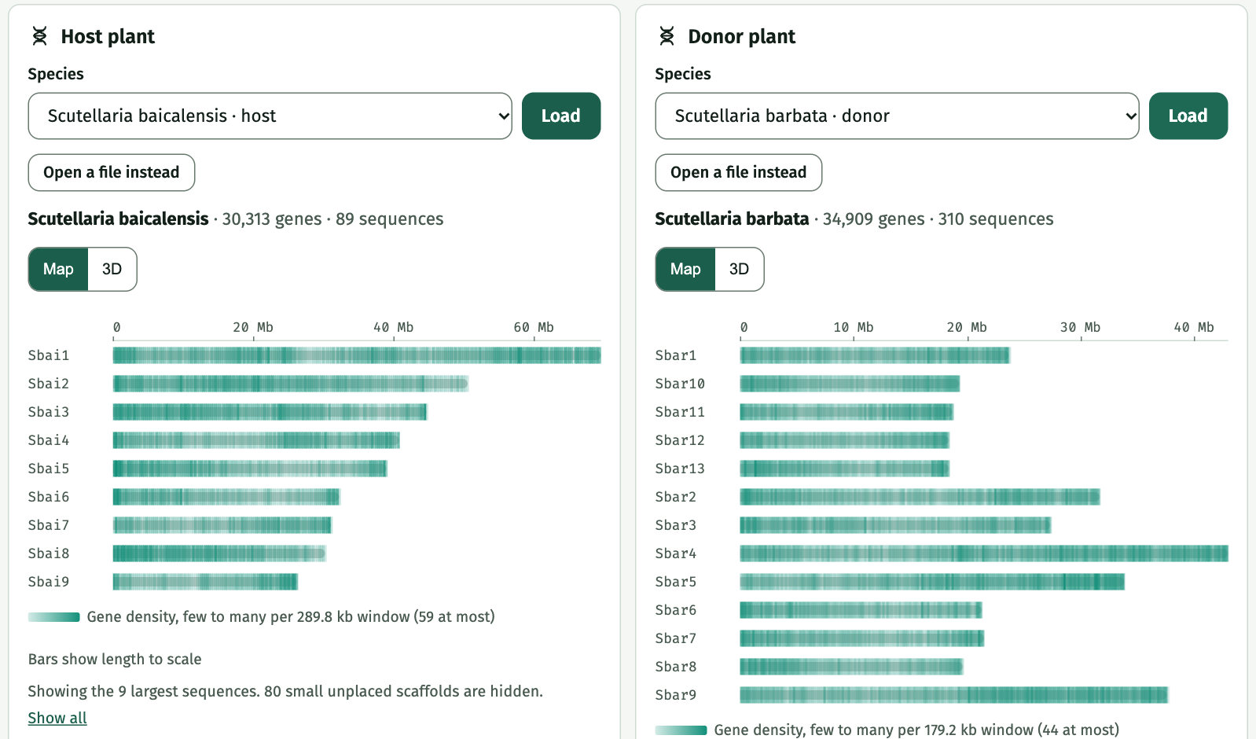
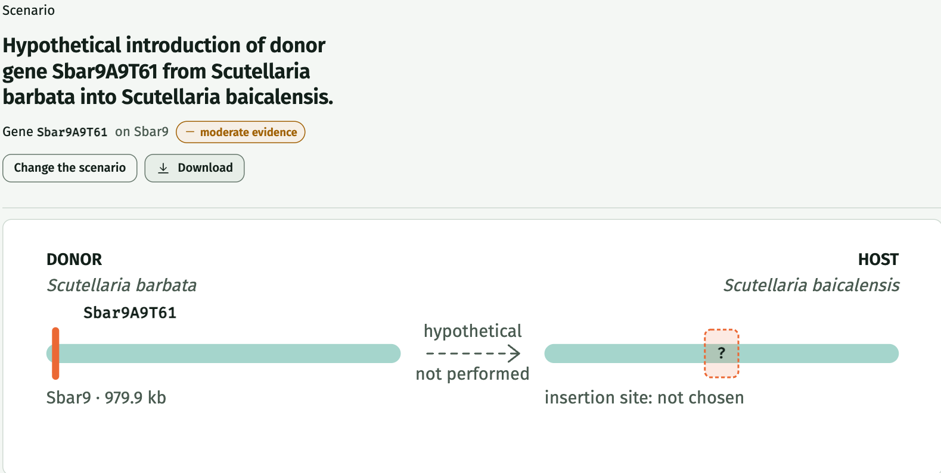
From genomes to a report you can trace
Genomes: 30,313 and 34,909 genes on the real assemblies
Report: scenario, evidence level, what we don't know and the limits
Dashboard
Genome Explorer
GeneBridge
Pathway Explorer
CRISPR Studio
Virtual Plant Report
Notes:
Through our web application, users can explore six main sections: a dashboard with both plant species, a Genome Explorer showing chromosome organization and selected gene locations, GeneBridge for comparative genetic analysis, a Pathway Explorer connecting genes, enzymes and natural compounds, CRISPR Studio for hypothetical modifications, and finally a Virtual Plant Report presenting the proposed scenario, supporting evidence, consequences and limitations. The screenshots are from the live app, using the real published genomes. This creates a complete research journey, from genomic information to an evidence-based engineering hypothesis.

Slide 12
What the prototype found
Paper's gene
In our annotation
Match
How sure
Mutual best match
SbarKPS2
Sbar9A9T61
100%
Same protein
Sbar9A9T61 and Sbai8C203T0 pick each other as closest (89%).
SbarKPS1
Sbar9A10T43
94.8%
Best match
A tandem pair, as expected
SbaiKPS1
Sbai8C203T0
84 to 89%
The two donor genes sit 38 kb apart on the same sequence and strand.
Best match only
Two of the three matches are inferences from sequence similarity. We call them best matches, not proven identical.
Evidence level: moderate
One experimental study supports the donor gene (PMID 37395679).
Method: BLAST+ blastp against both proteomes, then a reciprocal check. The live app shows the same results.
Notes:
This is what the working prototype found. We took the two KPS protein sequences deposited with the 2023 paper and searched them with BLAST against the proteomes of both genomes. The SbarKPS2 sequence matches gene Sbar9A9T61 at 100 percent, so that is the same protein. SbarKPS1 matches Sbar9A10T43 at 94.8 percent, and SbaiKPS1 matches Sbai8C203T0 at 84 to 89 percent. Those last two are best matches from sequence similarity, so we call them best matches, not proven identical. The two donor genes sit 38 kilobases apart on the same sequence and strand, which fits a tandem pair, and the app's reciprocal check shows Sbar9A9T61 and Sbai8C203T0 as mutual best matches. The evidence level for the donor gene is moderate, from one experimental study. You can reproduce all of this in the live app.

Slide 13
How we checked it
1 A known answer
An honest limit
The paper’s SbarKPS2 protein finds gene Sbar9A9T61 at 100% identity, so the annotation holds the paper’s gene. SbarKPS1 finds Sbar9A10T43 at 94.8%, and the two sit 38 kb apart, as a tandem pair should.
86%
of 300 random donor genes also count as “related”, because both plants belong to one genus.
2 A clear best hit in the host
best
runner-up
SbarKPS1
84.2% Sbai8C203T0
So the signal is the mutual best match and the gap to the runner-up. Still unchecked: a benchmark of known orthologs, expression data, and other gene families.
56.5% Sbai8A89T185
SbarKPS2
88.5% Sbai8C203T0
57.2% Sbai8A89T185
Software: 221 backend tests at 98% coverage, 74 frontend tests, and seven CI checks on every change.
Notes:
Here is how we checked the work. First, a known answer. The two KPS protein sequences deposited with the 2023 paper were searched against our annotation. SbarKPS2 finds gene Sbar9A9T61 at 100 percent identity, so the annotation contains the paper's gene. SbarKPS1 finds Sbar9A10T43 at 94.8 percent, and the two genes sit 38 kilobases apart, which fits a tandem pair. Second, is the best hit clearly the best? In the host plant, both proteins find the same gene, Sbai8C203T0, at 84 and 88.5 percent, while the runner-up is only about 57 percent, a gap of roughly 28 to 31 points. Third, an honest limit: 86 percent of 300 random donor genes would also be labelled related, because the two plants belong to the same genus. So the label alone is not the signal. The signal is the mutual best match and the gap to the runner-up. We have not yet built a benchmark of known orthologs or added expression data, and we say so. On the software side we have 221 backend tests at 98 percent coverage, 74 frontend tests, and seven automated checks on every change. All of this is written up in our validation document.

Slide 14

Data sources, all public and cited
Genomes
Key paper
Genome Warehouse: GWHAOTO00000000 (S. baicalensis, 30,313 genes) and GWHAOTP00000000 (S. barbata, 34,909 genes). Genomics, Proteomics & Bioinformatics, 2020.
Qiu et al., The Plant Journal, 2023: PMID 37395679, doi 10.1111/tpj.16377. Characterizes the KPS enzymes in both species.
Protein sequences
Method
NCBI Protein: WJZ49119.1 (SbarKPS1) and WJZ49120.1 (SbarKPS2), deposited with the paper.
BLAST+ 2.17 blastp with a reciprocal best-hit check. Every step is written up in docs/SOURCES.md.
Documented: a README plus 14 documents covering architecture, scientific rules, sources, validation, testing, CI/CD, deployment and a demo script.
Notes:
All of our data is public and cited. The genomes come from the Genome Warehouse, with 30,313 genes for Scutellaria baicalensis and 34,909 for Scutellaria barbata. The key paper is Qiu and colleagues, The Plant Journal 2023, PMID 37395679. The KPS protein sequences are the ones deposited at NCBI with that paper. We compared them using BLAST plus with a reciprocal best-hit check. Every link and every step is written up in our documentation: a README plus fourteen documents covering architecture, scientific rules, sources, validation, testing, CI/CD, deployment and a demo script.

Slide 15


The tech stack today
Browser
Netlify
Render
Supabase
Researchers
React 18 + TypeScript + Vite
FastAPI + BLAST+ in Docker
Postgres, pgvector, Storage
Frontend
Backend
Data and quality
React 18, TypeScript 5, Vite 5
Cytoscape: pathway graph
three.js: 3D genome view
Vitest unit tests
Python 3.12, FastAPI, pydantic
BLAST+ (blastp, reciprocal best hits)
pandas and networkx
httpx to the Supabase REST API
Postgres with pgvector and row-level security
Four versioned SQL migrations
pytest with an 85% coverage gate
ruff, schema tests, science guardrails
Notes:
Under the hood: the browser loads a React app hosted on Netlify. It calls a FastAPI backend running in a Docker container on Render, which also runs BLAST+ for the sequence comparison. All data lives in Supabase: Postgres with the pgvector extension, row-level security, and private file storage for the genome files. The backend is tested with pytest under an 85 percent coverage gate, the frontend with Vitest, and the database schema is tested against a real Postgres in CI.

Slide 16




From a change to production
Branch
Pull request
Seven checks
Merge
Deploy
work on dev
into main
one gate
only when green
Netlify and Render
What the seven checks run
Kept safe on purpose
Backend lint and format
Backend tests on Python 3.11 and 3.12, 85% coverage
Database schema on a real Postgres with pgvector
Docker image build and a smoke test
Frontend lint, typecheck, tests and build
Dependency audit and secret scan
Science guardrails: no scores, no engineering claims
Database changes ship through a separate workflow with a dry run first
Secrets live only in GitHub and Render, never in git
The service key is backend-only
Notes:
Every change follows the same path. We work on a dev branch and open a pull request into main. Seven automated checks run on each pull request, and a single gate called CI passed must be green before merging. They cover linting, backend tests on two Python versions with an 85 percent coverage requirement, the database schema on a real Postgres with pgvector, the Docker image, the frontend build, security scans for dependencies and secrets, and a set of science guardrails that fail the build if the code ever introduces success scores or engineering claims. Merging to main redeploys the frontend on Netlify and the backend on Render. Database migrations are deliberately separate: a manual workflow that starts with a dry run.

Slide 17
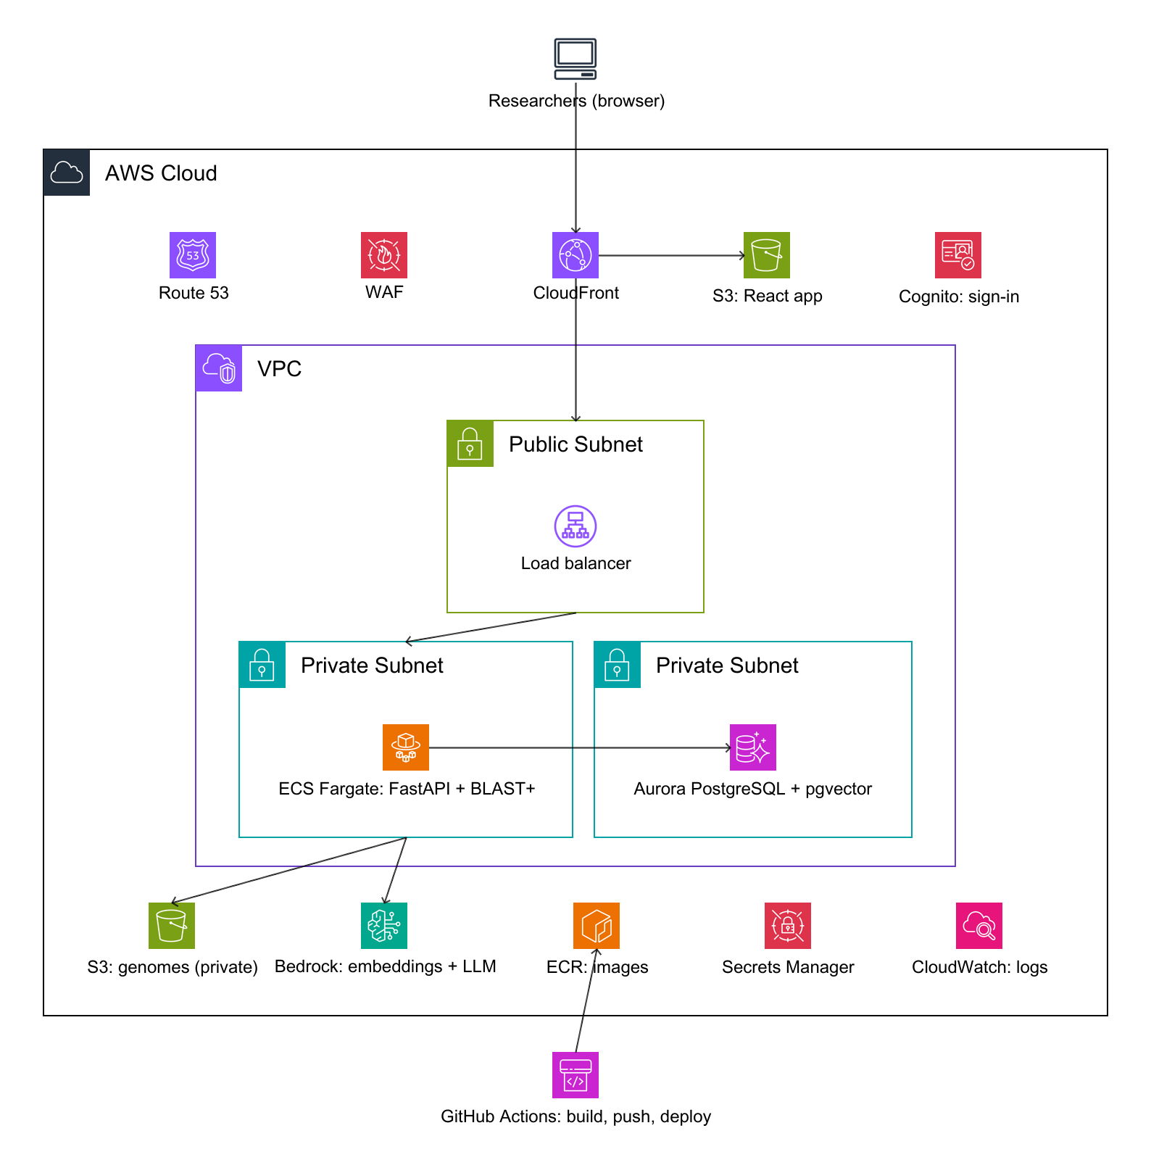
A potential AWS architecture
A plan, not deployed
1
Edge
CloudFront serves the React app from S3 and passes API calls on. Cognito sign-in and WAF come later.
2
Entry
An Application Load Balancer in a public subnet is the only door into the VPC.
3
Backend and data
FastAPI with BLAST+ runs on ECS Fargate in a private subnet, next to Aurora PostgreSQL with pgvector.
4
Services and delivery
A private S3 bucket for genomes, Bedrock, Secrets Manager and CloudWatch. GitHub Actions pushes images to ECR.
Generated as code with AWS Diagram-as-Code (awsdac)
Notes:
If we moved to AWS, this is the target. The React app is served from S3 through CloudFront. The FastAPI backend, with BLAST+, runs on ECS Fargate in private subnets behind an Application Load Balancer. Aurora PostgreSQL with the pgvector extension replaces Supabase Postgres, a private S3 bucket holds the genome files, and Secrets Manager holds configuration. Cognito for sign-in, WAF at the edge and Bedrock for embeddings are later additions. GitHub Actions would build the image and push it to ECR. This diagram was generated as code with AWS Diagram-as-Code, so it lives in the repository and can be regenerated. It is a plan: nothing in the platform depends on AWS today.

Slide 18

The path from today to AWS
Today
On AWS
Netlify static site
S3 + CloudFront
Render Docker service
ECS Fargate behind an Application Load Balancer
Supabase Postgres + pgvector
Aurora PostgreSQL with pgvector (pg_dump, pg_restore)
Supabase Storage bucket
Private S3 bucket
Secrets in dashboards
Secrets Manager
GitHub Actions to Render
GitHub Actions to ECR and ECS, with an OIDC role
Later additions: Cognito sign-in, WAF, Bedrock embeddings, CloudWatch. To scale: BLAST runs on candidate genes only, so whole-proteome comparisons would move to batch jobs. The schema is plain Postgres plus pgvector, so it should port without changes.
Notes:
The migration is deliberately boring. The database schema is plain Postgres plus pgvector, so a dump and restore into Aurora should work without changes. The genome files move from the Supabase bucket to a private S3 bucket, the backend container moves from Render to ECS Fargate, and the static frontend moves to S3 with CloudFront. Configuration moves into Secrets Manager. We have kept database access behind a thin data layer in the backend so this stays an infrastructure change, not a rewrite. None of this is started: it is a plan.

Slide 19
Why it matters, and what comes next
Potential real-world relevance
Future development
Helps researchers screen candidate genes on paper before costly laboratory work
Every finding traces to a PMID or DOI, so each assessment can be audited
Shows what is unknown, not only what is known, so effort goes where it counts
The same method can compare other plant pairs that have published genomes
Add gene expression data and more pathways, such as the full flavonoid route
Literature retrieval with embeddings: the database already supports it
Sign-in and rate limits before opening the API publicly
Move to AWS as planned, once the prototype is proven
Test the most promising hypotheses with laboratory partners
Notes:
What could this mean in the real world? It could help researchers screen candidate genes on paper before costly laboratory work. Every finding traces to a publication, so each assessment can be audited, and the tool shows what is unknown, not only what is known. The same method can compare other plant pairs that have published genomes. Next we want to add gene expression data and more pathways, use literature retrieval with embeddings, which our database already supports, add sign-in before opening the API publicly, move to AWS as planned, and test the most promising hypotheses with laboratory partners.

Slide 20

Responsible by design
What makes it different
What we will not claim
Plant genetics
That a virtual model is a successfully engineered plant
That a changed compound profile means better therapy
Any success score or probability
Computational biotechnology
Artificial intelligence
With a clear pharmaceutical research perspective. Genes are studied as parts of complex biological systems, not as isolated sequences.
Those questions need further experimental and pharmacological validation.
Notes:
So, what makes PhytoFusion AI different? We bring together plant genetics, computational biotechnology and artificial intelligence, with a clear pharmaceutical research perspective. Instead of looking at genes as isolated sequences, we investigate them as components of complex biological systems. We also believe scientific innovation must be responsible. We will not claim that a virtual model represents a successfully engineered plant, or that an altered natural-product profile automatically means improved therapeutic effectiveness. Those questions require further experimental and pharmacological validation.

Slide 21
The team
Edina Suma
Lerdi Salihi
Pharmacy
DevOps Engineer
Licensed Pharmacy Technician
Bachelor of Pharmacy student, Faculty of Medicine, University of Prishtina
Led the science: plants, genes, pathways and evidence
Software infrastructure, automation and system development
Built the pipelines, tests, deployment and the app
Turned the science into a reliable, reproducible tool
Try it live: photofusionai.netlify.app
Notes:
We are two people from two fields. Edina is a licensed Pharmacy Technician and Bachelor of Pharmacy student at the University of Prishtina, and led the science. I come from DevOps Engineering and built the pipelines, tests, deployment and the app. You can try the working prototype at photofusionai.netlify.app.

Slide 22
We are
PhytoFusion AI
Connecting plant genetics.
Exploring new possibilities.
Building the future of biotechnology.
Thank you!
S. barbata · 13 chromosomes
S. baicalensis · 9 chromosomes
photofusionai.netlify.app
Notes:
Our ambition is a platform that makes complex genetic information more accessible, understandable and useful for future research. Because sometimes the next scientific breakthrough does not begin with a ready-made answer. It begins with the right question, the right scientific evidence and a new way of connecting them. We are PhytoFusion AI. Connecting plant genetics. Exploring new possibilities. Building the future of biotechnology. Thank you!

