Slide 1
PhytoFusion AI
Exploring, on paper, what moving a gene between two medicinal plants could mean
S. barbata · 13 chromosomes
S. baicalensis · 9 chromosomes
From pharmacy to plant genetics · EthnoHack, Track 2
Notes:
Good morning everyone! Before introducing our project, let me briefly introduce myself. My name is Edina Suma. I am a licensed Pharmacy Technician, and I am currently pursuing my education as a Bachelor of Pharmacy student at the Faculty of Medicine, University of Prishtina. My teammate comes from a different but equally important field: DevOps Engineering. Although pharmacy and technology may seem like two different worlds, combining them lets us approach scientific challenges from different perspectives.

Slide 2



The problem
Medicinal plants make valuable compounds through genes spread across large, differently organised genomes.
Scattered data
Genomes, annotations and papers live in different places, under different names.
Genomes that differ
A researcher who asks "could a gene from one plant add a missing step in another?" has to piece together genomes, papers and pathways by hand, with no simple way to see how well the evidence supports the idea or what is still missing.
18 against 26 chromosomes, 30,313 against 34,909 genes: positions and names do not line up.
A match is not a result
A similar sequence is easily mistaken for a working, proven function.
Notes:
Here is the problem we set out to solve. Medicinal plants make valuable compounds through genes spread across large, differently organised genomes. A researcher asking whether a gene from one plant could add a missing step in another has to piece together genomes, papers and pathways by hand, and has no simple way to see how well the evidence supports the idea or what is still missing. The data is scattered, the genomes differ, and a similar sequence is easily mistaken for a proven function.

Slide 3


Two skullcaps, two chemistries
HOST · would receive the gene
DONOR · where the gene comes from
Scutellaria baicalensis
Scutellaria barbata
Known for flavonoids: baicalin, baicalein and wogonin
Studied for anti-inflammatory and antioxidant effects, including influence on IL-6 and TNF-alpha
A traditional Chinese medicine: the root is used to clear heat and dampness (Zhao et al. 2019, PMID 31236960)
Known for clerodane diterpenoids
Studied in preclinical work for effects on cancer cell proliferation and apoptosis
Used in traditional Chinese and Korean medicine, mainly to clear heat and detoxify (Wang et al. 2020, PMID 31577937)
Traditional use and these activities are reasons to study the plants, not proof that either is an established treatment.
Notes:
For our case study we selected two medicinal plants from the same genus: Scutellaria baicalensis and Scutellaria barbata. They have different natural-product profiles. Baicalensis is our proposed host plant, known for flavonoids such as baicalin, baicalein and wogonin, investigated for anti-inflammatory and antioxidant properties through mediators such as IL-6 and TNF-alpha. Barbata is interesting because of its clerodane diterpenoids, investigated for potential antitumor activity in preclinical studies. Both plants are used in traditional Chinese medicine, according to two published reviews. Importantly, traditional use and these activities are research findings and reasons to study the plants, not proof that either plant is an established treatment.

Slide 4
Our question: the KPS gene family
What the 2023 study found
THE QUESTION
Qiu and colleagues identified and functionally characterized KPS enzymes in both species
SbarKPS1, from S. barbata, produces an intermediate of clerodane diterpene biosynthesis
SbaiKPS1, its counterpart in S. baicalensis, showed very low expression in the tissues examined
Could introducing or changing the expression of a donor KPS gene theoretically alter the early steps of diterpenoid biosynthesis in S. baicalensis?
One gene is not a finished compound. The host would also need downstream enzymes, precursors and metabolic machinery.
Qiu T et al., The Plant Journal 2023 · PMID 37395679 · doi:10.1111/tpj.16377
Notes:
Our research focuses on genes for the biosynthesis of natural compounds. PAL, CHS, 4CL and CHI belong to flavonoid biosynthesis, but our main interest is the KPS gene family, involved in clerodane diterpene biosynthesis. A 2023 study by Qiu and colleagues characterized different KPS enzymes in these two Scutellaria species. SbarKPS1 in S. barbata produces an intermediate of clerodane diterpene biosynthesis, while the corresponding SbaiKPS1 in S. baicalensis showed very low gene expression in the examined tissues. This gives us a specific question: could introducing or modifying the expression of a donor genetic characteristic theoretically alter the early stages of diterpenoid biosynthesis in the host? Introducing one gene does not automatically produce a complete bioactive compound, and we want to investigate these requirements rather than assume a therapeutic effect. Hand over to my teammate.

Slide 5
Five connected engines
1
2
3
4
5
Scientific data ingestion
Comparative genomics
Pathway intelligence
GeneBridge AI
CRISPR simulator
Collects genomes, gene annotations and publications from established databases.
Compares gene and protein sequences, finds gene relationships and chromosome locations.
Links genes to proteins, enzymes, reactions and natural compounds.
Combines sequence analysis with literature to assess compatibility, with references.
Explores hypothetical gene modifications and states their limits.
GeneBridge assesses the evidence; the simulator uses it to explore a hypothetical scenario. The two work together.
Notes:
PhytoFusion AI is built around five connected computational engines. First, Scientific Data Ingestion collects genomic information, gene annotations and publications from established databases. Second, the Comparative Genomics Engine compares genetic and protein sequences of our two plants, investigates gene relationships and identifies their chromosomal locations. Third, Pathway Intelligence connects genes to proteins, enzymes, biochemical reactions and natural compounds. Our fourth and fifth engines, GeneBridge AI and the CRISPR Scenario Simulator, work together.

Slide 6




GeneBridge AI explains why, with evidence
Sequence
Are the selected genes genetically related?
The answer
An explainable assessment with an evidence class:
Function
Are their functions experimentally documented?
strong
moderate
limited
Pathway
Does the host have the needed pathway components?
Every finding traced to a PMID or DOI
Says "unknown" when evidence is missing
A class, never a score or probability
Expression
Is there supporting expression evidence?
Gaps
What important information is still missing?
Notes:
Our central innovation is GeneBridge AI. Comparing DNA sequences alone is not enough to decide whether two genetic characteristics are functionally compatible; two genes may have similar sequences but different functions. So GeneBridge combines computational genomic analysis with scientific literature retrieval. It asks: are the genes genetically related? Are their functions experimentally documented? Does the host have the needed pathway components? Is there supporting expression evidence? And what important information is still missing? The system then generates an explainable assessment supported by references. We do not want an AI that simply gives an answer; we want one that explains why and shows the evidence behind it.

Slide 7
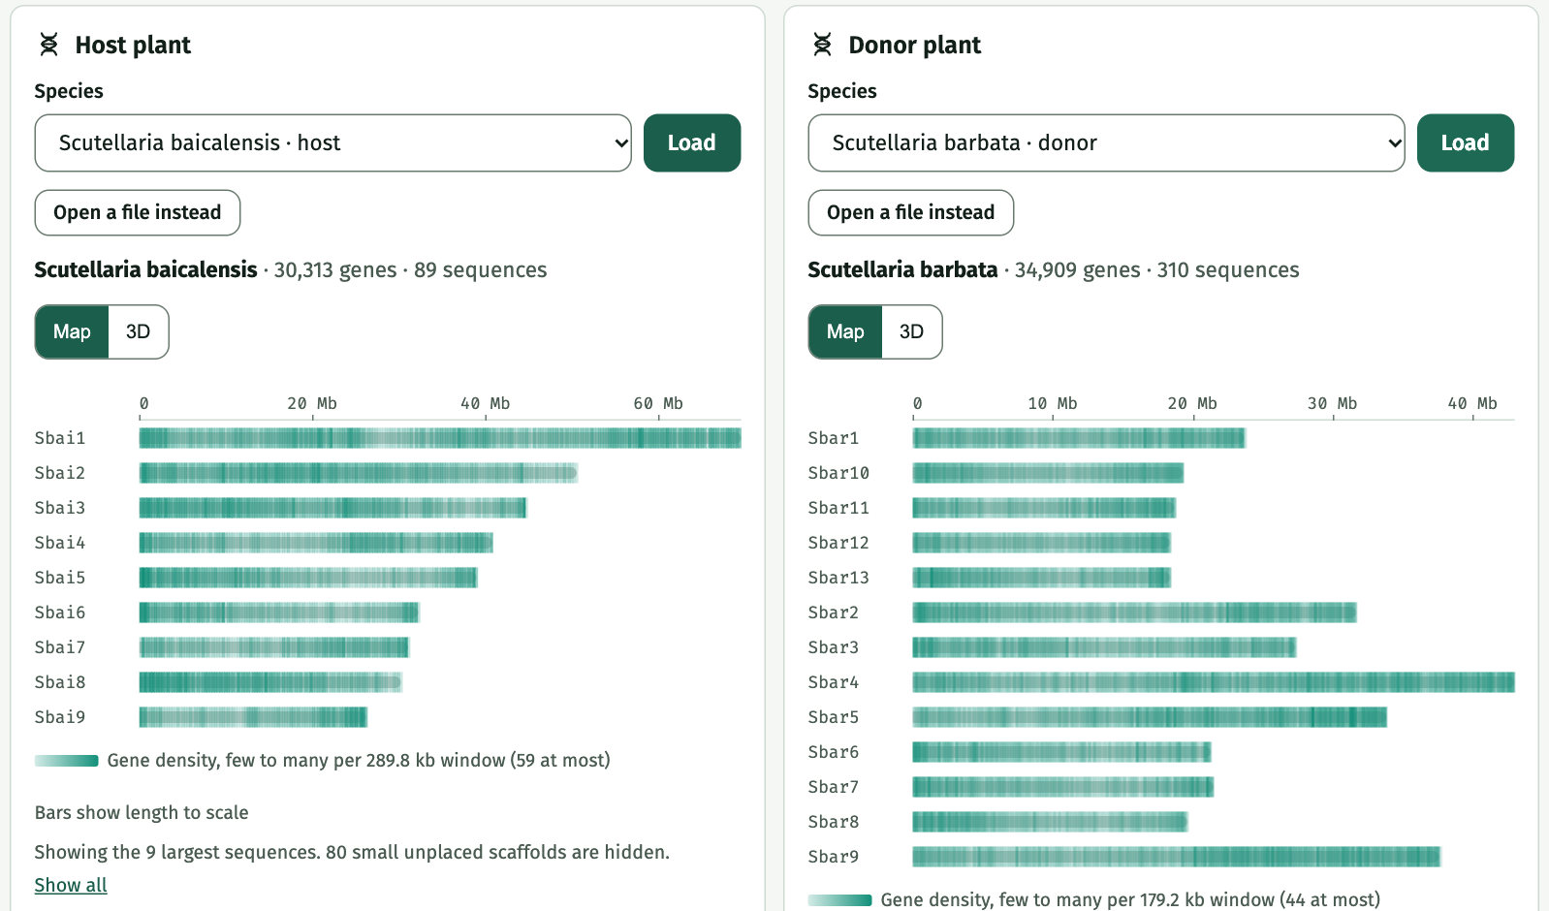
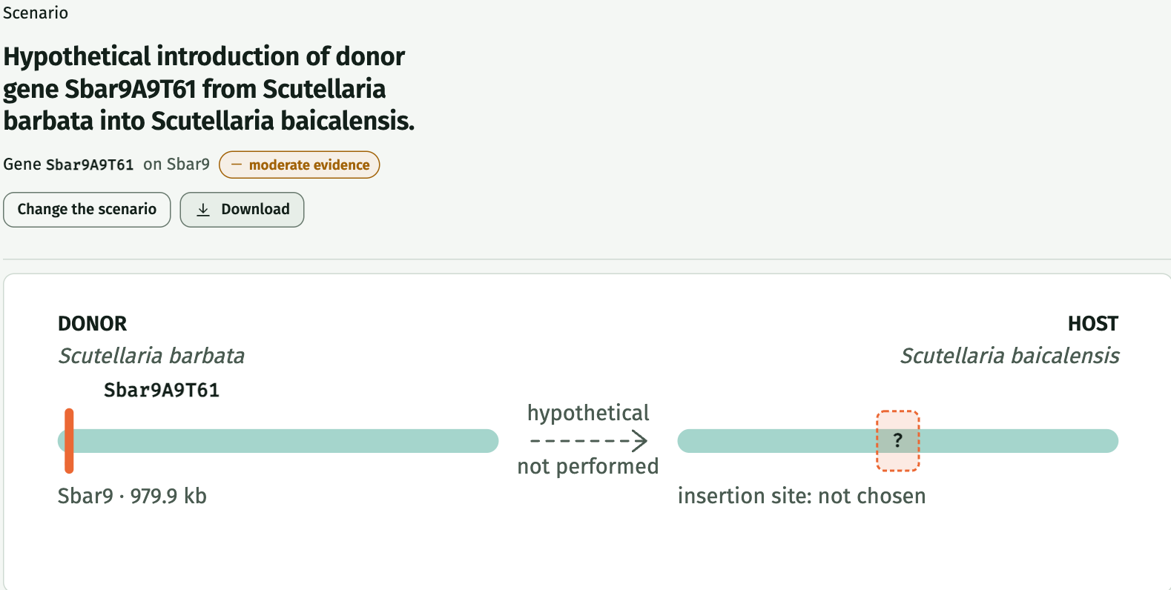
From genomes to a report you can trace
Genomes: 30,313 and 34,909 genes on the real assemblies
Report: scenario, evidence level, what we don't know and the limits
Dashboard
Genome Explorer
GeneBridge
Pathway Explorer
CRISPR Studio
Virtual Plant Report
Notes:
Through our web application, users can explore six main sections: a dashboard with both plant species, a Genome Explorer showing chromosome organization and selected gene locations, GeneBridge for comparative genetic analysis, a Pathway Explorer connecting genes, enzymes and natural compounds, CRISPR Studio for hypothetical modifications, and finally a Virtual Plant Report presenting the proposed scenario, supporting evidence, consequences and limitations. The screenshots are from the live app, using the real published genomes. This creates a complete research journey, from genomic information to an evidence-based engineering hypothesis.

Slide 8
What the prototype found
Paper's gene
In our annotation
Match
How sure
Mutual best match
SbarKPS2
Sbar9A9T61
100%
Same protein
Sbar9A9T61 and Sbai8C203T0 pick each other as closest (89%).
SbarKPS1
Sbar9A10T43
94.8%
Best match
A tandem pair, as expected
SbaiKPS1
Sbai8C203T0
84 to 89%
The two donor genes sit 38 kb apart on the same sequence and strand.
Best match only
Two of the three matches are inferences from sequence similarity. We call them best matches, not proven identical.
Evidence level: moderate
One experimental study supports the donor gene (PMID 37395679).
Method: BLAST+ blastp against both proteomes, then a reciprocal check. The live app shows the same results.
Notes:
This is what the working prototype found. We took the two KPS protein sequences deposited with the 2023 paper and searched them with BLAST against the proteomes of both genomes. The SbarKPS2 sequence matches gene Sbar9A9T61 at 100 percent, so that is the same protein. SbarKPS1 matches Sbar9A10T43 at 94.8 percent, and SbaiKPS1 matches Sbai8C203T0 at 84 to 89 percent. Those last two are best matches from sequence similarity, so we call them best matches, not proven identical. The two donor genes sit 38 kilobases apart on the same sequence and strand, which fits a tandem pair, and the app's reciprocal check shows Sbar9A9T61 and Sbai8C203T0 as mutual best matches. The evidence level for the donor gene is moderate, from one experimental study. You can reproduce all of this in the live app.

Slide 9
How we checked it
1 A known answer
An honest limit
The paper’s SbarKPS2 protein finds gene Sbar9A9T61 at 100% identity, so the annotation holds the paper’s gene. SbarKPS1 finds Sbar9A10T43 at 94.8%, and the two sit 38 kb apart, as a tandem pair should.
86%
of 300 random donor genes also count as “related”, because both plants belong to one genus.
2 A clear best hit in the host
best
runner-up
SbarKPS1
84.2% Sbai8C203T0
So the signal is the mutual best match and the gap to the runner-up. Still unchecked: a benchmark of known orthologs, expression data, and other gene families.
56.5% Sbai8A89T185
SbarKPS2
88.5% Sbai8C203T0
57.2% Sbai8A89T185
Software: 248 backend tests at 98% coverage, 74 frontend tests, and seven CI checks on every change.
Notes:
Here is how we checked the work. First, a known answer. The two KPS protein sequences deposited with the 2023 paper were searched against our annotation. SbarKPS2 finds gene Sbar9A9T61 at 100 percent identity, so the annotation contains the paper's gene. SbarKPS1 finds Sbar9A10T43 at 94.8 percent, and the two genes sit 38 kilobases apart, which fits a tandem pair. Second, is the best hit clearly the best? In the host plant, both proteins find the same gene, Sbai8C203T0, at 84 and 88.5 percent, while the runner-up is only about 57 percent, a gap of roughly 28 to 31 points. Third, an honest limit: 86 percent of 300 random donor genes would also be labelled related, because the two plants belong to the same genus. So the label alone is not the signal. The signal is the mutual best match and the gap to the runner-up. We have not yet built a benchmark of known orthologs or added expression data, and we say so. On the software side we have 248 backend tests at 98 percent coverage, 74 frontend tests, and seven automated checks on every change. All of this is written up in our validation document.

Slide 10
Why it matters, and what comes next
Potential real-world relevance
Future development
Helps researchers screen candidate genes on paper before costly laboratory work
Every finding traces to a PMID or DOI, so each assessment can be audited
Shows what is unknown, not only what is known, so effort goes where it counts
The same method can compare other plant pairs that have published genomes
Add gene expression data and more pathways, such as the full flavonoid route
Literature retrieval with embeddings: the database already supports it
Sign-in and rate limits before opening the API publicly
Move to AWS as planned, once the prototype is proven
Test the most promising hypotheses with laboratory partners
Made by Lerdi Salihi and Edina Suma
photofusionai.netlify.app
Built with Python, FastAPI, BLAST+, React, three.js and Supabase. 248 backend tests at 98% coverage, CI on every change.
Notes:
What could this mean in the real world? It could help researchers screen candidate genes on paper before costly laboratory work. Every finding traces to a publication, so each assessment can be audited, and the tool shows what is unknown, not only what is known. The same method can compare other plant pairs that have published genomes. Next we want to add gene expression data and more pathways, use literature retrieval with embeddings, which our database already supports, add sign-in before opening the API publicly, move to AWS as planned, and test the most promising hypotheses with laboratory partners.

