Slide 1
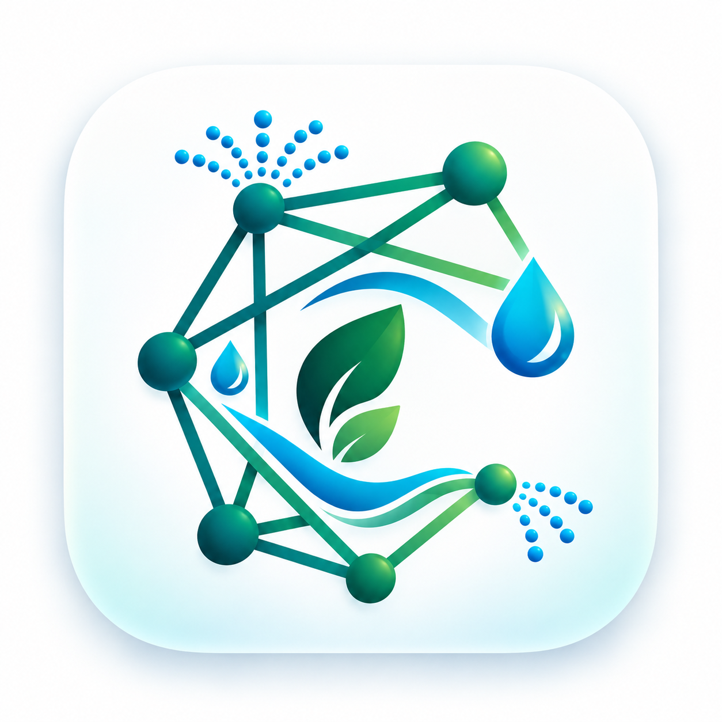
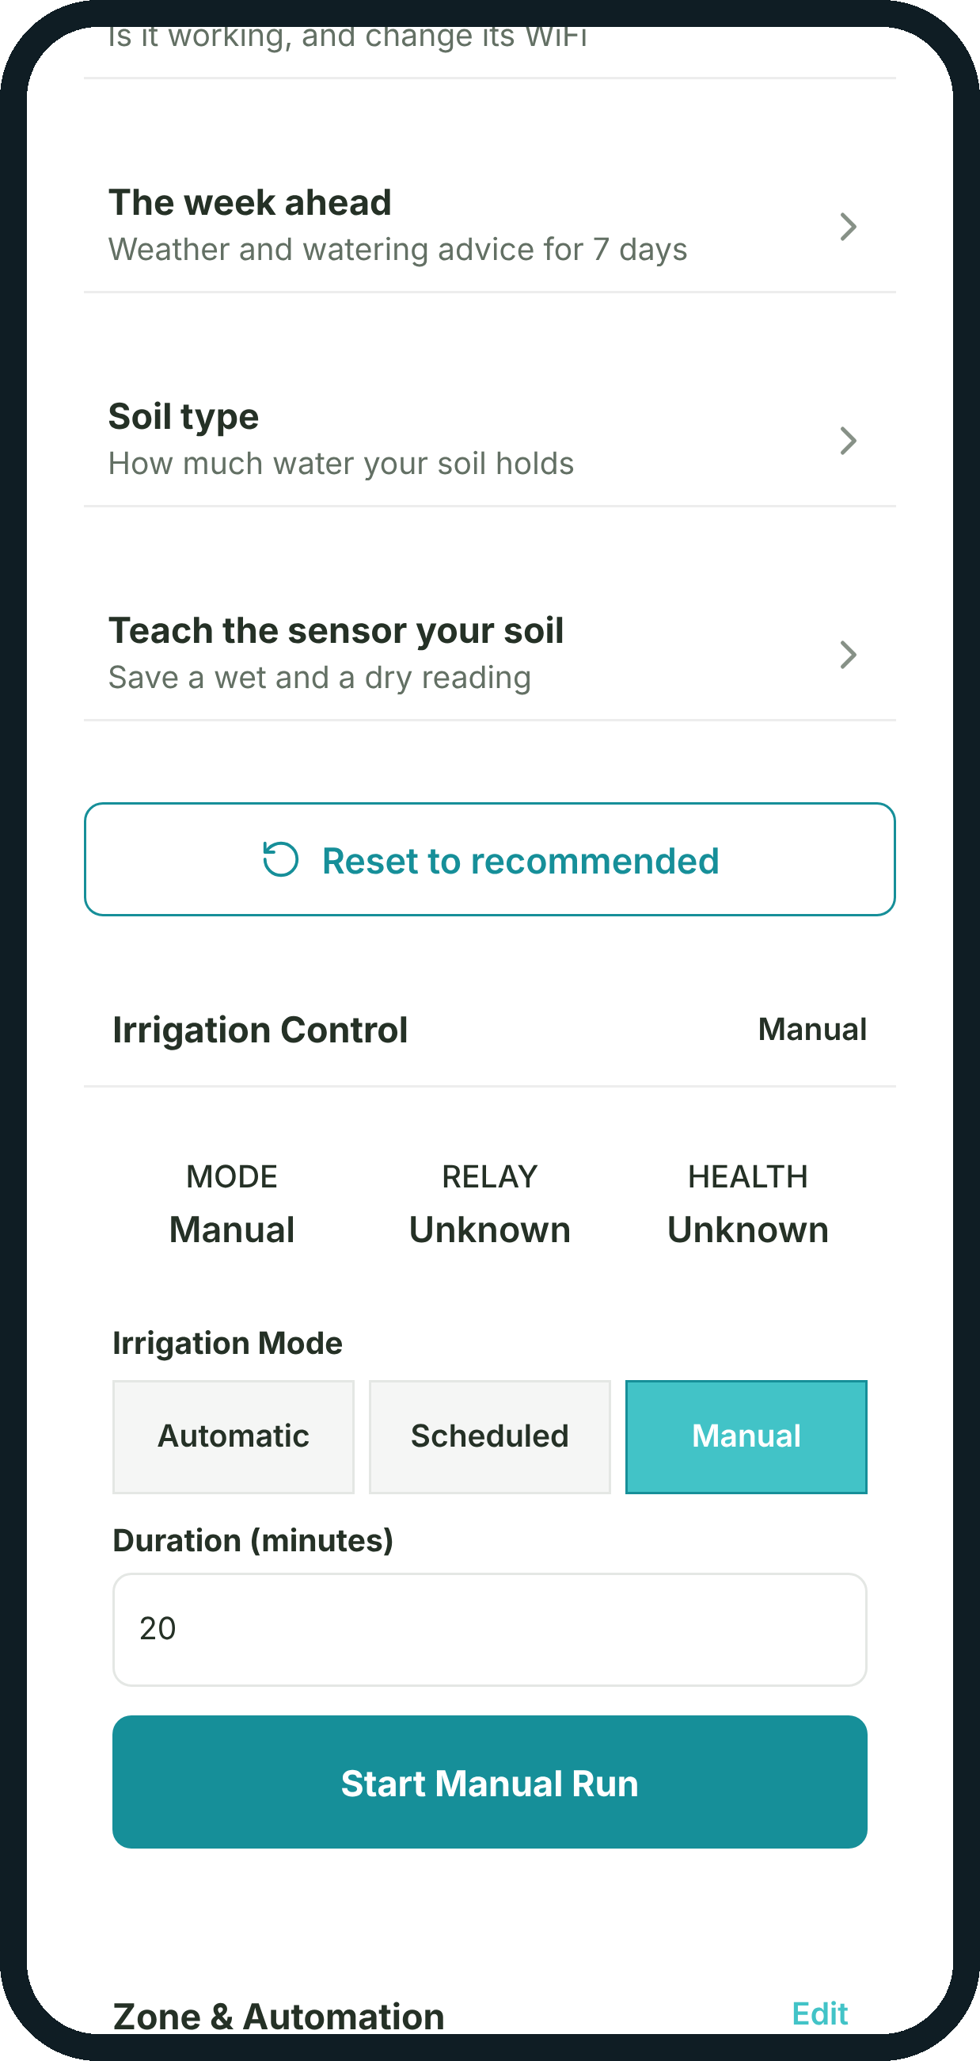
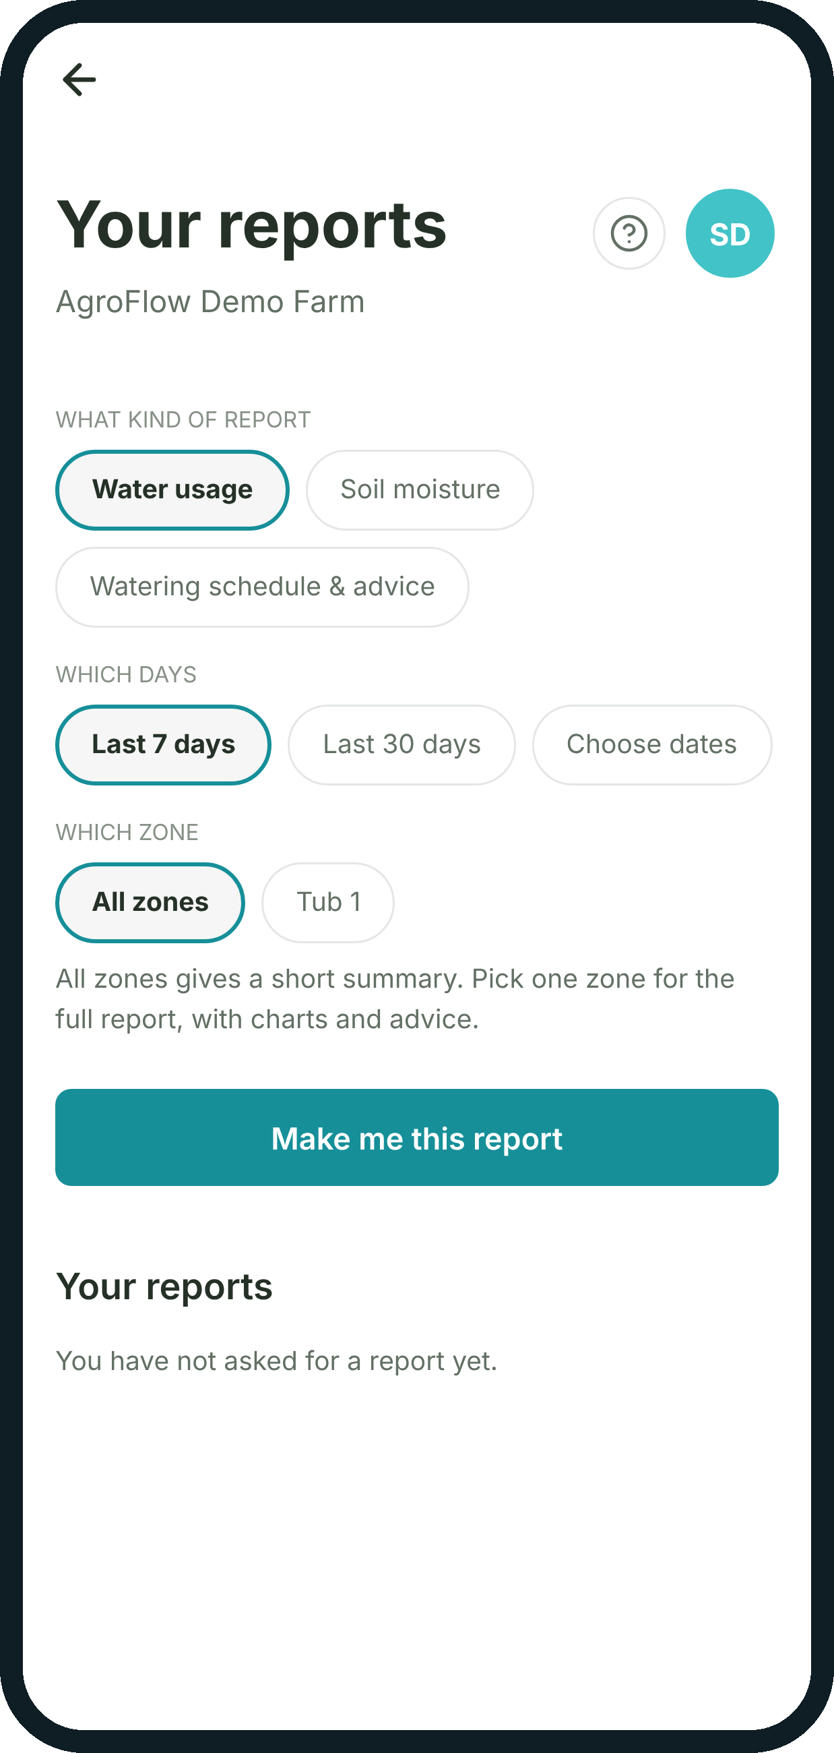




Lubaelihle
AGROFLOW
Smart Irrigation Management System
Agriculture
IoT
Irrigation
Software
INF3003W · Systems Development Project I
Team 2 · University of Cape Town · 2026
Sponsor: Mafikeng Cisco Edge Centre (MDiHub)
Real AgroFlow farmer app, running from the current repository
Notes:
SPEAKER 1 — Lubaelihle Msuku (Project Manager). ~20 s.
Good morning. We're Team 2, and this is AgroFlow, a smart irrigation management system.
It combines agriculture, IoT hardware in the field, irrigation control and software. The screens on the right are our real farmer app. The project was sponsored by the Mafikeng Cisco Edge Centre, MDiHub.
Source: Milestone 2/3 cover pages; app screens captured from apps/mobile (see source audit).

Slide 2
Meet Team 2
Lubaelihle
LM
add photo
LM
add photo
PT
add photo
ON
add photo
Lubaelihle Msuku
Leruo Matlhatsi
Philisile Tyobeka
Olwethu Nkabinde
Project Manager
Software Developer
Business Analyst
Soft Skills Specialist
Slides 1–3
Slides 4–5
Slides 6–7
Slides 8–10
Sponsor Boingotlo Molefhe · Mafikeng Cisco Edge Centre (MDiHub) Tutor Nazreen Ryklief Mentor Jodie Thorburn
Notes:
SPEAKER 1 — Lubaelihle. ~20 s.
I'm Lubaelihle, the project manager. Leruo is our software developer, Philisile our business analyst, and Olwethu our soft-skills specialist. All four of us will present today.
Our sponsor is Boingotlo Molefhe, and our tutor and mentor were Nazreen Ryklief and Jodie Thorburn.
Roles: Milestone 1, Table 14 (Summary of roles). Names: Milestone 1 cover / repo landing page.
ACTION: the circles are editable placeholders — no team photos were supplied. Replace each with a real photo (Insert > Picture, crop to circle).

Slide 3




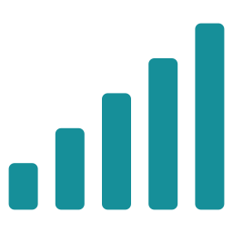
The irrigation challenge
Lubaelihle
Farmers have to decide when and how much to water without reliable, real-time visibility of their fields.
Manual checks
Time and labour
Walking zone to zone to judge the soil
Fixed timers
Over- and under-watering
Schedules ignore soil and weather
Sipho Dlamini
Small-farm owner (persona)
“Check soil conditions without walking to every zone.”
Little visibility
Decisions without data
No record of the water actually used
Rural conditions
Must keep working offline
Weak signal and load-shedding
Notes:
SPEAKER 1 — Lubaelihle. ~40 s.
Farmers have to decide when and how much to water without reliable, real-time visibility of their fields.
In practice that means walking from zone to zone to judge the soil, or relying on fixed timers that ignore the weather. The result is over- and under-watering, extra labour, and no record of the water used.
Rural sites also have weak signal and load-shedding, so the system has to keep working offline.
Our persona, Sipho Dlamini, wants to check his soil without walking to every zone.
Handover: Leruo will show how AgroFlow answers that.
Sources: Milestone 3 §1.1 Business Case Summary; Milestone 3 §2 (R10 connectivity, R14 load shedding); persona Figure 7.1 (goal: 'ability to check soil conditions without having to walk to every zone'). No yield or water-saving percentages are claimed — none were measured.

Slide 4
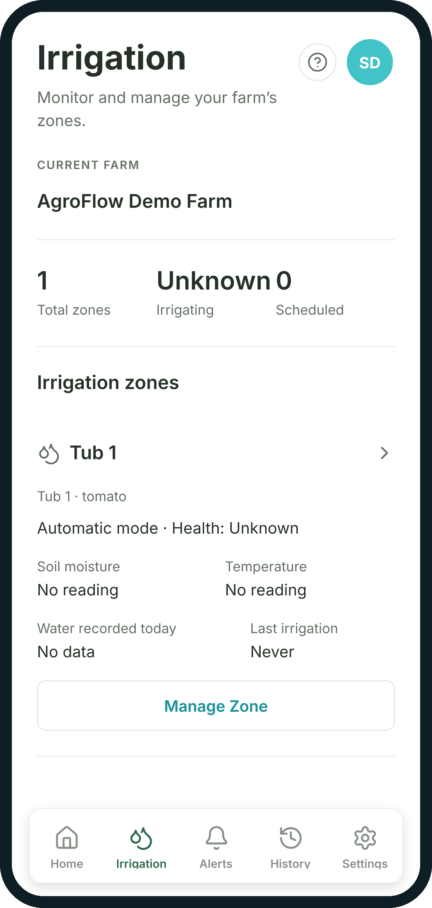



From field conditions to informed irrigation
Leruo
FIELD
CONNECTED PLATFORM
FARMER & ADMIN
ESP32 kit in every zone
Soil moisture, temperature and humidity every 30 s
Relay switches the pump
Stores readings, checks each zone
FAO-56 advice from crop stage + forecast
Telegram alerts when action is needed
Every zone on the farmer's phone
Automatic, scheduled or manual watering
Admins register farms and kits
Rule-based and sourced, not a black box: every advice figure traces to a sensor reading, a weather row or a cited FAO-56 value.
Farmer app · Irrigation
Notes:
SPEAKER 2 — Leruo Matlhatsi (Software Developer). ~35 s.
Thanks, Luba. AgroFlow is one connected system.
Each zone has an ESP32 kit that reads soil moisture, temperature and humidity every thirty seconds and switches the pump through a relay.
The platform stores those readings, checks each zone, and uses the FAO-56 method to advise how much water the crop needs. When a person needs to act, it sends a Telegram alert.
The farmer can leave a zone on automatic, schedule it, or water manually.
The advice is rule-based and sourced, not an AI model.
Sources: firmware SENSOR_REPORT_INTERVAL_MS = 30000 (AgroFlowIrrigationNode.ino:98); IrrigationMode.cs (automatic/scheduled/manual); Agronomy/IrrigationAdvisor.cs header ('This is NOT a language model'); TelegramNotificationService.cs.

Slide 5
How AgroFlow works
Leruo
FIELD HARDWARE
COMMUNICATION
PLATFORM
DATABASE
APPS
Zone kit · one per zone
Wi-Fi
site router / hotspot
AgroFlow.Api
ASP.NET Core (.NET 8) · Docker on Railway
Supabase
PostgreSQL
Auth
Row Level Security
Farmer app
Expo / React Native · Android APK
Soil probe
moisture
DHT11
temp · humidity
Sensor ingestion + zone health
HiveMQ Cloud
MQTT over TLS · readings in, commands out
Auto-irrigation decision
ESP32
firmware v1.4.0
FAO-56 advice engine
Admin console
TypeScript + Vite · web
HTTPS
enrol kit · log irrigation events · confirm commands
Command bridge → MQTT
Relay
Pump
Telegram notifications
Open-Meteo
weather
Telegram
Bot API
Irrigation command App → API → database queue → LISTEN/NOTIFY → MQTT → ESP32 → relay → pump → event logged
Notes:
SPEAKER 2 — Leruo. ~50 s.
This is the system as built, traced from our code.
The kit's sensors feed the ESP32, which drives the relay and pump. It publishes readings over MQTT, encrypted with TLS, to HiveMQ Cloud; enrolment and event logging use HTTPS.
Our ASP.NET Core API, running in Docker on Railway, stores readings in Supabase, decides whether automatic zones need water, runs the advice engine with Open-Meteo weather, and sends Telegram alerts.
Both apps read straight from Supabase, where row-level security keeps each farmer to their own farm.
Along the bottom is the command path: queued in the database, picked up by the API, sent over MQTT to the ESP32.
Handover: Philisile will walk through the process.
Sources: README.md Architecture; hardware/shared/MQTT_TOPICS.md; Mqtt/IrrigationCommandNotifyService.cs; Services/SensorReadingProcessor.cs; WeatherCollectionService.cs (Open-Meteo); migration 0011_row_level_security.sql; Dockerfile; Milestone 3 §2.1.4. NOTE: Milestone 3 describes an ESP-NOW gateway between boards and OpenWeatherMap; neither is in the final code — each board connects directly over Wi-Fi, and weather comes from Open-Meteo.

Slide 6
From monitoring to irrigation
Philisile
Review conditions and advice
Start a manual run (choose minutes)
See history and reports
FARMER
FAO-56 advice from forecast + crop stage
AGROFLOW PLATFORM
Automatic and below threshold?
Store reading, update zone health
yes
Queue command, publish over MQTT
Log event and litres used
no: keep monitoring
Read soil, temp and humidity every 30 s
Relay on → pump runs, stops on time, stop or safety cap
FIELD HARDWARE
Redrawn from the Milestone 2 To-Be activity diagram and updated to the implemented flow (SensorReadingProcessor.cs, FarmerEndpoints.cs, ESP32 firmware).
Notes:
SPEAKER 3 — Philisile Tyobeka (Business Analyst). ~45 s.
Thank you, Leruo. Our To-Be process has three lanes: farmer, platform and hardware.
The kit reads its sensors every thirty seconds. The platform stores each reading and updates the zone's health. If the zone is on automatic and below the farmer's threshold, it queues a start command; otherwise it keeps monitoring.
Meanwhile the farmer reviews the FAO-56 advice and can start a manual run for a chosen number of minutes.
Either way the command reaches the relay and the pump runs, until the time is up, a stop arrives, or a safety limit is hit. The event is logged and appears in the farmer's history.
Sources: Milestone 2 §3 To-Be Activity Diagram — Farmer (original: view conditions → initiate irrigation → check hardware → assess → irrigate loop → record). Updated because the implemented system adds automatic mode decisions (Zone.ShouldStartIrrigation), FAO-56 advice, and duration-limited manual runs (FarmerEndpoints.CreateManualCommandAsync). Safety cap: firmware SAFETY_MAX_RUN_MS = 5 minutes on every run (AgroFlowIrrigationNode.ino:105).

Slide 7
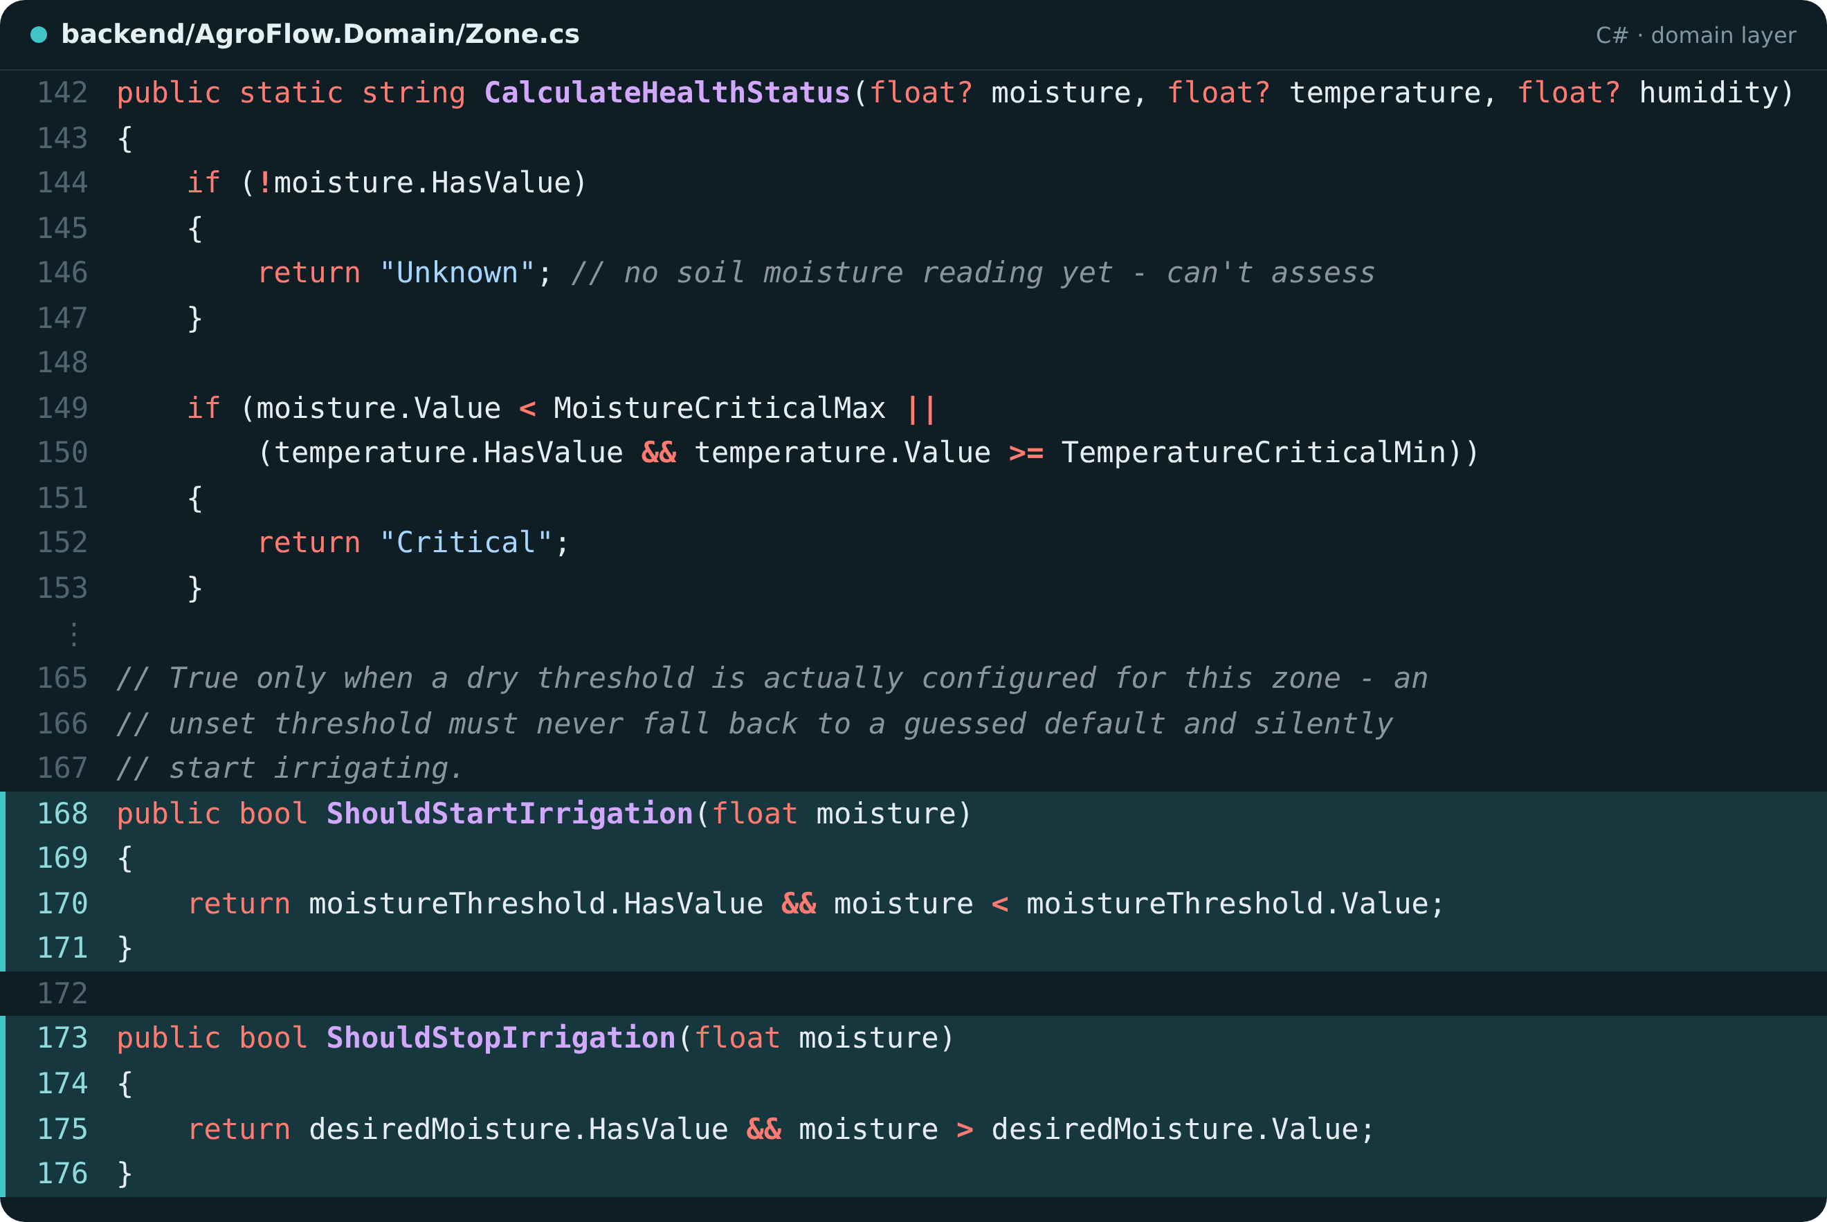
Designed as a connected system
Philisile
«abstract»
User
Farm
Weather
1..*
farmName
location
+ AddZone()
temperature
windSpeed
+ login()
owns
Admin
FarmUser
1..*
Zone
Hardware
0..*
cropType
moistureThreshold
+ ShouldStartIrrigation()
status
lastSeen
0..*
0..*
0..*
IrrigationLog
Alert
Advice
ESP32
Sensor
Pump
Implemented in the current AgroFlow codebase
The same Zone class decides when an automatic zone starts and stops watering.
runtimeSeconds
estimatedLitres
severity
message
Advice = class AIRecommendation in code: written by the rule-based FAO-56 engine, not an AI model.
Notes:
SPEAKER 3 — Philisile. ~35 s.
This is our domain model, simplified. A farm user owns farms, and each farm has zones.
The zone is the centre: it has hardware — the ESP32, sensors and pump all inherit from Hardware — and it collects irrigation logs, alerts and advice.
On the right is the real Zone class. ShouldStartIrrigation only returns true when the farmer has set a threshold; it never guesses.
Handover: Olwethu will show what we built.
Sources: backend/AgroFlow.Domain/*.cs (User abstract; FarmUser : User; Admin : User; ESP32/Sensor/Pump : Hardware; Farm.Zones collection); supabase/migrations (farm.owner_id, zone.farm_id, hardware.zone_id, alert/irrigation_event/ai_recommendation.zone_id, weather.farm_id). Changed since the Milestone 3 DCD: Admin extends User (not FarmUser); RelaySwitch, WeatherService, DashboardService and NotificationService are not domain classes — that work lives in API services. Maintenance (→ Hardware) and Report exist but are omitted here for readability.

Slide 8
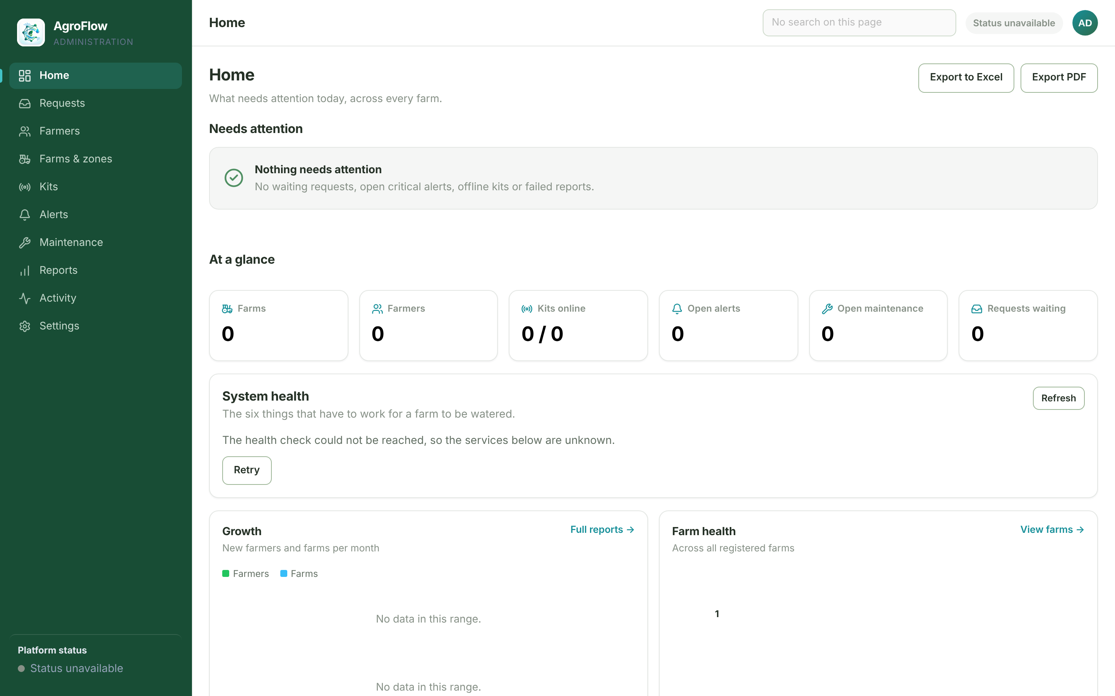
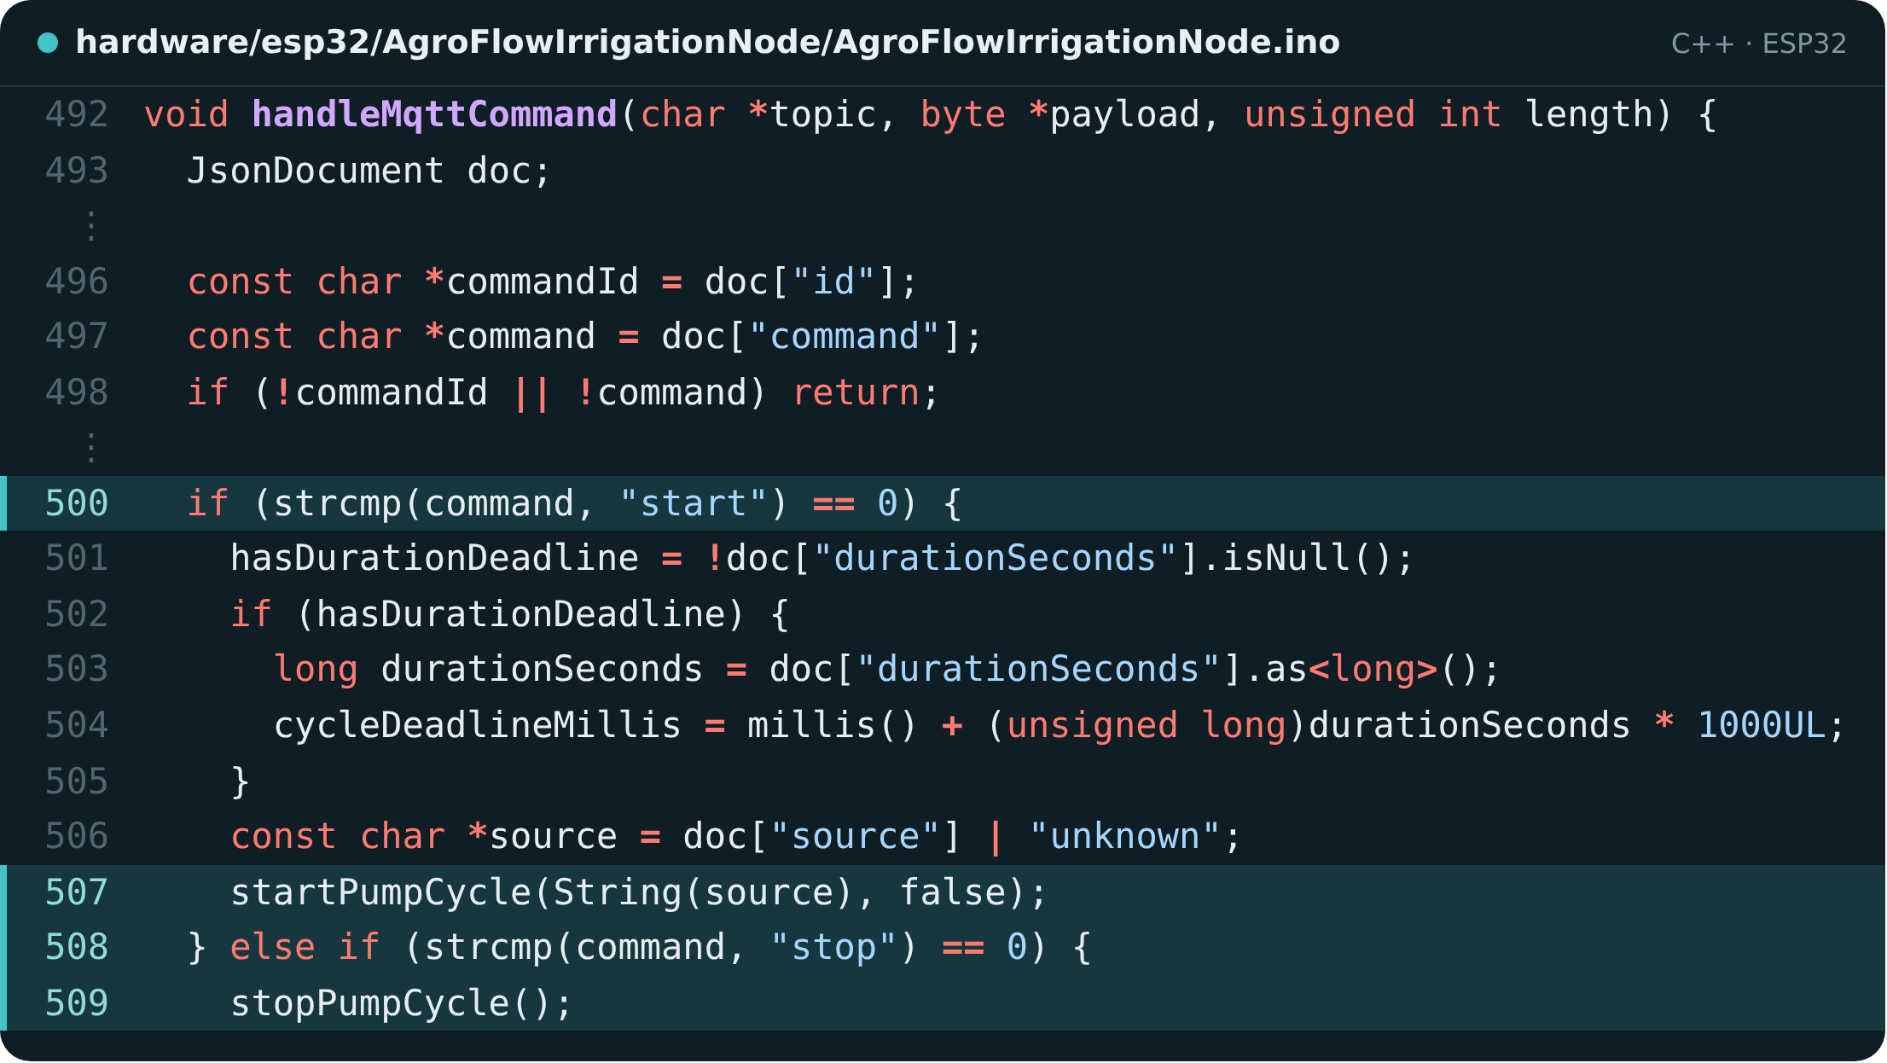
From design to implementation
Olwethu
MOBILE EXPERIENCE
PLATFORM OVERSIGHT
Expo / React Native farmer app
Admin console (TypeScript + Vite)
CONNECTED HARDWARE
INSERT REAL KIT PHOTO
No hardware photo in milestones or repo
IRRIGATION LOGIC
ESP32 kit · soil probe · DHT11 · relay · pump
ESP32 firmware acting on MQTT commands
Notes:
SPEAKER 4 — Olwethu Nkabinde (Soft Skills). ~30 s.
Thanks, Philisile. This is our evidence that AgroFlow is built, not just designed.
Top left is the farmer app; top right, the admin console, which opens on what needs attention. Bottom left is our kit [describe the photo once added], and bottom right is the ESP32 firmware switching the pump on a start command and off on a stop.
Sources: screenshots captured from the running apps on 6 Oct 2026 (apps/mobile via Expo web; apps/web/admin via Vite). The build sandbox could not reach Supabase or Railway, so data comes from a local fixture mirroring docs/demo-account.md — no sensor values were invented, which is why readings show 'No reading'. Code: hardware/esp32/AgroFlowIrrigationNode/AgroFlowIrrigationNode.ino lines 492–509.
ACTION: replace the dashed box with a real photo of the kit before presenting; consider re-capturing the app screens from the live system on a phone.

Slide 9




What AgroFlow delivers
Olwethu
FIELD SYSTEM
PLATFORM
FARMER APP
ADMINISTRATION
✓ Kit per zone: probe, DHT11, relay, pump
✓ One-time enrolment code + Wi-Fi setup
✓ Offline fallback watering
✓ 5-minute pump safety cap
✓ MQTT over TLS via HiveMQ
✓ Auto-irrigation from thresholds
✓ FAO-56 advice + Open-Meteo
✓ Telegram alerts
✓ Live zone readings and health
✓ Automatic / scheduled / manual
✓ Manual start and stop
✓ Water-usage reports (PDF)
✓ Farm and kit wizards
✓ Kits online / offline
✓ Alerts and requests
✓ Excel, PDF and CSV exports
○ NOT YET / NEXT
Maintenance jobs and alert assignment are session-only (no table behind them) · Per-kit uptime not measured
Kit restart / remove from console is session-only · ESP-NOW gateway and Supabase Realtime (Milestone 3 design) not built
Notes:
SPEAKER 4 — Olwethu. ~35 s.
Here is where we stand. The field kit enrols with a one-time code, keeps watering locally when offline, and caps every pump run at five minutes.
The platform, farmer app and admin console are all working, as listed.
Some things aren't finished. Maintenance and alert assignment don't persist yet, uptime isn't measured, and the ESP-NOW gateway from our design wasn't built.
Sources: docs/final-finish-report.md 'Still not done'; docs/release-notes-v2.md 'What is not connected yet'; firmware v1.2–1.4 header; admin exports commit 2ff6594. Not on the slide because it could not be verified here: the report states 650 domain tests pass (dotnet was not available in this environment), and the admin audit log depends on migration 0038 being applied and the dev branch being deployed.

Slide 10
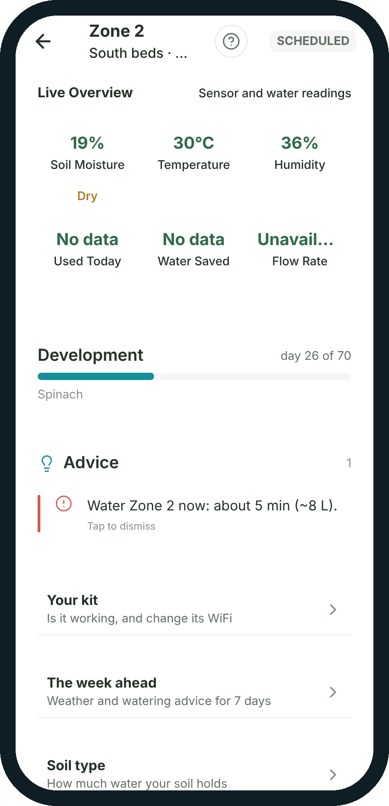
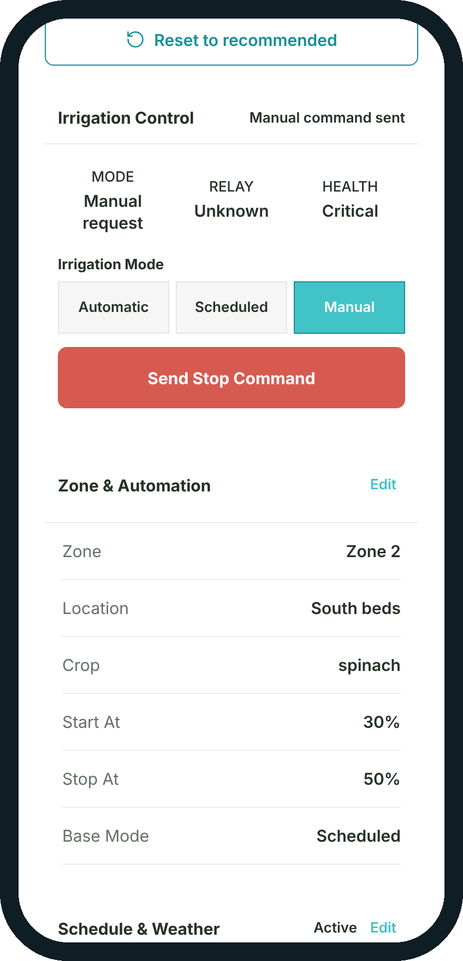
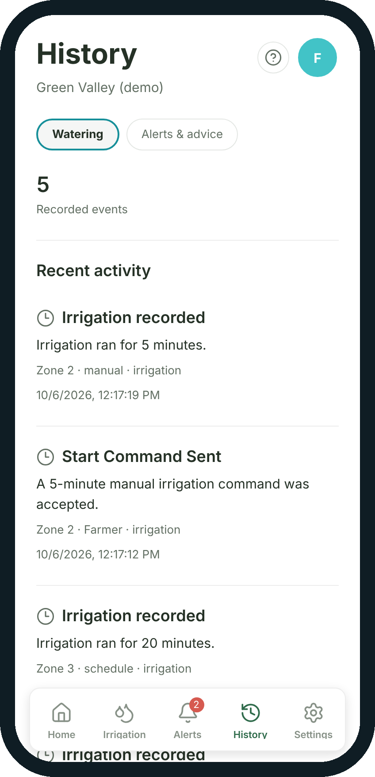
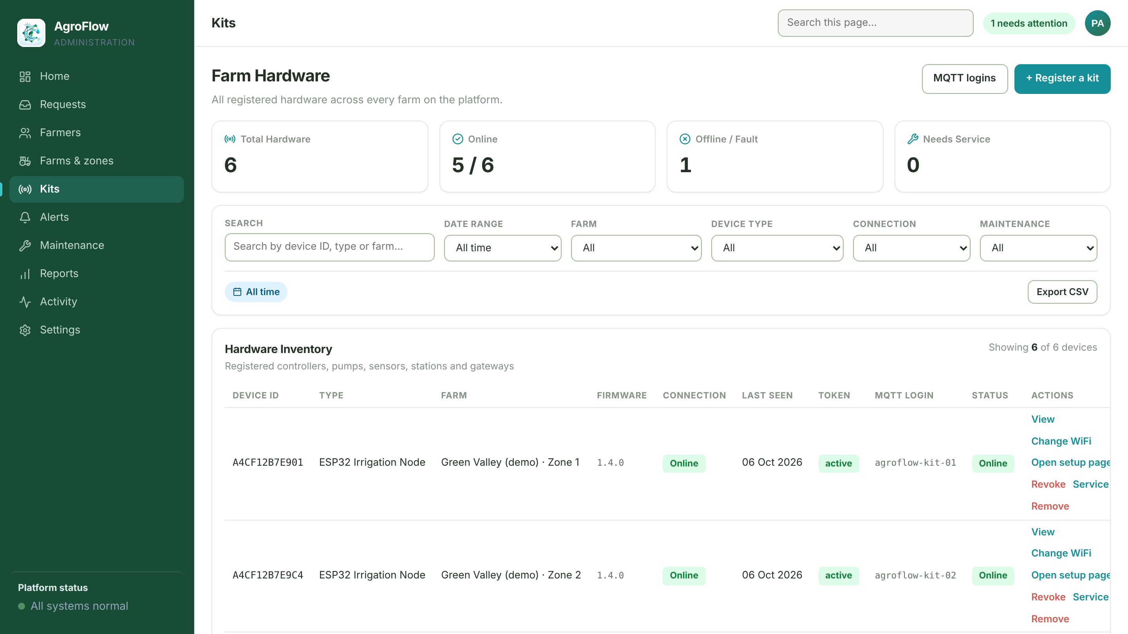
The journey we will demonstrate
Olwethu
1
2
3
4
5
6
7
Farmer opens AgroFlow
Zone 2 is critical
Reads the advice
Starts a manual run
Command reaches the kit
Run is recorded
Admin follows up
Drip points to today's one action
Soil moisture below its start level
FAO-56: water now, about 5 min
Switches the zone to Manual
API → MQTT → ESP32 → pump
History: 5 min, Zone 2, manual
Alert, kits, reports, activity
VALIDATION IN THE DEMO
Farmer types 90 minutes
↓
“Enter a duration between 1 and 60 minutes.”
↓
Corrected to 5 → confirmed → sent
Admin console · Kits (demo data)
Now, let's see AgroFlow in action.
Screens from our system demo: real app, illustrative demo data
Notes:
SPEAKER 4 — Olwethu. ~45 s.
Our system demo follows one farmer's day. They open AgroFlow, and Drip, the app's helper, points them to Zone 2. Its soil moisture has dropped below its start level, so the zone is critical, and the FAO-56 advice says to water now for about five minutes.
The farmer switches the zone to manual and starts a run. When they type ninety minutes, the app stops them, because a run must be between one and sixty minutes. They correct it to five. The command reaches the kit, the pump runs, and the run appears in their history. Finally, an administrator follows up the alert.
Now, let's see AgroFlow in action.
Source: the team's system demo (showcase/narration.md, showcase/system-audit.md, showcase/assets/screens/*). Screens are the real, unmodified app answering with clearly labelled illustrative demo data (showcase/capture/demo-data.mjs), approved by the team per showcase/system-audit.md. Validation: apps/mobile/src/app/zone/[id].tsx handleStartManualRun ('Enter a duration between 1 and 60 minutes.'). The demo uses 5 minutes, which fits the firmware's 5-minute safety cap.

