Slide 1
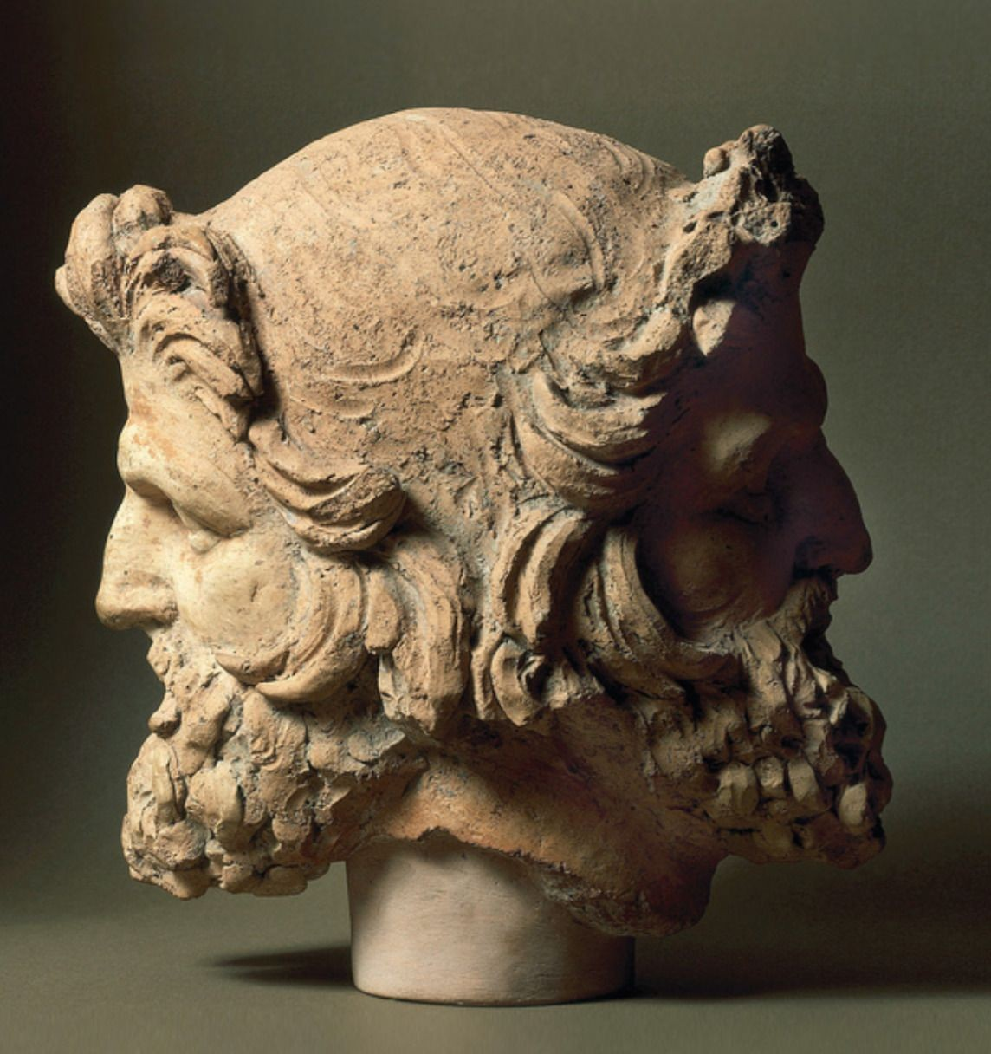

CONVEXITY CONVICTION
ALL HANDS / FEBRUARY 2026
Where We Stand
A hard look at our position. No sugarcoating. No panic.
But conviction.
01

Slide 2
THE HONEST NUMBERS
Where our funds sit today
FUND I / PILOT
FUND II / MERCURY
FUND III / MARS
8x
0.95x
$5M
TVPI
TVPI (current)
First Close
DPI
Fund Size
Bullish scenario
Fund Size
Target
Soft Commits
3x
$1.1M
~1.3x
$40M
$50M
~$2M
Exceptional returns. Real distributions. But LPs discount the fund size as "angel-scale, not institutional."
2022 vintage. Pre-seed/seed deep tech. Below water on marks. This is the number LPs see first.
Long way to go. 16 data room LPs ghosted. The fundraise is stalling.
02

Slide 3
CONTEXT
1.3x TVPI at year 4 is not a death sentence. But it is not enough to raise on numbers alone.
2022 is the worst vintage in a decade
But median does not raise a Fund III
Valuations peaked, markets crashed, follow-on funding dried up. Every 2022 vintage fund is sitting on compressed marks. This is not unique to us.
1.3x at year 4 is roughly median for the vintage. LPs want top quartile trajectory or a compelling story for why marks are about to inflect.
Deep tech J-curve is longer
What actually matters
SaaS marks up on revenue multiples. Deep tech marks up on technical milestones, government contracts, and large follow-on rounds. Our companies are pre-inflection, not failing.
It is the slope of the curve and the credibility of what comes next.
Funds settle into terminal quartile at year 5-6
If we show LPs that 0.95x is becoming 1.3x because specific companies received term sheets at validated external prices, that momentum signal is more persuasive than the number.
Cambridge Associates data is clear: judging a deep tech fund at year 3-4 is like judging a marathon runner at mile 8.
03

Slide 4
DIAGNOSIS
Why 16 out of 16 data room LPs went silent
1
Fund II gives them permission to wait
LP opens data room, sees below-water marks, thinks: "I will wait for momentum." Ghosting is easier than saying "your numbers are not there yet."
The compounding effect
No single factor is a dealbreaker. But combined, they create inertia. Performance gives permission to wait. Lack of differentiation gives no reason to act. Bucket mismatch removes the internal champion.
2
No urgency mechanism in our materials
Our pitch reads as standard deep tech thesis + team + portfolio. Nothing makes LPs feel they will miss something irreplaceable by waiting.
We need to break the compound.
Attack all three simultaneously.
3
Allocation bucket mismatch
"European pre-seed deep tech" is not a standard allocation category. We are asking LPs to create a new bucket. That is a fundamentally harder sale.
04

Slide 5

WHAT I HAVE BEEN WRESTLING WITH
BEING HONEST WITH YOU
The existential conflation
I am not sleeping well. I am scared the team falls apart. I owe you honesty.
When your life's work feels threatened, "this fundraise is hard" becomes "everything might fail." These are different problems. I am working to separate them.
The temptation to scatter
Fear drives us toward consensus solutions—launching products, offering consulting, hedging bets. It diverts our focus.
The organisation is funded for current salaries until mid-2027. Beyond that, we will need to reduce costs, assuming no Mars management fee. The pressure is on. I share this because I believe transparency and agency are our greatest strengths.
The thing I know to be true
We have created something truly unique. Fund I achieved an 8x return, validating the model. The portfolio companies are real. Our platform is real. The thesis works. The product is solid, The packaging needs to change.
05

Slide 6
ON AGENCY
We can turn things around. We thrive in adversity.
FROM OUR FOUNDER JOB in his „steel“ email
"Monday is the best day of the week. It's our chance to start fresh, to improve upon who we were last week. Today is a tougher Monday than usual: obviously, the situation with Brandon is challenging. But the most important question right now is this: Who are we going to be in the face of adversity?
For Hedy to fulfill its mission and achieve its vision, there's only one answer: we love adversity. We thrive in it. Adversity makes us stronger, sharper, and better. Like iron in a blast furnace, adversity burns away the weak points and forges steel.
The status quo isn't good enough today. Who we were last week won't cut it anymore. Activate your inner DARKMODE. Get better this week."
06

Slide 7
A REQUEST
I am not asking you to stay out of loyalty. I am asking you to stay out of conviction.
Help manufacture catalysts
Protect your energy
Mercury: We need 2-3 portfolio companies to hit visible milestones in the next 90 days. Term sheets, contracts, partnerships. This changes the fundraising narrative from "wait and see" to "momentum is building." Your relationships and support matter here.
We are a small team carrying a big mission. The next 12 months will not be easy. No side projects. No non-portfolio SPVs. No hedging through alternative revenues. No distractions. We give this a 100% shot.
Mars: We need to do 1-2 bold earliest stage investments at $1M each to build momentum with the Mars Fund.
07

Slide 8
THE PATH FORWARD
Seven moves. In order. No shortcuts.
1
Fix the data room
5
Kill the side projects
February. Get brutal feedback from Hutt and Isomer. What exactly triggers the "wait"?
NOW
Now. No marketplace. No consulting. Every hour goes to fundraising, portfolio, and deals.
NOW
2
Lead with identity, not data
6
Re-engage ghosted LPs with momentum
Feb-March. Rewrite the pitch. Who we are first. Numbers validate the story.
FEB
May. Push updated marks + new pitch to all 16 data room LPs. Different story, different energy.
MAY
3
Manufacture portfolio catalysts
7
Find peer GPs for mutual support
March-Oct. Pick 2-3 Mercury companies closest to milestones. Focus all support there for 90 days. Do 2-3 Mars Fund investments of $1M each.
MAR
Ongoing. 2-3 emerging managers in similar position. Isolation amplifies fear. Peer networks amplify clarity.
ONGOING
4
Launch follow-on SPVs
Q2-Q3. When catalysts hit, offer LPs co-investment into our own companies. Not random deals.
Q2
Target outcome
Second close at $15-20M by summer. Third close at $25-35M by year-end. Momentum narrative replaces "wait and see." To hit $50M+ we can extend the fundraising timeline into 2027 (subject to LPA).
08

Slide 9
TRANSPARENCY
Ideas we considered. And why we should question them.
Defense procurement marketplace
AI consulting for Mittelstand
SPVs into elite companies
DISCUSS
DISCUSS
DISCUSS
Building a marketplace is a full-time job for a dedicated team. Creates conflict of interest with portfolio companies. If it fails, we burned 12-18 months of bandwidth. If it works, LPs question whether we are a fund or an operator.
Consulting trades time for money at a linear rate. Zero convexity. Every hour consulting is an hour not fundraising. Signals to LPs that the fund cannot sustain itself. But it does generate short-term cash flow.
SPVs into companies we have no relationship with is a different skill set. Dilutes our brand. Hard to get allocation. But follow-on SPVs into our own portfolio could validate our picks, give LPs a low-risk entry, and extend runway.
09

Slide 10
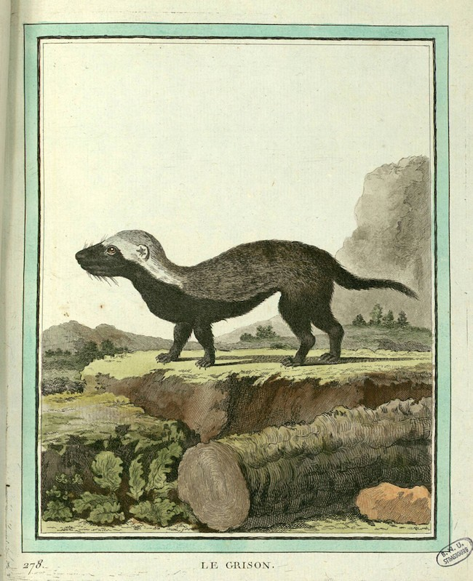
HONEY BADGER MINDSET
Fear whispers: "Pivot to safety. Diversify. Hedge."
That is what corporates would do. We all left them to build something meaningful.
The honey badger move is to attack. Double down on who we are, fix the packaging, manufacture the catalysts, and let the market validate what we already know about our portfolio.
10

Slide 11
We are not dying
CLOSING
We have runway, committed LPs, a proven thesis, and a portfolio that is pre-inflection, not failing.
This is not a crisis. This is a test.
The substance is right
8x Fund I. Sovereign compute thesis playing out. Defense pivot ahead of market. The packaging is wrong, not the product.
The hardest transition in fund management is micro to institutional. The mortality rate is high. But so is our conviction. We have done hard things before. We will do this one together.
We go forward together
No information asymmetry. Same numbers, same pressure, same mission. For us this is a life's work. That has not changed.
February 2026
11

