Slide 1
The "Stylo" Game
Developed by Stanislav Malyarchuk and Valeria Chernodolya, students of group 23931

Slide 2
The aim and the problems
The aim of this project is to create a game using the logic circuit design and modeling program “Logisim”, the processor “CdM 8” and the program CocoIDE, which writes assembly language programs for the processor.
According to the aim, it was necessary to solve the following problems:
To examine some games and their analogs and determine the direction of development;
To study the programs “Logisim”, “CocoIDE” and the assembly language;
To learn about the “CdM 8” processor, its commands and interaction with the development environment;
Define functional requirements.

Slide 3
The functional requirements
1. Controlled left-to-right movement of the car;
2. Uncontrolled movement of obstacles towards the player from top to bottom;
3. Keyboard control;
4. Scoring;
5. Playability;
6. Ability to pause and restart the game;
7. Speeding up and slowing down the car.

Slide 4

What is an arcade?

Slide 5
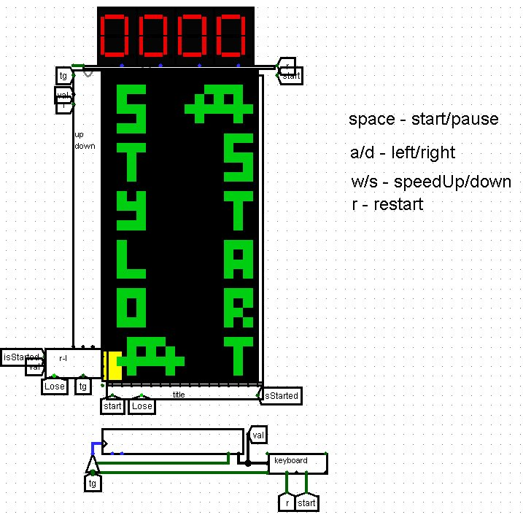
Screenshot of the “Main” circuit

Slide 6
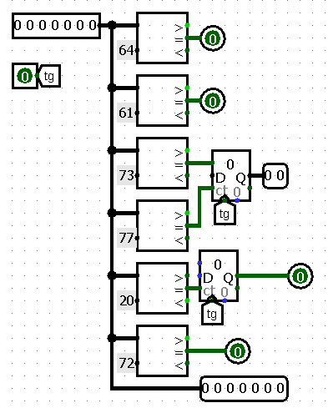
Screenshot of the “Keyboard” subcircuit

Slide 7
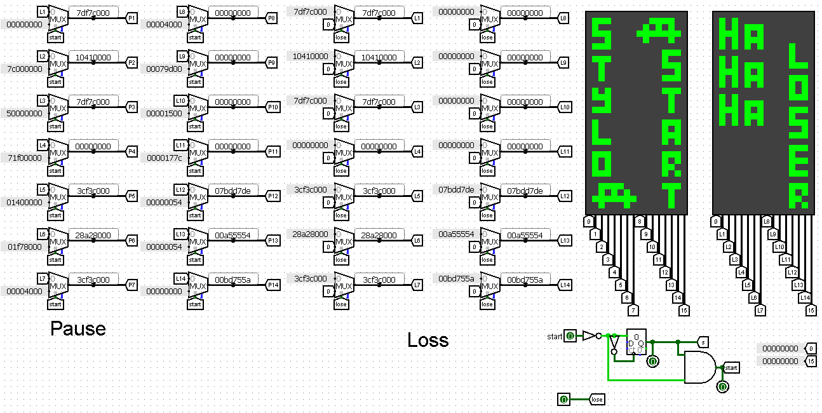
Screenshot of the “Title” subcircuit

Slide 8
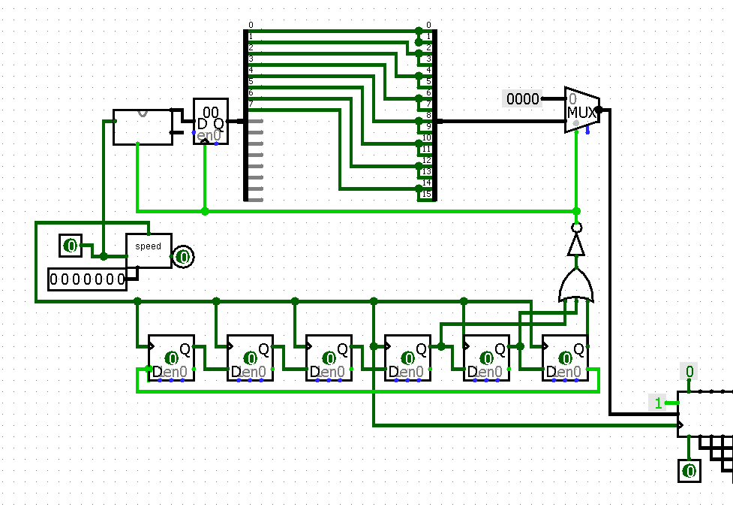
Screenshot of the “Up-down” subcircuit

Slide 9
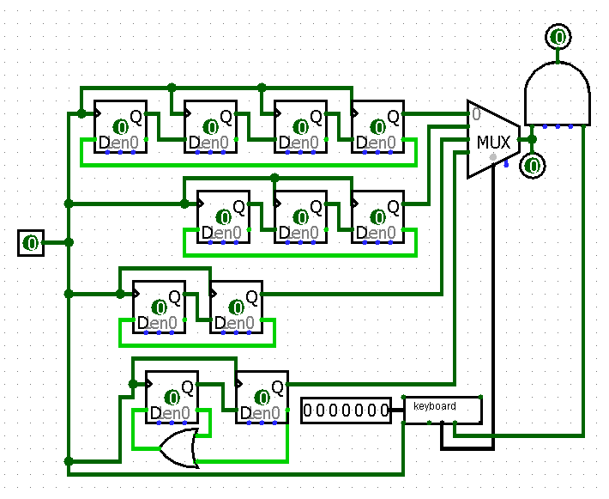
Screenshot of the “Faster-slower” subcircuit

Slide 10
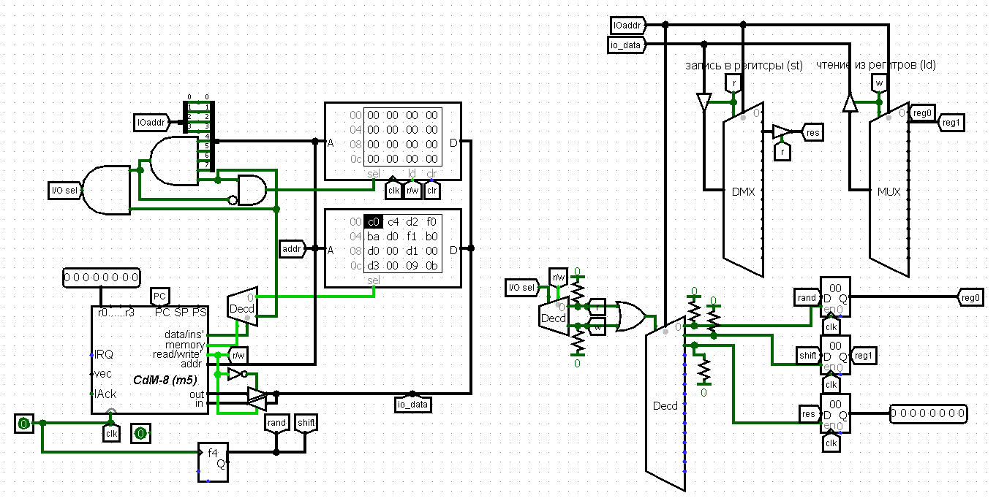
Screenshot of the “Harvard” subcircuit

Slide 11
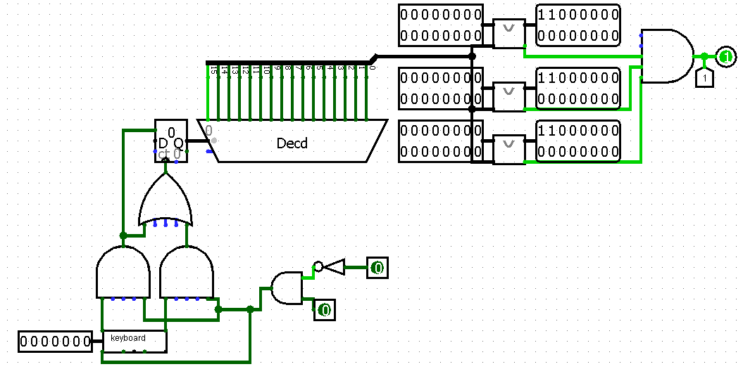
Screenshot of the “Right-left” subcircuit

Slide 12
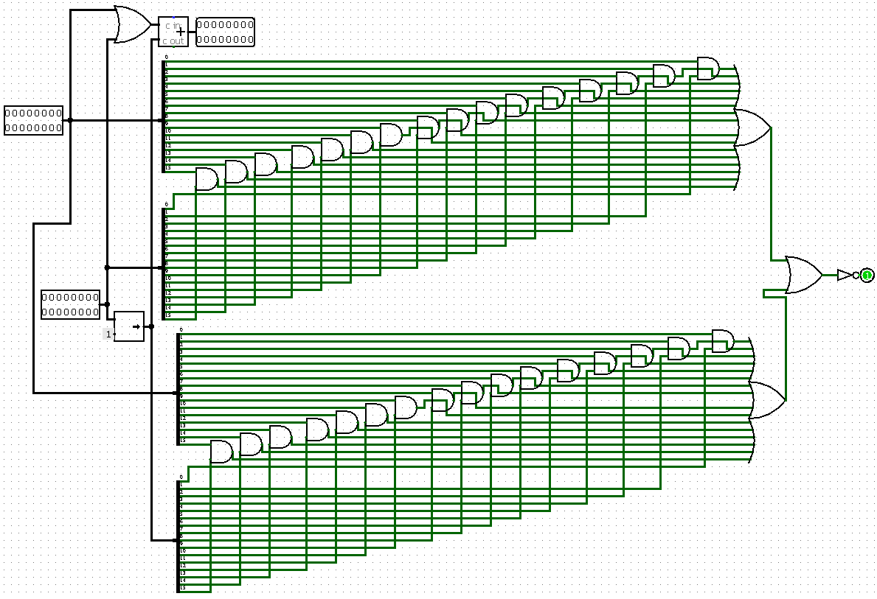
Screenshot of the “Collision” subcircuit

Slide 13
Conclusion
During the development of this project all the set tasks were achieved. The game “Stylo” was created with the help of logic circuits and processor “CdM 8” executing the required program. All the requirements stated were successfully realized. When creating this project, knowledge in the field of circuitry and working with the processor, namely the Harvard architecture, writing documentation for the project and experience of working in a team were gained.

