Slide 1
Scala
Aka cleaner java

Slide 2
Fast Facts
Scala is object-oriented but with more flexibility:
Allows for singletons (one object at a time) and allows you to add operations to existing classes even if they come from java
You can mix java and Scala classes throughout your programs
You can also use Java libraries, framework and tools in Scala
Functions are objects in Scala
Multithreaded code

Slide 3
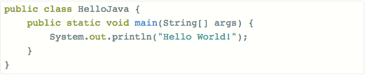
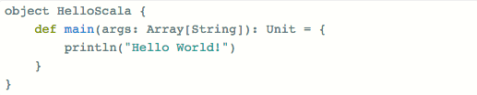
Java v Scala

Slide 4

Java v Scala

Slide 5
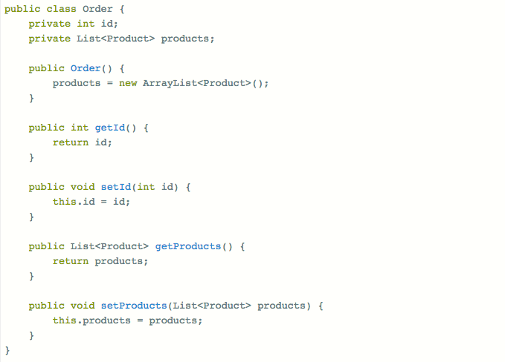
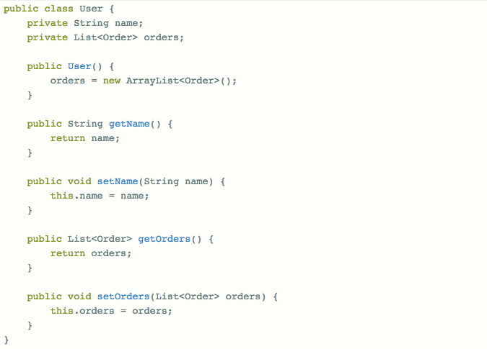
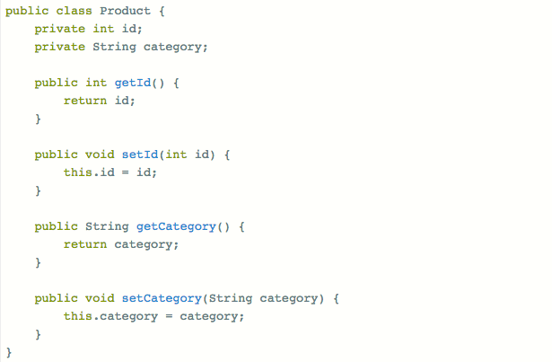
Java Classes

Slide 6
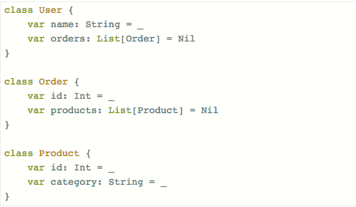
Scala Classes

Slide 7
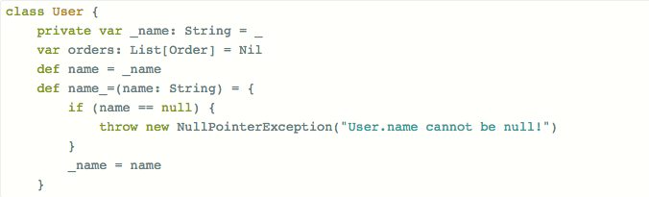
Scala Classes
There’s no need for getters & setters because you can add restrictions like this:

Slide 8

Scala Case Classes
Plain and immutable data holding objects
Implicitly defines equality comparisons

Slide 9
Collections
Simple way to store data with just a couple dozen methods needed to manipulate
Much more concise, allowing you to substitute multiple loops for just a line of code
Almost all errors caught by compiler
You can easily convert a sequential collection into a parallel one (for multi-thread processing)
val (minors, adults) = people partition (_.age < 18)
Partitions collection of people based on age quickly

Slide 10
Mutable & Immutable
Scala collections systematically distinguish between mutable and immutable
Collections in the package scala.collection.immutable are guaranteed to be immutable
Collections in the package scale.collection.mutable have some operations to change data
Collections in scala.collection can be either mutable or immutable:
collection.IndexedSeq[T] is a superclass of both collection.immutable.IndexSeq[T] and collection.mutable.IndexedSeq[T]
Usually the root in scala.collection is immutable

Slide 11
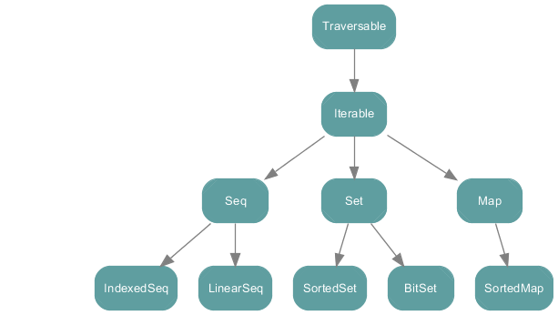
scala.collection

Slide 12
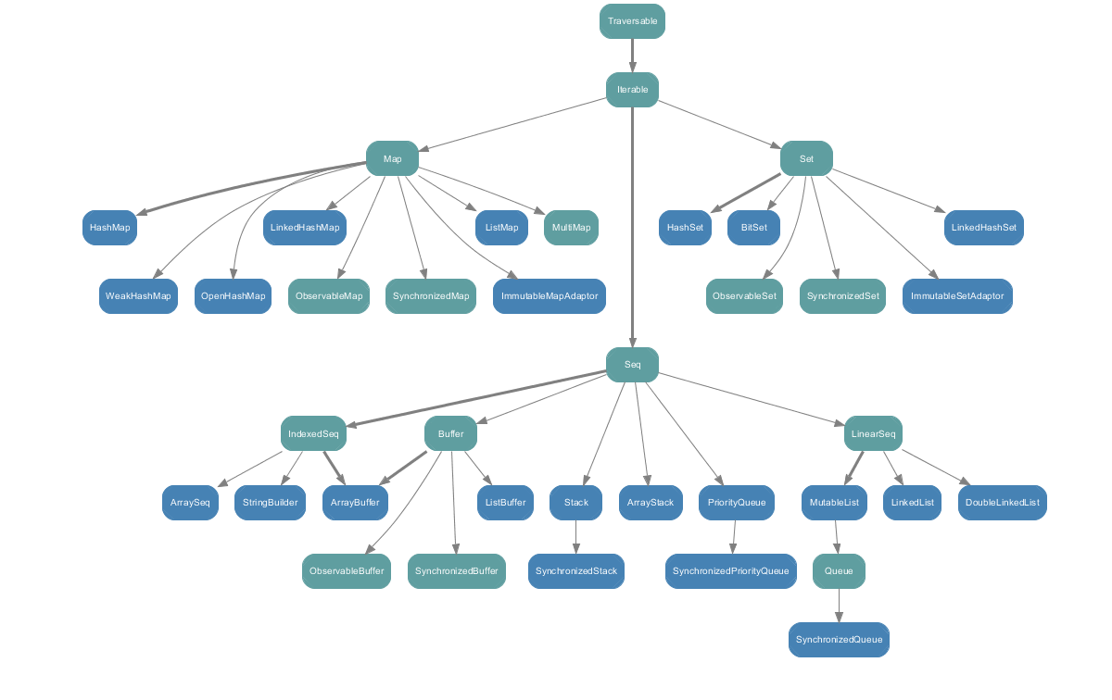
Scala.collection.mutable

Slide 13
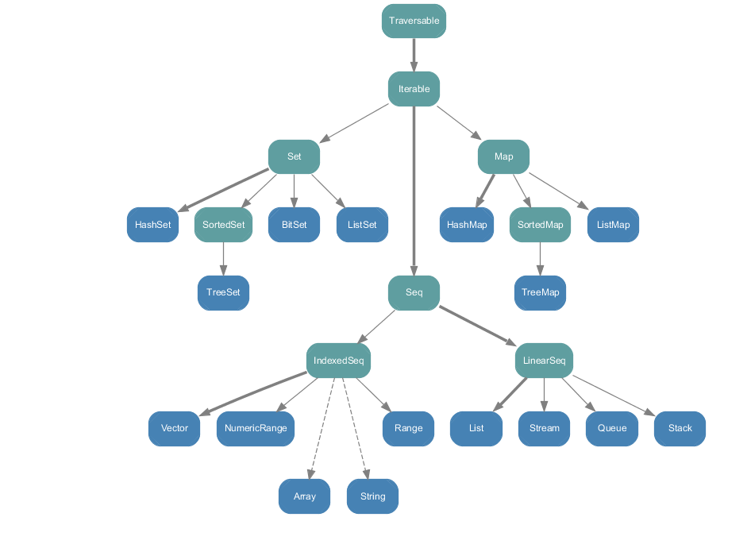
Scala.collection.immutable

Slide 14
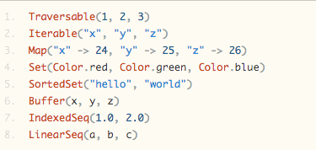
Implementation

Slide 15
Sequences
Sequences are iterables with a length and elements at fixed index positions, basically an array
Indexing and length operations: isDefinedAt, length, indices
Search operations: indexOf, lastIndexOf, indexOfSlice, indexWhere, prefixLength
Addition operations: +:, :+
Sorting operations: sorted, sortWith, sortBy
Comparisons: startsWith, endsWith, contains, corresponds
Multiset operations: intersect, diff, union, distinct

Slide 16
LinearSeq v. IndexedSeq
LinearSeq has efficient head and tail operations
IndexedSeq has efficent apply, length and update operations
Linear sequences are called lists sometimes and indexed sequences are called arrays

Slide 17
Buffers
Sub-category of mutable sequences
Also allows for element insertions, element removals, and efficient addition of elements at the end of the buffer

Slide 18
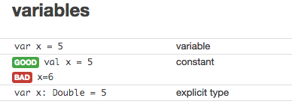
Variable Declaration

Slide 19
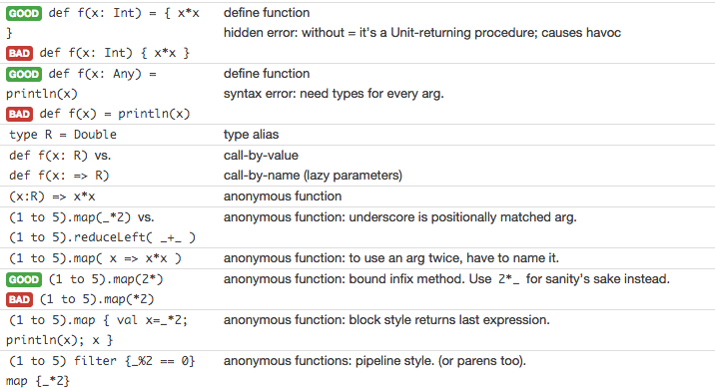
Functions

Slide 20
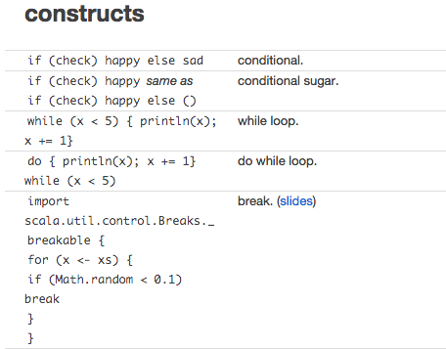

Slide 21
