Slide 1
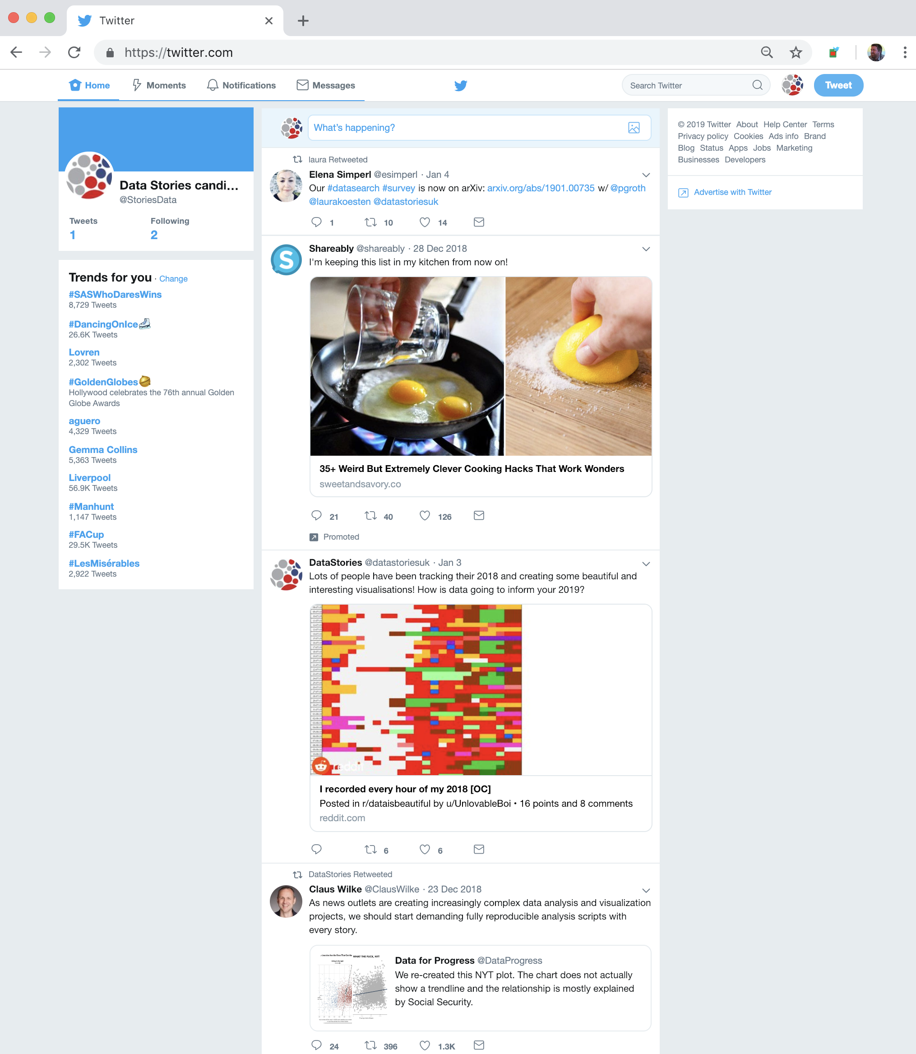
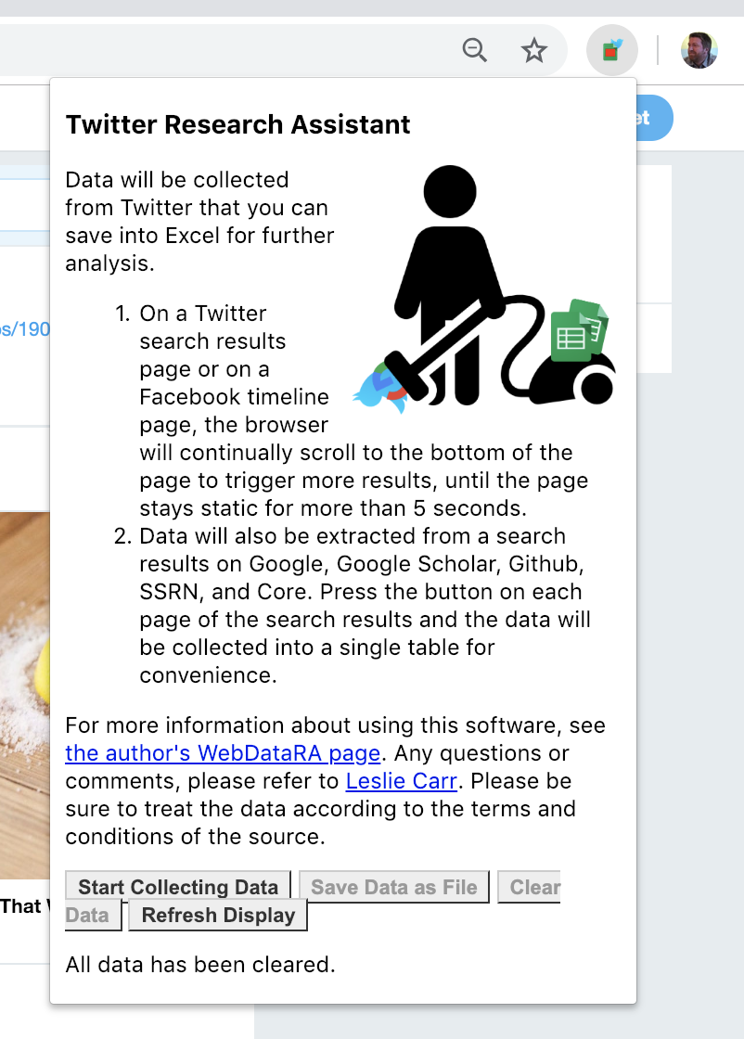
CONTENT PAGE
BACKGROUND PAGE
POPUP PAGE
update
STUFF
start
kickStart
scrollDown
scrollDown
clear
twitterpage
POPUP.JS
BACKGROUND.JS
twitteruser
helo
refresh
When the browser loads a twitter page, the extension injects the payload. It sends a helo message to the extension (background page), which either replies with kickStart(twitterpage) or kickstart(twitteruser). The extension works in two phases, (i) getting the original twitter data, and then (ii) the data from the profile pages of all the accounts mentioned in the first phase.
PAYLOAD.JS

