Slide 1

PROFESSIONAL PORTFOLIO
Lesego
Khaola
Educator Assistant & Community Volunteer
Westonaria, Gauteng, South Africa

Slide 2
01 / PROFILE
Who I am
I am an enthusiastic, self-motivated, reliable, responsible and hard-working person. I am a mature team worker and adaptable to all challenging situations. I can work well both in a team environment as well as using my own initiative — under pressure, with attention to detail and to strict deadlines.
LOCATION
Simunye Ext 4, Westonaria 1779
LANGUAGES
Setswana (home), English
AVAILABILITY
Educator assistant & admin roles

Slide 3
02 / EXPERTISE
Skills
01
Communication
02
Leadership
Clear, respectful conversation with learners, parents and staff.
Guiding groups of learners and volunteers through daily routines.
03
Problem solving
04
Writing
Practical solutions when plans or resources change.
Accurate reports, records and correspondence.

Slide 4
02 / EXPERTISE
Skills (continued)
05
Adaptability
06
Computer literacy
Comfortable across classroom, admin and community work.
Everyday digital admin, typing, records and documents.
07
Attention to detail
08
Time management
Careful grading, register keeping and record accuracy.
Meeting strict deadlines across several responsibilities.

Slide 5
03 / EDUCATION
Qualifications
Jan 2019 — Dec 2023
National Senior Certificate (Grade 12)
Kgothalang Senior Secondary School
SUBJECTS
English First Additional Language
Setswana Home Language
Life Orientation
Life Sciences
Tourism
History

Slide 6
04 / CERTIFICATION
Certifications
Educator Assistant Programme
2025
Basic Education Employment Initiative — Ipeleng Primary School
Completed a full placement cycle in classroom support and administration.
Community Volunteer Service
Ongoing
In His Presence Gospel Ministry
Recognised service in outreach, fundraising and youth support.

Slide 7
05 / EXPERIENCE
Educator Assistant
JUN 2025 — NOV 2025
Ipeleng Primary School
Classroom management and daily learner support.
Managing administrative duties including grading and records.
Providing extra help for students with special needs.

Slide 8
06 / COMMUNITY
Voluntary work
Community outreach
Church fundraising
Door-to-door support and care for families.
Organising and running fundraising events.
Homework supervision
Church upkeep
Helping learners complete daily homework.
Regular cleaning and preparation of the building.
Also: community gym instructor — leading fitness sessions and encouraging healthy habits.

Slide 9

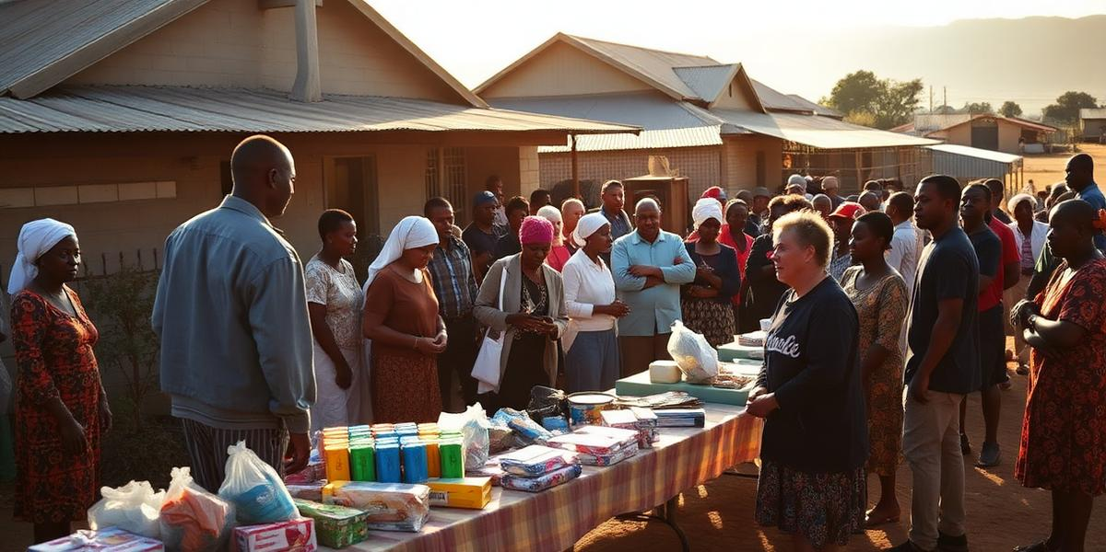
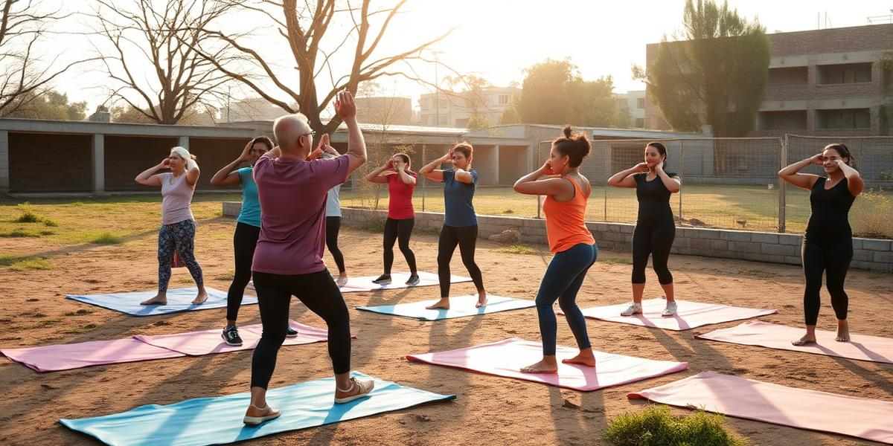
07 / SELECTED WORK
Projects
After-School Homework
Church Fundraising Drive
Community Fitness Sessions
Homework completed on time, with extra help.
Planning and running fundraising events for church programmes.
Leading group exercise and encouraging healthy habits.

Slide 10
08 / CONTACT
Let's work together
EMAIL
lesegokhaola@gmail.com
PHONE
072 993 6604 · 073 659 2311
ADDRESS
Simunye Ext 4, Westonaria 1779
References from Ipeleng Primary School and In His Presence Gospel Ministry available on request.

