Slide 1
Rock solid UI modeling using annotation processing
Case of study
@gdigugli
@jubaudry

Slide 2
Speakers
@gdigugli – Gilles Di Guglielmo
Java Developer since 1999
Software architect at
ILOG – IBM
2D Graphic toolkit
Rule Engine
Prima-Solutions
SOA Platform for J2EE
Domain models code generators
@jubaudry – Julien Baudry
Java Developer since 2007
Senior developer at
Prima-Solutions
SOA Platform for J2EE
Domain models code generators
Reinsurance software

Slide 3
Agenda
Context
Quick demo
Modeling approach
Dependency Model
Field features
Extensions
Live coding demo
Back to LesFurets.com

Slide 4
Context at LesFurets.com
5 questions sets for an insurance aggregator
Car form (160 questions)
Motorbike form (180 questions)
Health form (50 questions)
Home form (70 questions)
Loan form (40 questions)
A lot of questions with business rules linked by dependencies and business rules

Slide 5
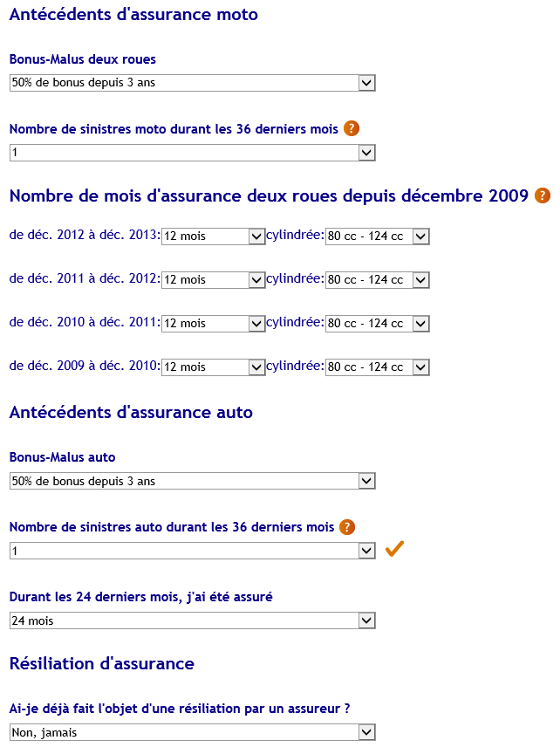
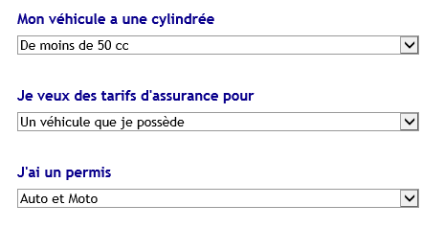
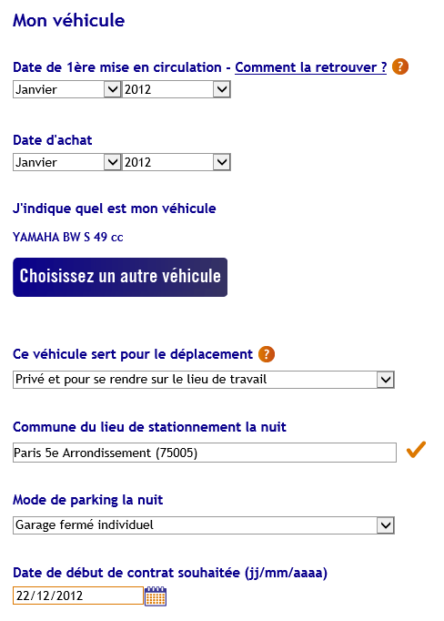
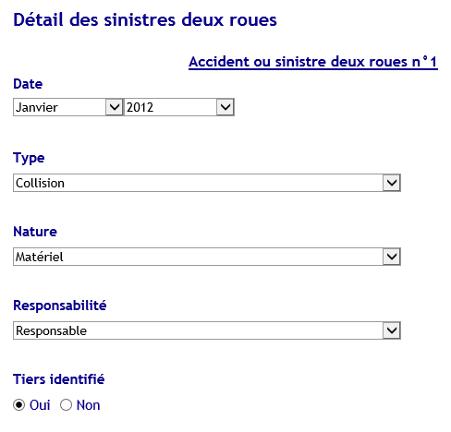
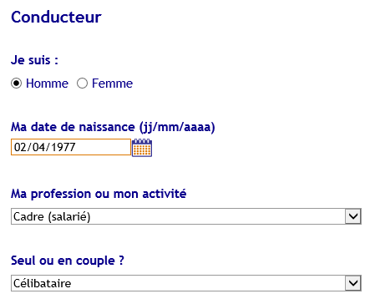
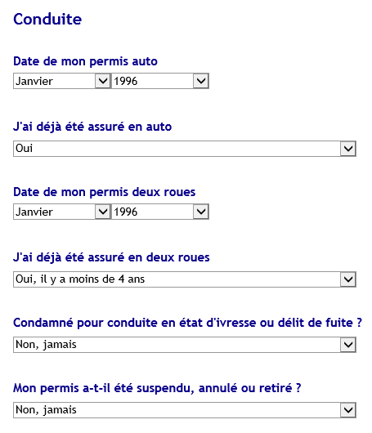
Sample : old question set for motorbike

Slide 6
Nature of dependencies
Visibility
I declare a claim -> question set for this child appears
Value range
I’ve been owning a car for one year -> constraint on the date for a claim should be later than the car’s purchase date
Reset
I change the number of occurred claims from 2 to 1 -> previous details of claim number 2 should be dropped
Validation
I change my date of birth -> I could not obtain my car license before being 18 years old

Slide 7
Complexity and bug hell
Historical design was based on a page scope
All the rules between fields were embedded in each page code
Business rules were directly written on the widget values without MVC pattern
Page navigation was triggering model updates that were sent to the server
Governance of the business rules between fields was difficult
Lots of side effects between rules
Improving or adding new rules provided a lot of regressions
Dependencies between fields was not documented
Adding new fields or shuffling the fields order required a lot of testing

Slide 8
The CSS ids : a limited starting point
All the form fields were still having a CSS class and an ID for CSS skinning
No real taxonomy
No guaranty that CSS ids are unique
Styling is evolving with his own constraints
Not the original purpose of CSS
Using CSS on web forms hides an implicit model that could be leveraged

Slide 9
Requirements
Ensuring non regression even with frequent changes on forms
No unexpected side effects between business rules
Make unit testing possible
Enabling a fast and up-to-date understanding of the form complexity
Reducing the maintenance effort
Supporting fields shuffle
Supporting AB testing

Slide 10
MDL4UI our OSS sandbox
Available on github
http://github.com/lesfurets/mdl4ui
Full framework and example
Based on GWT and Twitter bootstrap
Ready to fork and play
Requires Java 6+ and Maven
50 sec to build and run from scratch
WE ACCEPT PULL REQUESTS

Slide 11
Context
Quick demo
Modeling approach
Dependency model
Field features
Extensions
Live coding demo
Back to LesFurets.com

Slide 12
Context
Quick demo
Modeling approach
Dependency model
Field features
Extensions
Live coding demo
Back to LesFurets.com

Slide 13
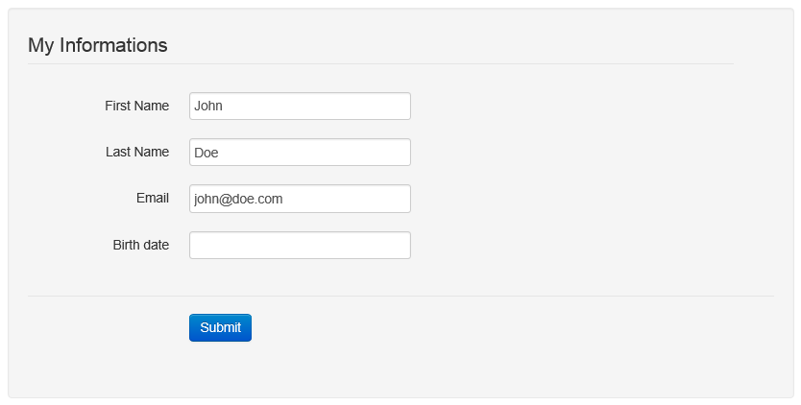
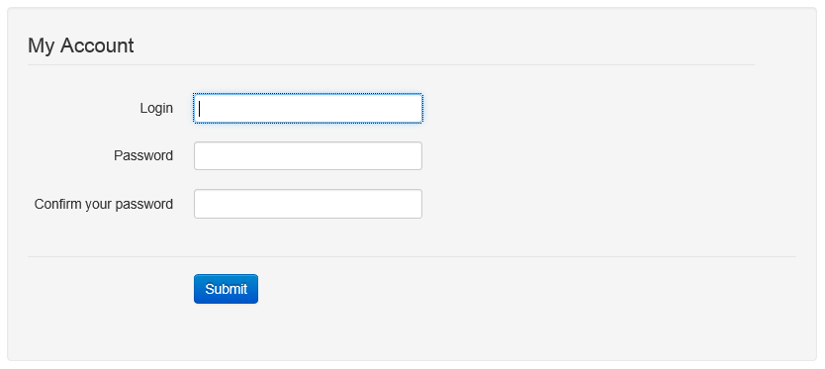
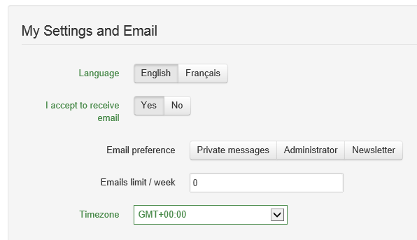
MDL4UI model concepts
Screen

Slide 14
MDL4UI model concepts
Blocks

Slide 15
MDL4UI model concepts
Groups

Slide 16
MDL4UI model concepts
Fields

Slide 17
Introducing MDL4UI model layers
FieldID – GroupID – BlockID – ScreenID - ScenarioID
MetaModel
Customization layer
EFieldSample – EGroupSample – BlockSample - EScreenSample
Model
Field – Group – Block - Screen
Model Instance (runtime)
FieldView – GroupView – BlockView - ScreenView
View of the MVC pattern (runtime)

Slide 18
FieldID – GroupID – BlockID – ScreenID - ScenarioID
MetaModel
We define a UI MetaModel, and all concept for other layers.

Slide 19
Customization layer
EFieldSample – EGroupSample – BlockSample - EScreenSample
Model
We define our UI model (screens, fields, etc.), only using enumerations.

Slide 20
Field – Group – Block - Screen
Model Instance (runtime)
We instantiate our UI model, with i18n resources injected.

Slide 21
FieldView – GroupView – BlockView - ScreenView
View of the MVC pattern (runtime)
We instantiate all HTML widgets from a UI model instance, using GWT and twitter bootstrap frameworks.

Slide 22
From the point of view of a screen
Model
MetaModel
Model Instance (runtime)
View of the MVC pattern (runtime)

Slide 23
From the point of view of a field
Model
MetaModel
Model Instance (runtime)
View of the MVC pattern (runtime)

Slide 24
Implementing the model

Slide 25
Why modeling as code ?
Sorry we are Java developers
Built-in continuous integration for the model
No code generation required to implement the model
Modeling concept understanding is not required
Modeling stack is transparent for UI development
Tooling is very fast
Memory footprint is very low
A lot of consistency checking is done by the compiler
More benefits to come in the next slides …

Slide 26
Context
Quick demo
Modeling approach
Dependency Model
Field features
Extensions
Live coding demo
Back to LesFurets.com

Slide 27
We need a dependency graph
Implementing business rules involves triggering the behaviors using a dependency model
No semantics on the dependency
Fields receive dependency events with source attribute
Each field implements various features to react to dependency events
Visibility of the fields
Value range definition
Reset of value
Validation of value

Slide 28
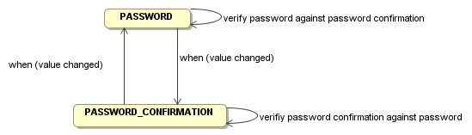
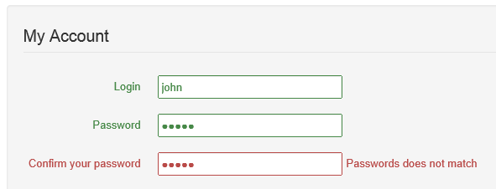
Validation dependency

Slide 29
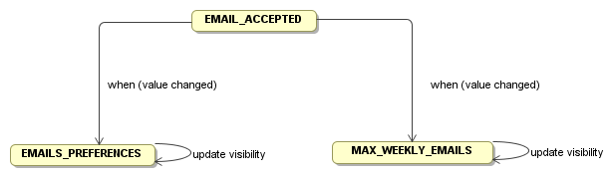

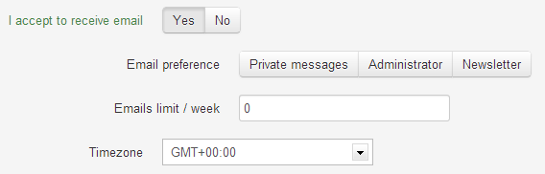
Visibility dependency

Slide 30
In code declarative dependencies modeling
Implemented using enumerations
Only direct dependency between fields
Reference one field as source
Reference multiple fields as targets

Slide 31
Dependencies processing
Declared
dependencies
Dependencies
graph
Deep dependencies resolved
A
A –> B
B –> D
D –> A
C –> D
A –> B,D
B –> D,A
D –> A,B
C –> D,A,B
B
C
D
Hand written code
Underlying model
Generated code

Slide 32
Deep dependency, dependency cycle, graph validation
Cycle declaration between fields is allowed
Deep dependencies are statically resolved
For each field the deep dependencies are generated during the compilation
Model declared in EFieldDependency[Sample]
Deep dependency are generated in EFieldDeepDependency[Sample]
Dependency order is not guaranteed
No runtime infinite loop

Slide 33
Simple dependency API
public interface FieldDependencyFactory {
FieldID[] get(FieldID fieldId);
}
Implementation is generated by our maven plugin
Graph is built from the FieldDependency declaration
Deep dependencies are statically resolved for each field
Look at the implementation EFieldDeepDependency[Sample]
No runtime computation of the dependencies
Safe and efficient

Slide 34
Code generation using a maven custom plugin
Model interfaces
Model declaration
Mdl4ui-base
Mdl4ui-model
Model interfaces
Model declaration
Implements a java code generator
XMI export of the model from code
Computes the deep dependencies graph
Based on the maven project compilation classpath
Mdl4ui-maven
Executes the MDL4UI maven plugin
Loads previously compiled model in Mdl4ui-model
Generates the graph as code
Compiles the generated code
Mdl4ui-fields

Slide 35
Walkthrough the model in a maven plugin
void lookOver(ElementID parentId) {
for (ElementID childId : parentId.childs()) {
if (childId.elementType() == GROUP ||
childId.elementType() == BLOCK)
lookOver(childId);
else
System.out.println("field :" + childId);
}
}
Simple tree API to explore the structure
Easy use of recursive algorithms

Slide 36
Maven plugin declaration
Model instance is available in the maven project classpath through the maven dependencies
We load the model from the screens elements
<plugin>
<groupId>org.mdl4ui</groupId>
<artifactId>mdl4ui-maven</artifactId>
<executions>
<execution>
<id>generate-model</id>
<phase>process-classes</phase>
<goals>
<goal>generateModel</goal>
</goals>
<configuration>
<screenClasses>
<screenClasse>org.mdl4ui.ui.sample.EScreenSample</screenClasse>
</screenClasses>
</configuration>
</execution>
….

Slide 37
Context
Quick demo
Modeling approach
Dependency Model
Field features
Extensions
Live coding demo
Back to LesFurets.com

Slide 38
Goal and inspiration
UI logic is often synonym of spaghetti code
Decoupling UI and logic is often difficult to implement
Slicing the logic in tiny pieces of code is the key for :
Testability
Governance
Inspiration
MVC (client side)
JavaBean
BeanValidation
Injection, CDI, Guice, Dagger
Browser runtime using JavaScript is a heavy constraint
Inversion of control is difficult to implement

Slide 39
Features provided by fields
FieldInitializer
Initialize default value and range
FieldEditor
MVC pattern to sync the model during form completion
Validation during form completion
Reset after visibility changes
FieldBehaviour
Visibility update
Dependency update
Labeling
Attached widget labels, help messages, place holders

Slide 40
FieldInitializer API
public interface FieldInitializer {
void init(Field field,
FieldEvent event);
}
Initialize the field during the bootstrap of the application

Slide 41
FieldEditor API
WizardContext is the entry point of the domain model for the MVC pattern
updateFromContext and updateContext read and update the domain model of the MVC pattern
reset is called after a field is hidden or a value change from a dependency
public interface FieldEditor {
void updateFromContext(Field field, WizardContext context,
FieldEvent fieldEvent);
void updateContext(Field field, WizardContext context,
FieldEvent fieldEvent);
void reset(Field field, WizardContext context,
FieldEvent fieldEvent);
FieldValidation validate(Field field, WizardContext context,
FieldEvent fieldEvent);
}

Slide 42
FieldBehaviour API
public interface FieldBehaviour {
boolean isVisible(FieldID fieldId,
WizardContext context,
FieldEvent fieldEvent);
void updateValue(Field field,
WizardContext context,
FieldEvent event);
}
isVisible returns the visibility following the value of the domain model
updateValue is triggered by the dependency management

Slide 43
Declaring a feature of a field
@InjectSampleBehaviour(
@OnField({ EFieldSample.EMAILS_PREFERENCES,
EFieldSample.MAX_WEEKLY_EMAILS }))
public class AcceptEmailsBehaviour extends DefaultBehaviour {
@Override
public boolean isVisible(FieldID fieldId, WizardContext context,
FieldEvent fieldEvent) {
SampleContext sampleContext = (SampleContext) context;
Boolean acceptEmail = sampleContext.getUserAccount().isAcceptEmail();
return acceptEmail != null && acceptEmail;
}
}

Slide 44
Injecting the field features with annotations and meta annotation
Meta annotation | Custom annotation | Injected resource
@InjectInit | @InjectSampleInit Reference one or more EFieldSample | Any class implementing FieldInitializer
@InjectEditor | @InjectSampleEditor Reference one or more EFieldSample | Any class implementing FieldEditor
@InjectBehaviour | @InjectSampleBehaviour Reference one or more EFieldSample | Any class implementing FieldBehaviour
@InjectLabel | @InjectSampleLabel Reference one or more EField, EGroup, EBlock and EScreen[Sample] | Any interface method without parameter returning a String
@InjectHelp | @InjectSampleHelp Reference one or more EField, EGroup, EBlock and EScreen[Sample] | Any interface method without parameter returning a String
@InjectPlaceHolder | @InjectSamplePlaceHolder Reference one or more EField, EGroup, EBlock and EScreen[Sample] | Any interface method without parameter returning a String

Slide 45
The plumbing using APT
We use Annotation Processing Tool to bind together the various field features and the fields
APT is a standard tooling packaged with the JDK since Java 6
Allows to generate source code and resources in the source path of the compiler during the early stage of the compilation process
Source code processing based on javax.lang.model API
Code processing is triggered by annotation
No built-in code generator
Use basic template mechanism to simplify source code generation

Slide 46
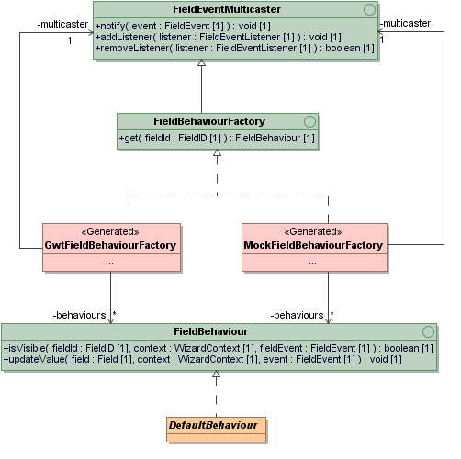
Generated pattern to glue things together
Code generation is triggered by @InjectBehaviour
APT processor is executed during the compilation of Mdl4ui-field project
We perform some validations, like detecting duplicated injections
We use a factory pattern returning the right instance for each field
An implementation for GWT client runtime purpose
A mock implementation GWT less for unit testing purpose

Slide 47
Replicate the factory pattern for each feald feature
Meta annotation | Feature factory
@InjectInit
@InjectEditor
@InjectBehaviour
@InjectLabel
@InjectHelp
@InjectPlaceHolder

Slide 48
Context
Quick demo
Modeling approach
Dependency Model
Field features
Extensions
Live coding demo
Back to LesFurets.com

Slide 49
Content of MDL4UI
Mdl4ui-I18n : foundation framework for text resource injection, containing APT processors and annotations
Mdl4ui-base: foundation framework for the UI model interfaces, containing APT processors and annotations
Mdl4ui-model: model instance for our code sample, including fields and dependencies
Mdl4ui-maven: maven plugin part of the foundation framework that generate and check the dependency graph between the fields, export the model in XMI
Mdl4ui-fields: business rules, validation and field editors (MVC pattern) for our sample
Mdl4ui-webapp: the web application that assembles the code, compiles various resources with GWT and adds styling
[INFO] Reactor Summary:
[INFO]
[INFO] mdl4ui-root ....................................... SUCCESS [0.375s]
[INFO] mdl4ui-i18n ....................................... SUCCESS [1.921s]
[INFO] mdl4ui-base ....................................... SUCCESS [0.829s]
[INFO] mdl4ui-model ...................................... SUCCESS [2.860s]
[INFO] mdl4ui-maven ...................................... SUCCESS [1.641s]
[INFO] mdl4ui-fields ..................................... SUCCESS [4.751s]
[INFO] mdl4ui-webapp ..................................... SUCCESS [39.632s]
[INFO] ------------------------------------------------------------------------
[INFO] BUILD SUCCESS
[INFO] ------------------------------------------------------------------------
[INFO] Total time: 52.166s

Slide 50
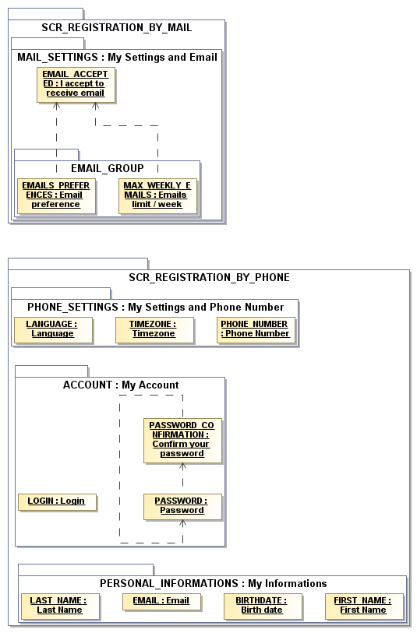
Generate UML to understand the model
Use to document the model and specify evolution
Visualize the dependency graph
Generated as an artifact of the continuous integration as artifact
MDL4UI | UML
ScreenID | Package
BlockID | Package
GroupID | Package
FieldID | Instance specification
FieldLabel | Class
FieldDependency | Dependency

Slide 51
Field tracking
Use field features to track
Field inputs
Field validation errors
Screen and block navigation
Use of tracking results
Find common user profiles
Improve forms for faster input
Find ergonomic issues

Slide 52
AB testing and shuffling the fields
Define two versions of a webpage (A and B)
Split traffic amongst those versions
Determine which one was more successful
Validate any new design
Improve your conversion rate
How it can be done?
Define new fields and new FieldBehaviour
Define two different scenarios

Slide 53
Unit testing
Need to test fields using regression tests:
validation rules
field visibility update
domain model read & update
domain model reset
Generated mock factories allow to execute features implementation without a web application container (GWT)

Slide 54
Unit testing
@Test
public void dependencies() {
FieldDependencyFactory dependencyFactory
= new FieldDependencySampleFactory();
Collection<FieldID> dependencies = Arrays.asList(dependencyFactory.get(EMAIL_ACCEPTED));
assertEquals(2, dependencies.size());
assertTrue(dependencies.contains(EMAILS_PREFERENCES));
assertTrue(dependencies.contains(MAX_WEEKLY_EMAILS));
}

Slide 55
Unit testing
@Test
public void visibility() {
FieldDependencyFactory dependencyFactory = new FieldDependencySampleFactory();
MockFieldBehaviourFactory behaviourFactory = new MockFieldBehaviourFactory();
SampleContext context = new SampleContext();
for (FieldID dependency : dependencyFactory.get(EMAIL_ACCEPTED)) {
FieldBehaviour behaviour = behaviourFactory.get(dependency);
context.getUserAccount().setAcceptEmail(false);
assertFalse(behaviour.isVisible(dependency, context, null));
context.getUserAccount().setAcceptEmail(true);
assertTrue(behaviour.isVisible(dependency, context, null));
}
}

Slide 56
Selenium and integration testing
Selenium is a test automation framework for web applications
sends commands to a browser
retrieves results (parsing the DOM)
Supports:
Java, Ruby, Python, C#, etc.
Firefox, Chrome, IE, iOS & Android browsers, etc.

Slide 57
Selenium and integration testing
Generation of page object classes
representing a screen or a block with selenium framework
exposing methods to manipulate each fields
Make testing easier
hide selenium framework complexity
minimize the test maintenance effort

Slide 58
Selenium and integration testing
@Test
public void testRegistration() {
RegistrationByMailScreen registrationScreen
= new RegistrationByMailScreen(getDriver());
registrationScreen.assertDisplayed();
registrationScreen.getPersonalInformations()//
.assertDisplayed()//
.setFirstName("John")//
.setLastName("Doe")//
.setBirthdate(new DateMidnight(1980, 1, 1))//
.setEmail("john@doe.com")//
.submit();
registrationScreen.getMailSettings().assertDisplayed;
}

Slide 59
Context
Quick demo
Modeling approach
Dependency Model
Field features
Extensions
Live coding demo
Back to LesFurets.com

Slide 60
Context
Quick demo
Modeling approach
Dependency Model
Field features
Extensions
Live coding demo
Back to LesFurets.com

Slide 61
Refactoring and Agile practice
Opportunity based
12 iterations with production deployment
1 year of step by step refactoring
Test coverage from 10% to 50% (in progress)
Automated testing on more than 400 fields in 5 complex forms

Slide 62
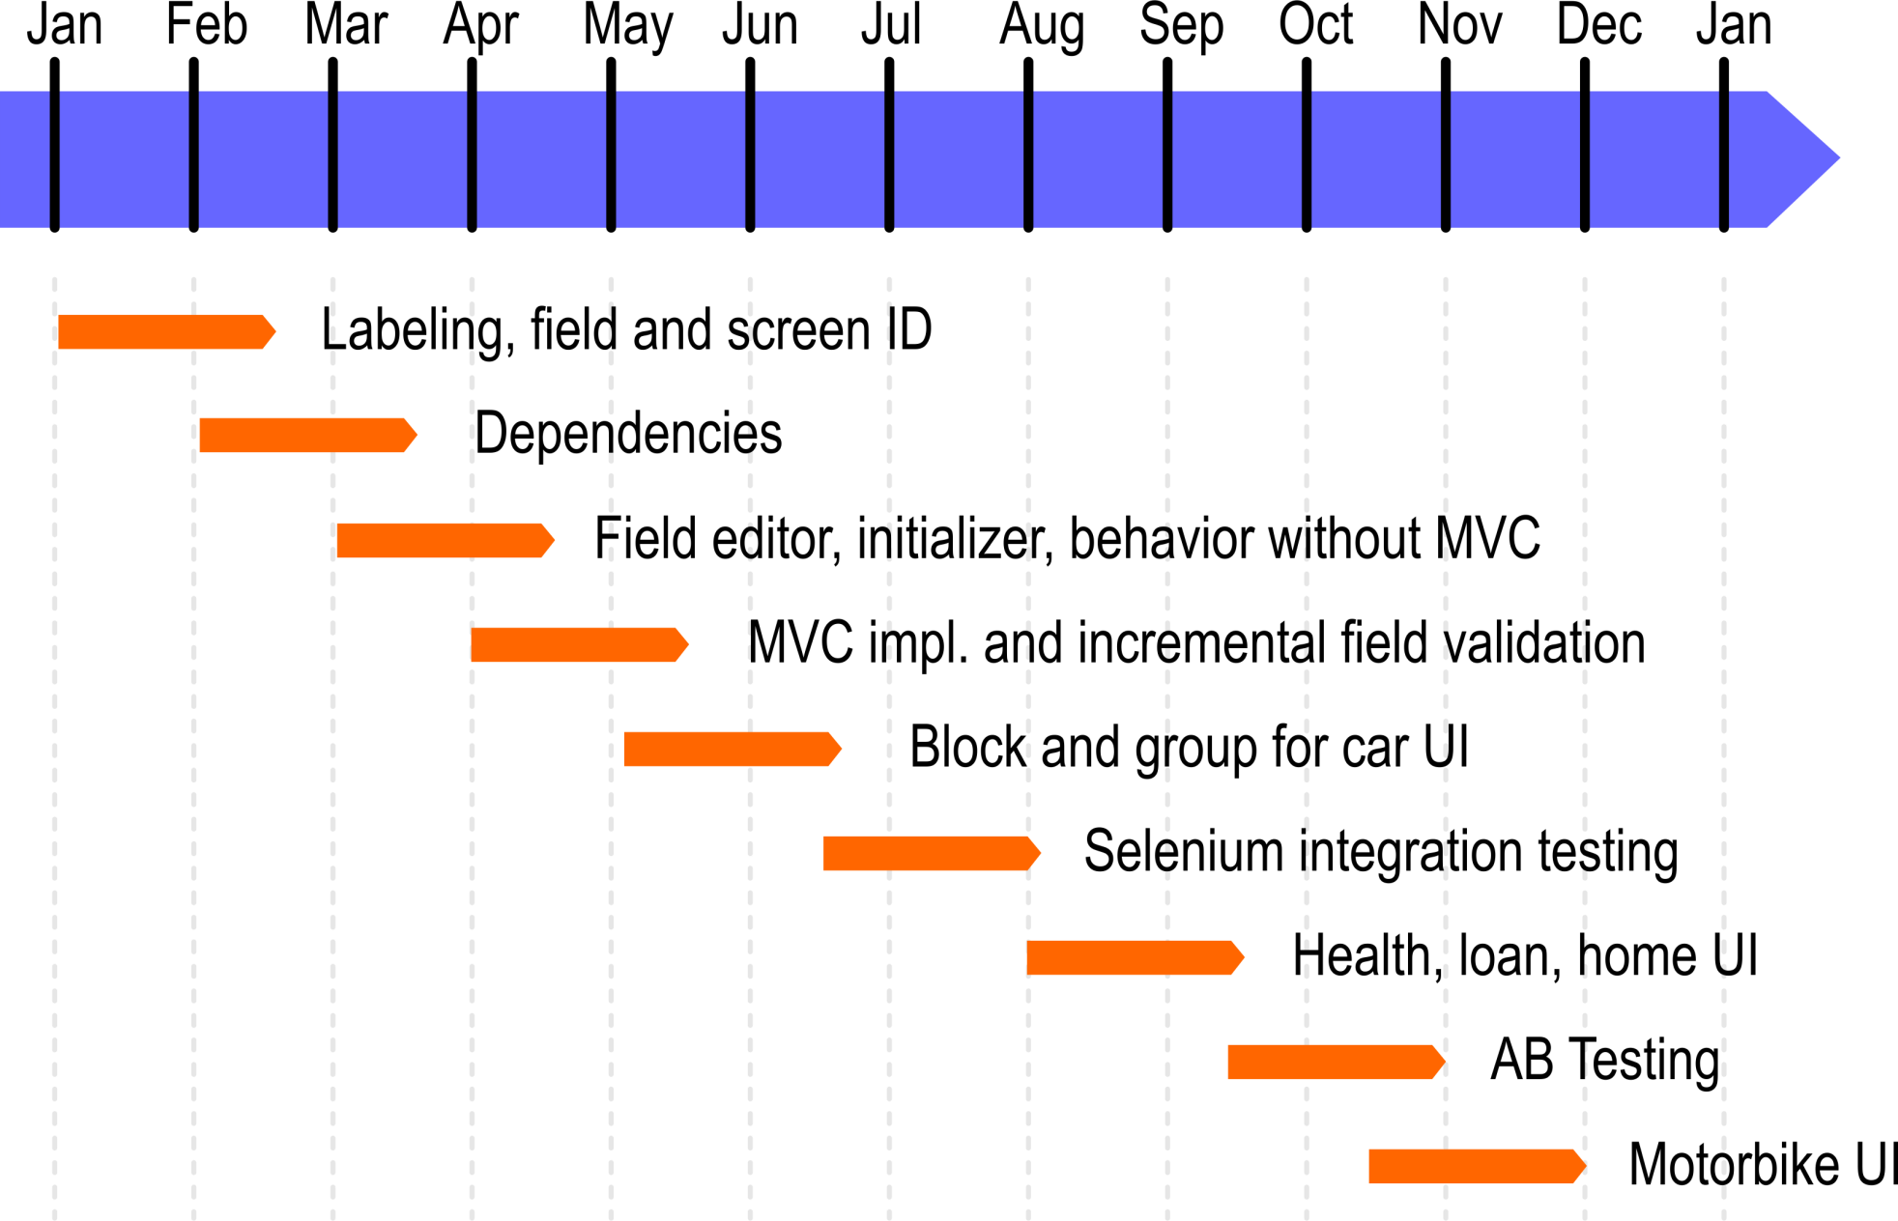
Project implementation timeline

Slide 63
Under investigation
Multi Variable Testing
Machine learning algorithm on field tracking
Dynamic shuffling of the fields order
Adaptive path for the forms completion

Slide 64
Enjoy MDL4UI

