Slide 1
EU MONITOR
European politics. Actually worth knowing.
A fortnightly European politics briefing for people under 30 —
built on a monitoring system that watches the EU institutions so nobody has to.
Concept deck
2026
Notes:
Opening line: "The code watches Europe. I decide what matters. Substack explains it. Instagram makes it accessible." Keep the intro to twenty seconds — the deck does the rest.

Slide 2
THE PROBLEM
The EU publishes everything.
Almost none of it reaches anyone.
240 INSTITUTIONAL PUBLICATIONS IN ONE FORTNIGHT
The Commission, Parliament, Council, the agencies and the Court between them put out hundreds of documents a fortnight. Almost all of it is procedural. A small amount of it changes something real for a 22-year-old.
Nobody has time to find out which is which — so most people under 30 simply do not follow European politics at all, and then find out about it when it has already happened to them.
5 OF THEM ARE WORTH YOUR TEN MINUTES
EU MONITOR
02
Notes:
The dot grid is the whole argument. Do not read the body text aloud — point at the five blue squares and say "that is the problem".

Slide 3
THE IDEA
A fortnightly briefing that finds the five things
that actually matter — and explains why.
01
The code watches Europe.
Fifteen institutional feeds, continuously, in the background.
02
I decide what matters.
A human reads the flags and cuts twenty items down to five.
03
Substack explains it.
Ten minutes, every fortnight, with the primary source on every claim.
04
Instagram makes it accessible.
The same research, cut for a scroll rather than a sit-down.
EU MONITOR
03
Notes:
Four sentences is the whole concept. If someone only remembers one slide, this is the one.

Slide 4
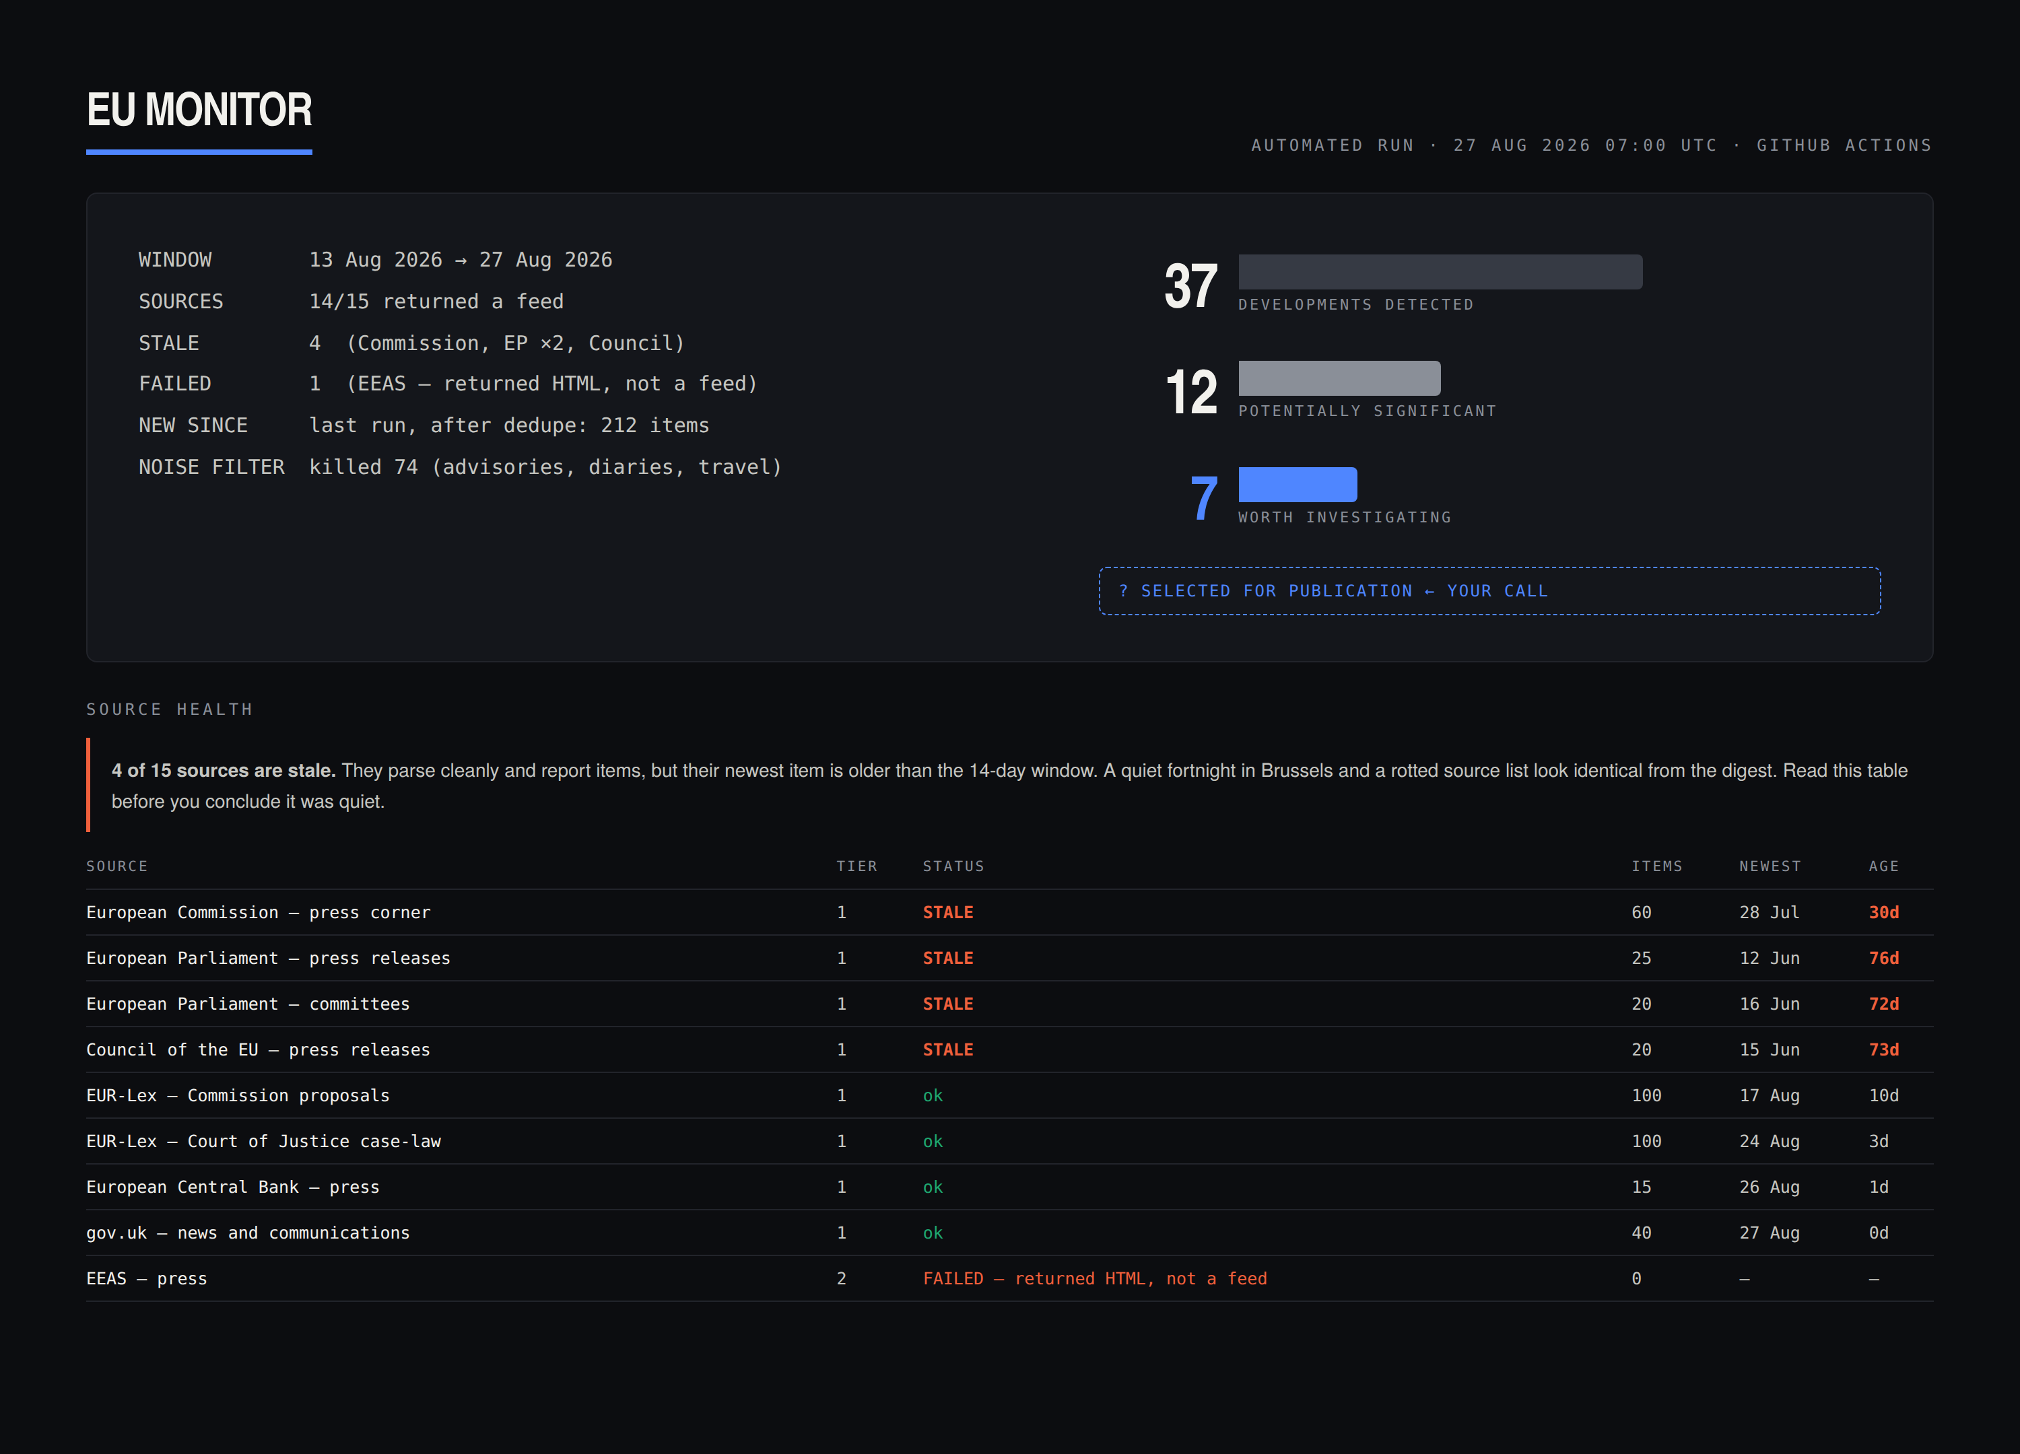
THE ENGINE
What you come back to
after two weeks.
The monitor runs on GitHub Actions on the 1st and 15th, with a source health check every Monday. It fetches, parses, drops what it has already seen, scores what is left, and writes a digest.
It reports how many sources are stale as prominently as it reports what it found — because a rotted source list and a quiet fortnight in Brussels look identical from the digest.
STANDARD-LIBRARY PYTHON · NO DEPENDENCIES · NO API KEYS
EU MONITOR
04
Notes:
Point at the source-health warning, not the numbers. "Four of fifteen feeds had published nothing in weeks. The system tells me that. Nothing else I looked at does."

Slide 5
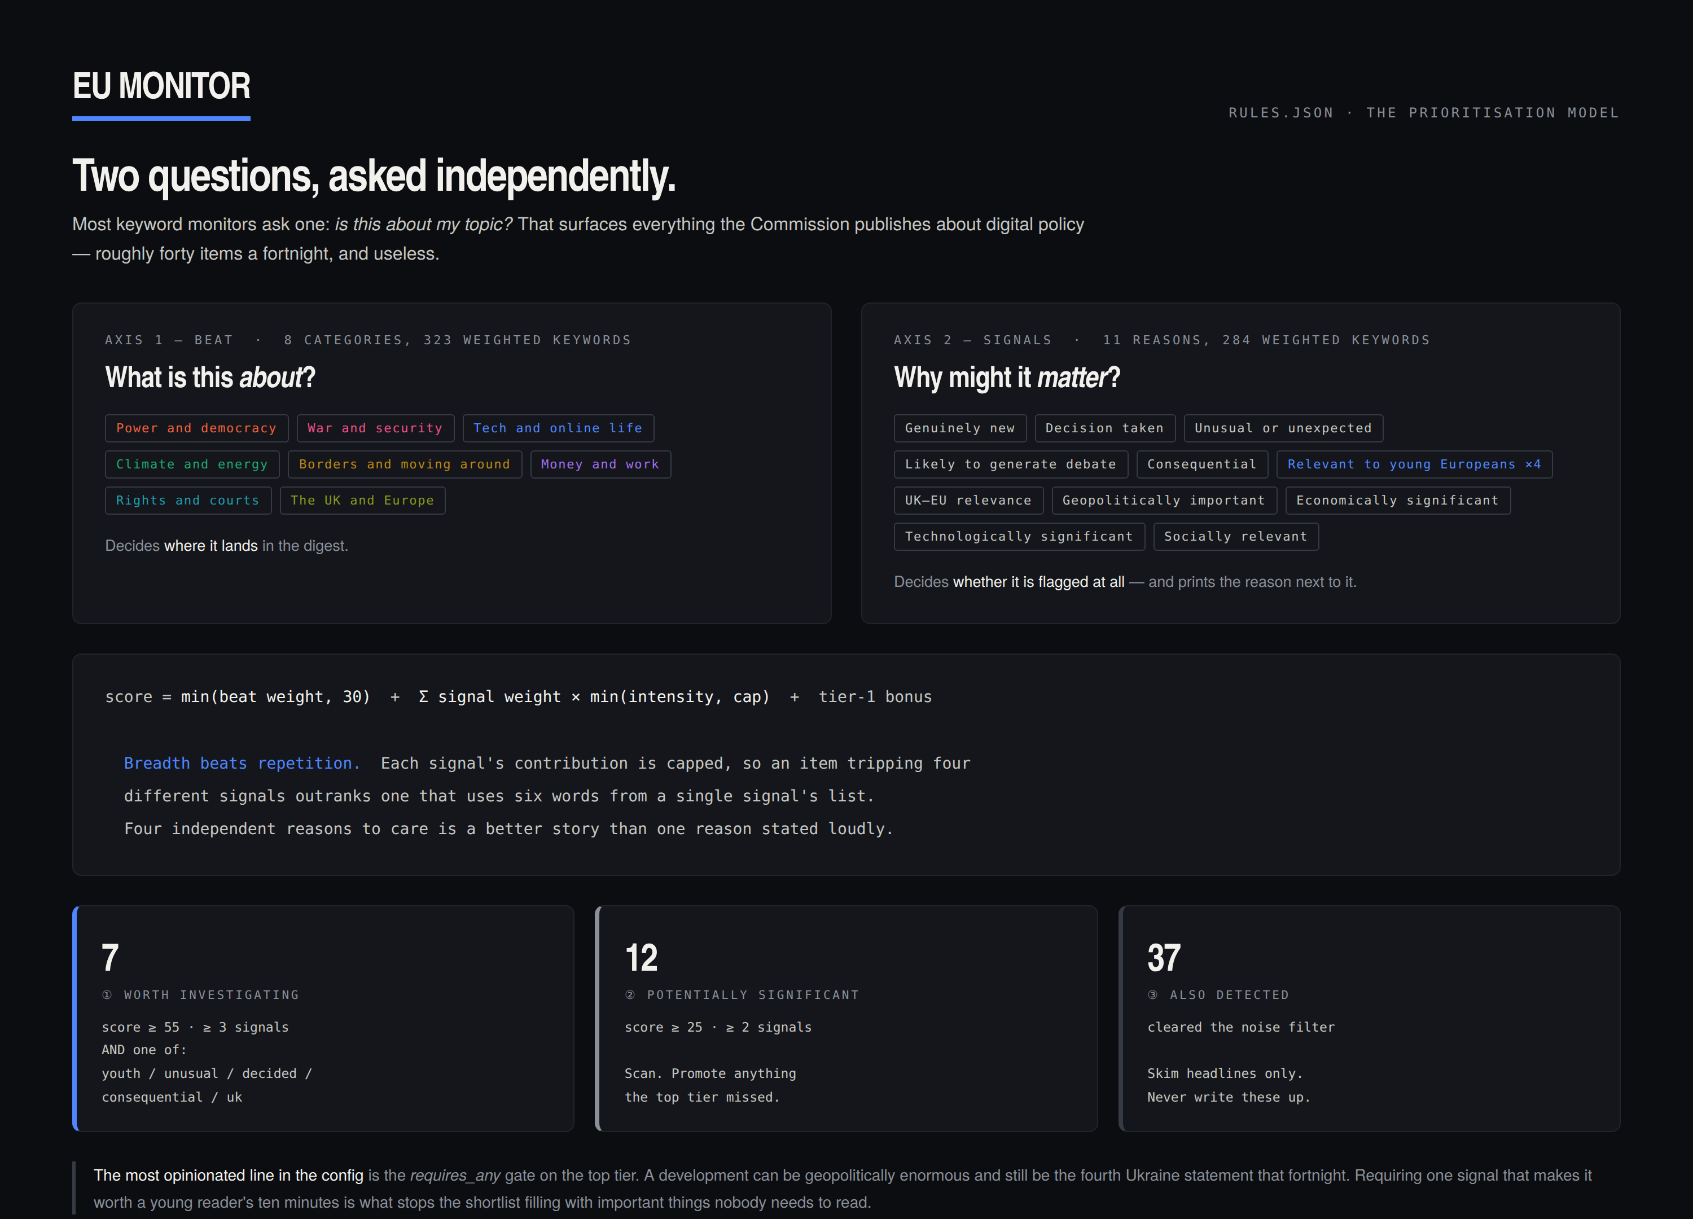
HOW IT DECIDES WHAT MATTERS
Two questions,
asked independently.
Most keyword monitors ask one: is this about my topic? That surfaces everything the Commission publishes about digital policy — forty items a fortnight, and useless.
This asks what a development is about and, separately, why it might matter. The second answer is printed next to every flag, so the review list explains itself.
8 BEATS · 11 SIGNALS · 607 WEIGHTED KEYWORDS
EU MONITOR
05
Notes:
The line that lands with technical audiences: "breadth beats repetition — four independent reasons to care outrank one reason stated loudly." That is a design decision, not a default.

Slide 6
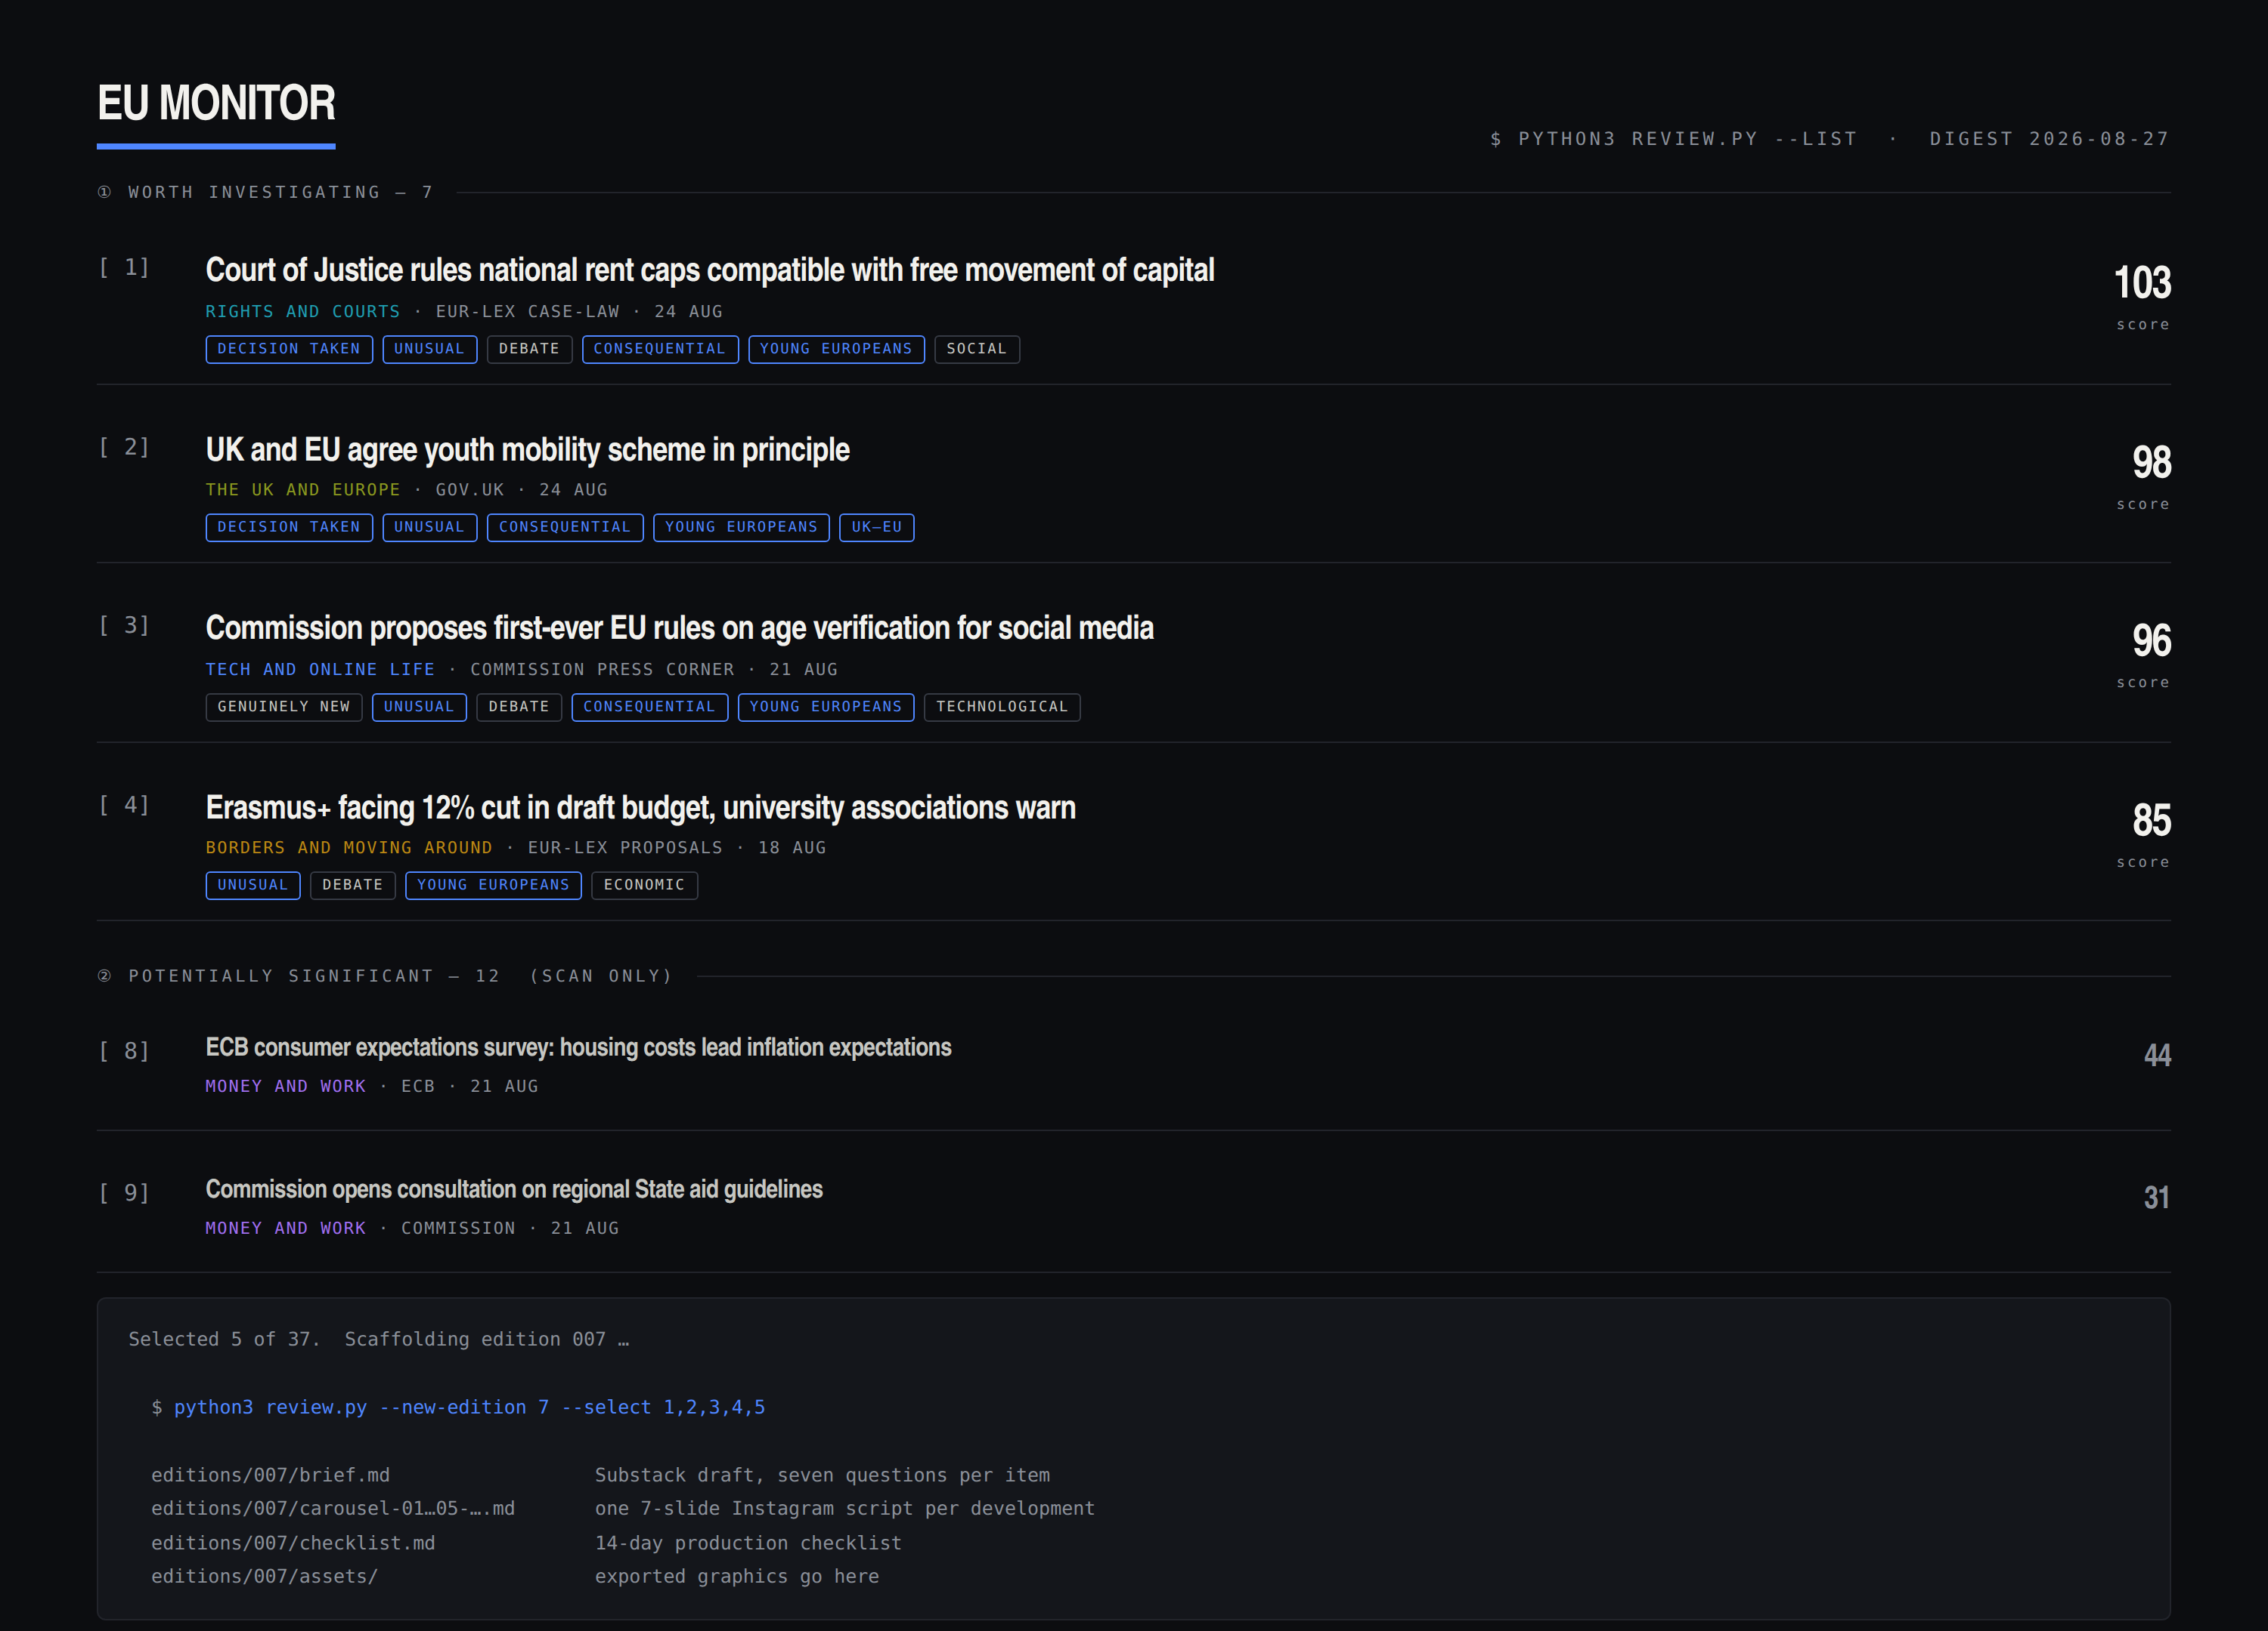
THE HUMAN LAYER
Automation does not replace editorial judgement.
SYSTEM FINDS
→
I REVIEW
→
I RESEARCH
→
I DECIDE
The machine says "this looks potentially significant." That is a different sentence from "this is worth your attention", and the difference is the entire value of the project.
Every selected development is researched against its primary source and answered against seven questions:
1. What actually happened?
2. What changed?
3. Why did it happen?
4. Who does it affect?
5. Why should a young person care?
6. What is the wider political significance?
7. What happens next?
EU MONITOR
06
Notes:
"If the honest answer to question five is they should not care, I cut the item." That sentence is the editorial standard of the whole publication.

Slide 7
THE CONTENT PIPELINE
Where machine judgement stops and mine begins.
AUTOMATED — RUNS WITHOUT ME
HUMAN — WHERE THE VALUE IS
EU
SOURCES
AUTOMATED
MONITOR
FLAGGED
DEVELOPMENTS
HUMAN
REVIEW
RESEARCH &
ANALYSIS
FORTNIGHTLY
BRIEFING
SUBSTACK +
INSTAGRAM
→
→
→
→
→
→
15 institutional feeds
fetch · parse · dedupe
37 → 12 → 7
read the flags, cut hard
primary sources, 7 questions
5 developments, 10 minutes
depth and reach
machine judgement ends here
The system produces raw material. It never writes a published word.
EU MONITOR
07
Notes:
Slow down here. The red dashed line is the argument: everything left of it is free, everything right of it is the work — and the work is the part worth paying for.

Slide 8
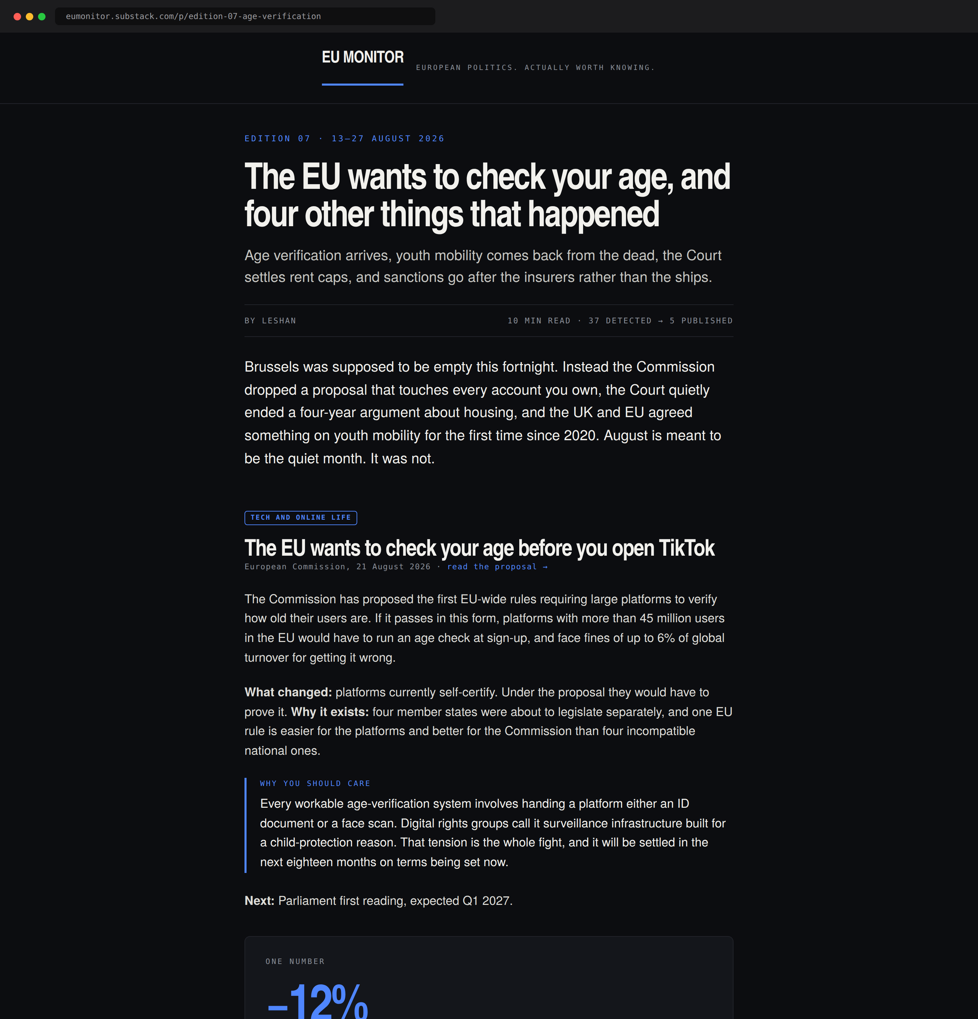
SUBSTACK — THE HOME OF RECORD
Five to eight developments. Ten minutes.
Every claim linked to a primary source.
Curation over volume. A reader should finish an edition thinking "I actually understand what has been happening in Europe" — not "I have now read a lot about Europe."
Every item carries a Why you should care panel. One statistic, chart or map per edition. One lighter or genuinely odd European development, because that is what makes people forward the email.
1,200–1,800 WORDS · EVERY OTHER THURSDAY · FREE
EU MONITOR
08
Notes:
The mock-up is a real layout, not a sketch — the beat chip, the source line under every headline, and the "why you should care" rule are all fixed furniture.

Slide 9
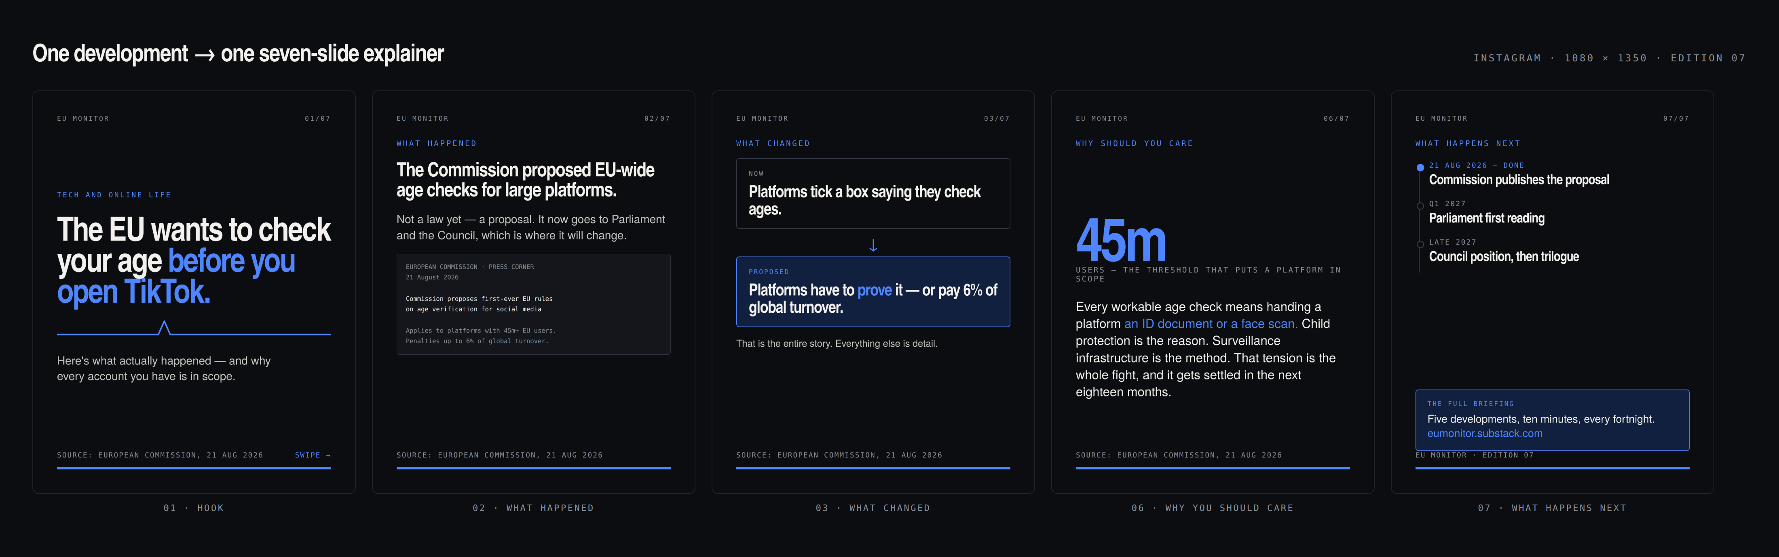
INSTAGRAM — A SECOND EDITORIAL FORMAT
Not an advert for the Substack.
If a carousel only says "new edition out now", it has wasted the slot. Each one is worth reading on its own — someone who never opens the Substack should still learn something.
Every slide carries one visual device — map, timeline, chart, before/after, comparison, screenshot, or a single large number. A slide of pure body text is the failure mode this format exists to avoid.
EU MONITOR
09
Notes:
Reference point is UK Fact Check Politics — but more substantive, more analytical and aimed squarely at 18–30. Slide six is the one that gets screenshotted, so it gets the most work.

Slide 10
ONE STORY, MULTIPLE OUTPUTS
One development. Ninety minutes of research.
Four published things.
21 AUG
The Commission proposes EU-wide age checks
Buried in a press-corner feed nobody reads
21 AUG
The system flags it — six signals, score 96
Automatic. Cost: nothing.
DAY 11
I select it, read the proposal, answer seven questions
90 minutes. This is the only expensive step.
DAY 13
Substack: a 180-word briefing with the source linked
Depth, archive, credibility
DAY 13
Instagram: a seven-slide explainer from the same research
Reach, accessibility, no new research
DAY 14
A university EU society reposts it to their members
Distribution I did not have to build
EU MONITOR
10
Notes:
The efficiency argument. One research effort, four outputs, and only one of the six steps costs real time.

Slide 11
THE AUDIENCE
Politically literate, chronically under-served.
18–30
UK-based, EU-curious
Already organised
University students, postgraduates, recent graduates and young professionals who follow politics but not EU politics
A readership that lost its institutional connection to Europe in 2020 and has had no accessible way back
EU, Politics, IR and European societies at every UK university — audiences that already meet, already have feeds, and already need content
DISTRIBUTION — THE UNIVERSITY SOCIETY NETWORK
Cross-posting a carousel
Co-branded explainers
Guest contributions from members
Instagram takeovers
Interviews
Newsletter cross-promotion
Joint events
Sequenced deliberately: publish three editions first, then approach the societies I already work with, then widen. One edition is a pitch. Three is a publication.
EU MONITOR
11
Notes:
Say the honest bit out loud: a student Substack I ran before died because everything depended on one person having a free week. The monitoring system is the fix — it produces the raw material whether or not I am paying attention.

Slide 12
THE FORTNIGHTLY CYCLE
Ten days of nothing, four days of work.
Designed to survive a dissertation, a job, and a fortnight when nothing gets done.
MACHINE
HUMAN
HUMAN
HUMAN
HUMAN
DAYS 1–10
DAY 11
DAYS 11–12
DAYS 12–13
DAY 14
The monitor runs.
You do not think about it.
Review the flags.
Select five.
Research against
primary sources.
Write the Substack.
Produce the carousels.
Publish and distribute
through the societies.
0 hours
1–1.5 hours
3–5 hours
4–6 hours
1 hour
9–13.5 hours per edition
Roughly five to seven hours a week, concentrated into a four-day burst. That is the whole argument for fortnightly: it fits inside a fortnight that also contains everything else.
EU MONITOR
12
Notes:
The failure plan matters as much as the schedule: publish short, or publish late, but never publish something you have not read the source for.

Slide 13
WHY THIS IS DIFFERENT
Between too much and too shallow.
TRADITIONAL EU NEWS
SOCIAL MEDIA POLITICS
EU MONITOR
Too much information.
Often too shallow.
Automated discovery.
Human analysis.
Accessible presentation.
Accurate, comprehensive, and written for people whose job it already is. Assumes you know what a trilogue is and why you should care.
Accessible and fast, but rarely sourced, rarely analytical, and structurally unable to tell you what happens next.
A machine reads everything so a person can read the five things that matter — and then explains them to someone who has never read a regulation.
The gap is not information. It is judgement, applied in public, by someone the reader's own age.
EU MONITOR
13
Notes:
Do not disparage the competition — the first two columns are good at what they do. The point is that neither is built for this reader.

Slide 14
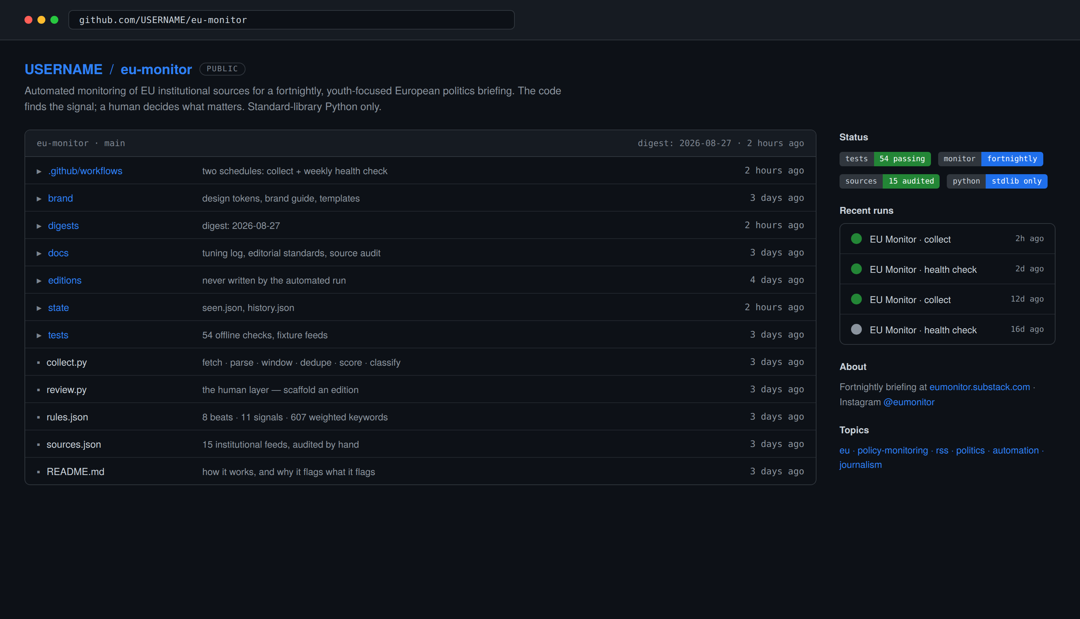
PORTFOLIO VALUE
The repo is the evidence.
The archive is the product.
Public affairs and policy job specs routinely ask for "experience of providing a legislative and policy monitoring service". This is that service — run independently, in public, with the code open and every edition linkable.
Political monitoring
Research
Analysis
Coding
Automation
Data
Writing
Visual communication
54 offline tests · 15 audited sources · 607 weighted keywords · a public tuning log
Social media
Stakeholder engagement
EU MONITOR
14
Notes:
The tuning log is the sleeper. It shows judgement being applied to the machine over time — which is exactly what a monitoring role is.

Slide 15
The ambition
A small, independent
European politics publication
built for the generation
that grew up online.
The code does the boring monitoring. I do the interesting part.
The system finds the signal. I decide what matters.
EU MONITOR
eumonitor.substack.com
@eumonitor
Notes:
Close on the two-line philosophy. Then stop talking.

