Slide 1
Pet Care
Leshi Shkelzen csd4486

Slide 2
Overview of Packages and Implementation
Following a briefly overview of the Pet Care project.
Using Diagrams for better understanding.
Checking what is done and what is not.

Slide 3
Overview
The Pet Care web application is designed to facilitate interaction between pet owners and pet keepers, providing a streamlined system for pet sitting services. It caters to different user roles administrators, pet owners, pet keepers, and visitors with specific functionalities tailored to each type of user. The application ensures a user-friendly environment where registered members can manage bookings, pet information, and communications, while administrators maintain full control over the system. This essay provides an overview of the system's key scenarios, user roles, and core functions.

Slide 4
Overview
User Types
The Pet Care application has four primary types of users: the administrator, pet keepers, pet owners, and visitors.
Administrator: The administrator has complete oversight of the system, with the ability to manage users and access system statistics. Administrators log in through a hidden page and use specific credentials to ensure privacy. Once logged in, they have the authority to view all registered users, delete users when necessary, and monitor system metrics such as the number of active users, bookings, and reviews.

Slide 5
Overview
Pet Owner: Pet owners register on the system to access its full features, which include adding and managing their pet’s information, booking pet keepers, and leaving reviews. Through the platform, pet owners can search for available pet keepers based on location, availability, and other criteria. They can also communicate directly with pet keepers to discuss the specifics of the pet sitting service and any special care instructions.

Slide 6
Overview
Pet Keeper: Pet keepers use the application to offer pet sitting services. After registering, they can update their personal information, manage bookings, and access details about the pets they will host. Pet keepers also have a direct line of communication with pet owners and can inquire about specific care needs. The application integrates ChatGPT to provide pet care support, allowing keepers to ask questions and receive assistance regarding the pets they are hosting. Additionally, pet keepers can view statistics related to their hosting activities, such as the number of pets they have hosted or reviews they have received.

Slide 7
Overview
Visitors (Guest Users): Visitors to the system are able to browse the profiles of pet keepers and view their availability, but they cannot book services or access other restricted features. Visitors can access general information about the system and learn about the services offered, without needing to register or log in.

Slide 8
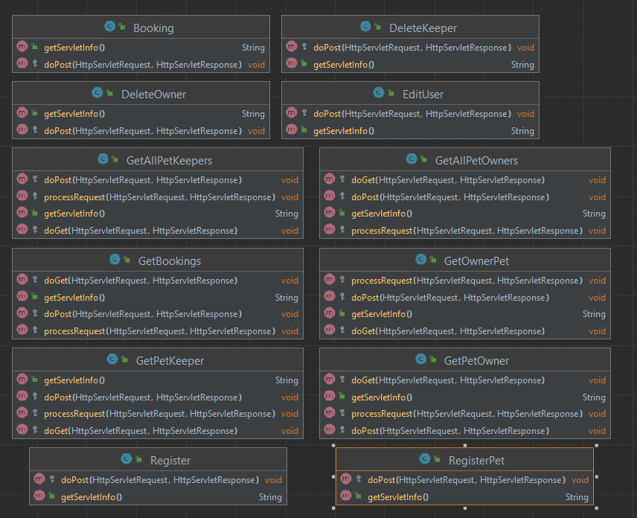
Servlets

Slide 9
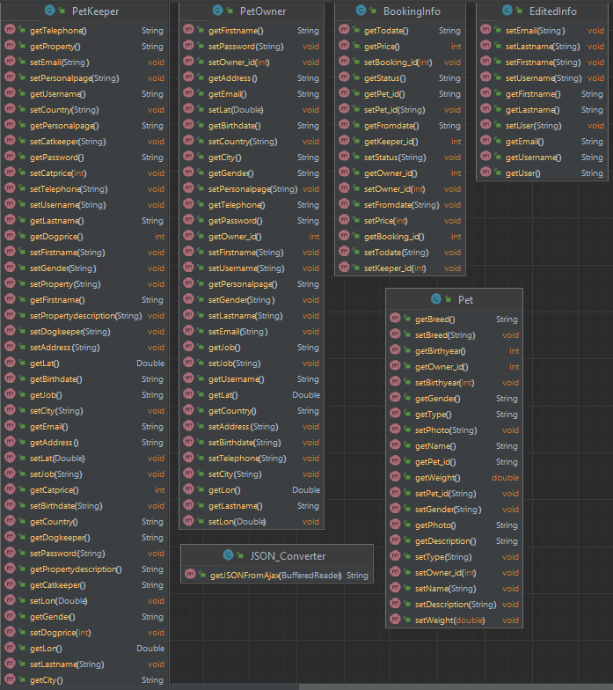
Main_classes

Slide 10
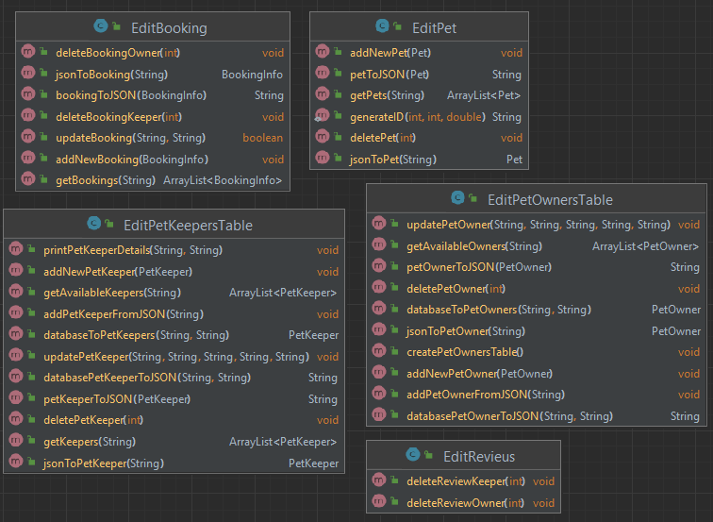
DB_Tables

Slide 11
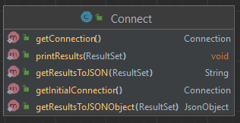
Connection

Slide 12
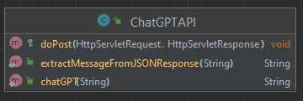
ChatGPT

Slide 13
Implementations
Function | Available
Login with correct credentials | YES
View and delete users | YES
View statistics | NO
Register/Edit profile information | YES
Manage bookings | YES

Slide 14
Implementations
Function | Available
Ask ChatGPT for advice on specific pets | YES
Update profile based on hosted pets | YES
Send messages to pet owners | NO
Register/Edit profile information | YES
Add pet details | YES
Search for Pet Keepers (ideally by location) | YES

Slide 15
Manage bookings | YES
Search and view Pet Keepers | YES
View information and links to other pet-related sites | YES

Slide 16
Conclusion
The Pet Care web application provides a comprehensive platform for pet owners and pet keepers to interact, manage bookings, and ensure proper care for pets. With tailored functionalities for each user type—administrators, pet keepers, pet owners, and visitors—the system offers a streamlined and user-friendly experience. The integration of ChatGPT enhances the service by providing keepers with on-demand support, while the privacy rules and simplified booking process ensure smooth operation. Overall, the Pet Care system is designed to foster efficient communication and service management, contributing to a seamless experience for all users.

