Slide 1
Emotion detection on news
HLT 23/24
LUCIA C. PASSARO

Slide 2

Agenda
Introduction
Why Detect Emotions
Our Approach
What We Aim to Achieve
What Lies Ahead
Team

Slide 3

Introduction
Enhances news recommendation system
Considers interests and emotions

Slide 4

Why detect emotions?
Emotion detection personalizes interactions
Benefit many domains and industries

Slide 5

Our Approach
Utilize supervised learning
Create system for uncovering emotions in news articles
Train, validate, test on Forex News Annotated Dataset¹
Refine model for accurate emotional identification
https://zenodo.org/records/7976208

Slide 6

Annotated Dataset
The dataset comprises 2,291 unique news headlines
Each headline sentiment is manually annotated
It uses three categories for annotation: positive, negative, and neutral
published_at | ticker | true_sentiment | title | author | url | source | text
2023-01-12 07:47:00 | EURCHF | Positive | Euro to benefit from the ECBs pronounced hawkish determination – Commerzbank | FXStreet Insights Team | https://www.fxstreet.com/news/… | FX Street | The Euro was able to appreciate particularly significantly…

Slide 7

The expected outcome
Develop emotion detection model for news articles
Understand sentiment behind articles
Explore ethical considerations

Slide 8

Conclusion
Emotion detection model enhances understanding of news sentiment
Integration into recommendation systems can improve user experience
Ethical considerations crucial for responsible deployment

Slide 9





Meet The Team
Alberte
Marco
Dragoș
Oleksiy
Erasmus
AI Student
Erasmus
AI Student

Slide 10

Have a question?
A.howitz@studenti.unipi.it

Slide 11
Emotion detection on news
project-in-progress
HLT 23/24
LUCIA C. PASSARO

Slide 12

Agenda
(Re-)Introduction
SotA
Data Analysis
Models
Emotion Analysis
What Lies Ahead

Slide 13

(Re-)Introduction
Enhances news recommendation system
Considers interests and emotions
Notes:
The data was extracted from reputable platforms Forex Live. and FXstreet over a period of 86 days Financial market reporting and analysis. The dataset comprises 2,291 unique news headlines

Slide 14
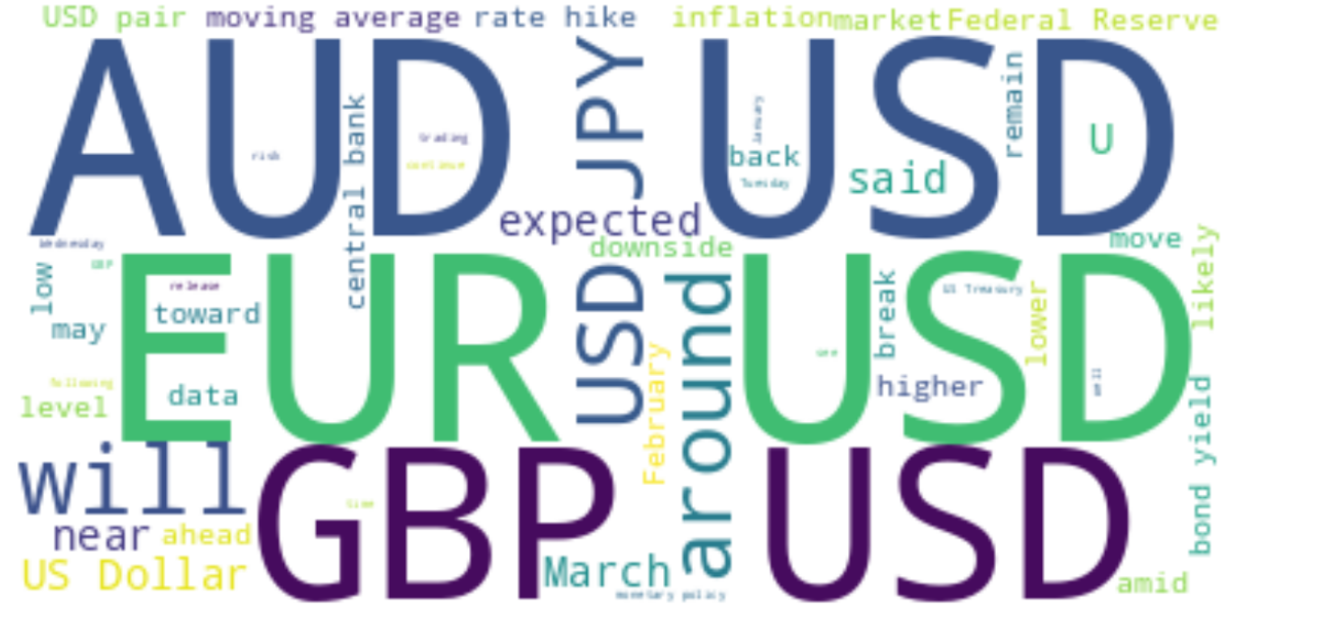
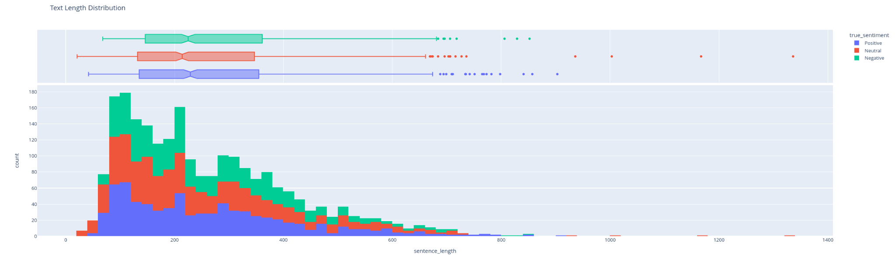
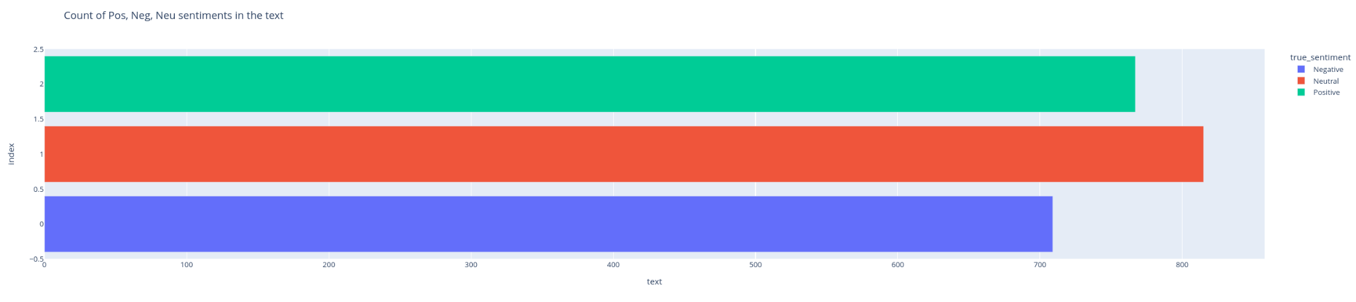
Data Analysis
Plenty of terms that does not help the sentiment analysis
More neutral articles
Text of articles are relative small

Slide 15

State of the Art
Deep learning models
  RNN
  CNN
  Transformer architectures
Commonly used model: BERT
CNN-LSTM: 98.05%
Notes:
The state-of-the-art (SOTA) for emotion detection often involves deep learning models, particularly those based on recurrent neural networks (RNNs), convolutional neural networks (CNNs), or transformer architectures. These models are capable of capturing complex patterns and dependencies in textual data, enabling them to accurately detect emotions expressed in text.
One of the commonly used SOTA models for emotion detection is BERT (Bidirectional Encoder Representations from Transformers) and its variants. By pre-training on large corpora of text data and fine-tuning on emotion detection datasets, BERT-based models can effectively capture contextual information and semantic relationships to infer the emotional content of text.

Slide 16
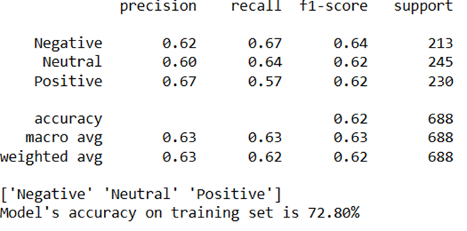
Models
Multi-Layer Perceptron
  Used news’ titles
  Removed some stopwords
  Sent2Vec
  70% train - 30% test
Notes:
One of the model studied for this task is a Multi-Layer Perceptron with 1 hidden layer with 80 neurons. We used the news titles and true sentiment from our dataset to train this model and we vectorized these sentences using the Vectorizer provided by sent2vec module, which uses a pre-trained Bert model. In order to obtain these result we removed some stopwords such as ‘the’ ‘and’ ‘to’ ‘in’. The dataset was splitted in this way: 70% of data used for the training and 30% for testing. For the development set the sklearn.fit function uses the 10% of the training data for the evaluation.

Slide 17
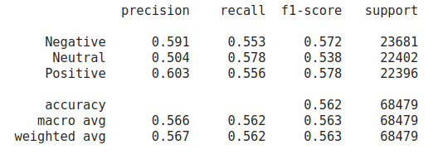
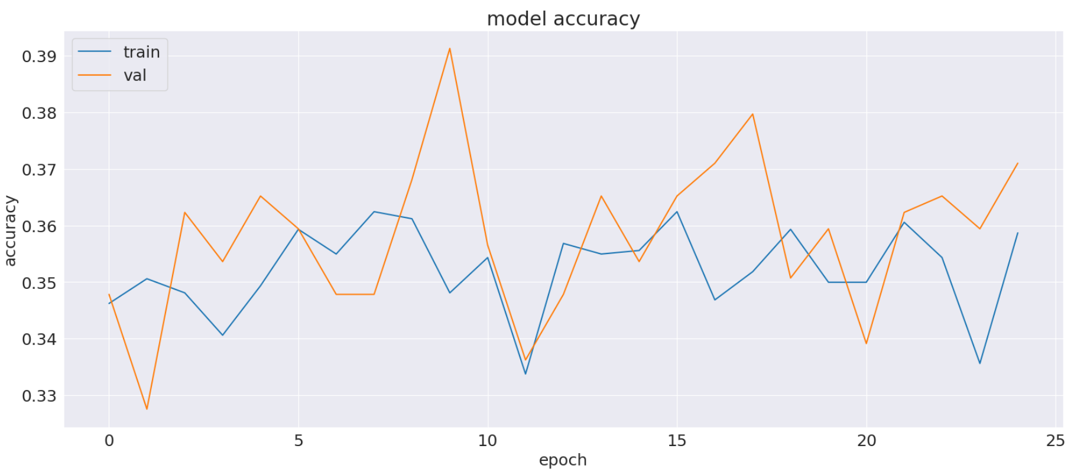
Models
Conditional Random Field:
  Preprocessing: removed stop words, lemmatization, part-of-speech tag
  Lexicons: SentiWordNet, (NRC-VAD)
  Feature functions: 30
  model size: 3.70M
  80% test - 20% train
TransformerBlock (encoder):
  Preprocessing: tokenization with pre-trained LLama tokenizer
  Trainable params: 1,070,659
Notes:
Conditional Random Field: undirected graphical models that represent the conditional probability of a certain label sequence, Y, given a sequence of observations X
class TransformerBlock(layers.Layer):
def __init__(self, embed_dim, num_heads, ff_dim, rate=0.1):
super().__init__()
self.att = layers.MultiHeadAttention(num_heads=num_heads, key_dim=embed_dim)
self.ffn = keras.Sequential(
[layers.Dense(ff_dim, activation="sigmoid"), layers.Dense(embed_dim),]
)
self.layernorm1 = layers.LayerNormalization(epsilon=1e-9)
self.layernorm2 = layers.LayerNormalization(epsilon=1e-9)
self.dropout1 = layers.Dropout(rate)
self.dropout2 = layers.Dropout(rate)
def call(self, inputs):
attn_output = self.att(inputs, inputs)
attn_output = self.dropout1(attn_output)
out1 = self.layernorm1(inputs + attn_output)
ffn_output = self.ffn(out1)
ffn_output = self.dropout2(ffn_output)
return self.layernorm2(out1 + ffn_output)

Slide 18
Models
Positive label:
K-Fold results with 95% CI
Precision | 0.608 ±0.0603
Recall | 0.676 ±0.0258
F1 score | 0.642 ±0.0382
Macro-PRF | 0.626 ±0.0317
Naive Bayes
  Achieved best results with Title
  Used only occurrences
  NLTM library for tokenization
  Applied “tickers” column to the input (making the assumption of independency):
  80% train - 20% test

Slide 19
Emotion Analysis
NRC VAD lexicon
  Valence
  Arousal
  Dominance
Enhances understanding of emotional nuances within content
Notes:
After cleaning and preprocessing via spaCy's English language model to classify text as either "headline" or "news_text" based on its length.
This classification aids in distinguishing shorter headlines from longer news text, enabling more targeted analysis.
And tokenizing the text into individual words or tokens and then lemmatizes each token to its base form.
The text data is standardized and cleaned, ensuring that it is suitable for the next step, emotion analysis.
Emotion analysis plays a crucial role in understanding the affective content of text data. It involves quantifying the emotional aspects present in the text, which can provide valuable insights into the overall sentiment, tone, and mood delivered by the content.
In our approach, we utilized the NRC VAD Lexicon, a lexicon that assigns valence, arousal, and dominance scores to words in the English language. These scores represent different dimensions of emotions. These can be defined as;
-Valence refers to the pleasantness of the stimulus,
-arousal indicates the level of alertness, activeness, or energy provoked by the stimulus and
-dominance represents the degree of control or dominance exerted by the stimulus or the emotion.
By using this specific lexicon, we can assign emotional scores in all three affective dimensions to the words present in news titles and textsa. These scores quantify the emotional content expressed by each word, allowing us to aggregate them to compute overall emotional scores for the entire text.
For example, a news title containing words with high valence and arousal scores may indicate a positive and exciting event, while a title with low valence and arousal scores may deliver a more negative or subdued tone. Similarly, dominance scores can provide insights into the assertiveness or passivity of the emotions delivered in the text.(maybe too extensive, delete?)
Deploying the NRC VAD Lexicon for emotion analysis in news articles enhances our understanding of the emotional nuances within the content. This deeper understanding serves as valuable input for our recommendation system, allowing it to tailor recommendations based on the emotional context of the articles.

Slide 20
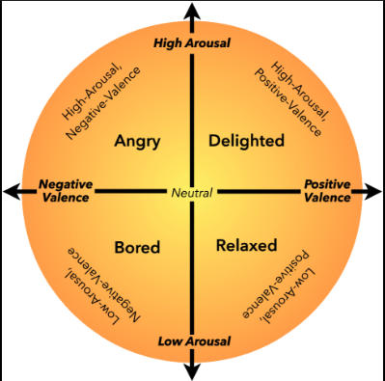
Emotion Analysis
Valence: pleasantness of the stimulus
Arousal: level of alertness, activeness, or energy provoked by the stimulus
Dominance: degree of control exerted by the stimulus
Enhances understanding of emotional nuances within content
Notes:
Maybe add picture of code for viusalization?

Slide 21
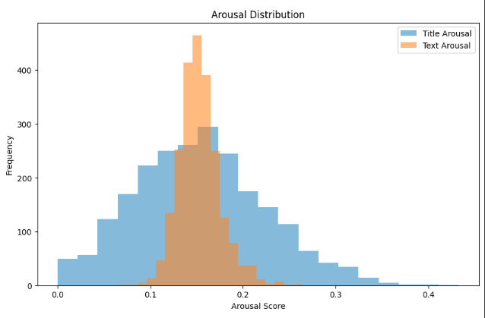
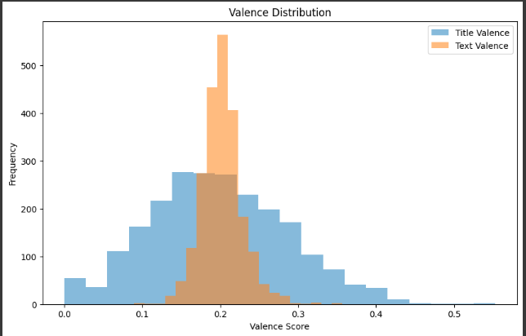
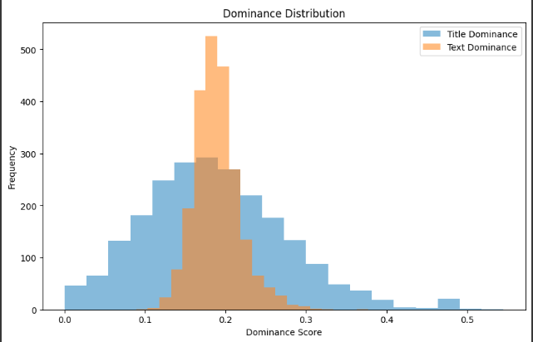
Emotion Analysis
Notes:
Maybe add picture of code for viusalization?

Slide 22

What lies ahead?
Incorporating model with emotion detection
Evaluation
Notes:
Incorporating model with emotion detection
Evaluation
(Perhaps additional finetuning)

Slide 23

Have a question?
A.howitz@studenti.unipi.it

Slide 24
Emotion detection on news
HLT 23/24
LUCIA C. PASSARO

Slide 25
(Re-)Introduction
Emotion detection on News dataset
Enhances news recommendation system
Considers interests and emotions
Notes:
Text-based emotion detection, TBED, involves identifying the emotions expressed in textual data.
As TBED for news remains a complex and evolving field with no simple solutions, given challenges as; ambiguity, bias, privacy, and ethical concerns, this project draws inspiration from previous personal experience and the multitude of papers on the given matter; especially the paper Transforming sentiment analysis in the financial domain with ChatGPT. The paper evaluates ChatGPTs capability for sentiment analysis in the foreign exchange market amongst other models, and will serve as our comparison benchmark, as our chosen data is referenced from this.
The data was extracted from reputable platforms Forex Live. and FXstreet over a period of 86 days Financial market reporting and analysis. The dataset comprises 2,291 unique news headlines
The state-of-the-art (SOTA) for emotion detection often involves deep learning models, like RNN, CNN and transformer architectures (BERT)r

Slide 26
Emotion Analysis
Valence: pleasantness of the stimulus
Arousal: level of alertness, activeness, or energy provoked by the stimulus
Dominance: degree of control exerted by the stimulus
Enhances understanding of emotional nuances within content
Notes:
The emotion analysis consists of utilizing the NRC Vad Lexicon (and SentiWordNet), categorizing emotions as valence, arousal and dominance
(SentiWordNet assigns to each synset of WordNet three sentiment scores: positivity, negativity, objectivity.)

Slide 27
Emotion Analysis
Notes:
From the emotion analysis, iit became clear that titles are more effective to utilize than the text as the representation is much more evenly distributed, hence the remainder of the project will be conducted on headlines exclusively.

Slide 28

Models
Positive label:
K-Fold results with 95% CI
Precision | 0.608 ±0.0603
Recall | 0.676 ±0.0258
F1 score | 0.642 ±0.0382
Macro-PRF | 0.626 ±0.0317
Naive Bayes
  Achieved best results with Title
  Used only occurrences
  Applied “tickers” column to the input (making the assumption of independency):
  80% train - 20% test
Notes:
In our last presentation we concluded that the Naive Bayes yielded the best results, compared with CRF and MLP, scoring 0.6 in precision and 0.68 in recall

Slide 29
Models
Llama-3-8b
  Used news’ titles
  Lowercasing characters
  NRC VAD & SentiWordNet
  80% train - 20% test
Notes:
Since then, we experimented with additional models, Llama-3-8b and Phi-3, with Llama-3-8b outperforming all our other models and thus selected as our chosen model for the project.
Among all the preprocessing techniques we tested, the only one that improved the results was normalizing the text by converting all characters to lowercase. We noticed a significant improvement in performance when we included the normalized lexicon scores for each headline in the prompt. We utilized the sum of NRC VAD and SentiWordNet lexicons scores for each word present, and subsequently normalized the values for each lexicon.
(maybe add visualisation? maybe add phi-3?)

Slide 30
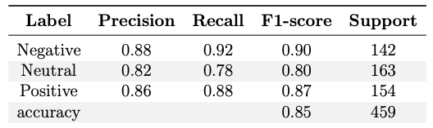
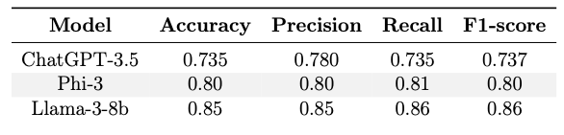
Evaluation
Notes:
We assessed the performance of Llama-3-8b (and phi-3..) and compared against the SotA.
Llama-3-8b performs very well overall, with high recall particularly noted for negative sentiments. However, it encounters challenges in correctly identifying neutral sentiments.
Our referenced paper Transforming sentiment analysis in the financial domain with ChatGPT, has conducted experiments with ChatGPT-3.5, one similar to ours is GPT-P3. The second table shows a comparison of the results obtained by our best models and those obtained by the authors.
It emerges that the new pre-trained models excel in identifying sentiment in headlines, particularly Llama-3-8b, which demonstrates very stable evaluations and consistently high scores across the board. It's important to consider that the lexicon values played a crucial role in improving the results.

Slide 31
What lies ahead?
Incorporating project with RecSys
Enlarging project
Notes:
Our exploration into the world of text-based emotion detection, TBED, within news sentiment, has served as a valuable tool for enhancing understanding; additionally considering the underlying challenges faced. By utilizing a range of machine learning models, we have achieved notable steps in the underlying emotional nuances within news content.
Moving forward, there exists a multitude of opportunities for further refinement and expansion. The integration of our TBED model into recommendation systems is one of them. By infusing personalized suggestions with a nuanced understanding of user sentiment, we can elevate the overall experience, leading to deeper engagement and satisfaction.
Considering enlarging the data in order to obtain better result would also suffice as another expansion of our project.
In conclusion, the journey has just begun, this project is merely a stepping stone towards a future where technology encompasses more than just. Through continued collaboration, innovation, and reflection, we can navigate toward a more informed, empathetic, and inclusive society; a world where TBED succeeds with $100\%$ satisfaction.

Slide 32
Thanks for listening!
Have a question?
A.howitz@studenti.unipi.it

Slide 33
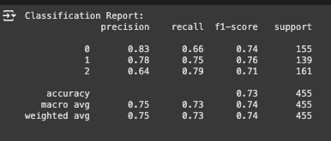
Evaluation
Notes:
(FinBERT)

