Slide 1
A.Y. 2018--‐2019 Software Engineering 2 Mandatory Project

Slide 2
Goals and Requirements
[G1] - Collect data (location, health status: cardiac rhythm, steps) from all registered users
R1: System should allow registration of users with codice fiscale and personal data (age, gender, blood type)
R2: System should collect and store date of the registered users
D1: Users have valid codice fiscale
D2: Location of users is obtained from GPS of the user's device
D3: Users are always connected to internet

Slide 3
[G2] Registered third parties can access data from individual users with permission
R3: System should allow registration of third party with valid ID
R4: System should pass requests from third party to individual based on codice fiscale
R5: System should make the requested data available to the third party only if the individual approves the request
D4: Third party knows the codice fiscale of the user
[G3] Registered third parties can request for anonymized data of groups of individuals
R6: System should be able to retrieve data based on category
R7: System should be able to accept or refuse a request based on the size of data
[G4] Registered third parties can subscribe and receive data
R8: System should allow subscription for data requests from third party
R9: System should send requested data as soon as they are produced

Slide 4
[G5] registered elderly users can subscribe for a personalized and non-intrusive SOS service
R10: System should allow subscription for elderly people by entering personal preferences (thresholds for health parameters)
[G6] Call an ambulance for subscribed elderly people if needed
R11: Monitor health parameters of subscribed elderly people continuously
R12: Call an ambulance only when health parameters go below threshold
D5: Facility to call an ambulance is available

Slide 5
[G7] Run organizers can set up a path for the run
R13: System should allow registration of run organizers
D6: System uses existing map application
[G8] run organizers can set up enrollment process
R14: System should allow creating an enrollment process
[G9] run participants can enroll for a run
R15: System should allow run participants to enroll for a run
D7: Run participants should be registered users of the Data4Help service
[G10] showing the situation of the run to spectators
R16: system should create a view of the map with all run participants positions
R17: system should allow spectators to have access to the view
D8: spectators have internet access

Slide 6
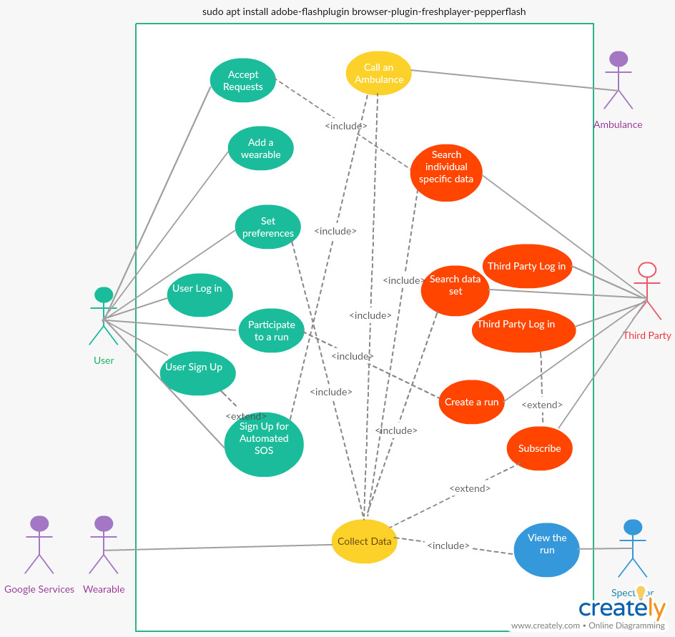
USE CASE DIAGRAM

Slide 7
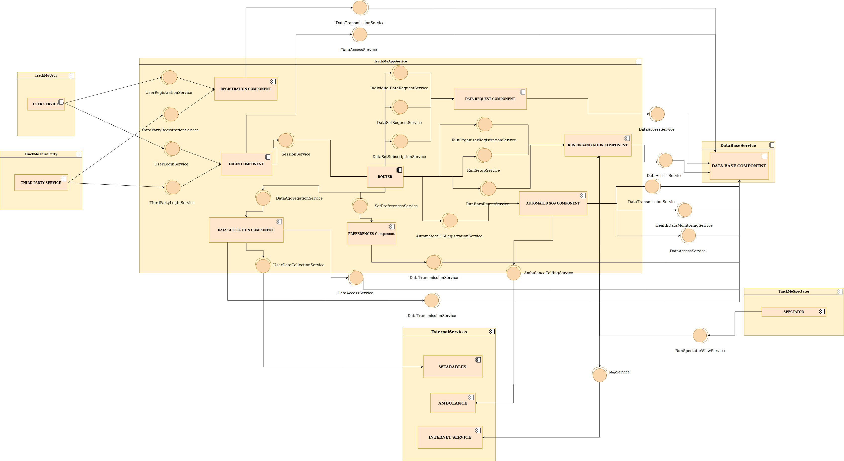

Slide 8
Thank you

