Slide 1
IDENTIFICATION AND MODELLING OF NONLINEAR PROCESS: - parametric approach with LS, RLS & IV - non-parametric approach
Gašper Leskovec

Slide 2
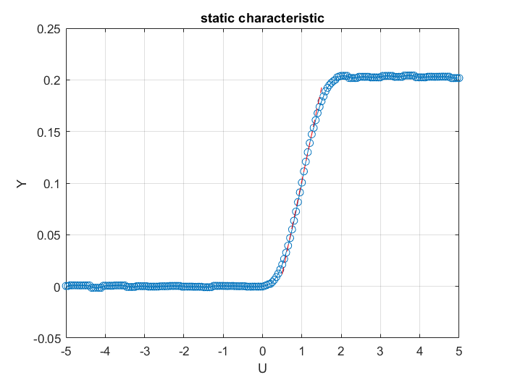
Static characteristic of nonlinear process
Operating interval for U: 0.7 – 1.3
Operating interval for Y: 0.048 – 0.1564

Slide 3
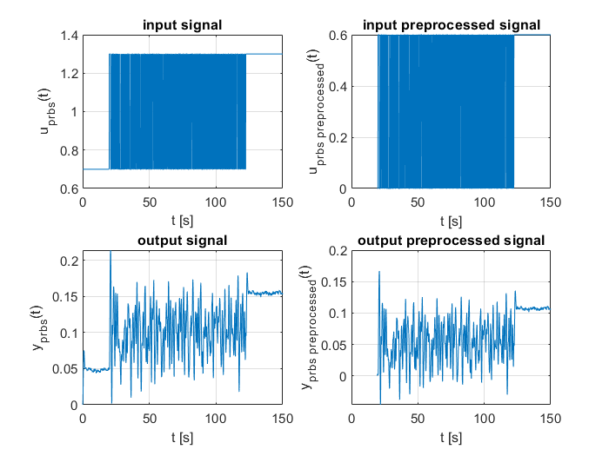
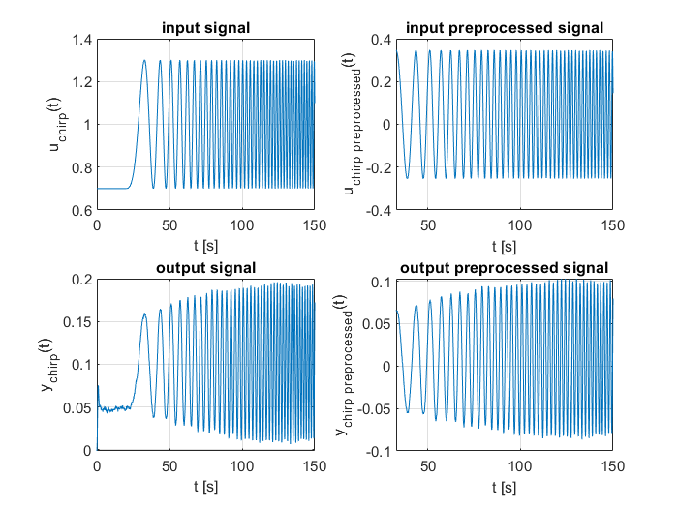
Verification & validation signal (PRBS, Chirp)
Both input signals needs to be in the operating region (0.7 – 1.3) of the system
Processing: deleting constant part & subtracting operating point

Slide 4
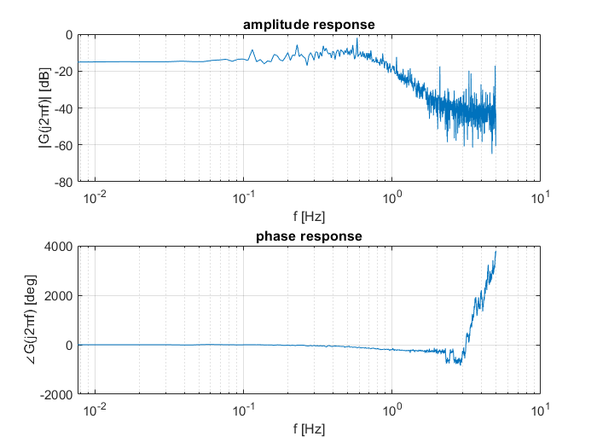

Frequency response of the PRBS signal
G (jω) $=$ $\frac{Y(\text{ω})}{U(\text{ω})}$
Second order system (- 40 dB/decade slope change)
2 poles and 1 zero (each pole -20dB/decade and each zero + 20 dB/decade)

Slide 5
Parametric Model Identification (LS)
Estimating transfer function parameters
Objective: Accurate modeling of the system based on measured data
Least Squares (LS) Method: A powerful technique for parameter estimation
Key Concept of LS: Minimizing the sum of squared errors between measured and simulated outputs.
Approach: Formulating a linear equation system based on input-output data.
Advantages:
Widely used in system identification due to its simplicity and robustness.
Handles noisy measurements by minimizing the error over the entire data set.
Provides reliable estimates of transfer function parameters.

Slide 6
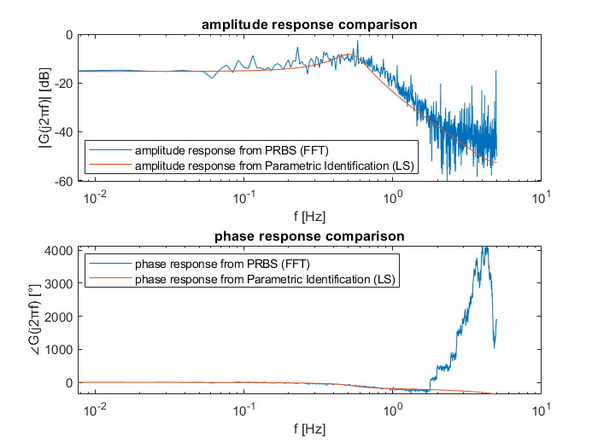
Frequency Response Comparison

Slide 7
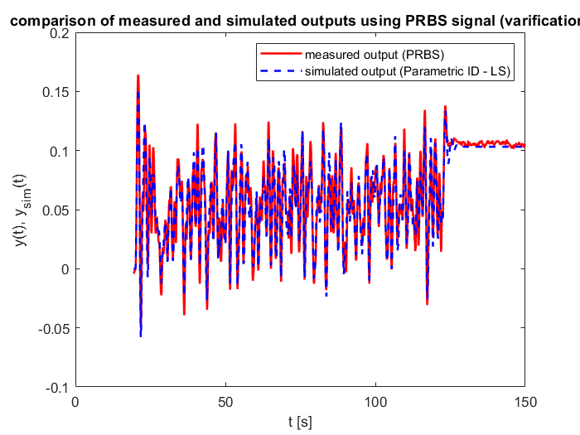
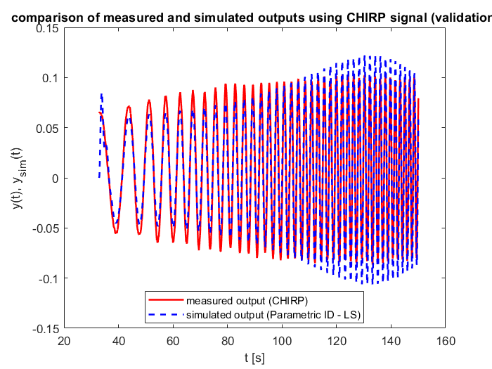
Output Comparison using PRBS & Chirp Signal
Measured output vs. simulated output with PRBS signal (visual verification of the identified model)
Measured output vs. simulated output with chirp signal (validation of the identified model)

Slide 8
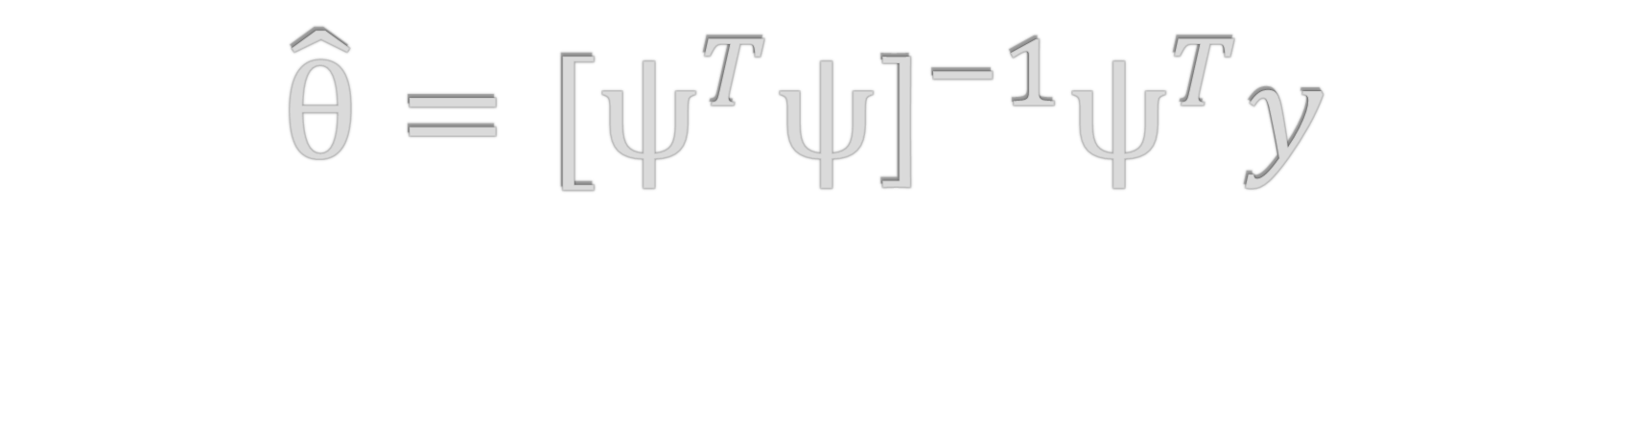
Calculation of parameters
$$\hat{\text{θ}}={{\text{[}\text{ψ}}^{T}\text{ψ}\text{]}}^{−1}{\text{ψ}}^{T}y$$

Slide 9
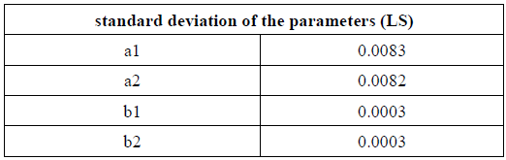
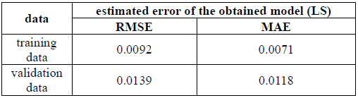
Parameter Uncertainty & Error Metrics

Slide 10
Nonparametric Model Identification:
Estimating the frequency response of a process.
Objective: Describing the behaviour of the process at different frequencies.
Orthogonal Correlation Method: A powerful technique for frequency response estimation.
Orthogonal Correlation Method:
Key Concept: Analysing the relationship between input and output signals at each frequency.
Calculation: Measuring the correlation between signals to determine amplitude and phase.
Advantages:
Non-parametric approach does not rely on predefined transfer function models.
Provides frequency-specific information about the process behaviour.
Applicable in cases where the underlying system dynamics are complex or unknown.

Slide 11
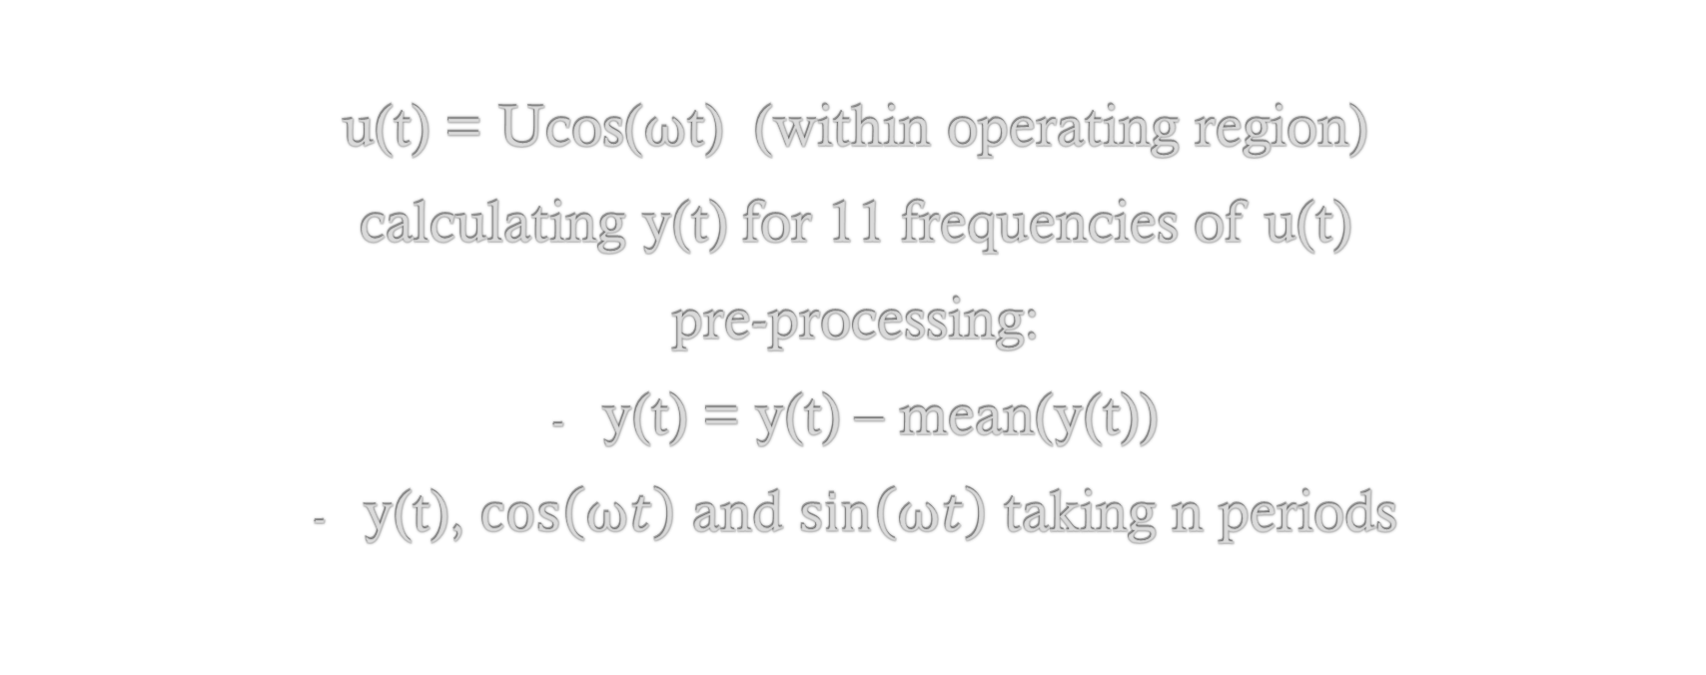
Calcualtion of amplitude and phase response
u(t) = Ucos($\text{ω}$t) (within operating region)
calculating y(t) for 11 frequencies of u(t)
pre-processing:
y(t) = y(t) – mean(y(t))
y(t), $\cos\left(\text{ω}t\right)$ and $\sin\left(\text{ω}t\right)$ taking n periods

Slide 12
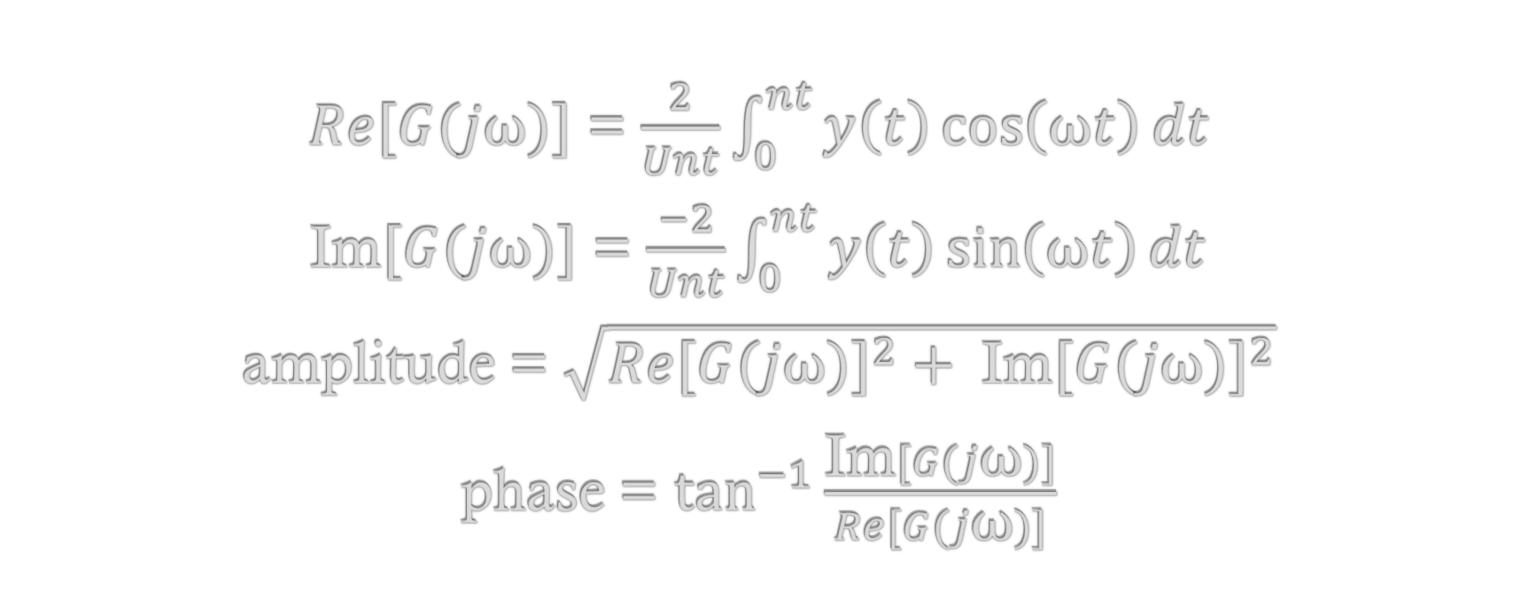
Calcualtion of amplitude and phase response
$Re[G(j\text{ω})]$ = $\frac{2}{Unt}\int_{0}^{nt}{y\left(t\right)\cos\left(\text{ω}t\right)dt}$
Im$[G(j\text{ω})]$ = $\frac{−2}{Unt}\int_{0}^{nt}{y\left(t\right)\sin\left(\text{ω}t\right)dt}$
amplitude = $\sqrt{{Re[G(j\text{ω})]}^{2}+ {\text{Im}[G(j\text{ω})]}^{2}}$
phase = $\tan^{−1}{\frac{\text{Im}[G(j\text{ω})]}{Re[G(j\text{ω})]}}$

Slide 13
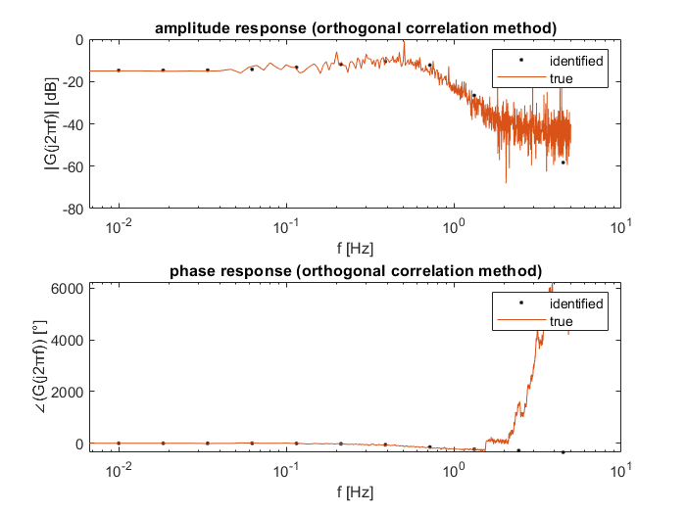
Frequency Response Comparison
- Comparison of Identified and True Frequency Responses (validation)

Slide 14
Alternative Identification Method (RLS):
Estimating parameters of a discrete-time system.
Objective: Accurate modeling of the system using input-output data.
Recursive Least Squares (RLS) Method: A powerful technique for online parameter estimation.
RLS Method:
Key Concept: Iterative estimation of system parameters using input and output signals.
Advantages:
Online parameter update allows adapting to time-varying systems.
Handles noisy measurements and can track system dynamics.
Suitable for real-time applications and adaptive control.

Slide 15
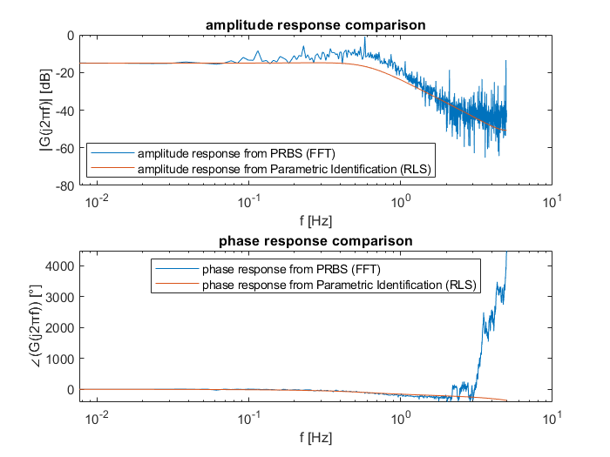
Frequency Response Comparison

Slide 16
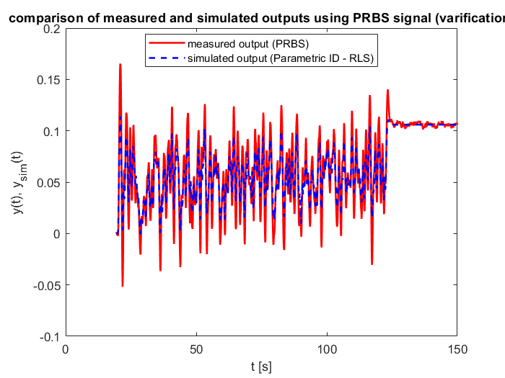
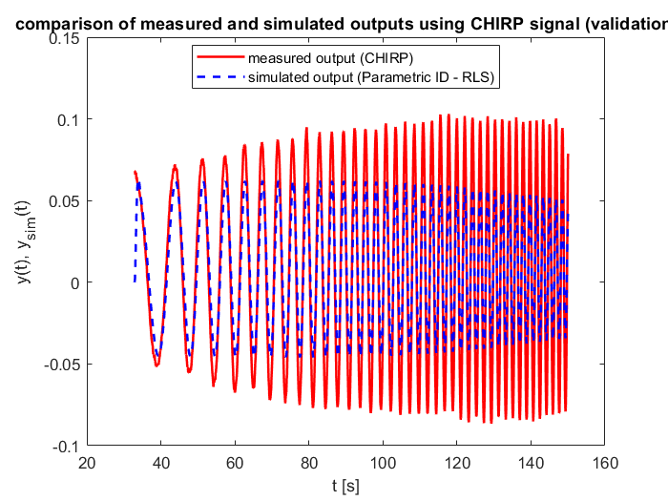
Output Comparison using PRBS & Chirp Signal
Measured output vs. simulated output with PRBS signal (visual verification of the identified model)
Measured output vs. simulated output with chirp signal (validation of the identified model)

Slide 17

Calculation of parameters
$$\hat{\text{θ}}(k+1)={{\hat{\text{θ}}\left(k\right)\text{ + }\text{P}\text{(}\text{k}\text{ + 1)}\text{ψ}\text{(}\text{k}\text{ + 1)[ }\text{y}\text{(}\text{k}\text{ + 1) - }\text{ψ}}^{T}\left(k+1\right)\hat{\text{θ}}\left(k\right) ] }^{}$$
last estimate
new measurement
updated estimate
correctiton gain
predicted measurement based on last estimate

Slide 18
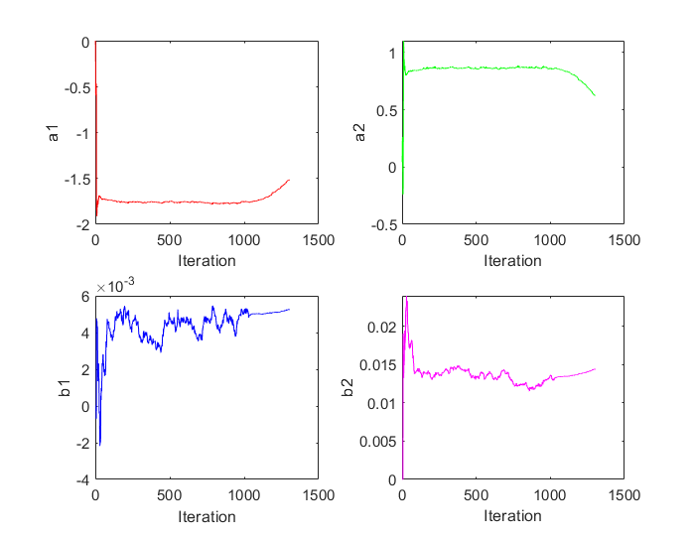
Parameter Updates
- Real-time visualization of parameter updates (a1, a2, b1, b2).
- Illustrates the iterative nature of the RLS method.

Slide 19
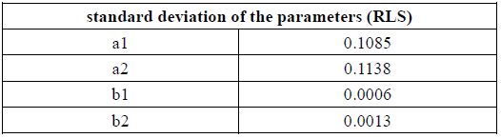
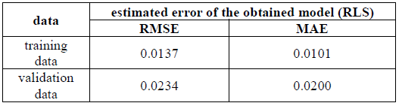
Parameter Uncertainty & Error Metrics

Slide 20
Additional Identification Method (IV)
Estimating parameters of a linear time-invariant system.
Objective: Accurate modeling of the system using measured data.
Instrumental Variables (IV) Method: A robust technique for parameter estimation.
IV Method:
Key Concept: Utilizing instrumental variables to enhance parameter estimation.
Advantages:
Addresses measurement noise and endogeneity issues.
Provides reliable and consistent parameter estimates.
Suitable for systems with correlated disturbances.

Slide 21
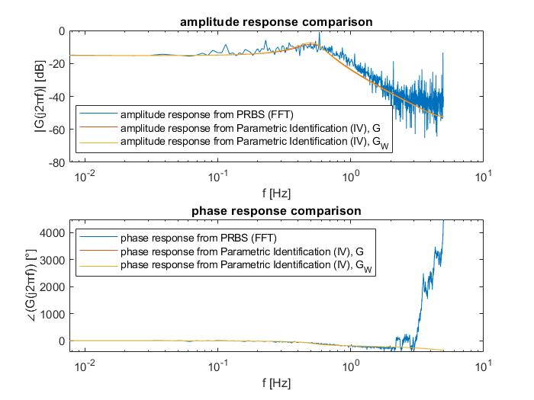
Frequency Response Comparison

Slide 22
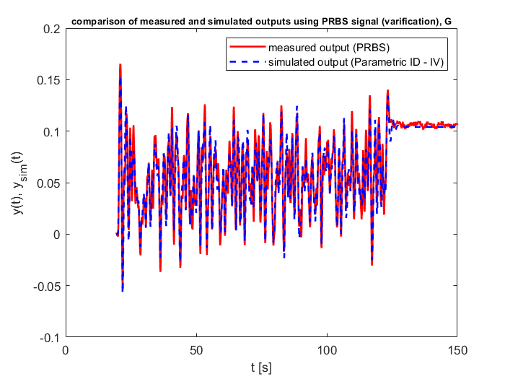
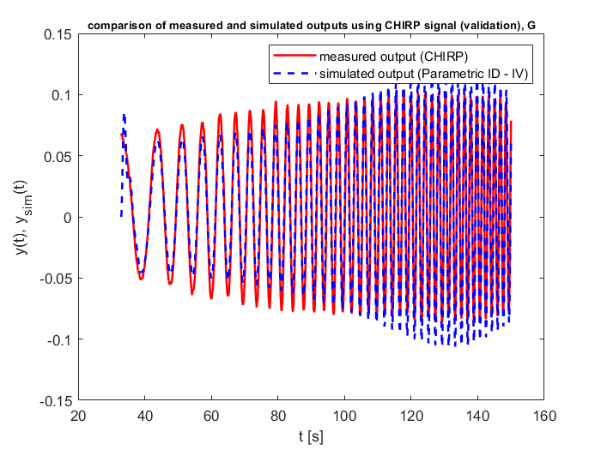
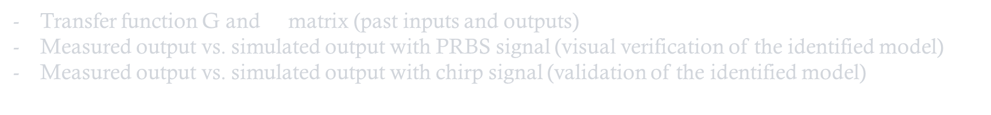
Output Comparison using PRBS & Chirp Signal
Transfer function G and $\text{ψ}$ matrix (past inputs and outputs)
Measured output vs. simulated output with PRBS signal (visual verification of the identified model)
Measured output vs. simulated output with chirp signal (validation of the identified model)

Slide 23

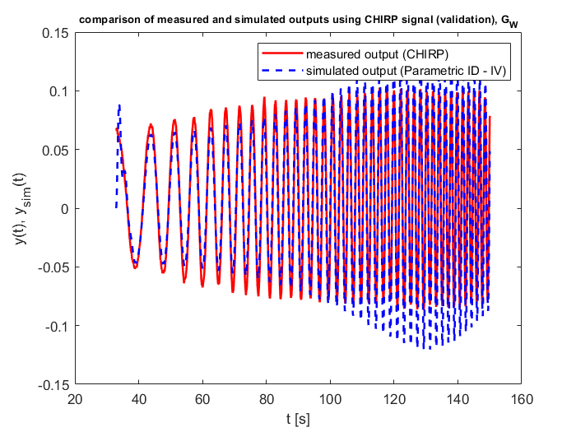
Output Comparison using PRBS & Chirp Signal
Transfer function G_W and W matrix (instrumental variables)
Measured output vs. simulated output with PRBS signal (visual verification of the identified model)
Measured output vs. simulated output with chirp signal (validation of the identified model)

Slide 24

Calculation of parameters
$\hat{\text{θ}}= {[W^{T}\text{ψ}] }^{−1}W^{T}$y - ${[W^{T}\text{ψ}] }^{−1}W^{T}$v
bias
matrix of instrumental variables

Slide 25
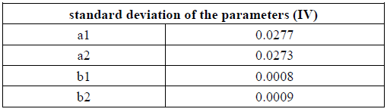
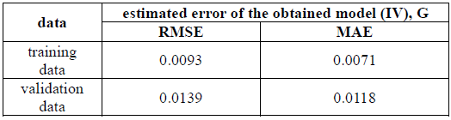
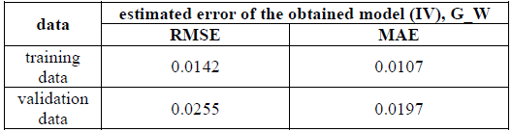
Parameter Uncertainty & Error Metrics

Slide 26
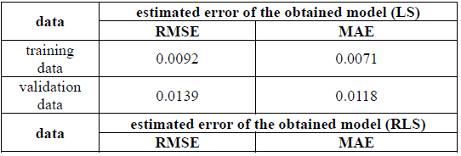
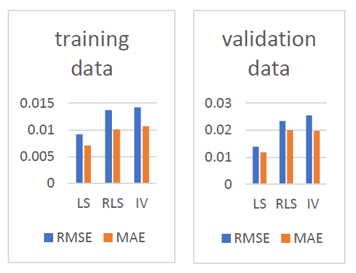
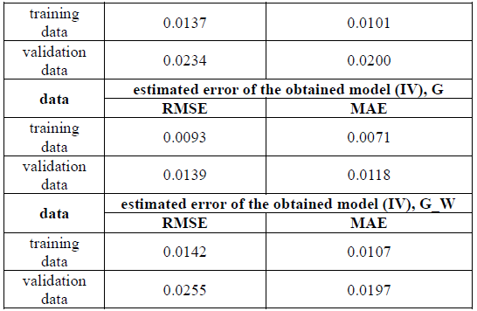
Comparison of System Identification Methods
Good fit to the data (LS)
Slightly higher errors than LS method (RLS)
Higher errors than other methods (IV)

Slide 27

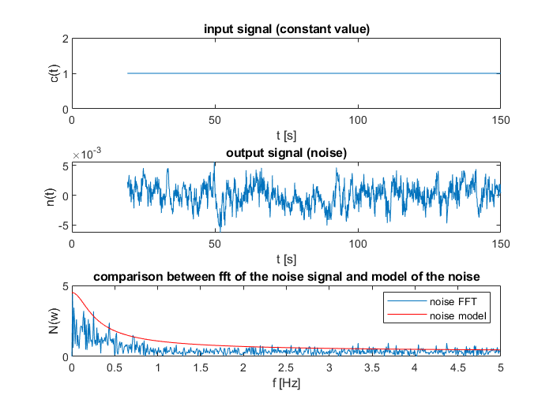
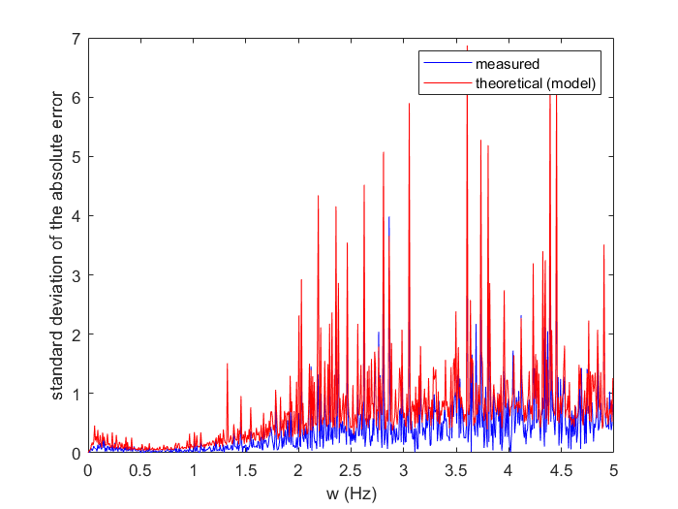
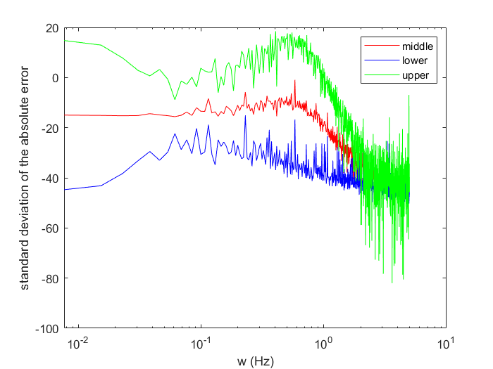
Noise Analysis and Standard Deviation Comparison
Input: constant signal > output: noise signal > FFT calculation and noise model (comparison).
Comparison of Measured and Theoretical Standard Deviations.
Visualization of standard deviation applied to the reference signal.

Slide 28
Thank you for your attention!

