Slide 1
Smart Energy pilot

Slide 2
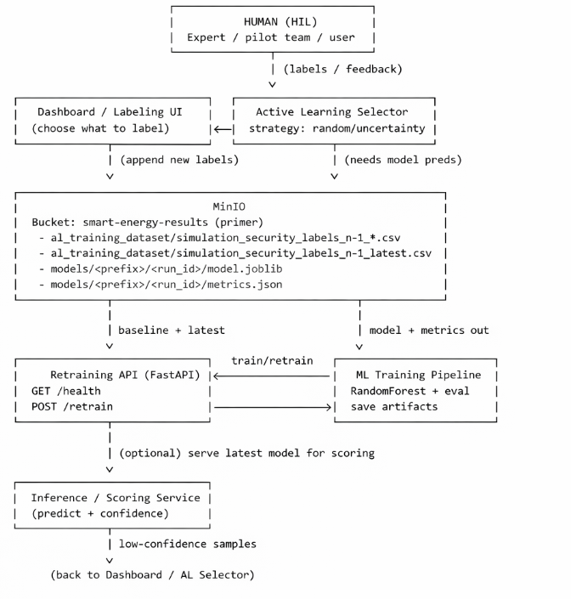
Architecture

Slide 3
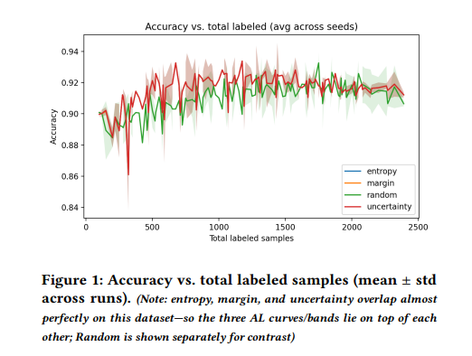
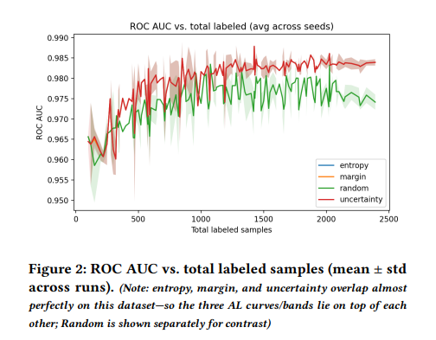
Results - Active Learning reaches target performance with fewer labels

