Slide 1
SMART ENERGY – ACTIVE LEARNING + HITL
Gašper Leskovec

Slide 2
1. What has been done (Sept – Today)
Baseline RF model trained on N-1 security dataset
Implemented Online Active Learning loop (entropy, uncertainty, margin, random)
Integrated simulator as labeling oracle (cost-aware queries)
MinIO artifact versioning (dataset + model)
Developed FastAPI retraining endpoint (/retrain)

Slide 3
2. Current Problem
Labeling via N-1 simulations is computationally expensive
No fully automated closed-loop retraining yet

Slide 4
Plans Forward
Deploy retraining API on Atena server
Connect Dashboard → Active Learning → Human → Retrain
Reduce simulator calls while improving model performance
Enable full Human-in-the-loop production workflow

Slide 5
3. Human-in-the-Loop (HITL)
Active Learning selects most uncertain grid states
Human validates critical borderline N-1 scenarios
Prevents error propagation from noisy labels
Improves robustness & convergence speed
Reduces overall labeling cost

Slide 6
4. Results Overview
Uncertainty strategy converges faster than random sampling
Higher final accuracy and ROC AUC
30–40% fewer simulator calls for same performance
Improved cost-efficiency of labeling process

Slide 7
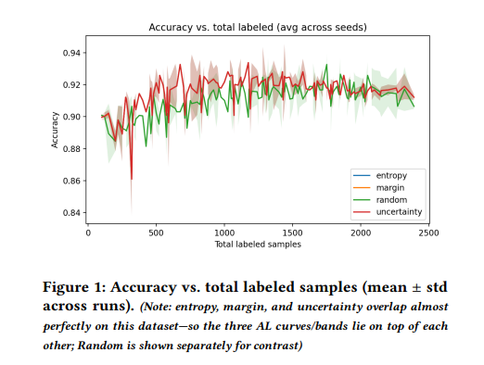
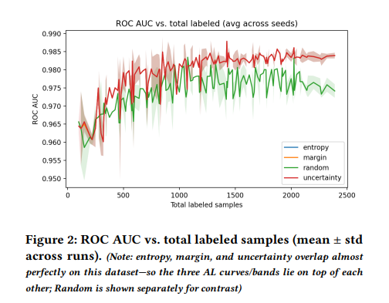
Results – Active Learning reaches target performance with fewer labels
• Entropy and uncertainty strategies reach target performance faster than random sampling
• Same or higher ROC AUC achieved with significantly fewer labeled samples
• Direct reduction in simulator calls → lower labeling cost

Slide 8
System Architecture (Simplified)
Power Grid Scenario
↓
Simulator (N-1)
↓
MinIO (datasets & models)
↓
Active Learning
↓
Dashboard (Human validation – HITL)
↓
Retraining API (Atena server)
↓
Updated Model
↓
Security Prediction + Dashboard metrics

