Slide 1

AI-Powered Customer Support Workflow
Transforming Customer Support with AI-Driven Workflow Optimization:
Analysis, Insights, and Recommendations
Lesley Colon
AI Automation | Project 1

Slide 2
Transforming Customer Support with AI
Analysis, Insights, & Recommendations
Our current customer support process relies on customers reaching out through channels such as email, phone, web forms, or social media, after which support agents manually log and categorize inquiries. Supervisors then assign each case based on the issue type and available staff, and agents investigate, resolve, or escalate issues as needed, often following up to collect feedback. While this approach ensures every request is addressed, it is highly manual, frequently resulting in slow response times, process inefficiencies, and inconsistent customer experiences. The goal of this project is to significantly improve efficiency and service quality by integrating AI-powered solutions that automate routine tasks, streamline workflows, and enable faster, more accurate support for our customers.

Slide 3
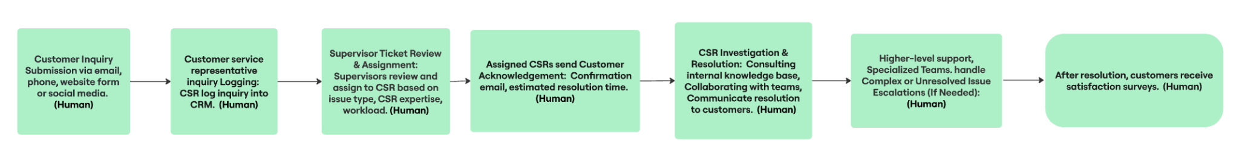
Current Workflow Overview

Slide 4
Key Problems Identified
Complaints
Top issues reported in 2025 are long wait times (affecting up to 60% of customers), repeated information requests (72% complaint rate), and slow or ineffective resolution resulting in 57% switching brands after one bad experience.
Customer contact volume has increased 20% since 2020, putting more strain on support teams and highlighting the need for AI-driven automation to improve speed, accuracy, and consistency.
Key Bottlenecks Identified in Current Workflow
Workflow Stage | Problem | Impact
Manual logging | Slow, error prone data entry | Delays, lost tickets
Supervisor Ticket Assignment | Bottleneck, uneven workload | Longer response times
Escalation | Lack of seamless handoff | Extended resolution time

Slide 5
Proposed AI integration
Suggested AI tools and how they fit into the workflow:
Zendesk AI, Salesforce Einstein, Forethought: Automate inquiry logging, classification, and prioritization for faster response times and error reduction.
Freshdesk Freddy AI, Crescendo.ai: Smart ticket routing and workload balancing improve agent productivity and reduce bottlenecks.
Ada, Tidio (Lyro AI), Intercom Fin AI: 24/7 AI chatbots handle routine queries instantly, offering consistent, personalized customer interactions and reducing human workload.
Twilio Studio, HubSpot Service Hub: Automate proactive status updates and follow-ups, enhancing transparency and customer trust.
Forethought Solve, OpenAI GPT-powered copilots: Support agents in real-time with suggestions and knowledge base access, decreasing resolution time and burnout.
Crescendo.ai, Zendesk Explore: Perform sentiment analysis on feedback to drive continuous quality improvements.
Expected benefits and improvements:
Faster response and resolution times with 24/7 AI-powered support
Increased agent productivity by automating routine tasks and smart ticket routing
Scalable support operations that handle surges without proportional headcount increases
Personalized, context-aware customer experiences improving satisfaction and loyalty
Proactive status updates and transparent communication reduce frustration
Continuous improvement through data-driven insights and feedback analysis
Potential risks or limitations:
Over-reliance on AI potentially reducing human empathy; mitigate by maintaining human oversight and escalation options
Data privacy and security concerns requiring robust compliance and protection measures
Integration complexity with existing CRM and enterprise tools that may be costly or time-consuming
Customer resistance to automation; address by clearly communicating AI benefits and offering easy access to human agents

Slide 6
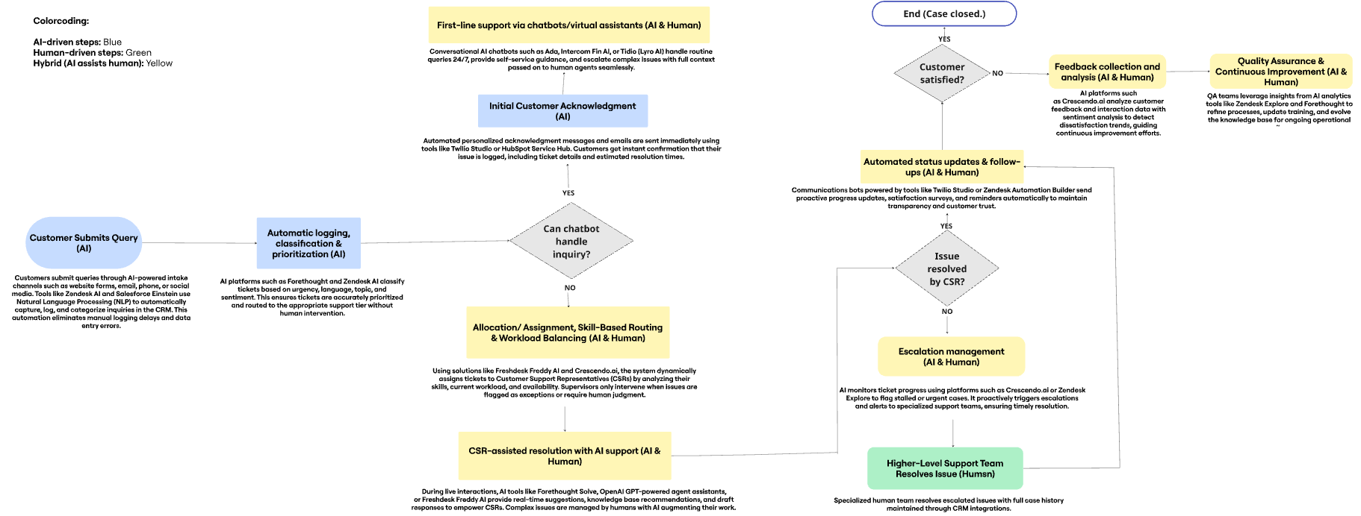
Updated Workflow with AI

Slide 7
Conclusion
Integrating AI technologies into the customer support workflow offers a transformative opportunity to eliminate bottlenecks, accelerate response times, and deliver consistently excellent service. By automating routine tasks, enabling intelligent ticket routing, and empowering agents with real-time assistance, this approach enhances both efficiency and customer satisfaction. While careful attention to privacy, human oversight, and gradual implementation is essential, the benefits of AI-driven support—such as scalability, personalization, and proactive communication—position the business for long-term success in an increasingly digital and customer-centric landscape. Embracing AI today means building a smarter, faster, and more empathetic customer support experience for tomorrow.

