Slide 1


Automation of Weather-Based Sales and Staffing Decisions
Lesley Colon
AI Automation | Project 5

Slide 2
The Problem
Right now, the manager is spending 15+ minutes every morning manually checking weather forecasts, then making educated guesses about what products to stock and how many staff to schedule. Those delays mean missed opportunities. In a coastal city like Miami where weather changes fast, by the time the plan is ready, customers are already showing up. This automation solves that by making decisions instantly.

Slide 3
Solution
Instead of manual checking, we built an automated workflow that runs every single morning at 7:00 AM. It fetches the real-time weather from OpenWeather, uses Google's Gemini AI to interpret the forecast and generate smart recommendations—what products to focus on, how many staff to add, and two personalized promo messages—then sends it all in a friendly email to Emily before 7:30 AM. She has her full plan before opening

Slide 4
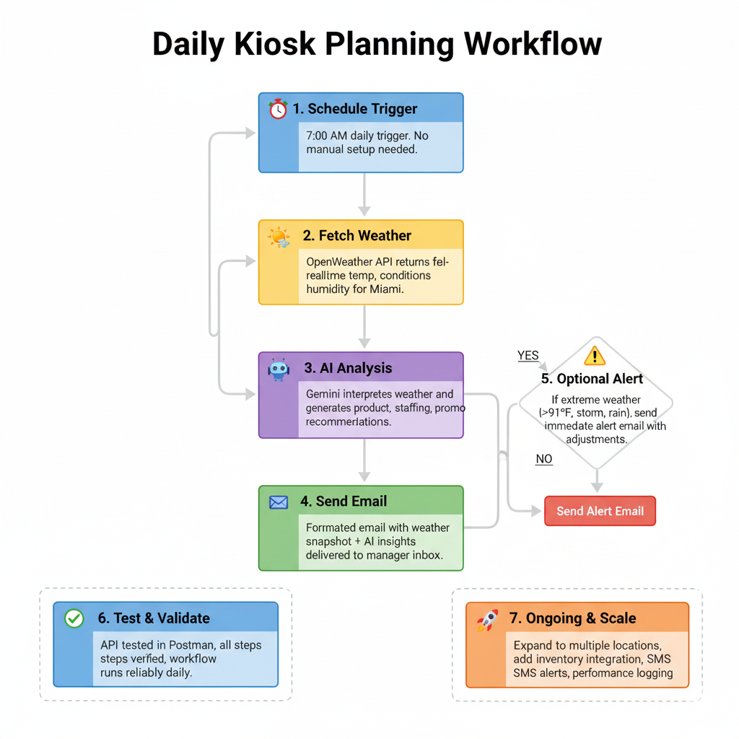
Workflow
The workflow starts with a Zapier Schedule trigger that runs every day at 7:00 AM, ensuring the process kicks off before the kiosk opens. It first calls the OpenWeather API via Webhooks by Zapier to fetch live weather data for Miami, including temperature in Fahrenheit and a short description like “scattered thunderstorms,” which becomes the context for all later decisions. That data is passed into a Google AI (Gemini) step, where a structured prompt instructs the model to generate three outputs: a product focus recommendation across hot drinks, cold drinks, gelato, and pastries; a staffing suggestion indicating whether to add, reduce, or keep staffing the same; and two short, weather-tailored promotional messages under 120 characters each. The AI’s response, along with the raw weather values, is then merged into a formatted Gmail message addressed to the manager, Emily Davis, with a clear subject line and friendly body that summarizes the weather, recommends the product mix and staffing, and includes ready-to-use promos. Finally, an optional Zapier Filter watches for severe conditions—temperature above 91°F or descriptions containing “storm” or “rain”—and, when triggered, sends a separate alert email with guidance on how to adjust operations for extreme weather.

Slide 5
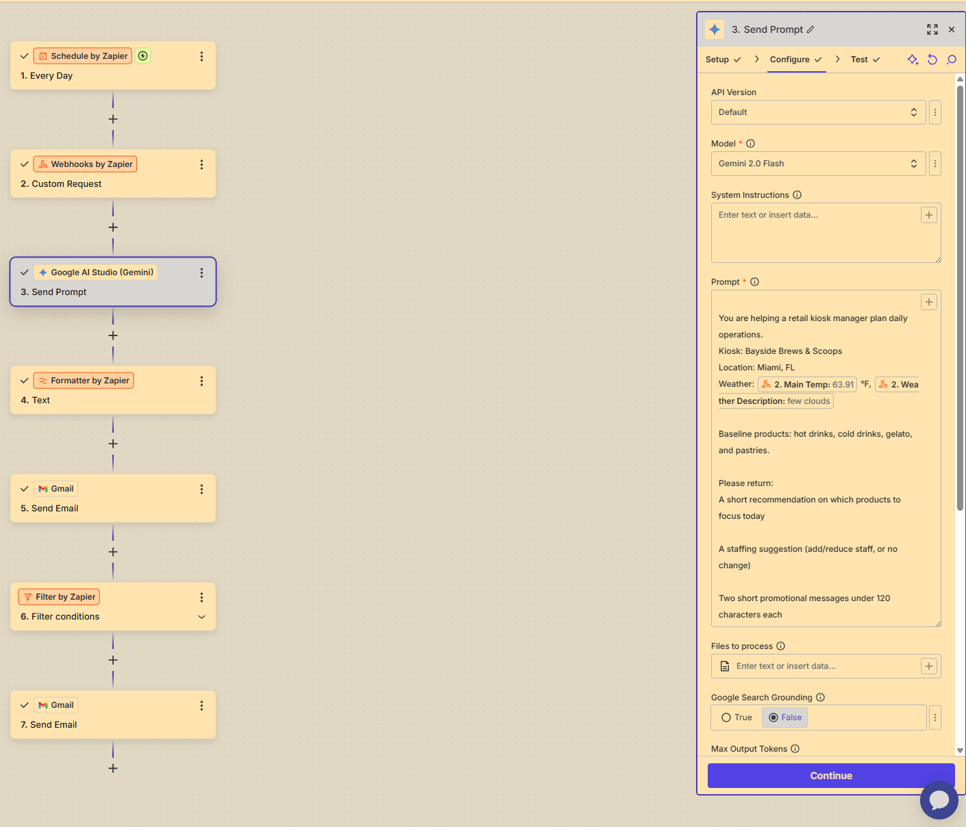
Workflow In Action
Gemini Prompt:

Slide 6
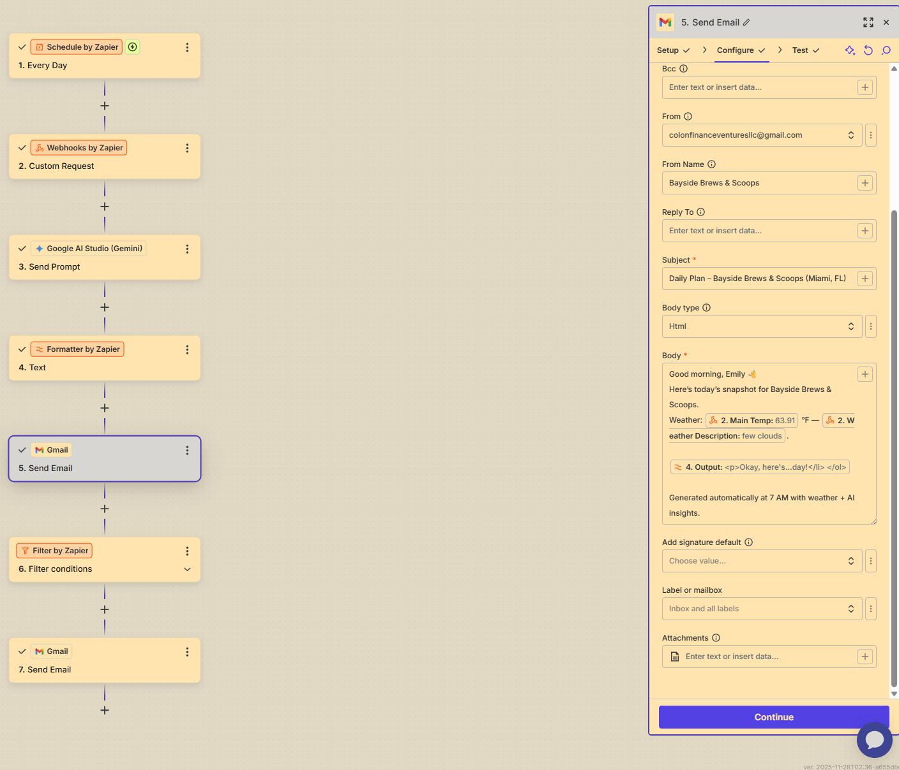
T

Slide 7
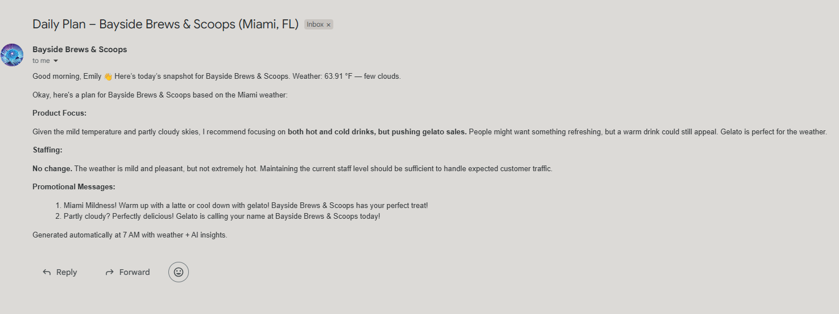
T

Slide 8
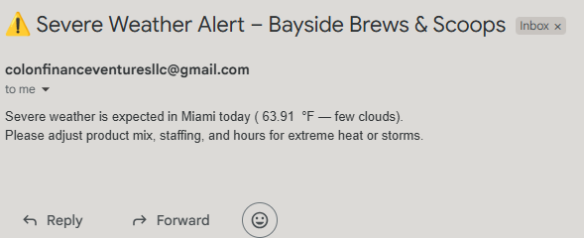
T

Slide 9
Benefits
This workflow reduces manual effort for the kiosk manager, who no longer needs to check forecasts or guess demand each morning, freeing up time for higher-value tasks and improving consistency in daily planning. It improves decision quality by combining real-time weather data with AI-generated recommendations, helping align product mix, staffing levels, and promotions with actual conditions at the beach, which can boost sales and reduce waste for a weather-sensitive business. It also supports better customer experience and revenue potential over time, because the kiosk is more likely to have the right items stocked, the right number of staff on shift, and timely weather-tailored promotions that attract customers on hot, rainy, or stormy days.

Slide 10
Severe Weather Alert ⚠️
Filter step that triggers if: Temperature > 91°F, OR Description contains "storm" or "rain".
Sends immediate alert email to the manager
Includes quick operational adjustments for extreme heat or storms
It goes beyond the basic 5-step workflow (Schedule → Weather API → AI Analysis → Email) and adds intelligent conditional logic to handle edge cases.
Optional Extras

Slide 11
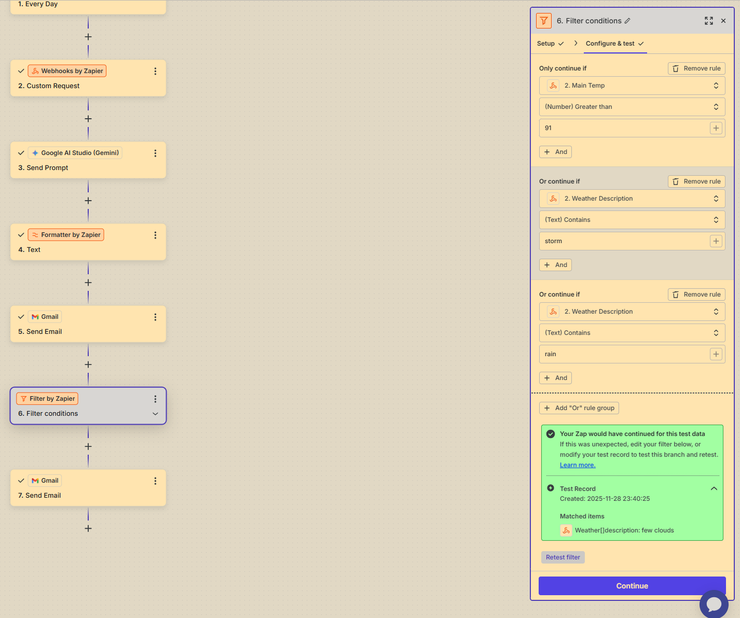
T

Slide 12
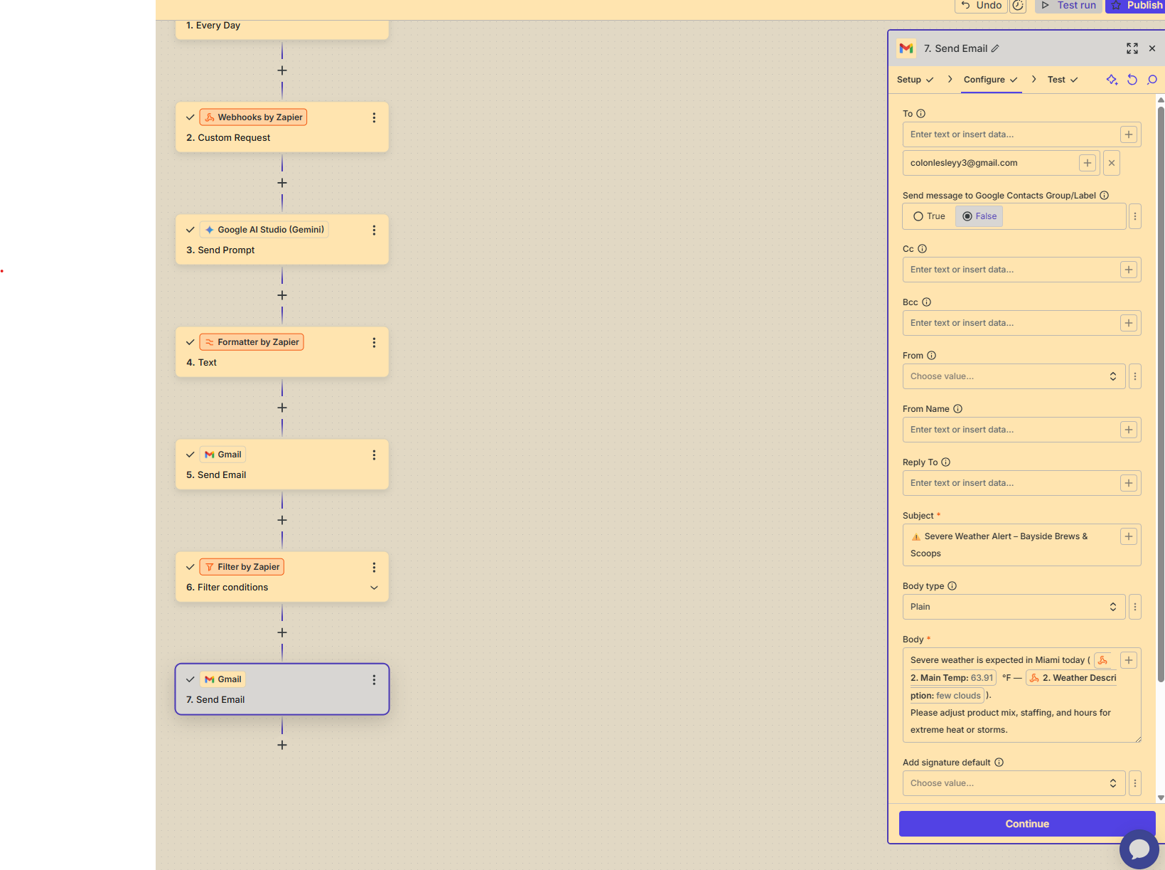
T

Slide 13
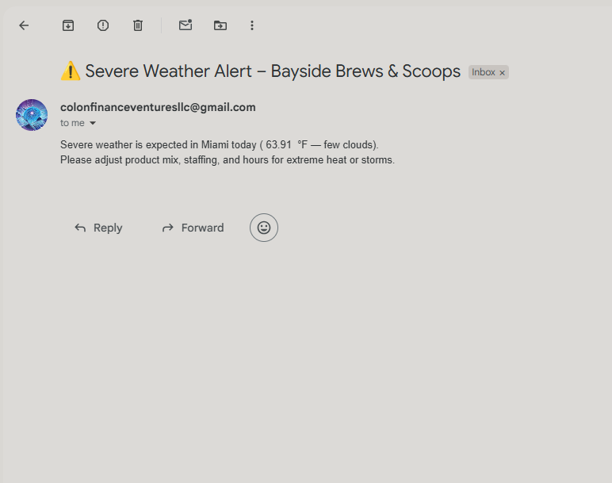
T

Slide 14
What worked well
The daily 7:00 AM schedule made the process fully hands-off, so the manager consistently receives a plan before opening without needing to remember anything.​
Integrating OpenWeather with Zapier Webhooks and Gemini created a smooth data flow from raw weather information to actionable, AI-generated recommendations in one automated chain.​
Clear testing (Postman for the API, Zap tests, and email checks) helped ensure reliability, which is a key success factor in workflow automation projects.​
What could be improved with more time/tools
Add monitoring and logs (e.g., log weather, AI output, and sales) to analyze performance over time and refine prompts and rules based on real data.​
Build resilience and fallbacks, such as using cached or previous-day data if the weather API fails, and adding alerts when a Zap step errors out.​
Scale and enrich the workflow by supporting multiple kiosk locations, integrating inventory systems, and adding dashboards to visualize impact and KPIs
Challenges & Improvements

