Slide 1
Standards are the fundamental reference for a system of weights and measures, against which all other measuring devices are compared *
*Wikipedia.com

Slide 2
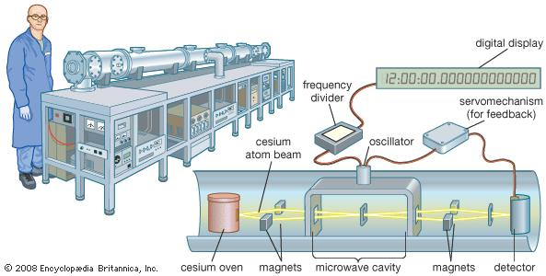

Standards are the fundamental reference for a system of weights and measures, against which all other measuring devices are compared *
*Wikipedia.com

Slide 3


Standards are the fundamental reference for a system of weights and measures, against which all other measuring devices are compared*
*Wikipedia.com

Slide 4


Standards are the fundamental reference for a system of weights and measures, against which all other measuring devices are compared*
*Wikipedia.com

