Slide 1
Network analysis

Slide 2
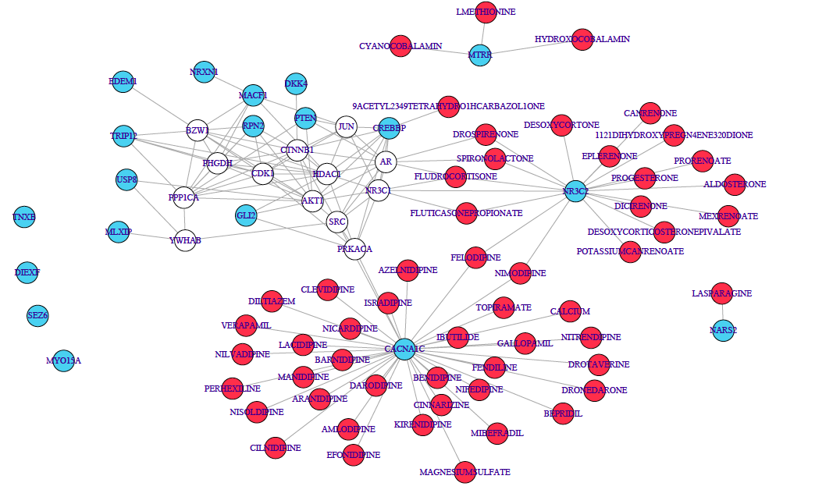
Nodes (vertex)
Edges
Connected components
Degree
Directed vs undirected

Slide 3
Adjacency matrix
0.3
A
A B C D
A
0.3 | 0.8 | 0 | 0
0.8 | 0 | 0.6 | 0.5
0 | 0.6 | 0 | 0
0 | 0.5 | 0 | 0
0.8
B
B
0.5
C
D
0.6
D
C

Slide 4

Using co-expression to define edges
gene1
gene2
Gene 1
Pearson correlation
Gene 2

Slide 5
Partial correlations
Observed correlations
A
A
B
B
C
C

Slide 6
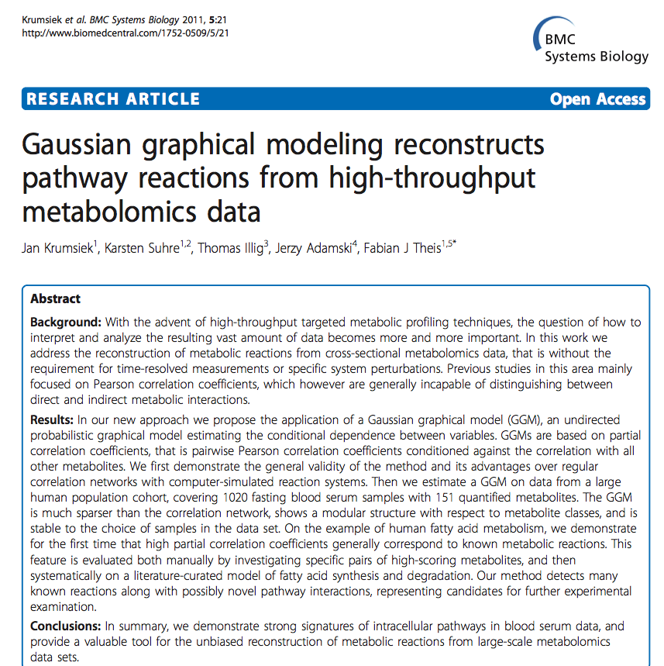

Slide 7
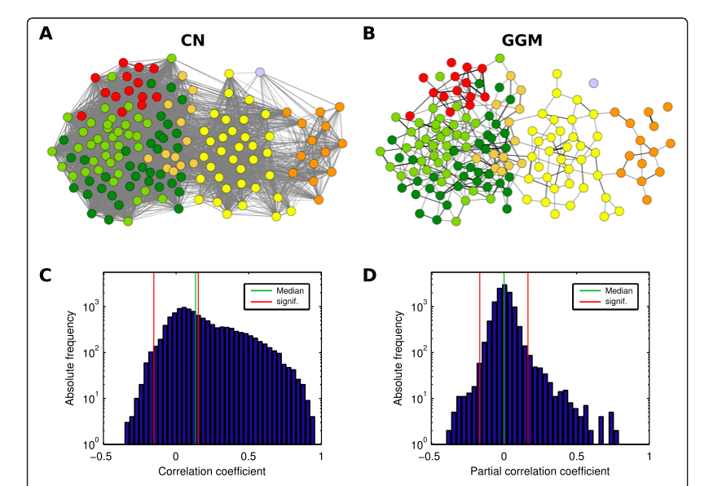
These are the same networks (B) is corrected with Gaussian Correlation and partial correlations have been removed
Krumsiek et al, 2011

Slide 8
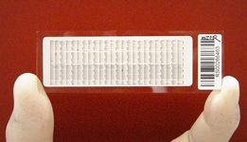
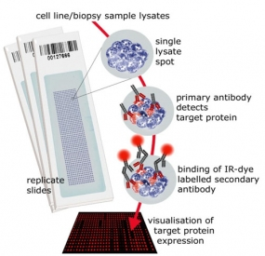
Dataset: TCGA reverse phase protein array

