Slide 1

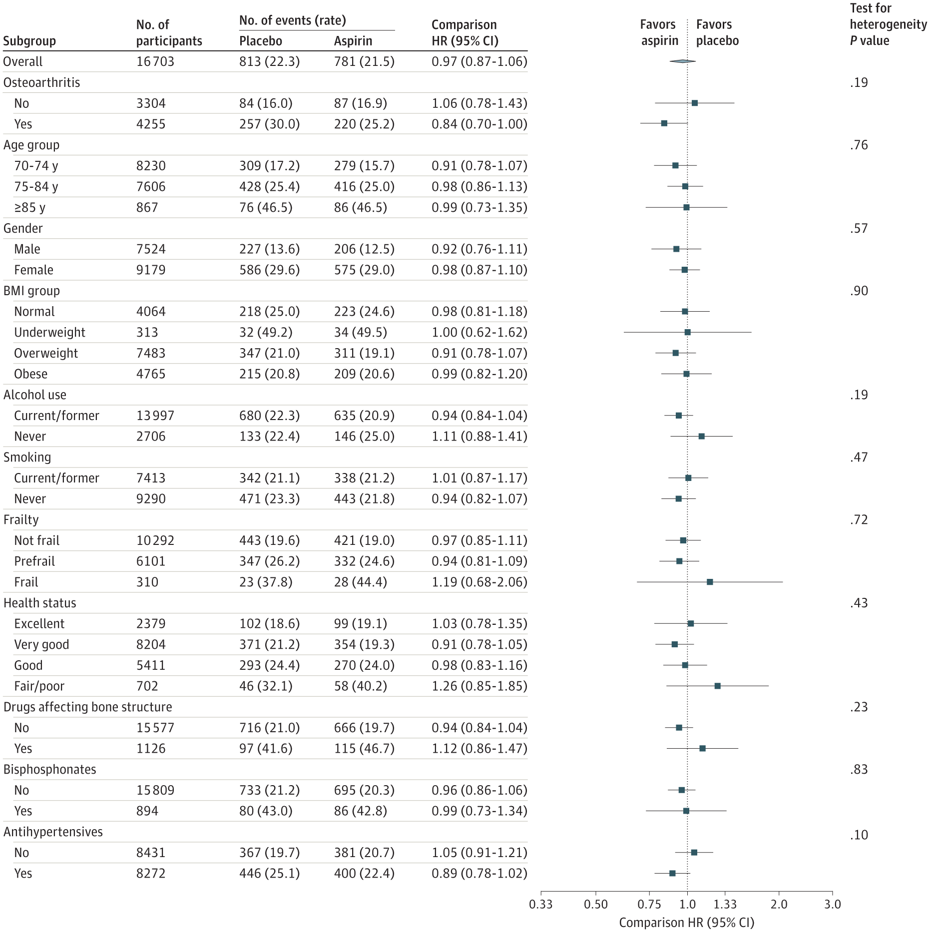
From: Daily Low-Dose Aspirin and Risk of Serious Falls and Fractures in Healthy Older People: A Substudy of the ASPREE Randomized Clinical Trial
JAMA Intern Med. 2022;182(12):1289-1297. doi:10.1001/jamainternmed.2022.5028
^{Figure Legend:}
Forest Plot of Placebo vs Aspirin for First Fracture Event (Rate Is Events per 1000 Person-Years) by Subgroup
^{Date of download: 9/15/2025}
Copyright 2022 American Medical Association. All Rights Reserved.

