Slide 1
R Workshop, Part I
Steve Mooney
Harborview Injury Prevention & Research Center
SER 2017

Slide 2

Why learn R?
Statistical analysis
Graphics
Simulation
Sharing Methods
Replacement for GIS
Transparent
Free

Slide 3
R does statistical analysis
Stratified Independent Sampling design (with replacement)
svydesign(id = ~1, strata = ~strata_pat, weights = ~gps_group_wt,
data = enough_trips)
Call: svyglm(formula = hh1area_km ~ as.factor(agegroup), gps_survey)
Coefficients:
(Intercept) as.factor(agegroup)2 as.factor(agegroup)3 as.factor(agegroup)4
1.1686 0.1431 0.2414 0.1836
Degrees of Freedom: 567 Total (i.e. Null); 556 Residual
(1 observation deleted due to missingness)
Null Deviance: 252.5
Residual Deviance: 249.8 AIC: 1525
But SAS and Stata do that too…

Slide 4
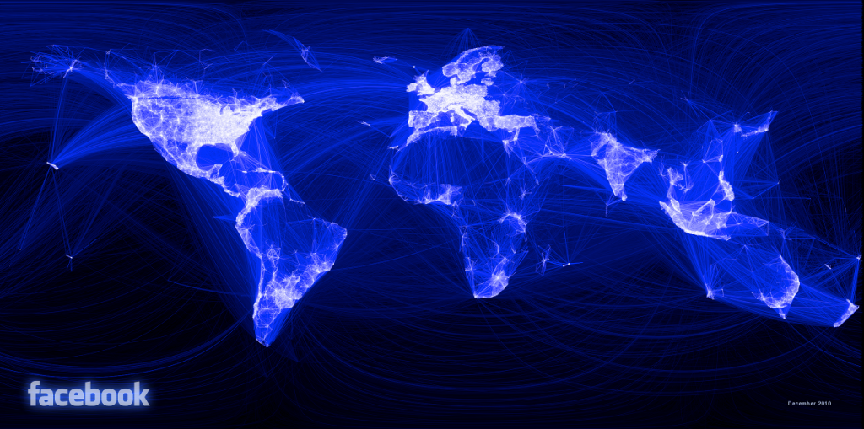
R makes pretty graphics

Slide 5
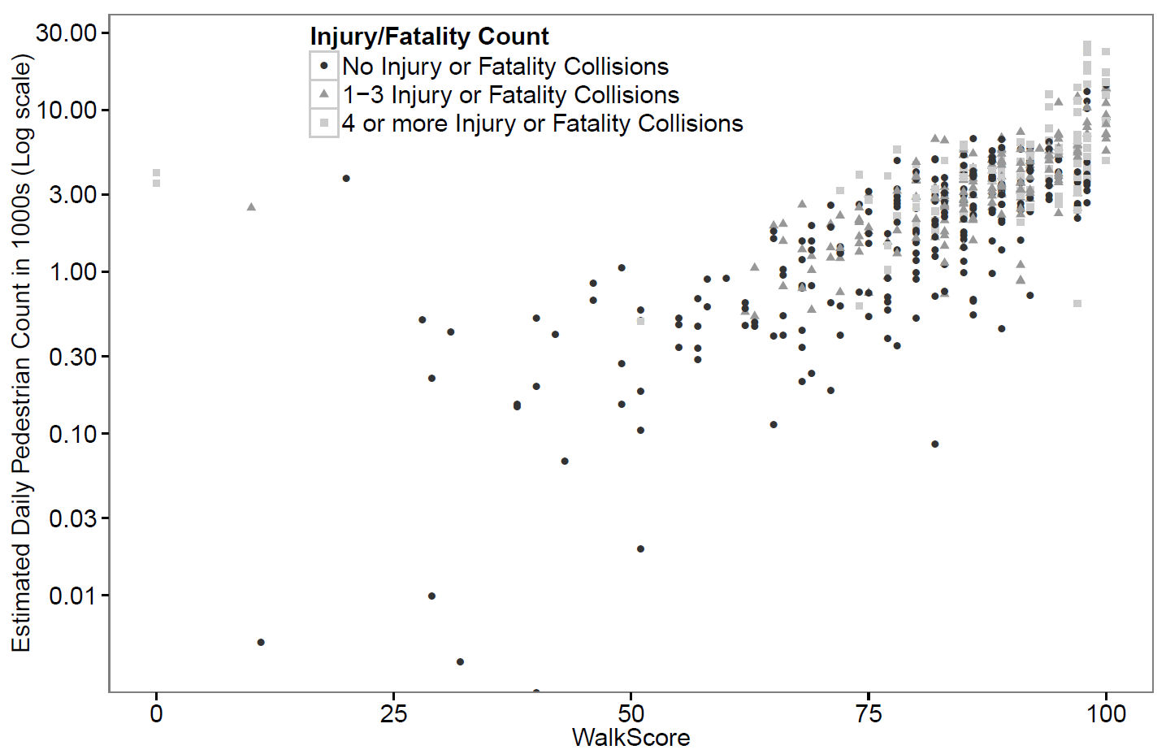
R makes graphics (fairly) easy

Slide 6
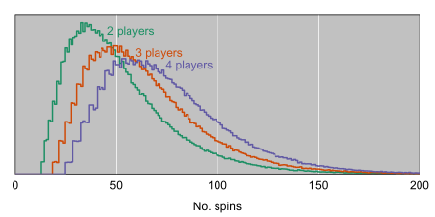
R makes simulations easy
How long does a chutes and ladders game last on average?

Slide 7

R is a language for sharing methods
New statistical methods increasingly published in R
This is particularly true in bioinformatics used for –omic research, where the methods are improving quickly
She may be using R while she does SCIENCE!

Slide 8
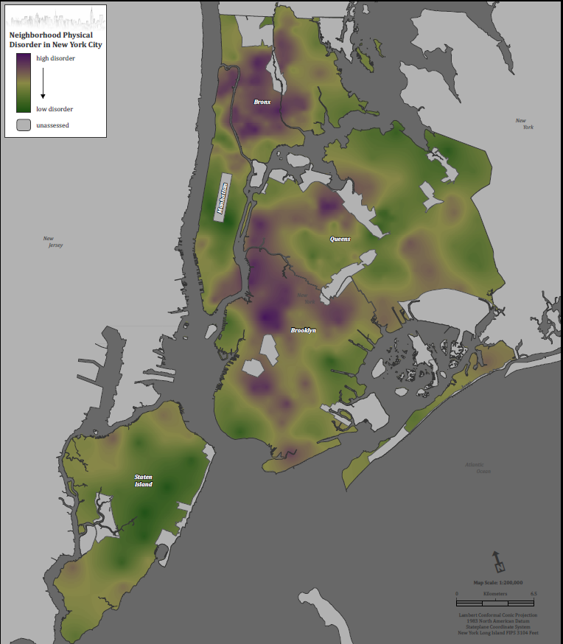
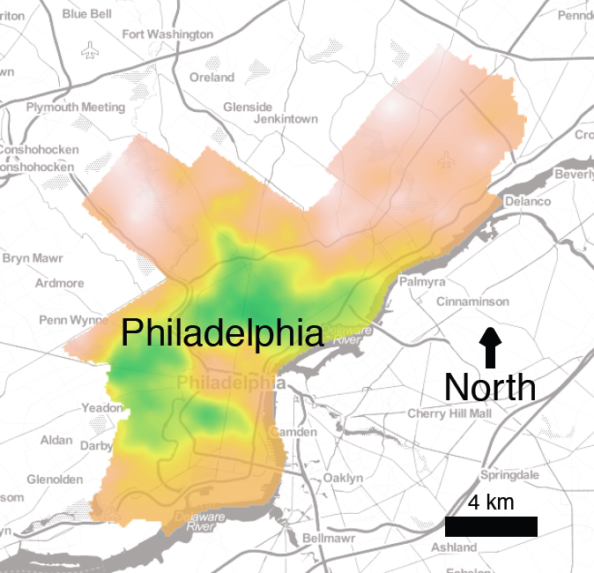
R is a GIS System
Map made in ArcGIS
Map made in R

Slide 9
R is a GIS System
Spatial Analysis for this map: Done in R
Spatial Analysis for this map: Done in R

Slide 10
R is transparent*
The underlying code for most methods is available, sometimes from directly within R
> chisq.test
function (x, y = NULL, correct = TRUE, p = rep(1/length(x), length(x)),
rescale.p = FALSE, simulate.p.value = FALSE, B = 2000)
{
DNAME <- deparse(substitute(x))
if (is.data.frame(x))
x <- as.matrix(x)
if (is.matrix(x)) {
if (min(dim(x)) == 1L)
x <- as.vector(x)
}
...
* usually

Slide 11


R is Free
SAS - $Lots
SPSS - $Lots
Stata - $Some
R - $0.00
RStudio* - $0.00
Which one are you?
* The free version, anyway

Slide 12
Why NOT learn R
Initial learning curve is steep
R comes with no warranty (if it runs, it can be on CRAN)
R is not well suited to large (100K+ row) datasets
But the R community is working on this

Slide 13
Basics
People learn best by doing … but the goal here is to impart my knowledge to you and listening to lectures is not doing
My goal: to give you the tools to overcome hurdles on your own, which will be a mix of guided doing, printed materials, and pointing to Stack Overflow

Slide 14
Process
Generally, I'll talk/demo interactively for a little while, then challenge you to write some code yourself
Because some people will finish challenges earlier than others, I will often suggest self-test problems to test another aspect of the lecture in case you find yourself waiting. Self-test questions and answers are in the handout

Slide 15
Orientation
Open WorkshopSession1.R from the file share
Let's switch to R for a bit here…

Slide 16
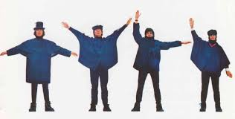
First: Help!
You can get the help page for any function with help(function-name):
help(table)
Or ?function-name:
?table
Or google…
NUJV, not HELP, in semaphore

Slide 17

The building blocks
Vector: A 1-dimensional collection of like elements
3* important types of like elements:
Numeric: 1, 3.5, 1000, -2, etc.
Character: "abcd", "P9489", etc.
Logical: TRUE, FALSE
* One more important type (the factor) we will discuss later

Slide 18
Some Examples of Vectors
Numeric: 1 2 3 4 5 6 7 8 9 10 11 12
Character: "a" "b" "c"
Logical: TRUE FALSE FALSE FALSE FALSE TRUE

Slide 19
Creating Vectors
Basic function: c()
c(1,2,3)
c(FALSE, TRUE)
c(F, T)
Use <- to save the result of c() to a variable
myvector <- c("a", "b", "c")
logicalvector <- c(FALSE)

Slide 20
Vectors in real life
The columns of your datasets are vectors
For example: dig$AGE is a vector of ages
More on this idea later…

Slide 21
Indexing Vectors
Get values back out of vectors using square brackets []
vec <- c(1, 3, 5)
vec
vec[1] # 1
vec[2] # 3
vec[3] # 5
We will talk more about indexing later…

Slide 22

Challenges
One good way to test whether you really know how to code something up is to try
I'm going to describe some challenges in words – you try to write the code!

Slide 23

Challenge #1
1. Run this code:
myvec <- c(1,4,7)
2. Now write the code to select the number 4 from myvec
myvec[2]
(Bonus: self-test # 1 & 2)

Slide 24
The building blocks
Matrix: A 2-dimensional collection of like elements
Same types of like elements as for vectors:
Numeric: 1, 3.5, 1000, -2, etc.
Character: "abcd", "P9489", etc.
Logical: TRUE, FALSE

Slide 25
Some Examples of Matrices
2x6 numeric:
11 12 13 14 15 16
17 18 19 20 21 22
2x2 character:
a b
c d

Slide 26
Creating matrices
Function for creating matrices: matrix()
mymatrix <- matrix(c("a", "b", "c", "d"), nrow=2)
First parameter to matrix() is a vector!
x <- c(1, 2, 3, 4)
matrix(x, nrow=2)
In real life, often use table()
table(dig$TRTMT, dig$DEATH)

Slide 27
Creating matrices
Can also use cbind and rbind to create matrices by 'binding' vectors together:
x <- c(1,2,3)
y <- c(4,5,6)
cbind(x,y)
rbind(x,y)

Slide 28
Indexing Matrices
Get values back out of matrices using square brackets [] and row and column separated by a comma
mtx <- matrix(c(1, 3, 5, 7), nrow=2)
mtx
mtx[1,1] # 1
mtx[2,2] # 7

Slide 29
More building blocks
Array: A 3- (or more-) dimensional collection of like elements
Same types of like elements as vectors and matrices:
Numeric: 1, 3.5, 1000, -2, etc.
Character: "abcd", "P9489", etc.
Logical: TRUE, FALSE

Slide 30
One Example of an Array
Array
Think stratified analysis
1 2 3
4 5 6
7 8 9
10 11 12
Stratum 1
Stratum 2
Function for creating arrays: array()
myarray <- array(1:12 dim=c(2, 3, 2))

Slide 31
Creating arrays
Dim specifies dimensions
array(1:12, dim=c(3,2,2))
array(1:12, dim=c(2,2,3))
Again, first parameter is a vector:
y <- c("a","b","c","d","e","f","g","h","i","j","k","l")
array(y, dim=c(2,2,3))

Slide 32
Challenge #2
Construct a classic 2x2 table, wherein the a cell has 50 people, b (exposed/not diseased) has 100, c has 75 and d has 150
50 | 100
75 | 150
My answer:
matrix(c(50, 75, 100, 150), nrow=2)
(Bonus: self-test # 3)

Slide 33
Challenge #2 (alternate solution)
By default, matrix fills in cells in a column-wise order. An alternative is to use byrow=T:
matrix(c(50, 100, 75, 150), nrow=2, byrow=T)

Slide 34
Quick break

Slide 35
Warmup Challenge
Construct a 4 unit vector wherein the first value is 20, the second is 40, the third is 60 and the fourth is 80
My answer:
c(20, 40, 60, 80)

Slide 36
Reminder: basic types
Basic R object types
Vector
Matrix
Array
List
Data Frame
Before the break
Coming soon…

Slide 37
Why vectors?
Vectorized math can be powerful:
x <- c(1, 4, 3)
x * 2
x + 3
x/2
x/x
x + c(1, 3, 4)
x + c(1, 2)

Slide 38
Functions operating on vectors
Some functions make use of whole vector:
sum(x)
cumsum(x)
sort(x)
var(x)
sd(x)
length(x)

Slide 39

Factors
Factors are a compound type, containing a defined set of integer levels and a mapping from levels to names
But essentially… a way to encode categorical variables

Slide 40
Creating factors
Function for creating factors: factor()
x <- c(1, 3, 2, 1, 3)
factor(x, labels=c("low", "medium", "high"))
Can make factors ordered, define levels explicitly, etc.
?factor to see help page

Slide 41
Review: Basic like element (‘atomic’) types in R
Vector: 1 dimensional collection of like elements
Matrix: 2 dimensional collection of like elements
Array: 3+ dimensional collection of like elements
Important kinds of like elements
Numerics
Logicals
Characters
Factors (are really a special case of numerics)

Slide 42

Names
Can give names to rows and columns in vectors, matrices, and arrays:
namedvec <- c(first=1, second=2)
namedvec
Vector

Slide 43
The 3 kinds of indexing
Can index using logical, numeric, or characters
namedvec[1]
namedvec[c(1,2)]
namedvec['first']
namedvec[c(TRUE, FALSE)]
We'll talk more about this

Slide 44

Pay attention: Coercion
Try this:
c("word", 3)
Is the resulting vector numeric or character?
How could you find out?
mode(c("word", 3))

Slide 45
Coercion
R automatically coerces all elements in an atomic object (vector, matrix or array) to a single mode:
Character if any characters present
Numeric if only numerics and logicals present
c(2.3, FALSE)

Slide 46

Some important Non-Atomic types
List: collection of objects of any kind (mix and match allowed)
Data Frame: tabular data set (each row a record, each column a like element or variable
Not this kind of non-atomic

Slide 47
Lists
One-dimensional, like vectors, but elements need not be the same mode:
1 "word" TRUE
mylist <- list(1, "word", TRUE)
mylist

Slide 48
Lists as Recursive Types
Because elements need not be the same mode, they need not be atomic:
mylist <- list(1,
c("word 1", "word 2"),
TRUE)

Slide 49

List vs. Vector
Lists are for keeping a bunch of stuff in the same object. For example, results of a chi-square test, where you want:
Chi-square score
P-value
Degrees of freedom
Etc.
Vectors are for raw data, where you may want some operation across the whole thing
List
Vector

Slide 50
List vs. Vector in action
myvec <- c(2, 3, 4)
mean(myvec)
mylist <- list(2, 3, 4)
mean(mylist)
list(2, c(2,3,4))
c(2, c(2,3,4))

Slide 51
Indexing a list
Index a list using double square brackets: [[
mylist <- list(2, 3, c(2, 4))
mylist[[1]]
mylist[[3]]
May want to index result of indexing:
mylist[[3]][2]

Slide 52
Named lists
It's often easier to track what’s in a list by name than by number:
results <- list(pval=0.5,
test="fisher exact test",
df=23)
results[[1]]
results[['pval']]
As a result, there's a special way of indexing a list entry by name: $
results$pval

Slide 53
Challenge
Compute the mean of 1,3, 5, 7, and 9.
Hint: Do you want a list or a vector?
My Answer:
myvec <- c(1,3,5,7,9)
mean(myvec)
(Bonus: self-test # 4-7)

Slide 54
Challenge
Create a list with three items, where:
The first item is named values and is a vector containing 1, 5, and 9
The second item is named mean and is the mean of 1, 5, and 9
The third item is named pval and has the value 0.163
My answer:
list(values=c(1,5,9), mean=mean(c(1,5,9)), pval=0.163)
(Bonus: self-test # 4-7)

Slide 55
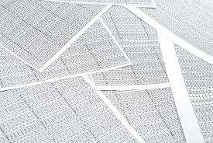
Data Frames
The usual way of looking at data in R
each row is a record or observation
each column is a field or variable (usually numeric vector or factors)
"A list that behaves like a matrix"
Data, yo

Slide 56
Creating a data frame
Usually, load from CSV or subset from data frame loaded from CSV (loading data coming up…)
Can also use data.frame() function
df <- data.frame(nums=1:5, words=c("one", "two", "three", "four", "five"))

Slide 57
Indexing a data frame
Index a data frame using square brackets and row, column syntax (like a matrix)
df[1,2]
df[2,1]
Can index by name or mix of name and number as well:
df[1,"words"]

Slide 58
Data Frames as Lists
Can think of a data frame of a list of vectors of an identical length
Can index columns by name using $:
df$words
But need [row, column] syntax to index rows by name
df['1',]

Slide 59
Data Frames vs. Matrices
Use a data frame for your raw data
Use a matrix for summaries (e.g. 2x2 tables)
We'll go into more detail on data frames after the break

Slide 60
Summary: Basic Object Types for Epidemiologists
Vectors: observations of a single variable
Matrix: contingency (2x2) tables
Arrays: stratified analysis results
Data Frames: observations and variables
Lists: results of complex functions
Factors: categorical variables

