Slide 1
Black-box uncertainty propagation with Python
Dr Ioanna Ioannou, University of Liverpool

Slide 2
# How can we propagate uncertainty through a black-box model?
Black box models
Some models or functions cannot be decomposed into simple arithmetic operations, due to
Secrecy.
Legacy codes.
Just too complex.
They can be queried by evaluating them for particular (scalar) inputs.

Slide 3
# Uncertainty Propagation – the function
from pyuncertainnumber.propagation.uncertaintyPropagation import Propagation
y = Propagation(vars, fun, method)
‘Propagation’
Acts as a high-level interface.
It checks that your UP method is appropriate for the ‘UncertainNumber’ objects.
It propagates the uncertainty.
The minimum input the user needs to specify for the function to run are
vars: A list of ‘UncertainNumber’ objects.
fun: A function which should return 1D np.arrays.
method: The propagation method to be implemented.

Slide 4
# Aleatory Uncertainty Propagation – the function
from pyuncertainnumber.propagation.uncertaintyPropagation import Propagation
y = Propagation(vars, fun, method)
If all uncertain numbers in vars are precise probability distributions, the user can select from
method: { "monte_carlo",
"latin_hypercube",
"taylor_expansion" # Not implemented yet.
}
Underlying assumption for this version: input variable independence.
We could generalise to accept a matrix of corrections or dependence functions (copulas).
Notes:
Dispersive monte carlo - reference

Slide 5
# Aleatory Uncertainty Propagation – Sampling methods
y = Propagation(vars, fun,
# n_sam = 500,
method = "monte_carlo")
y = Propagation(vars, fun,
# n_sam = 500,
method = "latin_hypercube")
Sampling: Use Monte Carlo or Latin Hypercube sampling (default iterations = 500) from the input variables. In this version, input variable independence is considered only.
Estimate outputs: Calculate function output(s) for each sampled input combination.
Determine: The empirical distribution(s) of the function output(s).
Notes:
Change the figures to distributions.

Slide 6
# Aleatory Uncertainty Propagation – Sampling methods
y = Propagation(vars, fun,
# n_sam = 500,
method = "monte_carlo")
y = Propagation(vars, fun,
# n_sam = 500,
method = "latin_hypercube")
Error depends only on replications (1/√N)
20% accuracy for 95% of cases (2 sigma) needs N = 50.
20% accuracy in 99.9% of cases needs N = 113.
Does not depend on dimensionality of inputs.
Works with arbitrary input distribution shapes.
Can accommodate correlation among inputs.
Works well if uncertainty is only distributional and if you’re just interested in the point value.
Notes:
How to estimate this20% accuracy for 95% of cases (2 sigma) needs 50 ?

Slide 7
# Aleatory Uncertainty Propagation – Sampling methods
y = Propagation(vars, fun,
# n_sam = 500,
method = "monte_carlo")
y = Propagation(vars, fun,
# n_sam = 500,
method = "latin_hypercube")
These approaches are not suitable when:
We care about uncertainty of the tail risks.
We do not know dependencies perfectly.
There is doubt about the form of the model.
There is any epistemic uncertainty anywhere.
Notes:
Alternative if the dependency is not knows is to use dispersive Monte Carlo sampling, conservative approach but the paper simply discuses intrusive cases, in our general black box model how do you do that?

Slide 8
# Interval Propagation function
from pyuncertainnumber.propagation.uncertaintyPropagation import Propagation
If all uncertain numbers in vars are intervals, the user can select from the following list of methods
method: { "endpoints",
"extremepoints",
"subinterval reconstitution",
"monte_carlo", # sampling method
"latin_hypercube", # sampling method
"cauchy_deviates", # sampling method
"local_optimization", # optimisation
"genetic_optimization", # optimisation
"Bernstein_expansion" # is not implemented in the current version
}

Slide 9
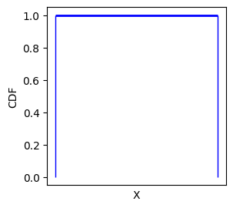


# Interval Propagation – "endpoints" or "vertex"
This method can yield rigorous and best possible results if the function is monotonic.
Generates combinations: Creates all possible combinations of the lower and upper bounds of the input intervals.
Estimates output(s):
(x0, u0, v0) → f(x0, u0, v0)
(x0, u0, v1) → f(x0, u0, v1)
.
.
.
(x1, u1, v1) → f(x1, u1, v1)
Determines output range: Determines the min and max for each output from the generated combinations.
Number of combinations: 2**d
Where d is the number of input uncertain numbers.
Add an example.
y = Propagation(vars, fun, method = "endpoints")
x0
x1
u0
u1
v0
v1

Slide 10
# Interval Propagation–"extremepoints"
Optimizes the search for minimum and maximum output values by using the sign of the partial derivatives to guide the selection of input values for the two extremes.
Generates the base case where all input as set to their lower value and then d number of combinations where only one input is set to its upper value.
Estimates the output(s) from function f for each input combination.
(x0, u0, v0) → f(x0, u0, v0)
(x1, u0, v0) → f(x1, u0, v0)
(x0, u1, v0) → f(x0, u1, v0)
(x0, u0, v1) → f(x0, u0, v1)
Determines whether the output increases or decreases with the change of an input value.
Determines the two input combinations to yield the min and max for each output.
Total number of combinations: d+3
Where d is the number of input uncertain numbers.
y = Propagation(vars, fun, method = "extremepoints")
x0
x1
u0
u1
v0
v1

Slide 11
# Interval Propagation– "subinterval"
To accommodate for the presence of non-monotonic trends, the input intervals are subdivided into smaller subintervals.
Estimate the cartesian product of all subintervals.
…
Determine the min and max of the output(s) for each subinterval combination using endpoints (other methods such as Cauchy can be used but not supported in this version) and then constructs the union of all the subinterval combination.
Total number of combinations: (n_sub+1)**d
Where d is the number of input uncertain numbers.
y = Propagation(vars, fun,
# n_sub = 3,
method = "subinterval")

Slide 12
# Interval Propagation – Sampling methods
y = Propagation(vars, fun,
# n_sam = 500,
method = "monte_carlo")
y = Propagation(vars, fun,
# n_sam = 500,
method = "latin_hypercube")
Transforms intervals: Each interval becomes beta-like distribution be tuned to be uniform distributions or bathtub distributions x0 + (x1-x0)*beta(1/b,1/b) x0 + (x1-x0)*beta(1/b,1/b) that emphasise values near the interval endpoints according to the value of b in [1,Inf)’. In this version only the uniform distribution (min = lower bound, max = upper bound).
Sampling: Uses Monte Carlo or Latin Hypercube sampling (default iterations = 500).
Estimates outputs: Calculates function output(s) for each sampled input combination.
Determines output range: Finds the minimum and maximum of each output from the generated samples.
x0
x1
u0
u1
v0
v1
Notes:
In your outside ppt. Scott it is stated: ‘’ ystematic or random sampling used for black boxes
Wiggle inputs; query black box; remember range of outputs
When there are many inputs, output range too small
With 100 function queries, output range of the sum of 30 unit intervals using uniform sampling is a third of what it should be
Even with a million function calls, it is only half as wide
Underestimation worsens as the number of inputs grows
Need a better way to push intervals through a black box
I do nto understand this: With 100 function queries, output range of the sum of 30 unit intervals using uniform sampling is a third of what it should be
Even with a million function calls, it is only half as wide
I also need to read the naïve I will do it today.

Slide 13
# Interval Propagation – Sampling methods
y = Propagation(vars, fun,
# n_sam = 500,
method = "monte_carlo_endpoints")
y = Propagation(vars, fun,
# n_sam = 500,
method = "latin_hypercube_endpoints")
Transforms intervals: Each interval becomes beta-like distribution In this version only the uniform distribution (min = lower bound, max = upper bound).
Sampling: Uses Monte Carlo or Latin Hypercube sampling (default iterations = 500).
Estimates outputs: Calculates function output(s) for each sampled input combination.
Incorporates bounds of inputs (endpoints): Combines the two sampling methods with the endpoints method to account for interval bounds.
Determines output range: Finds the minimum and maximum of each output from the generated samples.
x0
x1
u0
u1
v0
v1

Slide 14
# Interval Propagation – Sampling methods
y = Propagation(vars, fun,
# n_sam = 500,
method = "cauchy")
Transform intervals: Each interval becomes a Cauchy distribution.
Sampling: Generate random samples with Monte Carlo sampling, or ‘deviates’, from each Cauchy distribution (default iterations = 500).
The samples not necessarily inside the interval!
Estimate outputs: Calculate function output(s) for each sampled input combination.
Determine output range: The resulting output values form a distribution that reflects the combined uncertainty of the input variables. Find the minimum and maximum of each output from the generated samples.
x0
x1
u0
u1
v0
v1
Notes:
The method is built on the assumption that the model can
be approximated well with a first order Taylor expansion over the input intervals. That is, the
function must be (close to) linear given the input uncertainty.
“Sample” from around interval
Points not necessarily inside the interval!
Scale results to get an asymptotically correct estimate of the interval uncertainty of the output

Slide 15
# Interval Propagation – Sampling methods
y = Propagation(vars, fun,
# n_sam = 500,
method = "cauchy")
Depends on the number of samples, not inputs
Works just as well for 1000 input variables as 10.
Similar in performance to Monte Carlo.
Need about 200 samples to obtain 20% relative accuracy of half-width of output range
With fewer samples, we would get lower accuracy, but we can compensate for this by scaling by √N, which works under the linearity assumption.
x0
x1
u0
u1
v0
v1
Notes:
The method is built on the assumption that the model can
be approximated well with a first order Taylor expansion over the input intervals. That is, the
function must be (close to) linear given the input uncertainty.
Q: Need to better understand how to get the statement on the 200 samples.

Slide 16
# Interval Propagation – Sampling methods
y = Propagation(vars, fun,
# n_sam = 500,
method = "cauchy")
Intervals have to narrow relative to the nonlinearity
Based on a linearization approximation.
Function almost linear OR uncertainties small.
Could combine with subinterval reconstitution.
Most efficient when dimensionality is high.
Asymptotically correct, but not rigorous.
Only handles interval uncertainty.
x0
x1
u0
u1
v0
v1
Notes:
The method is built on the assumption that the model can
be approximated well with a first order Taylor expansion over the input intervals. That is, the
function must be (close to) linear given the input uncertainty.

Slide 17
# Interval Propagation – Optimisation methods
Initialise:
x0 (1D or 2D array): Optionally accepts an initial guess for the optimization starting point. If not provided, the midpoint of each variable's interval is used.
tol_loc (float or 2-element np.array): Allows setting tolerances for termination.
options_loc (dict): Accepts solver options as a dictionary (same for min/max) or a list of two dictionaries (separate options).
method_loc (str, optional):The optimization method to use.
Optimise:
Uses scipy.optimize.minimize to find both the minimum and maximum of f within the given bounds.
Minimizes f directly.
Maximizes f by minimizing the negated function -f.
y = Propagation(vars, fun, method = "local_optimisation"
# x0= None, tol_loc = None,
# options_loc= None, method_loc='Nelder-Mead’
)
x0
x1
u0
u1
v0
v1
This method can yield rigorous and best possible results if the function is monotonic.
Notes:
The end solution is guaranteed to be the global optimum of theobjective function, only if the output of the model is unimodal, which is seldom the case. The
major drawback of these methods is that they do not broadly explore the valid search space and therefore tend to concentrate on local optima, which is a problem if the model is highly nonlinear, e.g., has multiple local minima and maxima next to the global minimum or maximum. A possible solution to this would be to sample widely in the valid search space for initial values to ensure that as wide as possible a search space is explored.

Slide 18
# Interval Propagation – Optimisation methods
Initialise:
pop_size: Optional population size. Default is 1000.
n_gen: Optional number of generations. Default is 100.
tol: Optional tolerance for convergence check (scalar or 2-element array for different tolerances for min/max). Default is 1e-3.
n_gen_last: Optional to check for convergence only in the last generations (scalar or 2-element array). Default is 10.
algorithm_type: Optional to choose between 'NSGA2' (default) or 'GA' algorithms.
Optimise:
Uses genetic algorithms (NSGA2 or GA) to find both the minimum and maximum of f within the given bounds.
For each optimization (min/max), it creates a ProblemWrapper class and runs the chosen algorithm.
Uses a custom ‘ConvergenceMonitor’ callback to check for convergence based on the ‘tol’ and ‘n_gen_last’ parameters.
y = Propagation(vars, fun,
# pop_size=1000, n_gen=100, tol=1e-3,
# n_gen_last=10, algorithm_type="NSGA2",
method = "genetic_optimisation")
x0
x1
u0
u1
v0
v1
This method can yield rigorous and best possible results if the function is monotonic.

Slide 19
# Interval Propagation – the function
Method | Underlying assumptions | Cost | Rigor
"endpoints" | Monotonic over intervals | 2**d | High
"extremepoints" | Monotonic over intervals | d+1 | High
"subinterval reconstitution" | Monotonic over subintervals | (m+1)**d | High
"monte carlo" or "latin hypercube" | Independence among variables | m | Low
"cauchy" | Linear over intervals | m | Medium
"local optimization" | Problem dependent | m | Medium
"genetic optimization"
"genetic optimization" |  | ≤ m | Medium

Slide 20
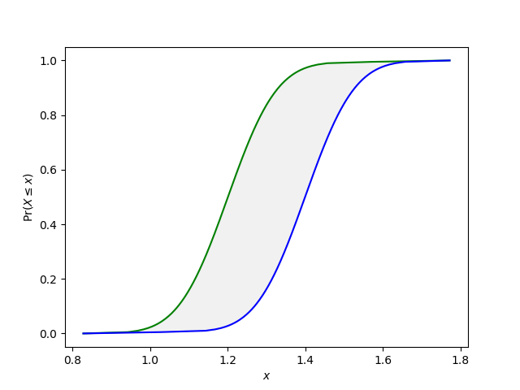
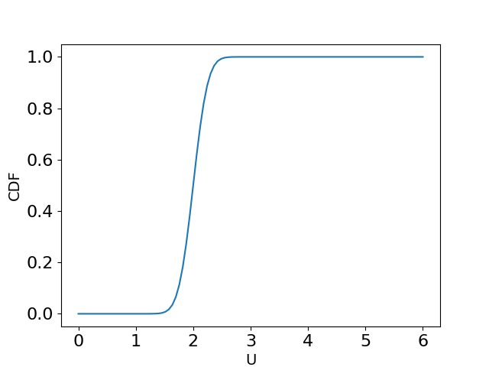
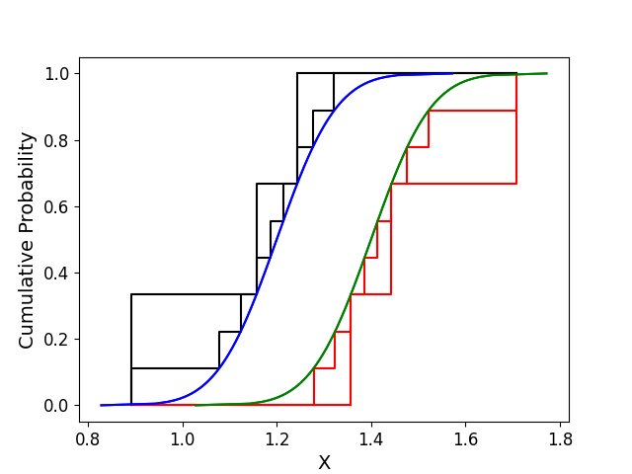
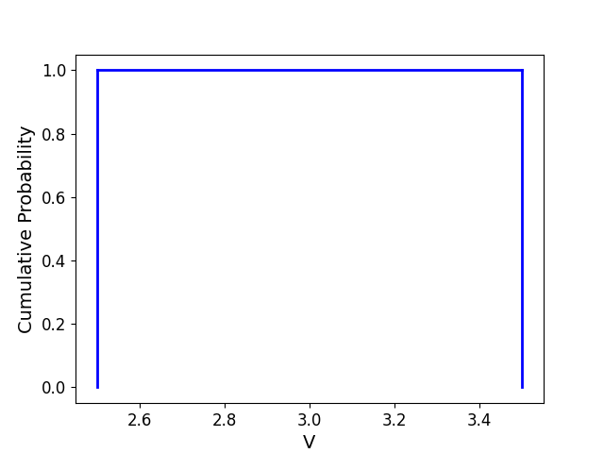
# Mixed Uncertainty Propagation – Condensation
For mixed uncertainty input in vars
At least one probability box (p-box) among the uncertain numbers.
A mix of inputs with interval and precise probability distributions.
Precise probability distributions only.
To propagate the uncertainty of complex p-box or distributions we reduce them to intervals.
Notes:
3 and 9 slices

Slide 21
# Mixed Uncertainty Propagation – the function
from pyuncertainnumber.propagation.uncertaintyPropagation import Propagation
y = Propagation(vars, fun, method)
For mixed uncertainty input in vars
At least one p-box among the uncertain numbers.
A mix of input with interval and precise probability distributions.
Precise probability distributions only.
The user can select from the following list of methods
method: {"varied_discretisation_extremepoints",
"focused_discretisation_endpoints",
"focused_discretisation _extremepoints",
"focused_discretisation_cauchy_deviates" # Not implemented yet.
}

Slide 22
# Mixed Uncertainty Propagation – focused discretisation
from pyuncertainnumber.propagation.uncertaintyPropagation import Propagation
y = Propagation(vars, fun,
# n_disc = 10, tOp = 0.999, bOt= 0.001,
# condensation = None,
method = "focused_discretisation_endpoints")
y = Propagation(vars, fun,
# n_disc = 10, tOp = 0.999, bOt= 0.001,
# condensation = None,
method = "focused_discretisation_extremepoints")
For mixed uncertainty input in vars
At least one p-box among the uncertain numbers.
A mix of input with interval and precise probability distributions.
Precise probability distributions only.

Slide 23
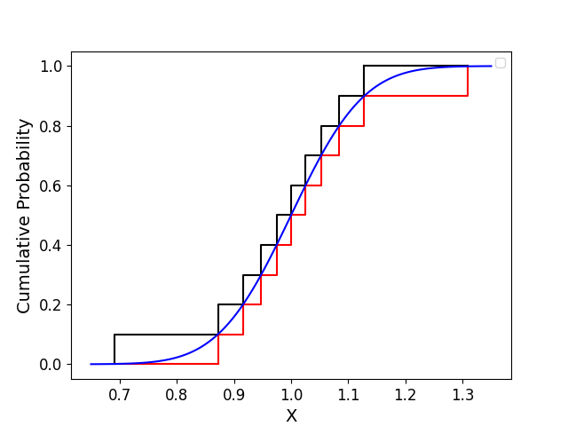
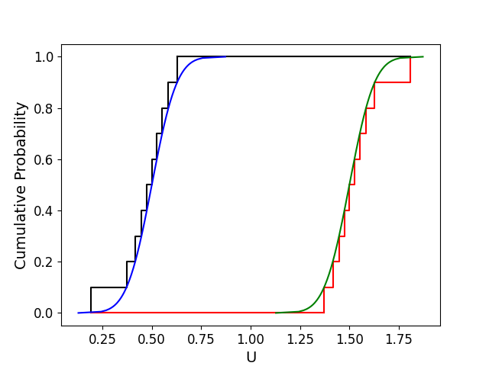
# Mixed Uncertainty Propagation – focused discretisation
(x9,p9)
A precise distribution or p-box are decomposed into a list of pairs (interval, mass)
The interval corresponds to each horizontal box across the distribution or p-box
The mass corresponds to the thickness in probability.
n_disc: Union[int, np.ndarray] determines how many pairs will be produced (default is 10).
tOp: Union[int, np.ndarray] Upper quantile limits for discretization, needed for non-bounded distributions, e.g., normal (default is 0.999).
bOt: Union[int, np.ndarray] Lower quantile limits for discretization, needed for non-bounded distributions, e.g., normal (default is 0.001).
The user may use different discretisations for each uncertain number.
For each uncertain number, all pairs can only have identical masses for this version!
P-boxes/distributions step functions # need to implement.
.
.
.
X1=[]
(x1,p1)
(x0,p0)
(u9,q9)
.
.
.
(u1,q1)
(u0,q0)
Notes:
Talk about outer approximation
#distribution
y = UncertainNumber(essence = ‘distribution', distribution_parameters= ["gaussian",[1.0, 0.10]])
#pbox
y = UncertainNumber(essence = 'pbox', distribution_parameters= ["gaussian",[[0.5, 1.5], 0.10]])
F distribution or lognormal
tOp, bOt really matter for tails.
Tail emphasizing algorithms.

Slide 24
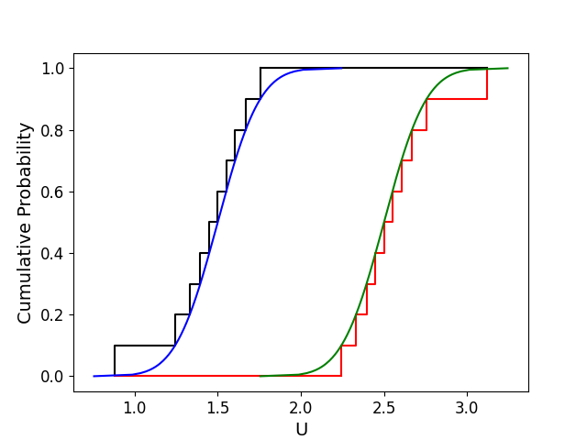
# Mixed Uncertainty Propagation – focused discretisation
Step 1.The cartesian product of the pairs for all uncertain numbers is considered.
(x0, u0, v0)
(x0, u1, v0)
(x0, u2, v0)
…
(x9, u9, v0)
We make an independence assumption here but in theory you could account for dependence even in a black box case.
(x9,p9)
.
.
.
Step 2.For each combination of focal points the min and max of the output can be obtained by performing epistemic uncertainty propagation methods.
The code supports endpoints, extremepoints methods to estimate the min and max for each combination of focal points.
Cauchy deviates and Bernstein expansion will be included in future versions.
(x1,p1)
(x0,p0)
(u9,q9)
.
.
.
(u1,q1)
(u0,q0)
This method incurs a high computational cost!
(v0,m0)

Slide 25
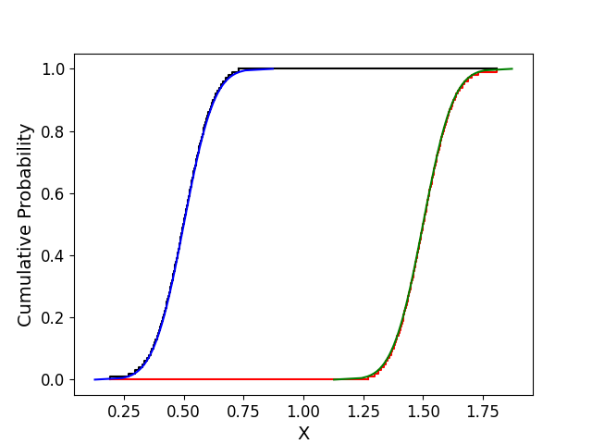
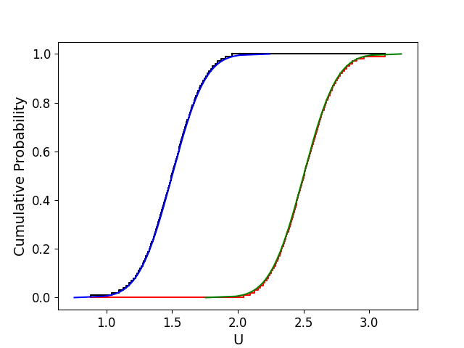
# Mixed Uncertainty Propagation – focused discretisation
condensation: (Union[int, np.ndarray], optional) A parameter or array of parameters to control the condensation of the output p-boxes. Defaults to None.
Assume k uncertain numbers in the cartesian product has n intervals-mass pairs, then the analysis will result in n**k such pairs.
The cartesian product might result to a rather large number of pairs.
To present more manageable results, the output pbox can be condensed and only present one every ‘condensation’ number of points by adopted a similar outward-directed scheme explained earlier.
For example, if there are two input p-boxes with 100 elements each, the output pbox will be based on 100**2=10,000 elements. The user may decide to record only 1 in every 100th element.
(x99,p99)
.
.
.
(x0,p0)
(u99,q99)
.
.
.
(u0,q0)

Slide 26
# Mixed Uncertainty Propagation – varied discretisation
from pyuncertainnumber.Propagation.uncertaintyPropagation import Propagation
y = Propagation(vars, fun,
# n_disc = 10, tOp = 0.999, bOt= 0.001,
# condensation = None,
method = “varied_discretisation_extremepoints")
For mixed uncertainty input in vars
At least one p-box among the uncertain numbers.
A mix of input with interval and precise probability distributions.
Precise probability distributions only.
For this version,
The user can only use the same discretization number for each uncertain number.
For each uncertain number, all pairs can only have identical masses!
Empirical p-boxes or distributions have not been tested

Slide 27
# Mixed Uncertainty Propagation – varied discretisation
(x9,p9)
A precise distribution or p-box are decomposed into a list of pairs (interval, mass)
The interval corresponds to each horizontal box across the distribution or p-box
The mass corresponds to the thickness in probability.
n_disc: Union[int, np.ndarray] determines how many pairs will be produced (default is 10).
tOp: Union[int, np.ndarray] Upper quantile limits for discretization, needed for non-bounded distributions, e.g., normal (default is 0.999).
bOt: Union[int, np.ndarray] Lower quantile limits for discretization, needed for non-bounded distributions, e.g., normal (default is 0.001).
.
.
.
X1=[]
(x1,p1)
(x0,p0)
(u9,q9)
.
.
.
(u1,q1)
(u0,q0)
Notes:
Talk about outer approximation
#distribution
y = UncertainNumber(essence = ‘distribution', distribution_parameters= ["gaussian",[1.0, 0.10]])
#pbox
y = UncertainNumber(essence = 'pbox', distribution_parameters= ["gaussian",[[0.5, 1.5], 0.10]])
F distribution or lognormal
tOp, bOt really matter for tails.
Tail emphasizing algorithms.

Slide 28
# Mixed Uncertainty Propagation – varied discretisation
Step 1.For each input, its focal points are combined with a simplified version of all other input uncertain numbers.
(x0, u0, v0)
(x1, u0, v0)
(x2, u0, v0)
…
(x9, u0, v0)
For each combination of focal points the min and max of the output can be obtained by performing the ‘extremepoints’ method and results in a p-box.
(x9,p9)
.
.
.
Step 2. It then combines these individual p-boxes by finding the overlapping region of uncertainty that is common to all of them. This overlapping region represents the overall uncertainty in the output(s).
(x1,p1)
(x0,p0)
(u0,q0)
(v0,m0)
Notes:
The function analyses the effect of each input individually assuming all other are reduced to intervals. It uses the `extremepoints` to determine the signs of the partial derivatives of the function. For each input, the function constructs a pbox output.
All itnervals an interval. More than one?

Slide 29
# Uncertainty Propagation – Results
y = Propagation(vars, fun, method, results = Propagation_results)
Propagation_results is a class used to manage the uncertainty propagation data.
Centralised storage: this class stores efficiently and organizes key data generated during the analysis.
Multiple outputs, unified data: the class is designed to handle analyses with multiple uncertain outputs, while keeping the input data and core calculations shared for efficiency.
Rich Data Components: Stores not just the final Uncertainty Numbers but also raw data.
Enhanced Organization: Uses a combination of NumPy arrays and dictionaries to structure the data logically for easy access and interpretation.
Clear Presentation: Provides a built-in print() method to display the results in a clean, formatted way, even for complex multi-output scenarios

Slide 30
# Uncertainty Propagation – Results
attributes:
'un'(np.ndarray): np.array of UncertainNumber objects (one for each output).
'raw_data' (dict): Dictionary containing raw data shared across outputs:
'x' (np.ndarray): Input values.
'f' (np.ndarray): Output values.
'min' (np.ndarray): Array of dictionaries, one for each output, containing 'x', 'f' for the minimum of that output.
'max' (np.ndarray): Array of dictionaries, one for each output, containing 'x', 'f' for the maximum of that output.
'bounds' (np.ndarray): 2D array of lower and upper bounds for each output.
Propagation_results
un
raw_data
x
f
bounds
max
min
part_deriv_sign
x
f
x
f

Slide 31
# Uncertainty Propagation – Results
base_path = 'C:\\Users\\Ioanna\\Documents\\GitHub\\PyUncertainNumber\\test'
y = Propagation(vars, fun, method, save_raw_data = ‘no’)
y = Propagation(vars, fun, method, save_raw_data = ‘yes’, base_path = base_path)
save_raw_data (str, optional): Whether to save raw input – output data.
Defaults to ‘no’. If `save_raw_data` is set to 'yes’,
it saves the raw propagation data (input samples and corresponding output values) to a file, as a pandas data.frame in a file named after the adopted method.
base_path (str, optional): Path for saving results (if save_raw_data is 'yes').
Defaults to np.nan.

Slide 32
End

Slide 33
The Challenge
For a low-speed NACA 2412 airfoil with
Simple flap starting at 70% chord and hinged at the midpoint
At nominally zero degree of angle of attack
Is the lift coefficient in the range 0.155 to 0.265.
Is the moment coefficient (about the quarter chord)) in the range -0.050 to -0.044.
To standardise the challenge, a particular version of XFOIL is used.
The discretization error is ignores here but you can read the 2024 AIAA invited papers.

Slide 34
The Challenge
AIAA 2024 relevant papers
Cary, A.W., Schaefer, J.A., DeCarlo, E.C., Duque, E.P. and Khurana, M., 2024. Overview of Fluid Dynamics Uncertainty Quantification Challenge Problem and Results. In AIAA SCITECH 2024 Forum (p. 0705).
Hristov, P.O., Ioannou, I. and Ferson, S., 2024. How to Exploit What We Know About Input and Model: A Trans-probabilistic Approach to the 2022 AIAA UQ Challenge. In AIAA SCITECH 2024 Forum (p. 0944).
Bhaduri, A., Ravi, S.K., Pidaparthi, B.K., Jacobs, R., Pandita, P., Zhang, F., Ghosh, S., Tsilifis, P., Luan, L., Pilania, G. and Amer, A.W., 2024. A probabilistic framework for uncertainty quantification in the presence of aleatory and epistemic inputs: Application to sailplane payload delivery. In AIAA SCITECH 2024 Forum (p. 0943).
Parekh, J. and Bekemeyer, P., 2024. A Surrogate-based Approach for a Comprehensive UQ Analysis in CFD. In AIAA SCITECH 2024 Forum (p. 0707).
Rumpfkeil, M.P. and Sundararajan, A., 2024. Multi-Fidelity Sparse Polynomial Chaos Surrogate Models Applied to the UQ Challenge Problem. In AIAA SCITECH 2024 Forum (p. 0708).
Schaefer, J.A., Cary, A.W. and Khurana, M., 2024. Surrogate Model and Discretization Error Impacts on the Fluid Dynamics Uncertainty Quantification Challenge Problem. In AIAA SCITECH 2024 Forum (p. 0706).
Shaw, S., 2024. MBDA Approach to the AIAA Uncertainty Quantification Challenge Problem. In AIAA SCITECH 2024 Forum (p. 0709).

Slide 35
Uncertainties
Speed and Reynolds Number:
Mach number is considered low enough that compressibility will not contribute to the analysis.
The exact speed is unknown, which leads to uncertainty in the Reynolds number.
Airfoil Condition:
The exact condition of the airfoil's surface is unknown due to
Aeroelastic deformation (how the wing bends under aerodynamic load)
Surface ripples
Surface contamination (dirt, bugs, etc.)
Angle of Attack:
The angle between the airfoil and the oncoming airflow is uncertain due to:
wind gusts
Aeroelastic twist (how the wing twists under load)
Uncertainty in how the aircraft's pitch changes with velocity
Flap Deflection:
The position of the flaps on the wing can vary due to aerodynamic loads or other settings, further influencing the airfoil's performance.
Notes:
The Reynolds number is a crucial parameter in aerodynamics that describes the relationship between inertial and viscous forces.

Slide 36
Problem parameterisation
The problem is parameterised by 5 inputs (chord is taken to be a unit length):
*
*Epistemic intervals correspond to ±3 standard deviations (99.7% probability mass) of the corresponding distributions.
Parameter | Symbol | Unit | Aleatory distribution | Epistemic interval*
Angle of attack | ⍺ | Degree | N(0, 0.1) | [−0.3, 0.3]
Reynolds number | Re | ND | N(500 000, 2500) | [492500, 507500]
Upper surface trip location | x_{tt} | ND | N(0.3, 0.015) | [0.255, 0.345]
Lower surface trip location | x_{tb} | ND | N(0.7, 0.021) | [0.637, 0.763]
Flap deflection | 𝛿 | Degree | N(0, 0.08) | [−0.24, 0.24]

Slide 37
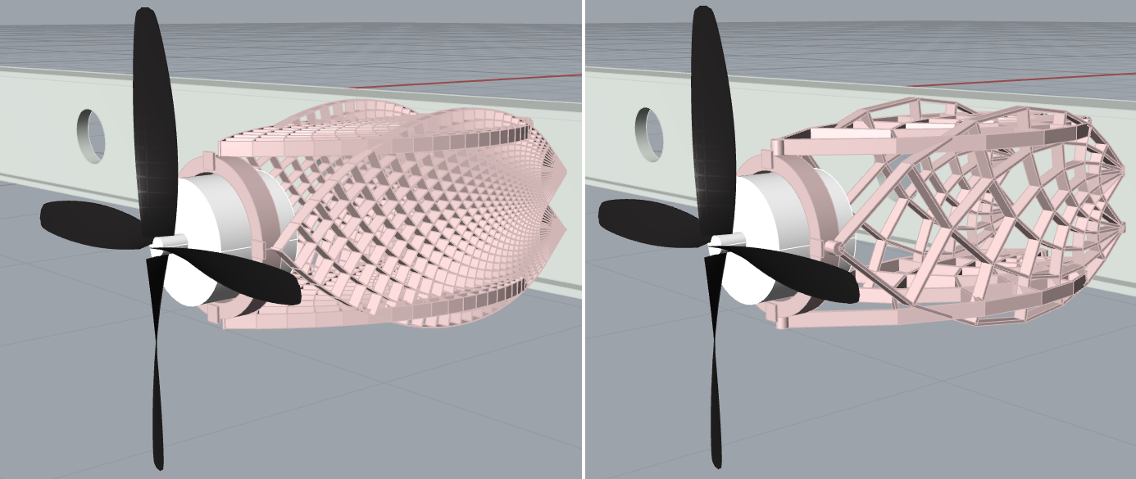
# 3rd Problem: Michell Truss
## Preliminary aircraft propulsion system.
A motor mount is constructed through procedural geometry modelling.
The aim is to minimise its weight.
Each side is a stainless steel Michell truss
The topology of each lattice is described by geometric parameters.
Length of motor mount, L = 1.9m
A downward load, F, is applied.
Maximum deflection constraint =50mm.
Computational infrastructure is Rhino® 7 via its Grasshopper® visual programming interface.
The problem is that the uncertainty can only be propagated through the software Rhino.
We could still use the python UP module to obtain the input combinations of endpoint/subinterval reconstitution/sampling/endpoints Cauchy methods.

Slide 38
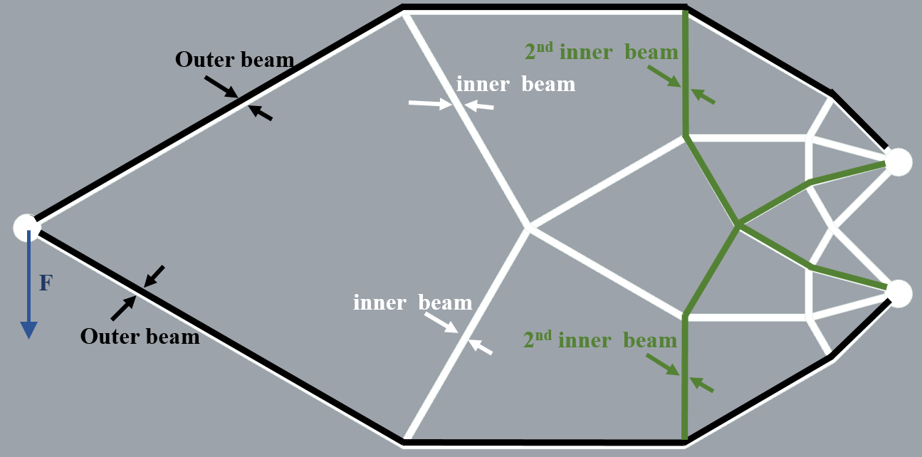
# Michell Truss
## Uncertainty Characterisation
Create 5 uncertain numbers assuming they are intervals with the lower and upper values are seen below
D = [4, 24]
Rout = [0.002, 0.008]
Rin = [0.25, 1.00]
Rin2 = [0.25, 1.00]
F = [15, 25] kN
Notes:
D = Number of divisions,
Rout = between the width of the outer beams (black) and the overall length of the lattice, 𝐿.
Rin = the ratio between the width of the inner beamsof the lattice (white), excluding the second beams, and the width of the outer beams.
𝑅𝑖𝑛2= and the ratio between the width of the second inner beams (green) and the width of the outer beams.
F= downward load in kN.

Slide 39
# Michell Truss
## Epistemic Uncertainty Characterisation
from PyUncertainNumber.characterisation.uncertainNumber import UncertainNumber as UN
D = UN(name='divisions', symbol='D', essence='interval', bounds=[4, 24])
R_out = UN(name='outer_length_ratio', symbol='R_out', essence='interval', bounds= [0.002, 0.008])
R_in = UN(name='inner_outer_ratio', symbol='R_in', essence='interval', bounds= [0.25, 1.00])
R_in2 = UN(name='inner2_outer_ratio', symbol='R_in2', essence='interval', bounds=[0.25, 1.00])
F = UN(name='vertical force', symbol='F', units='kN', essence='interval', bounds= [15, 25])
D.display()
Notes:
D = Number of divisions,
Rout = between the width of the outer beams (black) and the overall length of the lattice, 𝐿.
Rin = the ratio between the width of the inner beamsof the lattice (white), excluding the second beams, and the width of the outer beams.
𝑅𝑖𝑛2= and the ratio between the width of the second inner beams (green) and the width of the outer beams.
F= downward load in kN.

Slide 40
# Michell Truss
## UC Modelling with fun undefined.
If fun =None, the aim is to save the input combinations, where possible, and run them in grasshoppers through a loop functions to propagate the uncertainty.
<<add figure from grasshoppers>>
<< perhaps add more info on the Cauchy deviates>>>>
Notes:
D = Number of divisions,
Rout = between the width of the outer beams (black) and the overall length of the lattice, 𝐿.
Rin = the ratio between the width of the inner beamsof the lattice (white), excluding the second beams, and the width of the outer beams.
𝑅𝑖𝑛2= and the ratio between the width of the second inner beams (green) and the width of the outer beams.
F= downward load in kN.

