Slide 1
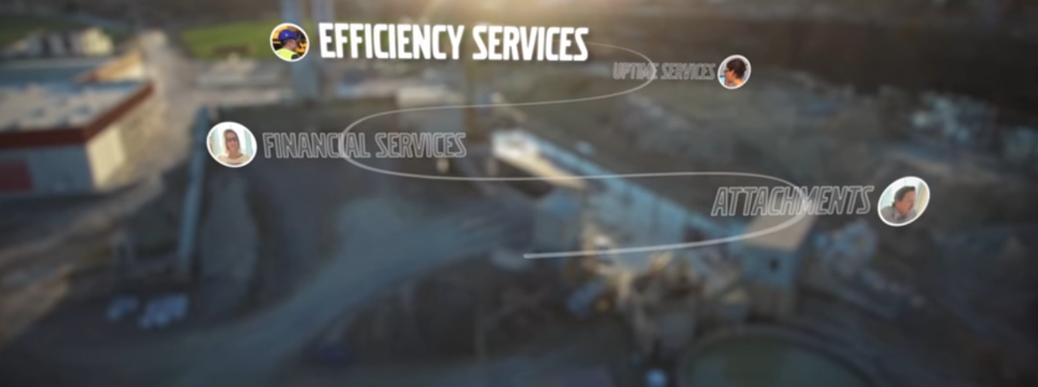
Volvo Eco driving
SE Project Course

Slide 3
Project over all idea
We want an app to make the operator drive more efficient
It’s optionally for the operator to compete
The time interval for running the game is optional
The algorithm will be based on real time machine data (keep it simple)
We want the high score to be published on web portal
Your own historical data shall be possible to reach via the app. The last 10 driving cycles, this to understand and be able to improve

Slide 4
development environment
You will receive the Volvo Co Pilot HW and harness
You will have access to the Volvo Lab at Mdh, to use the simulators
A virtual machine with the development environment is delivered to Mdh. You can either use this or set your own environmnet with help of our guideline
You have the possibility to record and replay the data on CAN4 and GPS. This to make it easy to develop and test in an emulator in Android Studio

Slide 5
algorithm idea
We want an algorithm that calculates high score based on machine real time signals. This should be based on the following signals:
Vehicle Speed (km/h)
Engine Speed (RPM)
Instant Fuel consumption (Liter/hour)
Current material weight in bucket (kg)
Travel distance via GPS position (Via sensor bus)
Altitude via GPS
E.g.

Slide 6
App idea
You basically start the app
You will be promted to add you name / alias
In the app you start choose the ”Driving period”
The Cycle will start
We want you to come up with 3 concepts.
We want to evaluate and choose the best one.
We encourage good / instant feed back so the operator understands that he / she use the machine in a correct way.
Your own historical data for a cycle should be possible to view. This to understand and imporve.
It is ok to only have one type of machine, Wheel Loader, Articulated Hauler or an Excavator. Or you can choose them all.

Slide 7
Web idea
Keep it simple. Select a web server of your own choice. We have no requirements on the selected technique. We want you to come up with 3 concepts.
Our idea of the interface is:
Title ”VOLVO ECO DRIVING”
Circular buffer of the high score, the 20 highest

Slide 8
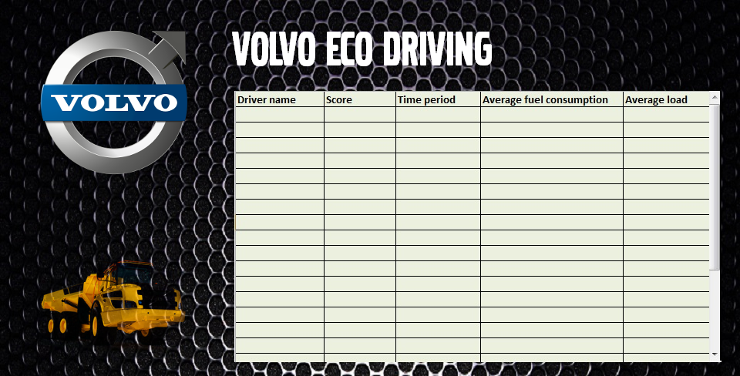
Web graphical idea

Slide 9
project deliverys
Algorithm as source code
Document the 3 concepts for the app
App source code and .apk
Document the 3 concepts for the web portal
Report of project
Power point to be able to present the project for others

