Slide 1
DATA ENGINEERING + ML PORTFOLIO PROJECT
Goodwill Donation Analysis
Part 1 of 3 | Original Slides 1–5
Split for GitHub Upload
Original slide formatting and graphics preserved
Part 1/3

Slide 2
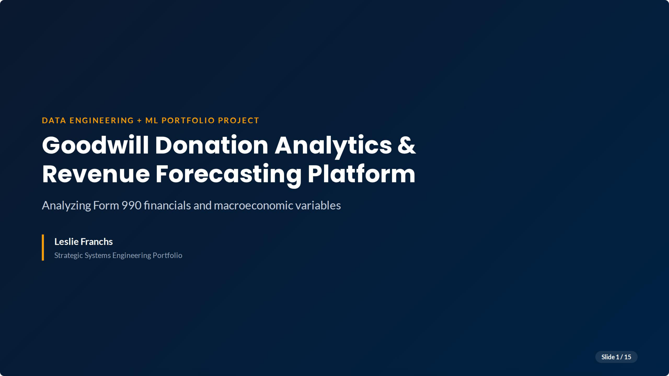

Slide 3
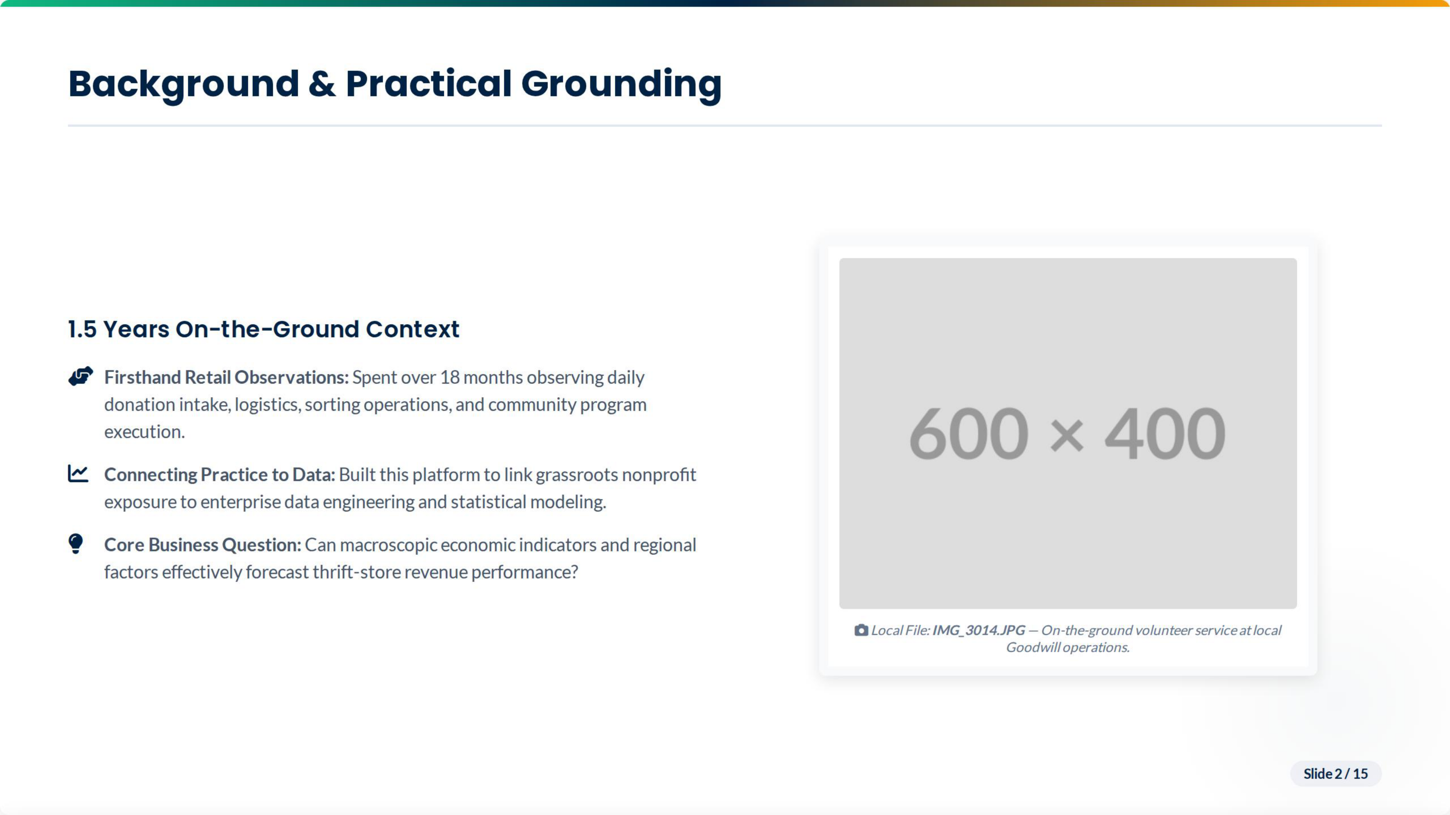
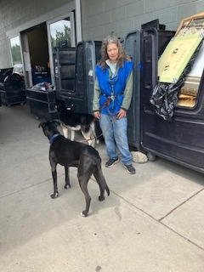
Goodwill volunteer service — firsthand exposure to donation intake and local operations.

Slide 4
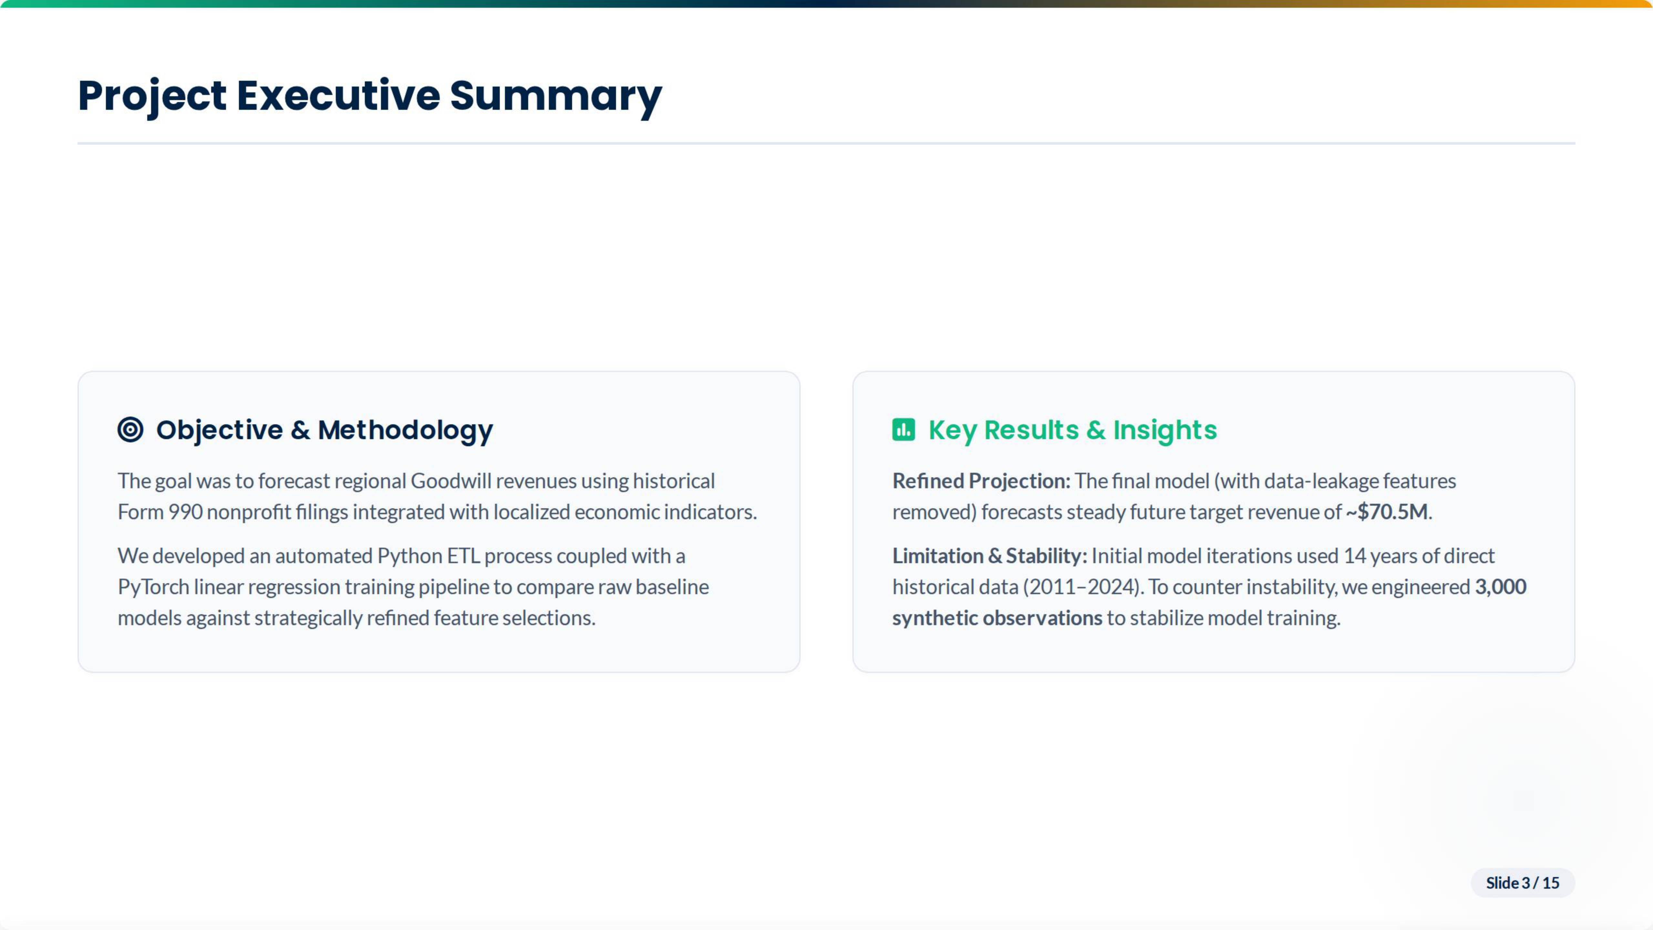

Slide 5
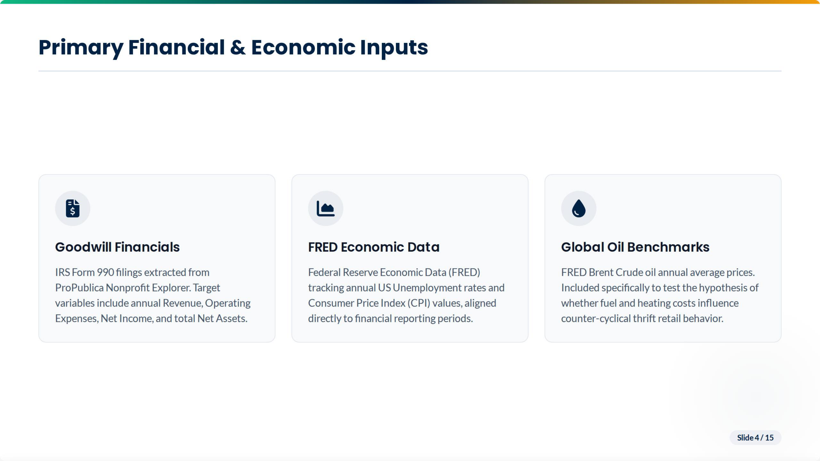

Slide 6
