Slide 1
DATA ENGINEERING + ML PORTFOLIO PROJECT
Goodwill Donation Analysis
Part 2 of 3 | Original Slides 6–10
Split for GitHub Upload
Original slide formatting and graphics preserved
Part 2/3

Slide 2
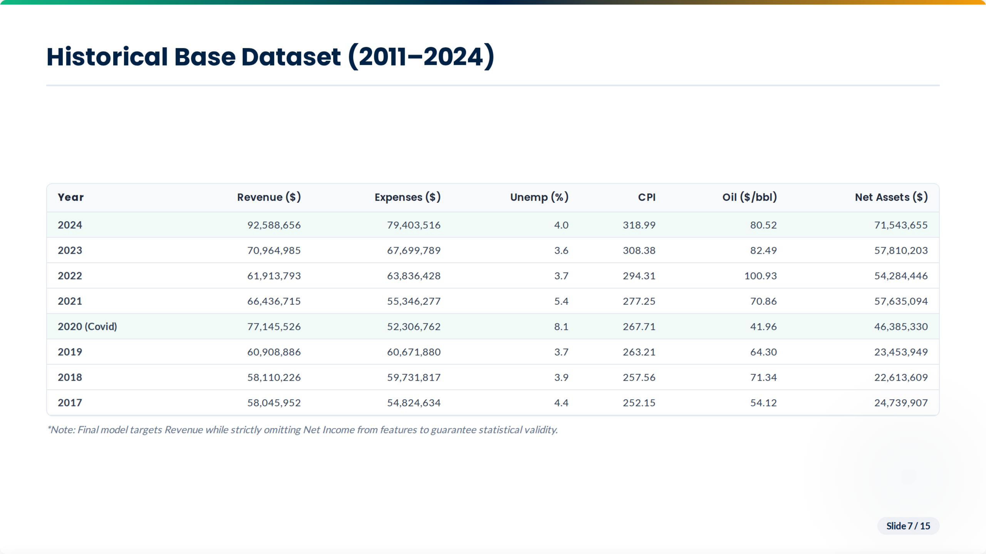

Slide 3
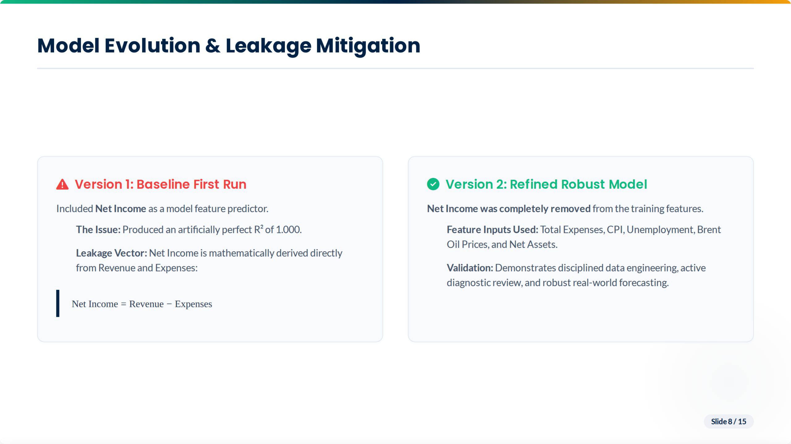

Slide 4
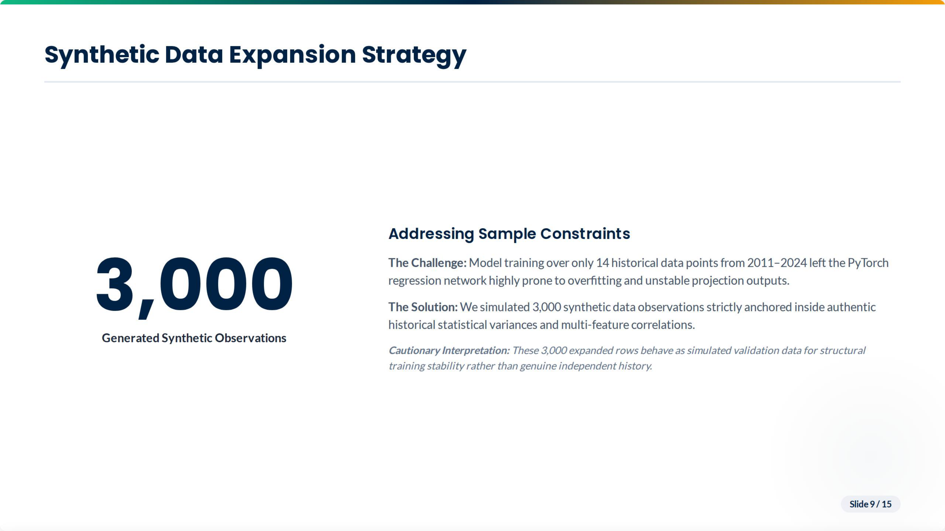

Slide 5
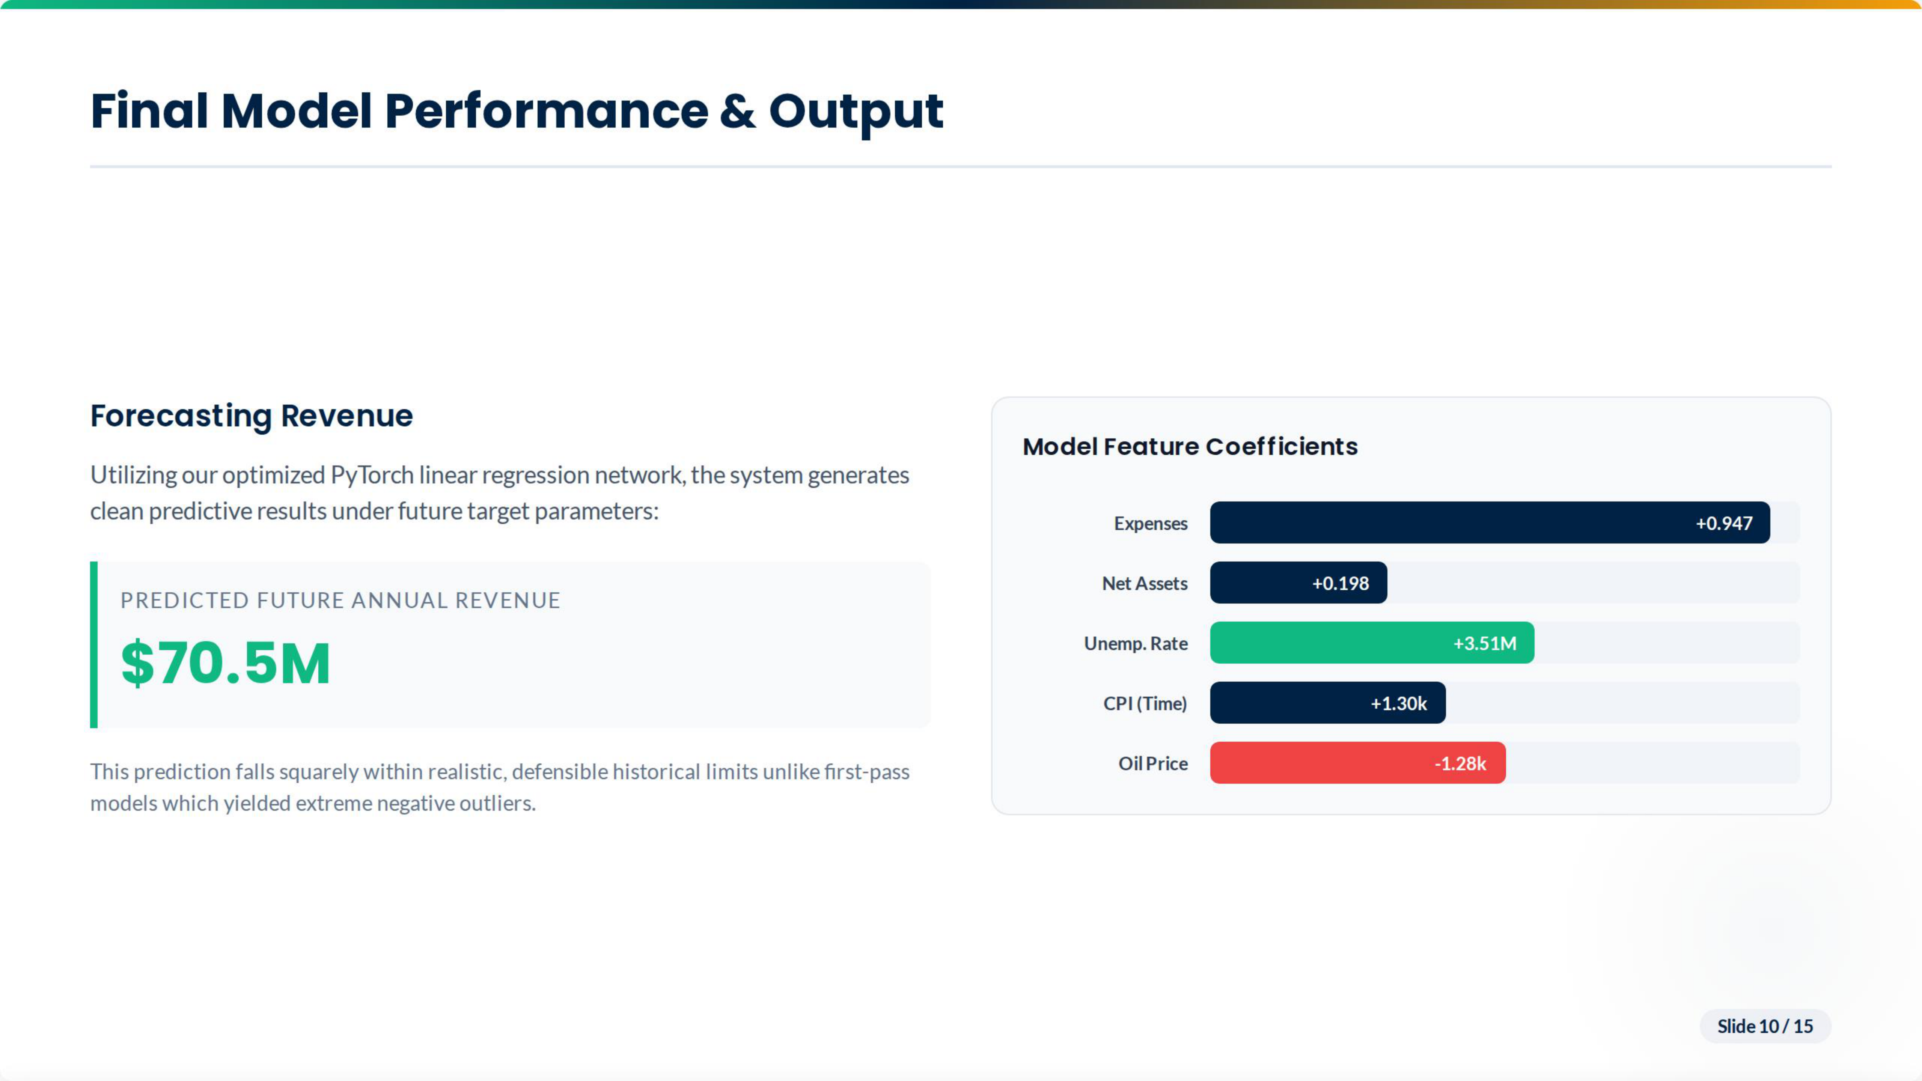

Slide 6
