Slide 1
DATA ENGINEERING + ML PORTFOLIO PROJECT
Goodwill Donation Analysis
Part 3 of 3 | Original Slides 11–13
Split for GitHub Upload
Original slide formatting and graphics preserved
Part 3/3

Slide 2
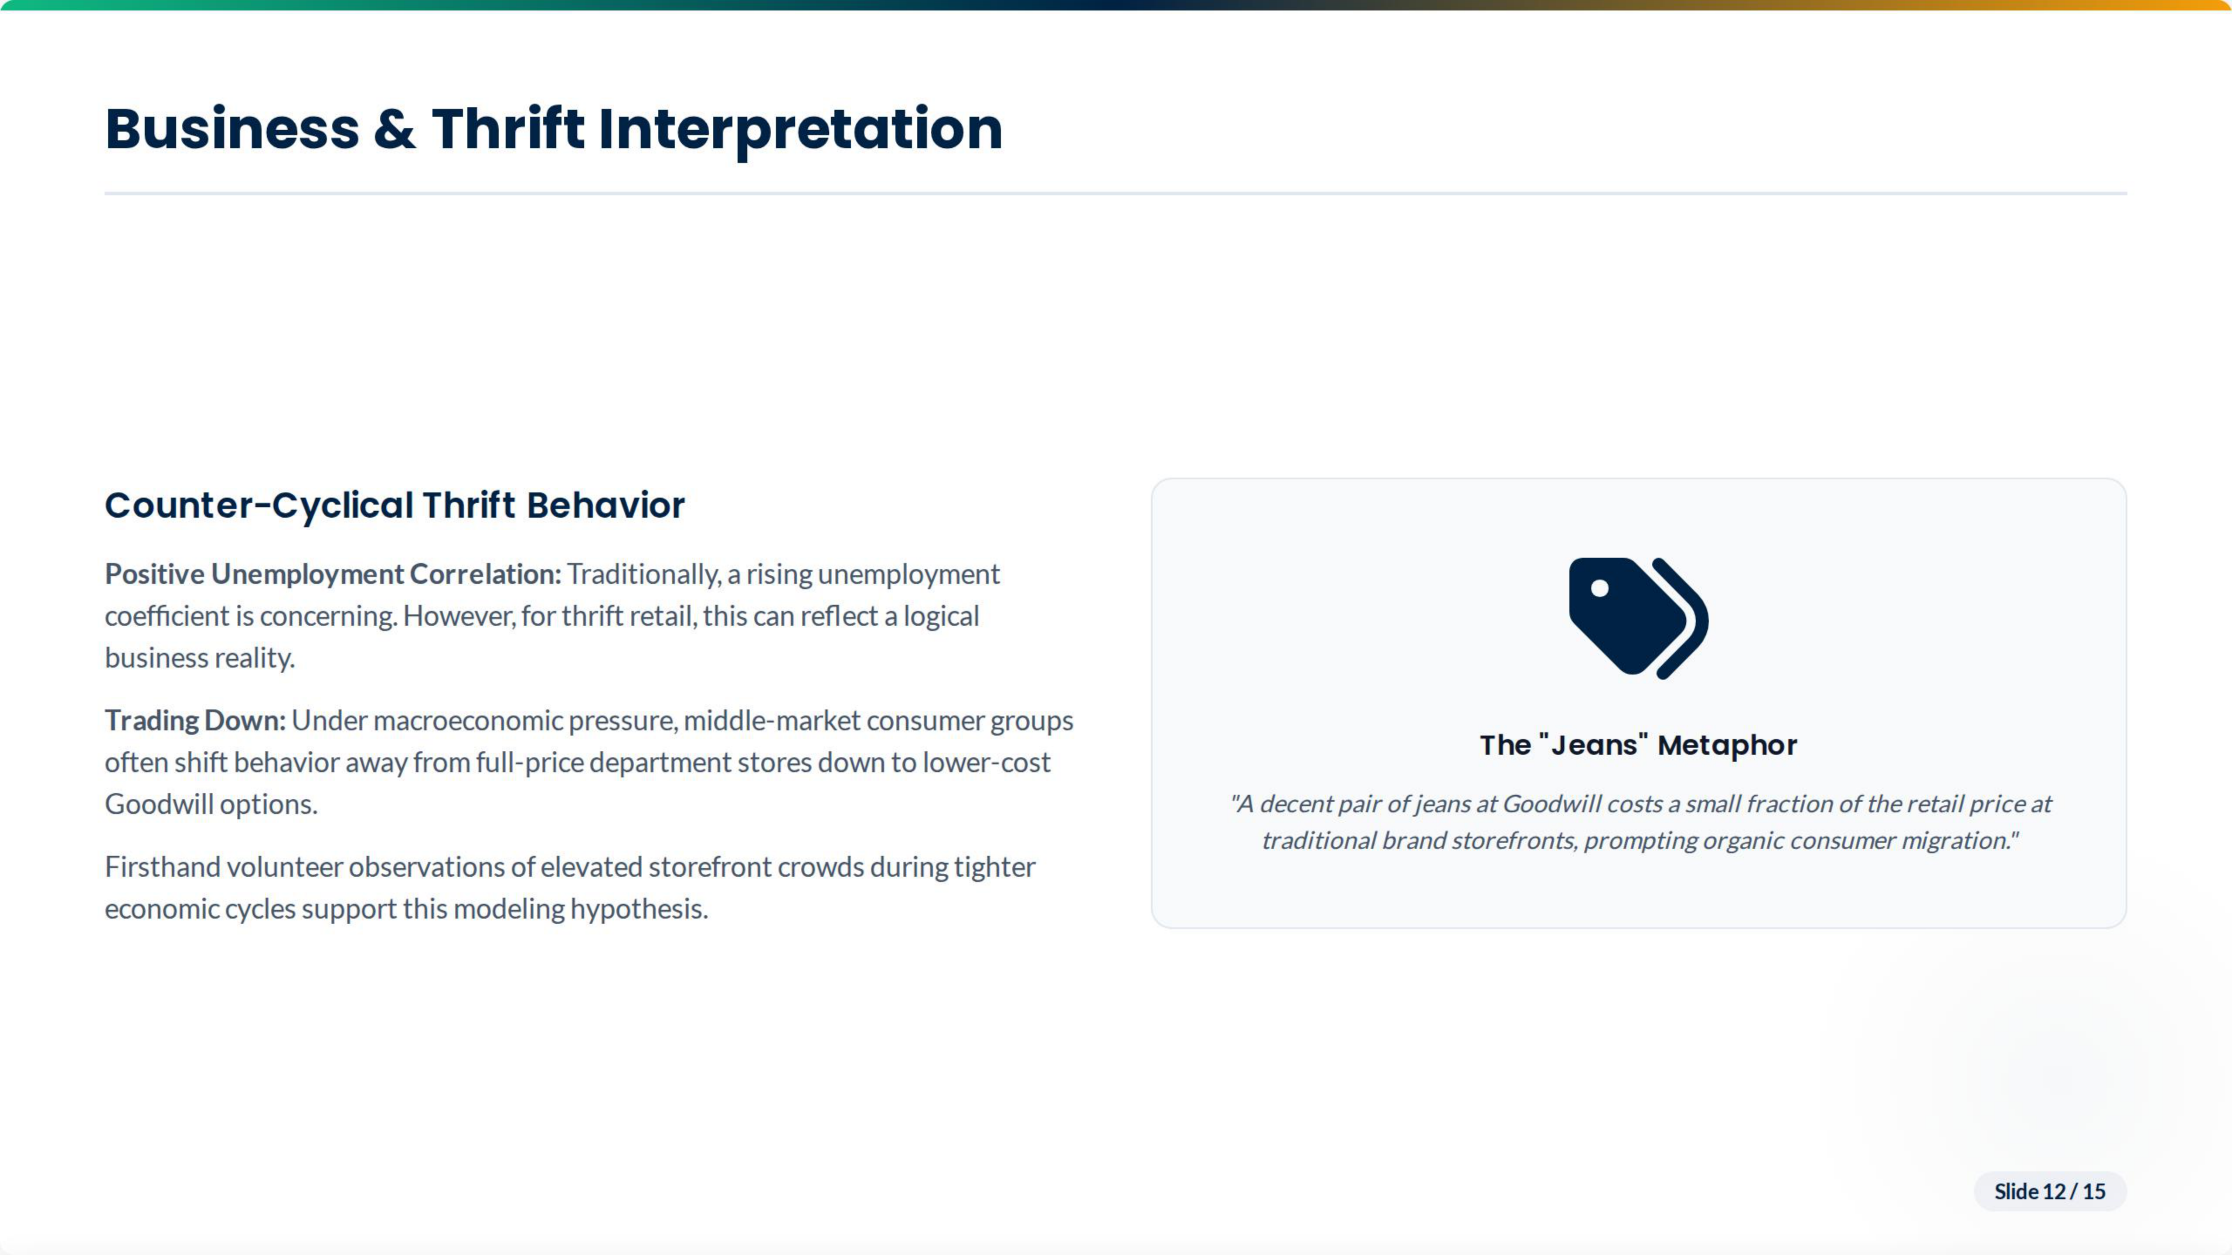

Slide 3
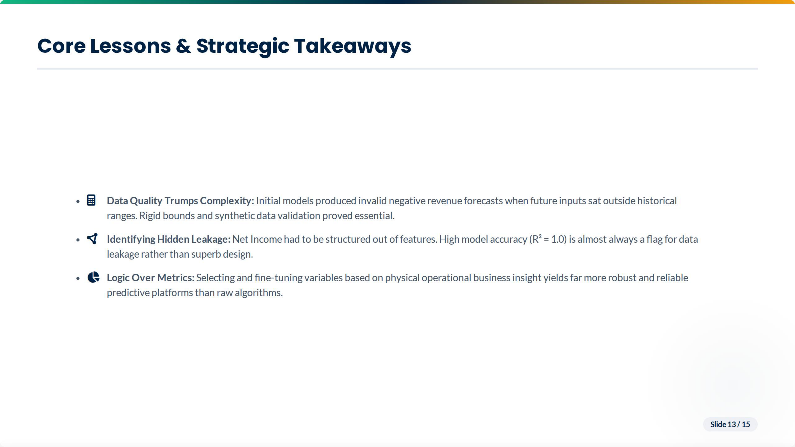

Slide 4
