Slide 1
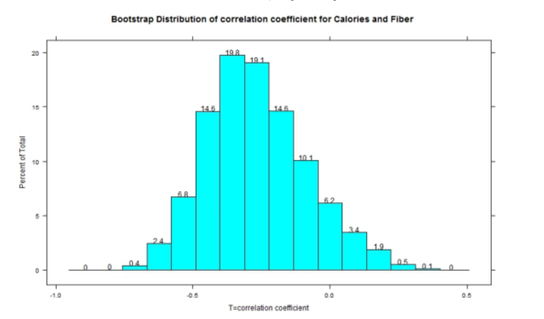
Nutrition researchers are interested in examining the relationships between several character-
istics of breakfast cereals per serving including calorie content and fiber (grams).
Above is a bootstrap distribution of the correlation coefficient for calories and fiber. Find an approximate 95% confidence interval for the true correlation coefficient from the plot above.

