Slide 1
An instructor is curious if his student's letter grades (A,B,C,D,F) are different overall depending on their housing situation(on-campus or off-campus). To answer this question, he takes a random sample of students in his class from each of these housing categories and examines each student's letter grade.
What kind of test is this?
What are the hypotheses?
What distribution does the test statistic follow under the null hypothesis?
If the p-value is 0.38 and the test statistic is 2.12, write your conclusion in the context of the problem.

Slide 2
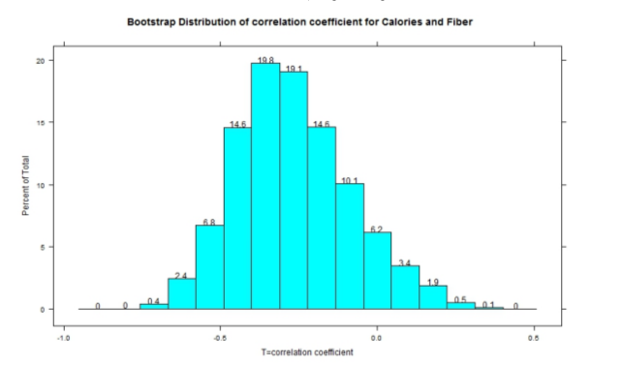
Nutrition researchers are interested in examining the relationships between several character-
istics of breakfast cereals per serving including calorie content and fiber (grams).
Above is a bootstrap distribution of the correlation coefficient for calories and fiber. Find an approximate 95% confidence interval for the true correlation coefficient from the plot above.

Slide 3
Based on the 95% confidence interval you found above, does there appear to be a relationship between calories and fiber?

Slide 4
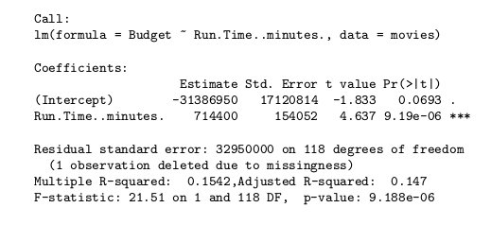
Data on the cost (in dollars) and the
running time (in minutes) for major release films of 2005 are summarized in the simple linear
regression output below.
What is the explanatory variable and what is the response variable?
One of the movies in the study had a run time of 90 minutes and a cost of 32909100. What is the residual for this point?

Slide 5
Define R² for this example
Where do you find R² in the output?

