Slide 1
In a study of the television viewing habits of children, a developmental psychologist selects a random sample of 200 first grade girls and a random sample of 100 first grade boys. Each child is asked which of the following TV programs they like best: The Lone Ranger, Sesame Street, or The Simpsons. Results are shown in the contingency table below.
Lone Ranger Sesame Street The Simpsons
Boys 50 30 20
Girls 50 80 70
1. Is this a test of homogeneity or independence? Why?

Slide 2
Lone Ranger Sesame Street The Simpsons
Boys 50 30 20
Girls 50 80 70
2. Write the hypotheses being tested.
3. What are the assumptions for the parametric test?
4. What is the expected number of boys who watch Sesame Street?
5. The test statistic is 15.9 and the p-value is 0.0003. What distribution does the test statistic follow under the null hypothesis?
6. Write your conclusion in the context of the problem.

Slide 3
Write down three facts about the correlation coefficient (r)

Slide 4
A simple linear regression model was fit to describe the age length relationship in halibut. The R output is below. Age is in years, length is in inches.
lm(formula = age ~ length.in, data = fish.stat)
Coefficients:
Estimate Std. Error t value Pr(>|t|)
(Intercept) 2.714056 0.188703 14.38 <2e-16 ***
length.in 0.215400 0.005299 40.65 <2e-16 ***
Residual standard error: 2.765 on 3536 degrees of freedom
Multiple R-squared: 0.3185, Adjusted R-squared: 0.3183
F-statistic: 1653 on 1 and 3536 DF, p-value: < 2.2e-16
1. Predict the age of a 29 inch halibut.
2. Interpret b1

Slide 5
fit lwr upr
8.960645 3.537597 14.38369
fit lwr upr
8.960645 8.852978 9.068313
Above is the predicted age for a 29 inch halibut and the uncertainty intervals. Suppose you go out tomorrow and catch a 29 inch halibut. You want to report the age of the halibut. Which uncertainty interval should you report?

Slide 6
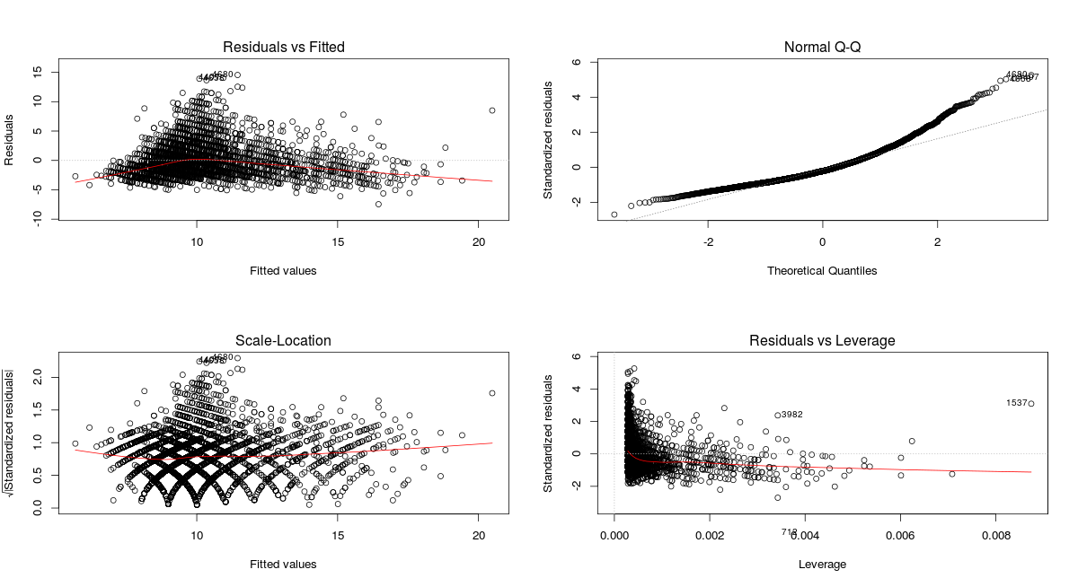
The residual plots for the fish model are shown above. Provide two reasons why a log transformation is appropriate.

Slide 7
lm(formula = log(age) ~ length.in, data = fish.stat)
Residuals:
Min 1Q Median 3Q Max
-1.16830 -0.18002 -0.02371 0.16491 0.91952
Coefficients:
Estimate Std. Error t value Pr(>|t|)
(Intercept) 1.5075145 0.0181013 83.28 <2e-16 ***
length.in 0.0219263 0.0005083 43.14 <2e-16 ***
Residual standard error: 0.2653 on 3536 degrees of freedom
Multiple R-squared: 0.3448, Adjusted R-squared: 0.3446
F-statistic: 1861 on 1 and 3536 DF, p-value: < 2.2e-16
1. The log model is shown above. Which variable was log transformed?
2. Predict the age of a 29 inch halibut on the original scale.
3. Interpret b1 on the original scale.

