Slide 1
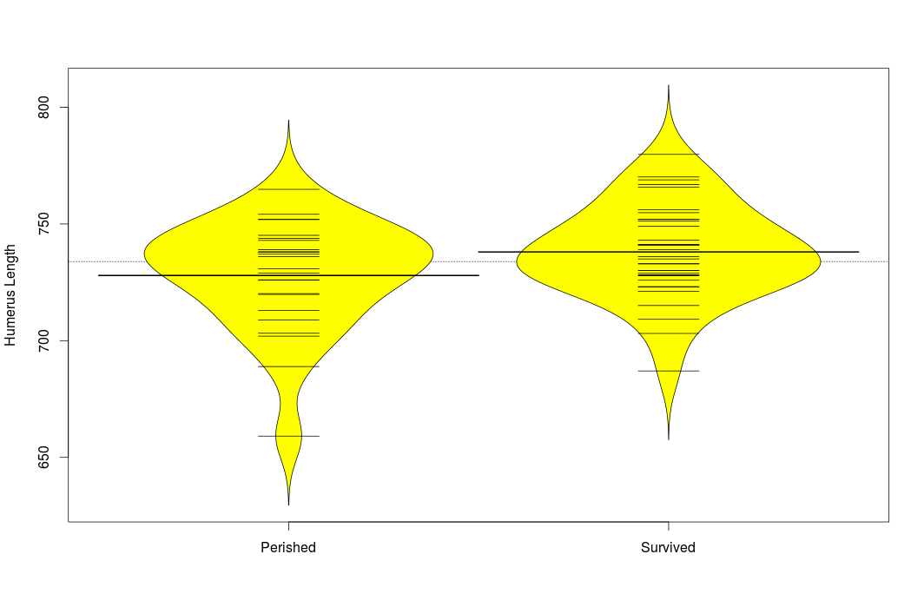

Slide 2
Think back to project 2 where we looked at the humerus lengths for birds that survived versus birds that perished. The estimated difference in humerus lengths was 10.08 with a 95% confidence interval from -1.28 to 21.45. Choose the correct interpretation of this confidence interval.
A. We are 95% confident that the true mean humerus length for birds that survived the storm is between 21.45 cm greater and 1.28 cm lower than the true mean humerus length of birds that perished in the storm.
B. We are 95% confident that the average humerus length in the sample for the birds that survived is between 21.45 cm greater and 1.28 cm lower than the average humerus length in the sample for the birds that perished.

