Slide 1
A total number of 26 male subjects, imprisoned between 3 to 48 months (M = 24.54; SD = 16.33), participated in the study. Aged between 20 and 59 years (M = 35.77; SD =10.55) the detainees were held in custody for sexual offences. This particular population
of prisoners was chosen because they are subjected to severe stress and idleness as they are housed separately from other prisoners in reason of the bad perception the latter
have of their particular crimes. The participants were divided into two groups: 15 Sportsmen (aged 20 to 57 years, Mean: 33.3 9.4) who chose to follow the physical programme; and 11 References (aged 26 to 59 years, Mean: 39.1 11.5), who did not and wished to remain sedentary.

Slide 2
A researcher randomly selected 1000 men and women in 1952 aged 18-22. The researcher followed each subject and recorded whether or not the subject smoked and whether of not the subject developed lung cancer.

Slide 3
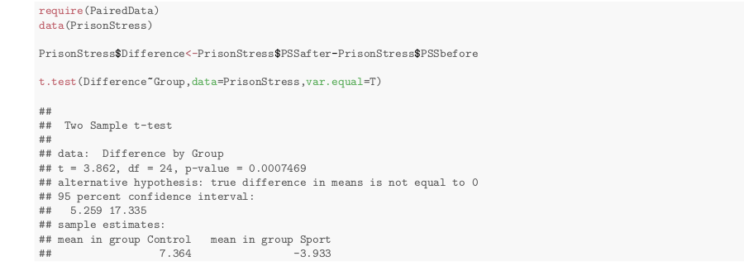

Slide 4
One Way Anova Activity
Suppose you want to know whether score depends on the type of handicap. There are two ways you can write the hypotheses to answer this question. Write them both.
On your paper, draw a long horizontal line at the grand mean.
Now, label the y24 response on the plot above. Assume the numbering starts at the bottom and goes up.
Now, assume we decide to use the null, single mean model. Label the residual error, e24, on your page.

Slide 5
One-Way Anova Activity
Now, draw short horizontal lines at the group averages.
Assume we use the alternative, separate means model and label the residual error, e24, on your page.
Write out the true alternative (cell means) model. Be sure to define your subscripts.

