Slide 1

How to Build an R Shiny Application
Travis Linscome-Hatfield,
Leslie Gains-Germain
www.neptuneinc.org

Slide 2
R Shiny Examples
Ohio R. risk characterization tool: https://orsanco-hab.shinyapps.io/shiny-ohio-river/
Race-course app
Experimental Stream Facility app

Slide 3
Shiny Use Cases
Exploratory Data Analysis: visualize and interact with your own data
Collaboration: Share your data and analyses with collaborators in an interactive session
Advantages
easy to spin up, easy display of analyses in R, easy to style
comes with browser compatibility, responsive designs, and good help resources
you can write a Shiny app in either R or Python (https://shiny.posit.co/)
Disadvantages
can be slow because HTML/Javascript is not written natively - it has to be generated from the shiny package functions
The UI (user interface) is created in R, which isn’t ideal for web developers not familiar with R
can be trickier to customize due to framework constraints
Production websites? Wasn’t originally created for this, but is coming along.

Slide 4
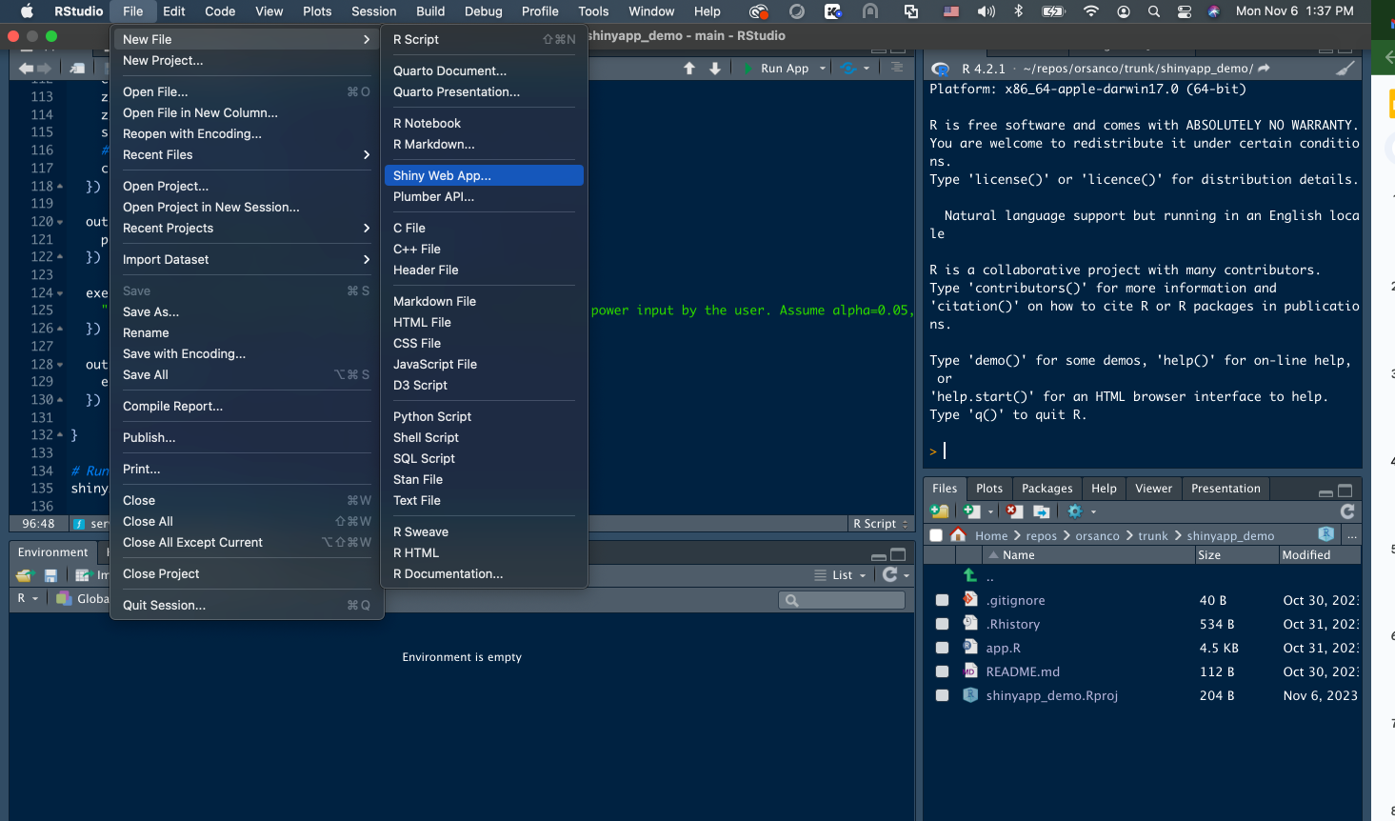
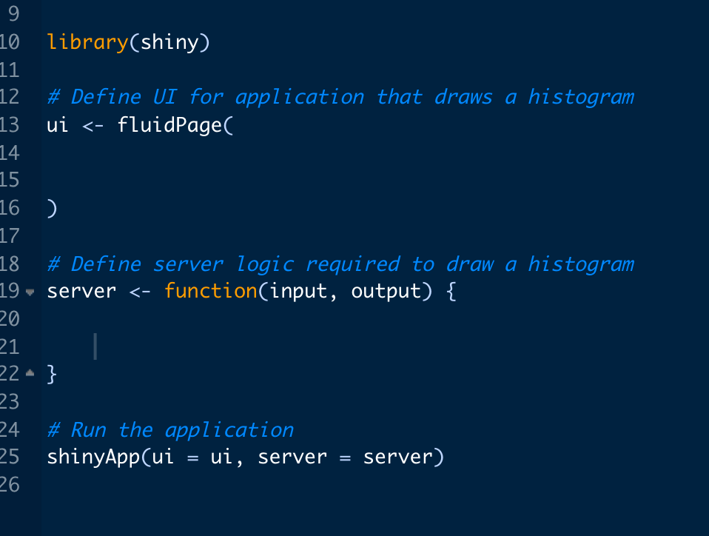
Getting Started
Start by creating an app.R file
Rstudio will create the code outline for you if you select New File > Shiny Web App
The app.R file needs to have two parts: User Interface (UI) and Server code
UI (user interface) side: Defines the graphical layout of the webpage and interactive elements such as buttons, dropdowns, navigation bars, etc
Server side: all the backend computation to create output based on user selections (e.g., plots, tables, text, reports, etc)

Slide 5
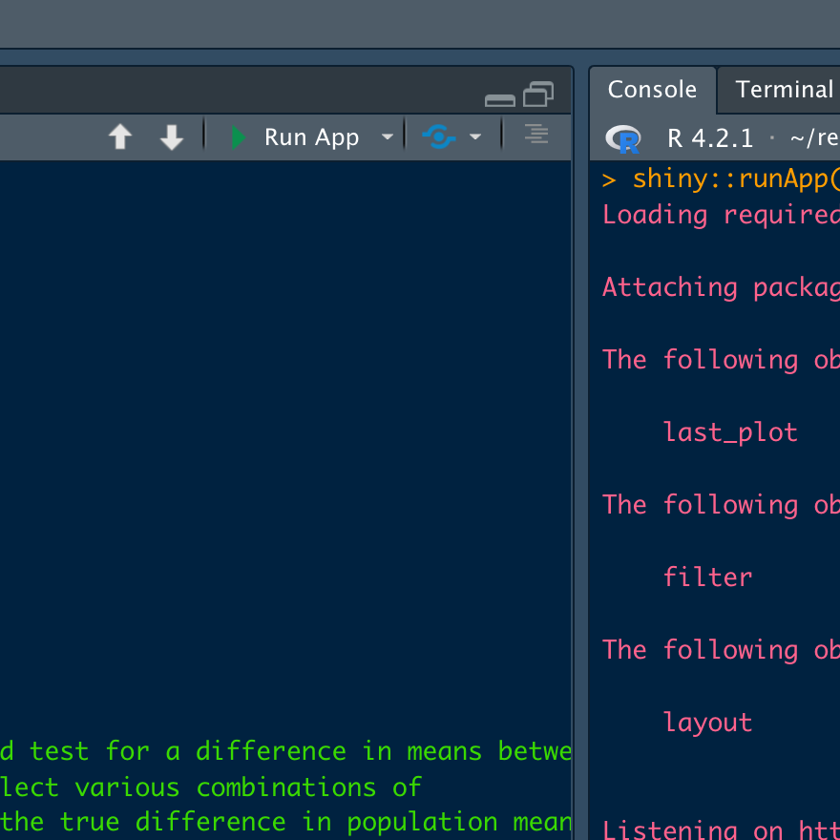
Demo app
Download the code here: https://github.com/lesliegg1/shinyapp_demo
Open app.R in Rstudio and run it by clicking “Run App”
Features of the demo app:
Colors, icons, custom CSS
Two types of reactive elements, eventReactive() and reactive()
Different input types: sliderInput(), actionButton(), radioButton()
Output types: plot and text
Parameterized report
Tips and Tricks
browser()
Diagnosis.RDS
Don’t forget your session variable

Slide 6
Shiny Alternatives
Multilanguage Notebooks - less interactive but easy to make
R or Quarto notebooks: R, Python, Julia, Javascript
Jupyter notebooks: Python, R, Julia, Javascript
Observable notebooks: Javascript, SQL, HTML, CSS
Other web app frameworks
Javascript React app
Better as a public facing website
For example - Great Lakes geodashboard; https://greatlakestogulf.org/#/, https://github.com/geostreams/geodashboard
Python based web app frameworks Django and Flask
Blog post about recreating a shiny app in Flask https://www.jumpingrivers.com/blog/r-shiny-python-flask/
Plumber (backend) + React (frontend)
Plumber is an R package for creating APIs in R
Separates the UI design from the backend R code
Resource about making a Plumber+React app: https://www.jumpingrivers.com/blog/r-shiny-plumber-react-part-1/

Slide 7
Shiny Resources
Posit resources
Shiny basics: https://shiny.posit.co/r/getstarted/shiny-basics/lesson1/
More details https://shiny.posit.co/r/articles/build/layout-guide/
Online textbook on Shiny by Hadley Wickham: https://mastering-shiny.org/
Code style guide: http://adv-r.had.co.nz/Style.html
Customizing shiny https://shiny.posit.co/r/articles/build/css/
Shiny “Gadgets”: https://shiny.posit.co/r/articles/build/gadgets/
Shinytest R package for testing apps: https://rstudio.github.io/shinytest/index.html
Publishing platforms:
Posit connect: https://posit.co/products/enterprise/connect/
Shinyapps.io
Shiny in production conference 2023 recap https://www.jumpingrivers.com/blog/shiny-in-production-highlights-2023/
Shinylive package for running shiny applications from the browser: https://shinylive.io/r/examples/

