Slide 1
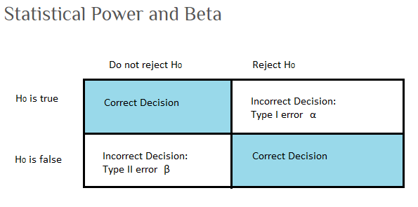
Power is 1-β

Slide 2
How many samples do we need to be confident that TP is less than some value?
POWER ANALYSIS
Power is the probability of rejecting the null hypothesis when it is false
In other words, the probability of detecting a difference from some value, if that difference actually exists
There is always random error (“noise”) when taking samples
How many samples do we need to collect to be reasonably sure we would find a signal amidst that noise, if it were there?
There are four elements in statistical hypothesis testing that are inter-related
Sample size
Significance level of the test (i.e. “p value”), which is the proportion of false positives we will tolerate
Effect size (signal to noise ratio)
Power (the probability of detecting the effect size we’re looking for)
Notes:
Four elements: 1, 2, 3 – I’ll explain more about this in a minute, but for now just understand that it’s essentially a measure of the expected signal to noise ratio. 4.
If you know any three of these things, you can calculate the fourth.

Slide 3
How many samples do we need to be confident that TP is less than some value?
POWER ANALYSIS
Power is the probability of rejecting the null hypothesis when it is false
In other words, the probability of detecting a difference from some value, if it is actually there
There is always random error (“noise”) when taking samples
How many samples do we need to collect to be reasonably sure we would find a signal amidst that noise?
There are four elements in statistical hypothesis testing that are inter-related
Sample size
P value
Effect size
Power
Notes:
For example, for a given sample size, and a given p value, and a desired effect size, we can determine the power, which is the probability of accurately detecting our desired effect size.

Slide 4
How many samples do we need to be confident that TP is less than some value?
POWER ANALYSIS
Power is the probability of rejecting the null hypothesis when it is false
In other words, the probability of detecting a difference from some value, if that difference exists
There is always random error (“noise”) when taking samples
How many samples do we need to collect to be reasonably sure we would find a signal amidst that noise?
There are four elements in statistical hypothesis testing that are inter-related
Sample size
P value
Effect size
Power
Notes:
Conversely, for a given p value, a given effect size, and a desired power (usually 80 or 90%), we can calculate how many samples we would need to achieve the chosen power level.

Slide 5
Effect Size:
Difference between sample mean and test value (“signal”)
Population standard deviation we expect (“noise”)
Example:
We want to know whether we have collected enough samples to determine, with some probability of confidence, that we would be able to detect whether the phosphorus concentration is less than 12 ug/L.
Power equation:
Sample mean = 10
Standard Deviation = 2
|10-12| equals effect size of 1
2
What standard deviation to use?
Also note: Analysis is quite a bit more complicated when data are not normally distributed
Notes:
The tricky part in all this is how to choose the effect size that we want to detect. So what exactly is effect size? Effect size can be thought of as a signal to noise ratio. The signal, in the numerator, is the difference between the mean of the samples, and the test value we wish to detect. The “noise”, in the denominator, is the standard deviation of our samples.
So for example. Suppose we want to know the number of samples .

Slide 6
What Standard Deviation should we assume in order to calculate our effect size?

Slide 7
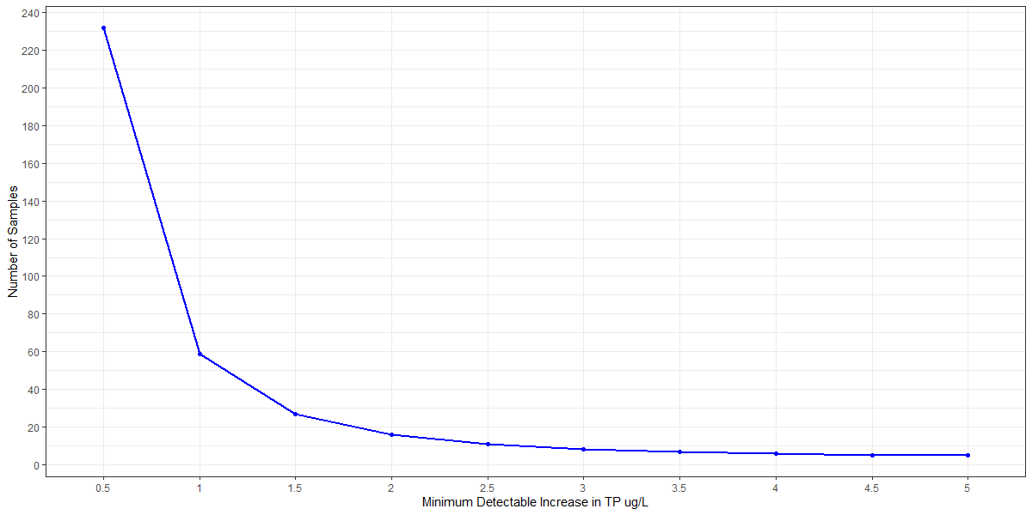
EXAMPLE – Miles Pond (stable trend)
13 years sampled | mean=11.4 | stdev=2.05 (95% c.i. = 1.33~3.05)
Take the worst-case scenario, stdev = 3
How many years of samples would we need to have an 80% probability of detecting an increase of X ug/L TP, with a p-value of 0.05?

Slide 8
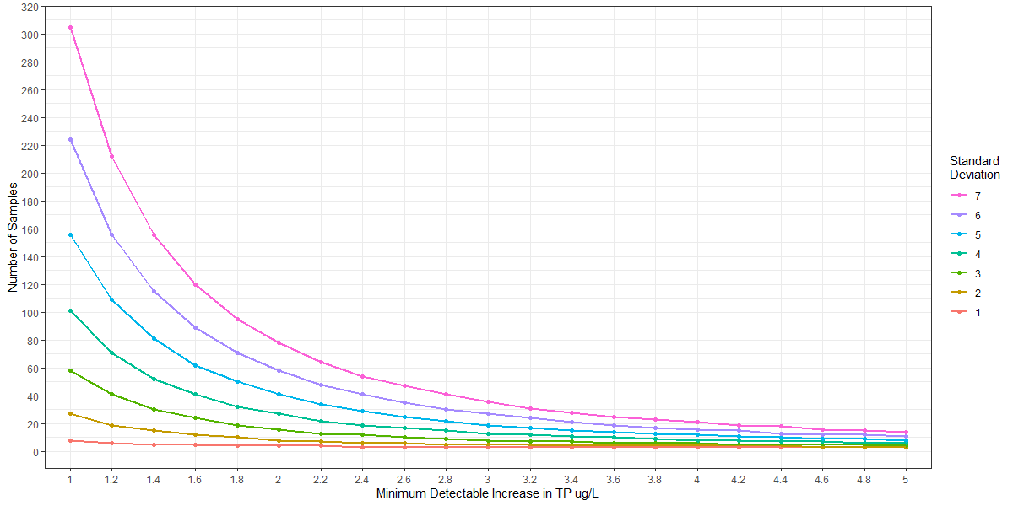
All lakes for a range of standard deviations - LMP Annual Means – lakes with normally distributed data
How many years of samples would we need to have an 80% probability of detecting an increase of X ug/L,
with a p-value of 0.05, given a certain standard deviation?
Some Example Lakes
Lake | N | Mean | St. Dev.
CARMI | 37 | 30.9 | 5.53
CASPIAN | 26 | 9.3 | 1.82
CURTIS | 25 | 18.1 | 3.58
DUNMORE | 23 | 12.8 | 2.73
JOES (DANVLL) | 14 | 20.2 | 7.24
MAIDSTONE | 26 | 6.8 | 1.09
MEMPHREMAGOG | 27 | 19.3 | 3.13
RAPONDA | 18 | 11.4 | 2.00
SEYMOUR | 23 | 9.0 | 2.41
SHELBURNE | 6 | 151.4 | 38.20
WILLOUGHBY | 25 | 10.5 | 3.70

Slide 9
All lakes for a range of standard deviations - LMP Annual Means – lakes with normally distributed data
How many years of samples would we need to have an 80% probability of detecting an increase of X ug/L,
with a p-value of 0.05, given a certain standard deviation?
Some Example Lakes
Lake | N | Mean | St. Dev.
CARMI | 37 | 30.9 | 5.53
CASPIAN | 26 | 9.3 | 1.82
CURTIS | 25 | 18.1 | 3.58
DUNMORE | 23 | 12.8 | 2.73
JOES (DANVLL) | 14 | 20.2 | 7.24
MAIDSTONE | 26 | 6.8 | 1.09
MEMPHREMAGOG | 27 | 19.3 | 3.13
RAPONDA | 18 | 11.4 | 2.00
SEYMOUR | 23 | 9.0 | 2.41
SHELBURNE | 6 | 151.4 | 38.20
WILLOUGHBY | 25 | 10.5 | 3.70

Slide 10
All lakes for a range of standard deviations - LMP Annual Means – lakes with normally distributed data
How many years of samples would we need to have an 80% probability of detecting an increase of X ug/L,
with a p-value of 0.05, given a certain standard deviation?
Some Example Lakes
Lake | N | Mean | St. Dev.
CARMI | 37 | 30.9 | 5.53
CASPIAN | 26 | 9.3 | 1.82
CURTIS | 25 | 18.1 | 3.58
DUNMORE | 23 | 12.8 | 2.73
JOES (DANVLL) | 14 | 20.2 | 7.24
MAIDSTONE | 26 | 6.8 | 1.09
MEMPHREMAGOG | 27 | 19.3 | 3.13
RAPONDA | 18 | 11.4 | 2.00
SEYMOUR | 23 | 9.0 | 2.41
SHELBURNE | 6 | 151.4 | 38.20
WILLOUGHBY | 25 | 10.5 | 3.70

Slide 11
All lakes for a range of standard deviations - LMP Annual Means – lakes with normally distributed data
How many years of samples would we need to have an 80% probability of detecting an increase of X ug/L,
with a p-value of 0.05, given a certain standard deviation?
Some Example Lakes
Lake | N | Mean | St. Dev.
CARMI | 37 | 30.9 | 5.53
CASPIAN | 26 | 9.3 | 1.82
CURTIS | 25 | 18.1 | 3.58
DUNMORE | 23 | 12.8 | 2.73
JOES (DANVLL) | 14 | 20.2 | 7.24
MAIDSTONE | 26 | 6.8 | 1.09
MEMPHREMAGOG | 27 | 19.3 | 3.13
RAPONDA | 18 | 11.4 | 2.00
SEYMOUR | 23 | 9.0 | 2.41
SHELBURNE | 6 | 151.4 | 38.20
WILLOUGHBY | 25 | 10.5 | 3.70

Slide 12
EXAMPLE – Miles Pond (stable trend) – LMP including all 8+ summer samples
13 years sampled | mean=11.4 | stdev=2.05 (95% c.i. = 1.33~3.05)
Take the worst-case scenario, stdev = 3
How many years of samples would we need to have an 80% probability of detecting an increase of X ug/L TP, with a p-value of 0.05?

Slide 13
All lakes for a range of standard deviations - LMP Annual Means – lakes with normally distributed data
How many years of samples would we need to have an 80% probability of detecting an increase of X ug/L,
with a p-value of 0.05, given a certain standard deviation?
Some Example Lakes
Lake | N | Mean | St. Dev.
CARMI | 37 | 30.9 | 5.53
CASPIAN | 26 | 9.3 | 1.82
CURTIS | 25 | 18.1 | 3.58
DUNMORE | 23 | 12.8 | 2.73
JOES (DANVLL) | 14 | 20.2 | 7.24
MAIDSTONE | 26 | 6.8 | 1.09
MEMPHREMAGOG | 27 | 19.3 | 3.13
RAPONDA | 18 | 11.4 | 2.00
SEYMOUR | 23 | 9.0 | 2.41
SHELBURNE | 6 | 151.4 | 38.20
WILLOUGHBY | 25 | 10.5 | 3.70

Slide 14
All lakes for a range of standard deviations - LMP Annual Means – lakes with normally distributed data
How many years of samples would we need to have an 80% probability of detecting an increase of X ug/L,
with a p-value of 0.05, given a certain standard deviation?
Some Example Lakes
Lake | N | Mean | St. Dev.
CARMI | 37 | 30.9 | 5.53
CASPIAN | 26 | 9.3 | 1.82
CURTIS | 25 | 18.1 | 3.58
DUNMORE | 23 | 12.8 | 2.73
JOES (DANVLL) | 14 | 20.2 | 7.24
MAIDSTONE | 26 | 6.8 | 1.09
MEMPHREMAGOG | 27 | 19.3 | 3.13
RAPONDA | 18 | 11.4 | 2.00
SEYMOUR | 23 | 9.0 | 2.41
SHELBURNE | 6 | 151.4 | 38.20
WILLOUGHBY | 25 | 10.5 | 3.70

Slide 15
All lakes for a range of standard deviations - LMP Annual Means – lakes with normally distributed data
How many years of samples would we need to have an 80% probability of detecting an increase of X ug/L,
with a p-value of 0.05, given a certain standard deviation?
Some Example Lakes
Lake | N | Mean | St. Dev.
CARMI | 37 | 30.9 | 5.53
CASPIAN | 26 | 9.3 | 1.82
CURTIS | 25 | 18.1 | 3.58
DUNMORE | 23 | 12.8 | 2.73
JOES (DANVLL) | 14 | 20.2 | 7.24
MAIDSTONE | 26 | 6.8 | 1.09
MEMPHREMAGOG | 27 | 19.3 | 3.13
RAPONDA | 18 | 11.4 | 2.00
SEYMOUR | 23 | 9.0 | 2.41
SHELBURNE | 6 | 151.4 | 38.20
WILLOUGHBY | 25 | 10.5 | 3.70

Slide 16
All lakes for a range of standard deviations - LMP Annual Means – lakes with normally distributed data
How many years of samples would we need to have an 80% probability of detecting an increase of X ug/L,
with a p-value of 0.05, given a certain standard deviation?
Some Example Lakes
Lake | N | Mean | St. Dev.
CARMI | 37 | 30.9 | 5.53
CASPIAN | 26 | 9.3 | 1.82
CURTIS | 25 | 18.1 | 3.58
DUNMORE | 23 | 12.8 | 2.73
JOES (DANVLL) | 14 | 20.2 | 7.24
MAIDSTONE | 26 | 6.8 | 1.09
MEMPHREMAGOG | 27 | 19.3 | 3.13
RAPONDA | 18 | 11.4 | 2.00
SEYMOUR | 23 | 9.0 | 2.41
SHELBURNE | 6 | 151.4 | 38.20
WILLOUGHBY | 25 | 10.5 | 3.70

Slide 17
Next Steps
Finish all lakes graph
Incorporate multiple samples per year
What to do about non-normal data?
power tests that assume log-normal distribution
non-parametric power tests
Other power levels (e.g. 90%) or alpha levels (e.g. 0.15)
Other parameters (Chla, SpringTP, etc.)

Slide 18
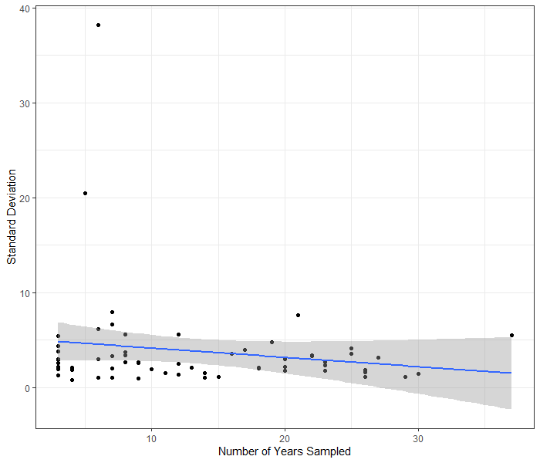
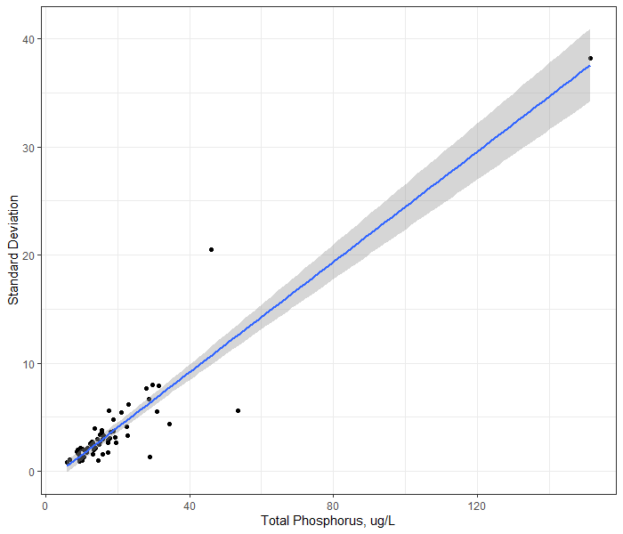
For lakes with normally distributed data (63 out of 70 lakes)
Number of Years Sampled versus Standard Deviation
Mean TP versus Standard Deviation
ANNUAL MEANS OR ALL DATA?

Slide 19
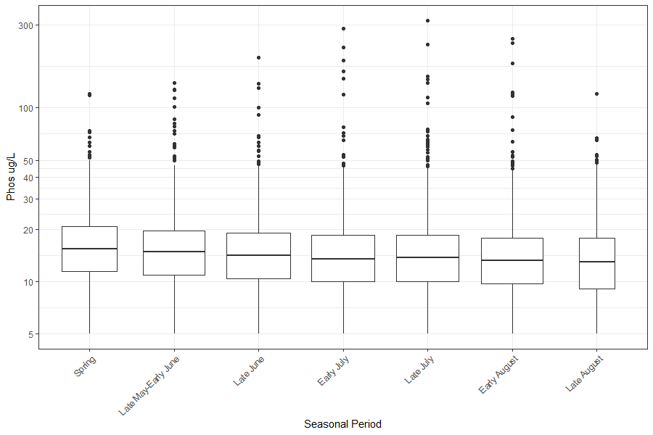
LMP data – is seasonality important?

